Slide 1




Kinds of Angles

Slide 2

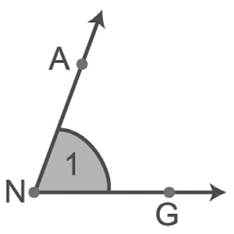
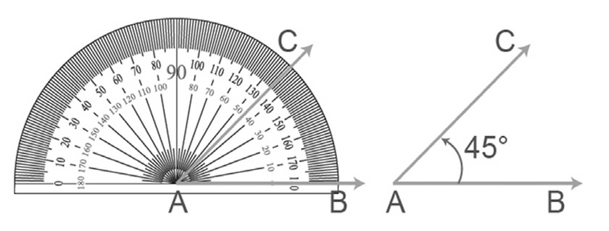
Kinds of Angles
Definition
An angle is formed by two noncollinear rays that have a common endpoint. The endpoint is the vertex of the angle and each ray is the side of the angle.
The symbol for angle is ∠. For the angle at the left, point N is the vertex and the sides are NA and NG. This angle can be named ∠ANG, ∠GNA, ∠N, or ∠1.
A protractor is used to measure an angle. A protractor assigns a number between 0° and 180° to an angle. That number is called the degree of the angle. Every angle has a degree measure m such that
0° ∠ m ∠ 180°.
Rex Curriculum Resource
WWW.REX.COM.PH

Slide 3
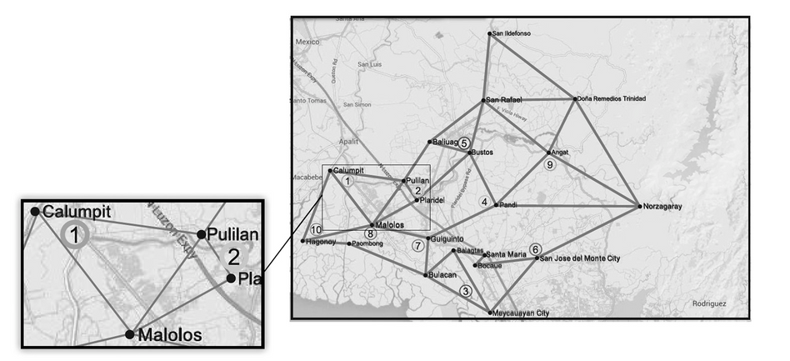
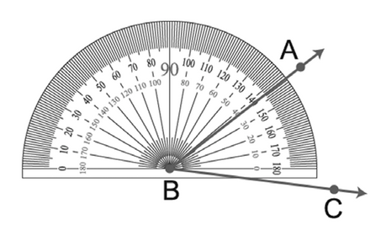
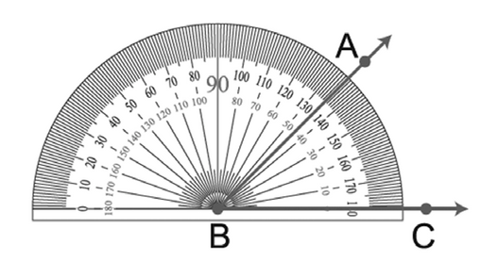
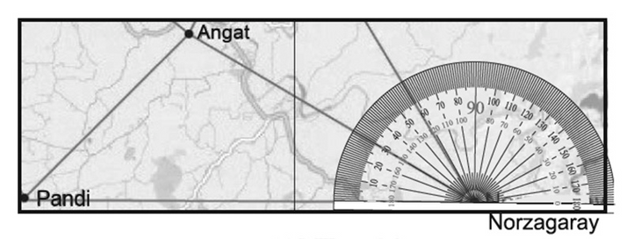
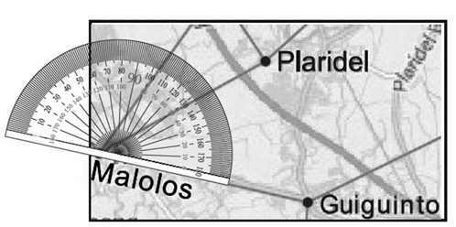
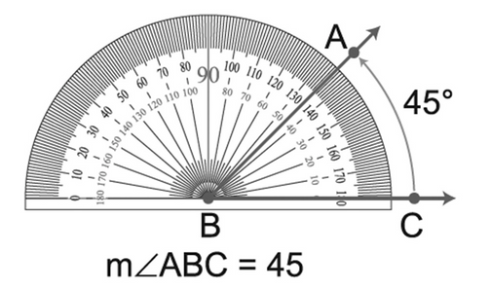
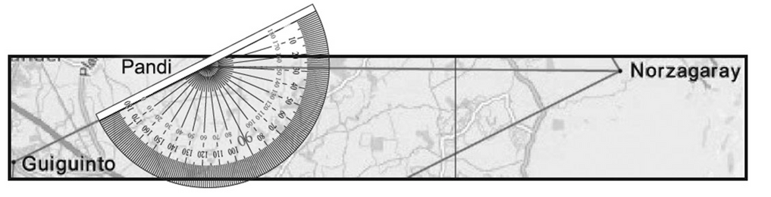
Kinds of Angles
If ∠1 is the same angle as ∠PCM (where P represents Pulilan, C represents Calumpit, and M represents Malolos), then the measure of ∠1 is 45°.
Likewise, the measures of ∠PMG, ∠GPN, and ∠ANP are 40°, 30°, and 152°, respectively.
To measure an angle using a protractor, follow these steps:
1. Place the center point of the protractor on the vertex of the angle to be measured.
2. Align the baseline of the protractor with one side of the angle.
3. Read the appropriate scale.
Rex Curriculum Resource
WWW.REX.COM.PH

Slide 4
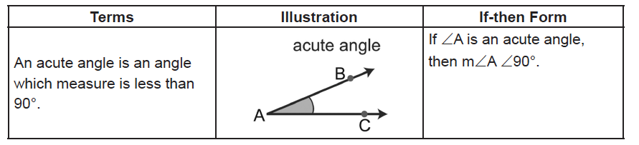
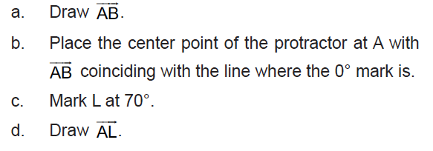
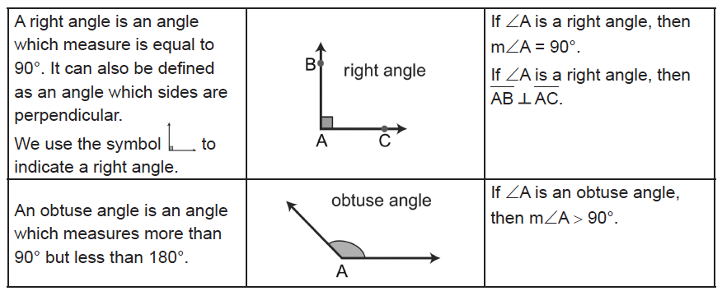
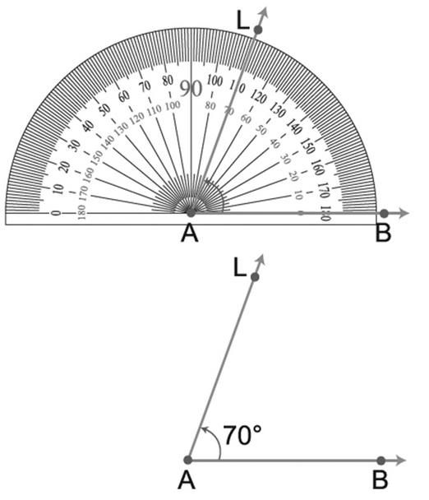
Kinds of Angles
Definition:
Example : Measuring Angles Using a Protractor
Draw ∠LAB so that m∠LAB = 70°. Use a protractor.
Solution:
Rex Curriculum Resource
WWW.REX.COM.PH

Slide 5
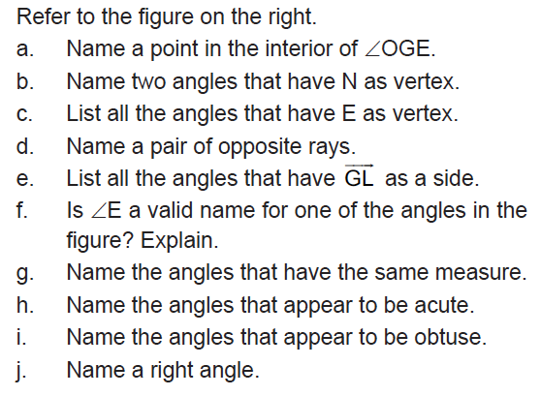
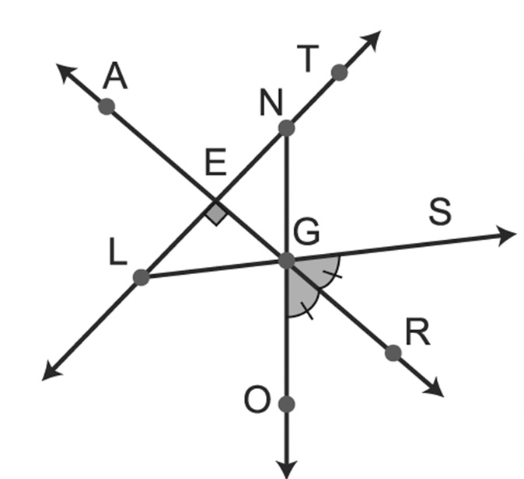
Kinds of Angles
Example 5: Angles and Angle Measures
Rex Curriculum Resource
WWW.REX.COM.PH

Slide 6
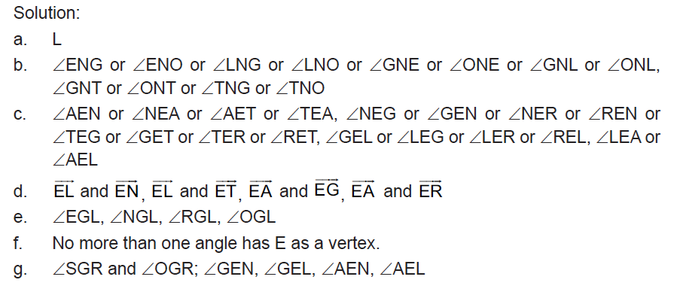
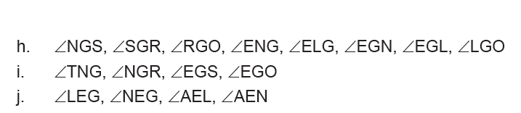
Kinds of Angles
Example 5: Angles and Angle Measures
Rex Curriculum Resource
WWW.REX.COM.PH

Slide 7
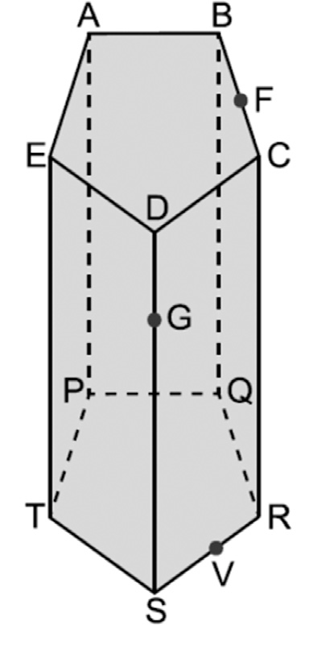
Activity:
Refer to the pentagonal prism on the right to answer each question. Only a portion of each plane is shown.
1. A line containing point G
2. A line passing through F
3. Two points collinear with point V
4. Two points coplanar with point V
5. A plane containing AB and AP
6. A plane containing points B, F, and C
Rex Curriculum Resource
WWW.REX.COM.PH

Slide 8
Activity: ANSWER KEY
Refer to the pentagonal prism on the right to answer each question. Only a portion of each plane is shown.
1. A line containing point G
2. A line passing through F
3. Two points collinear with point V
4. Two points coplanar with point V
5. A plane containing AB and AP
6. A plane containing points B, F, and C
ANSWER KEY:
1. line DS
2. line BC
3. points R and S
4. points R, S, G, C, and D (any two)
5. plane ABP (or any plane formed from points A, B, P, Q)
6. plane BCR (or any plane formed from points B, C, Q, R)
Rex Curriculum Resource
WWW.REX.COM.PH

Slide 9


