Slide 1
Exterior Angle Inequality Theorem

Slide 2
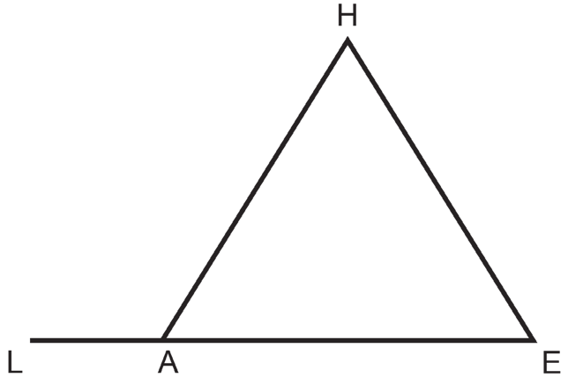
Exterior Angle Inequality Theorem
Example 1: Given the triangle on the right, determine the measure of:
a.
∠
HAL if m
H and m
E are 55° and 75°, respectively.
∠
∠
b.
∠
∠
∠
∠
E if m
HAL = 140°, m
H = 3x + 5, and m
E = 2x + 15.
Solution:
a.
According to the exterior angle theorem, m
∠
H + m
E = m
∠
∠HAL.
Thus, by substitution:
m
∠
→
→
H + m
E = m
HAL
55° + 75° = m
HAL
130° = m
HAL
∠
∠
∠
∠
b.
∠
∠
∠
HAL.
Thus, by substitution:
According to the exterior angle theorem, m
H + m
E = m
m
∠
→
→
H + m
E = m
HAL
∠
∠
3x + 5 + 2x + 15 = 140
5x + 20 = 140
5x + 20 = 140
→
5x = 120
→
x = 24
∠
Now substitute the computed value of x to determine the measure of
E.
m
∠
→
∠
→
∠
E = 2x + 15
m
E = 2(24) + 15
m
E = 63°
m
∠
Therefore,
E = 63°

Slide 3
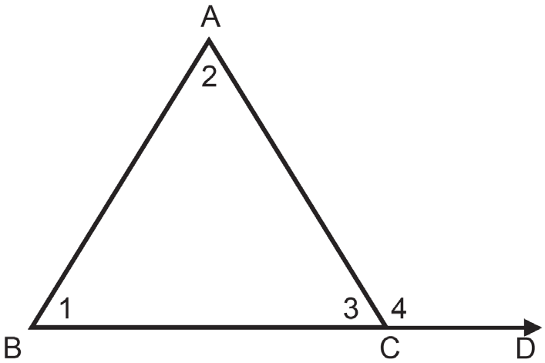
Exterior Angle Inequality Theorem
In both the examples 1a and 1b, observe that
m
∠
HAL > m
H and m
HAL > m
E. The consequence of
∠
∠
∠
the exterior angle theorem is the exterior angle inequality
theorem. It states that the exterior angle of a triangle is
always greater than either of its remote interior angles.
∠
∠
∠
That is, if
4 is an exterior angle of ∆ABC and
1 and
2
are its remote interior angles, you can say that m
∠
4 > m
∠
1
and m
4 > m
2.
∠
∠
Here is the proof of the exterior angle inequality theorem.
Given:
4 is an exterior angle and
∠
∠
1 and
2 are its remote interior angles.
∠
Prove: m
4 > m
1 and m
4 > m
2
∠
∠
∠
∠

Slide 4
Exterior Angle Inequality Theorem
Proof:
Statements | Reasons
1. | Definition of linear pair.
2. | Linear pair postulate (linear pairs are supplementary.)
3. | The sum of the interior angles of a triangle is 180°.
4. | Transitive property of equality
5. | Simplify
6. | Definition of greater than
∠3 and ∠4 form a linear pair.
m∠3 + m∠4 = 180°
m∠1 + m∠2 + m∠3 = 180°
m∠3 + m∠4 = m∠1 + m∠2 + m∠3
m∠4 = m∠1 + m∠2
m∠4 > m∠1; m∠4 > m∠2

Slide 5
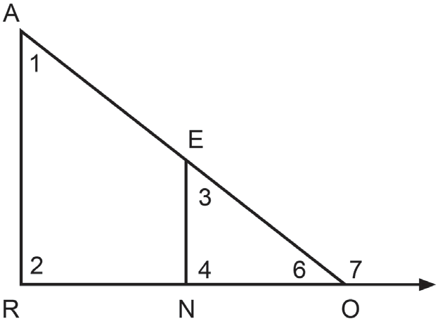
Exterior Angle Inequality Theorem
Example 2: Apply the triangle inequality theorem in answering the
following questions. Refer to the figure on the right.
a. In which pair of angles will the sum of ∠1 and ∠2 be equal to?
b. In which angles will ∠7 be greater than?
Solution:
a. ∠7; observe that ∠1 and ∠2 are the remote interior angles of ∠7. Hence, by the exterior angle theorem,
the sum of the measures of ∠1 and ∠2 is equal to the measure of ∠7.
b. According to the exterior angle inequality theorem, ∠7 will be greater than any of its remote interior angles.
Considering ΔARO, ∠1 and ∠2 are the remote interior angles of ∠7. Also, with respect to ΔENO, ∠3 and ∠4 are
the remote interior angles of ∠7. Thus, ∠7 is greater than any of the following angles: ∠1, ∠2, ∠3, and ∠4.

