Slide 1
Cycling of Materials in an Ecosystem

Slide 2
Cycling of Materials in an Ecosystem
Matter can change form as it undergoes physical and chemical changes, but matter is conserved through any of these changes. The same amount of matter exists before and after the change none is created or destroyed. This concept is called the law of conservation of matter.
Based on this law, it means that the materials currently found in the environment as well as those present in living things are no longer new and have existed for billions of years. They are just continually being reused by living things in the ecosystem through biogeochemical cycles, which involve the nonliving earth subsystems (the lithosphere, the atmosphere, and the hydrosphere) and the living subsystem (the biosphere).

Slide 3
Cycling of Materials in an Ecosystem
The movement of materials is often closely connected to the flow of energy through the food chain. Nutrients, which are important chemical substances needed to sustain life and undergo life processes, are either acquired from the environment or through feeding on other organisms. Plants obtain nutrients by absorbing them from the surrounding atmosphere, water, or soil. Animals obtain nutrients that they need by mostly consuming other organisms. The nutrients are utilized within the bodies of organisms through biochemical processes but are also returned to the environment through the excretion of wastes and decomposition when organisms die.
The cycling of materials may be slow (long-term cycles) or fast (short-term cycles). A long-term cycle involves a reservoir, which is a source that is usually unavailable to organisms. A rock containing materials that are buried deep within the Earth is an example of a reservoir. The materials will only be made accessible to organisms through geologic processes like uplift and weathering.

Slide 4
Cycling of Materials in an Ecosystem
Once materials are made accessible, they are said to be now present in exchange pools. An exchange pool is a source from which organisms take in materials. The atmosphere, bodies of water, and the soil act as exchange pools in ecosystems from which organisms can acquire and release materials back into them.
Four important materials essential to living things and the biogeochemical cycle they go through.
These materials are water, carbon dioxide, nitrogen, and phosphorus.
Hydrologic Cycle
Water is one of the essential materials that organisms need for them to survive. The hydrologic cycle or water cycle describes the movement of water from the various places where it is stored within the Earth. The hydrologic cycle involves two main processes: evaporation (liquid water to water vapor) and condensation (water vapor to liquid water).

Slide 5
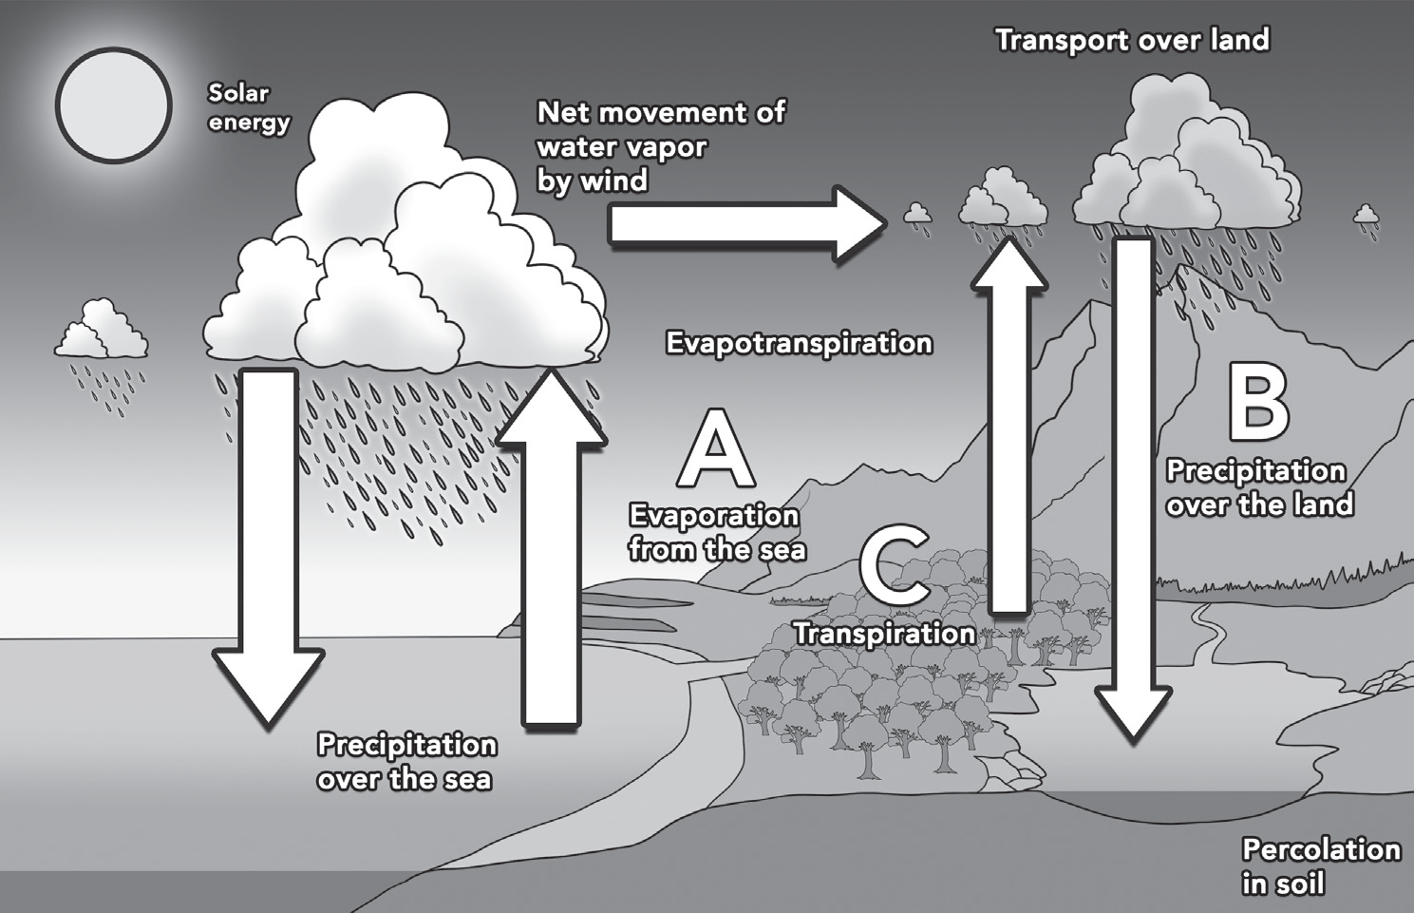
Cycling of Materials in an Ecosystem
These two processes allow water to change state and allow the movement through the ecosystem. Figure shows the hydrologic cycle and the other processes involved.
Water is constantly evaporating (see Figure A) into the atmosphere from surface bodies of water, the soil, and living organisms due to solar energy. The water vapor that is produced rises and begins to cool in the upper parts of the atmosphere. Clouds form when the cooling water vapor condenses into droplets around dust particles in the atmosphere. Water falls from clouds as precipitation (see Figure B) in the form of rain, sleet, snow, or hail.

Slide 6
Cycling of Materials in an Ecosystem
As shown in Figure, precipitation that falls on the land produces groundwater and runoff, which can then flow into streams, rivers, lakes, and oceans, where they can once again evaporate into the atmosphere to continue through the water cycle. Approximately 90% of water vapor evaporates from oceans, lakes, and rivers; about 10% evaporates from the surfaces of plants through a process called transpiration (see Figure C). The surface bodies of water and groundwater act as exchange pools, while glaciers and ice caps serve as the reservoirs of water as the solid ice makes it unavailable for use by living organisms.

Slide 7
Cycling of Materials in an Ecosystem
Carbon Dioxide Cycle
Carbon dioxide is made up of carbon and oxygen atoms. Both carbon and oxygen play important roles in living things. Atoms of carbon form the framework for organic molecules, and in combination with other elements, like hydrogen, oxygen, nitrogen, and phosphorus, they form biomolecules, like proteins, carbohydrates, lipids, and nucleic acids. Oxygen, thus, serves as a structural element for living things, but it is also needed in the production of energy inside the cell via cellular respiration.
The two main processes involved in the movement of carbon and oxygen into the ecosystem are photosynthesis (see Figure A) and cellular respiration. Figure below shows how these processes are connected. During photosynthesis, producers convert carbon dioxide and water into carbohydrates and release oxygen back into the air. These carbohydrates are used as a source of energy for all organisms in the food web.

Slide 8
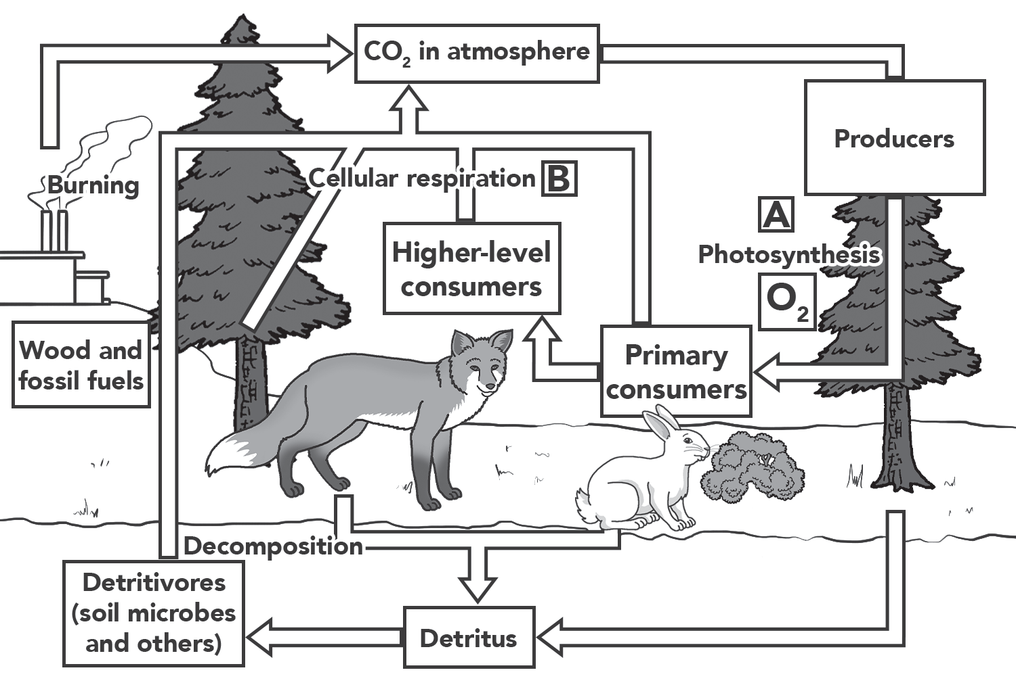
Cycling of Materials in an Ecosystem
Carbon dioxide can enter a long-term cycle when organic matter is buried underground and converted to fossil fuels, such as peat, coal, oil, or natural gas. In addition to combining to form fossil fuels, carbon dioxide can form calcium carbonate (CaCO3), which is found in the shells of marine animals. When these fall into the ocean floor, these can create vast deposits of limestone rock. Fossil fuels and limestone deposits serve as reservoirs for carbon dioxide. Weathering of limestone and burning of fossil fuels release carbon dioxide back into the atmosphere.

Slide 9
Cycling of Materials in an Ecosystem
Nitrogen Cycle
The air we breathe is composed mostly of nitrogen gas (N2), the most abundant gas present in the Earth’s atmosphere (78%). Nitrogen is important in the synthesizing of proteins and nucleic acids, but nitrogen gas cannot be used directly by plants and animals because it is stable. It must be first captured and converted into a form that is usable by living things.
This process is called nitrogen fixation (see Figure A), and it is something that is done by certain kinds of bacteria. In nitrogen fixation, nitrogen-fixing bacteria convert nitrogen gas into ammonium (NH4⁺). The ammonium can then be turned into other forms of nitrogen like nitrites (NO2⁻) and nitrates (NO3⁻) via nitrification (see Figure B). Nitrogen enters the food web when plants absorb nitrogen compounds from the soil and convert them into proteins. Consumers get nitrogen by eating plants or animals that contain nitrogen. They reuse the nitrogen and make their own proteins. The incorporation of nitrogen into living tissue is called assimilation (see Figure C).

Slide 10
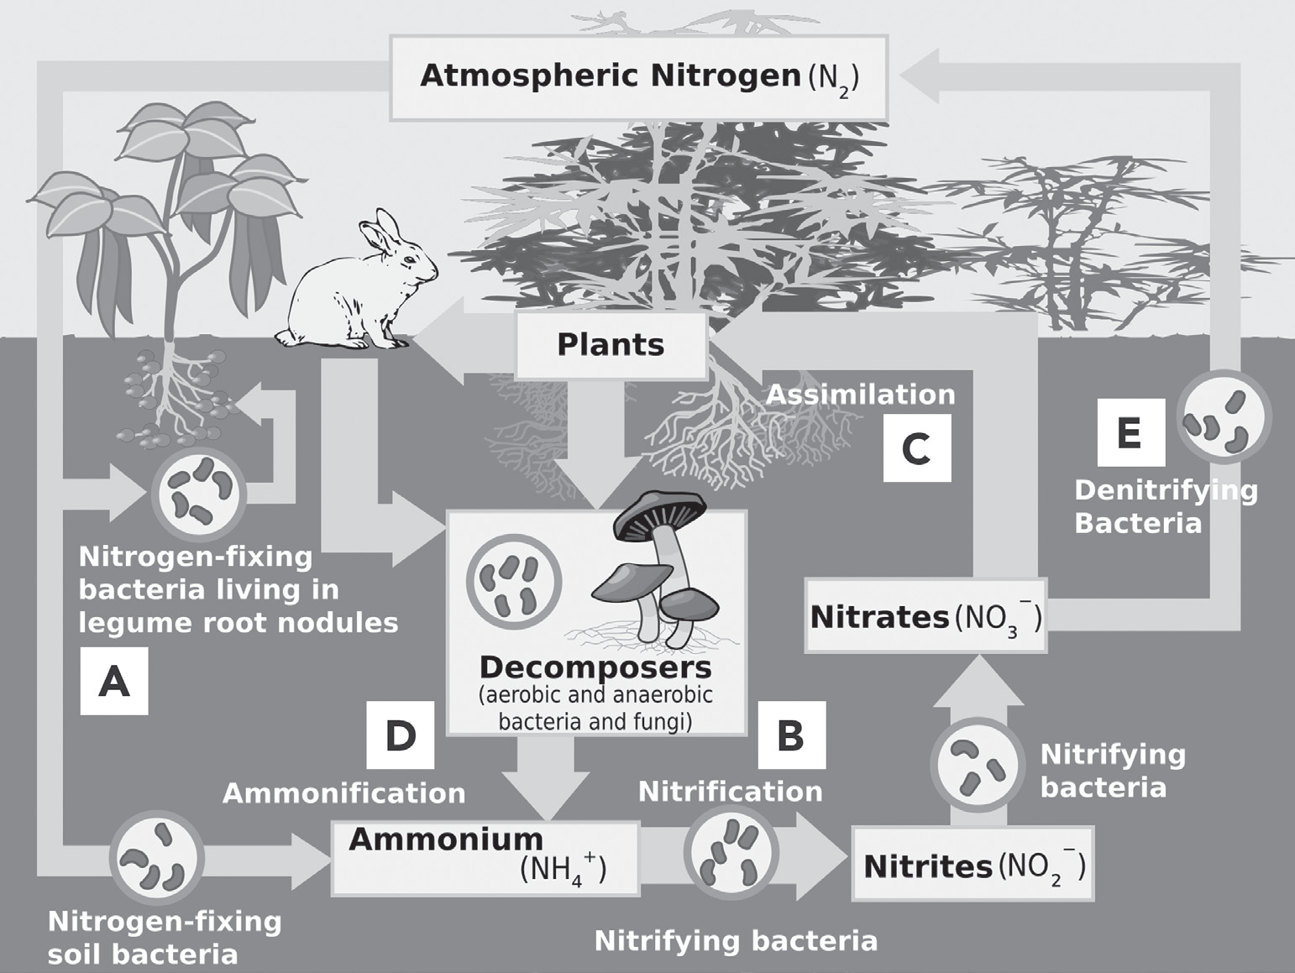
Cycling of Materials in an Ecosystem
Nitrogen is returned to the soil in many ways. When animals urinate, nitrogen returns to the water or to the soil and is reused by plants. When organisms die, decomposers transform the nitrogen in proteins into ammonia via ammonification (see Figure D). Organisms in the soil can then convert the ammonia into nitrogen compounds that plants can use by means of nitrification once more. Finally, in a process called denitrification (see Figure E), some soil bacteria convert fixed nitrogen compounds into nitrogen gas, which returns to the atmosphere. Because only a few organisms can convert nitrogen gas, the reservoir of nitrogen gas is still the atmosphere.

Slide 11
Cycling of Materials in an Ecosystem
Phosphorus Cycle
Phosphorus is an element that is essential for the growth and development of organisms. There are two possible cycles for phosphorus. The short-term cycle involves phosphorus being in the form of phosphates (PO4 ), which are soluble in water. These are cycled from the soil to producers and then from producers to consumers. Land plants absorb phosphates (see Figure A), which are then transformed into organic compounds. Consumers then acquire these phosphates by feeding on plants. When organisms die or produce waste products, decomposers return the phosphates into the soil, where they can be used again. Phosphates can reach aquatic environments by being leached from the soil and through surface runoff (see Figure B). Aquatic like algae and benthic plants absorb these phosphates, thereby making them available for aquatic food webs. Soil and water act as exchange pools for phosphorus.

Slide 12
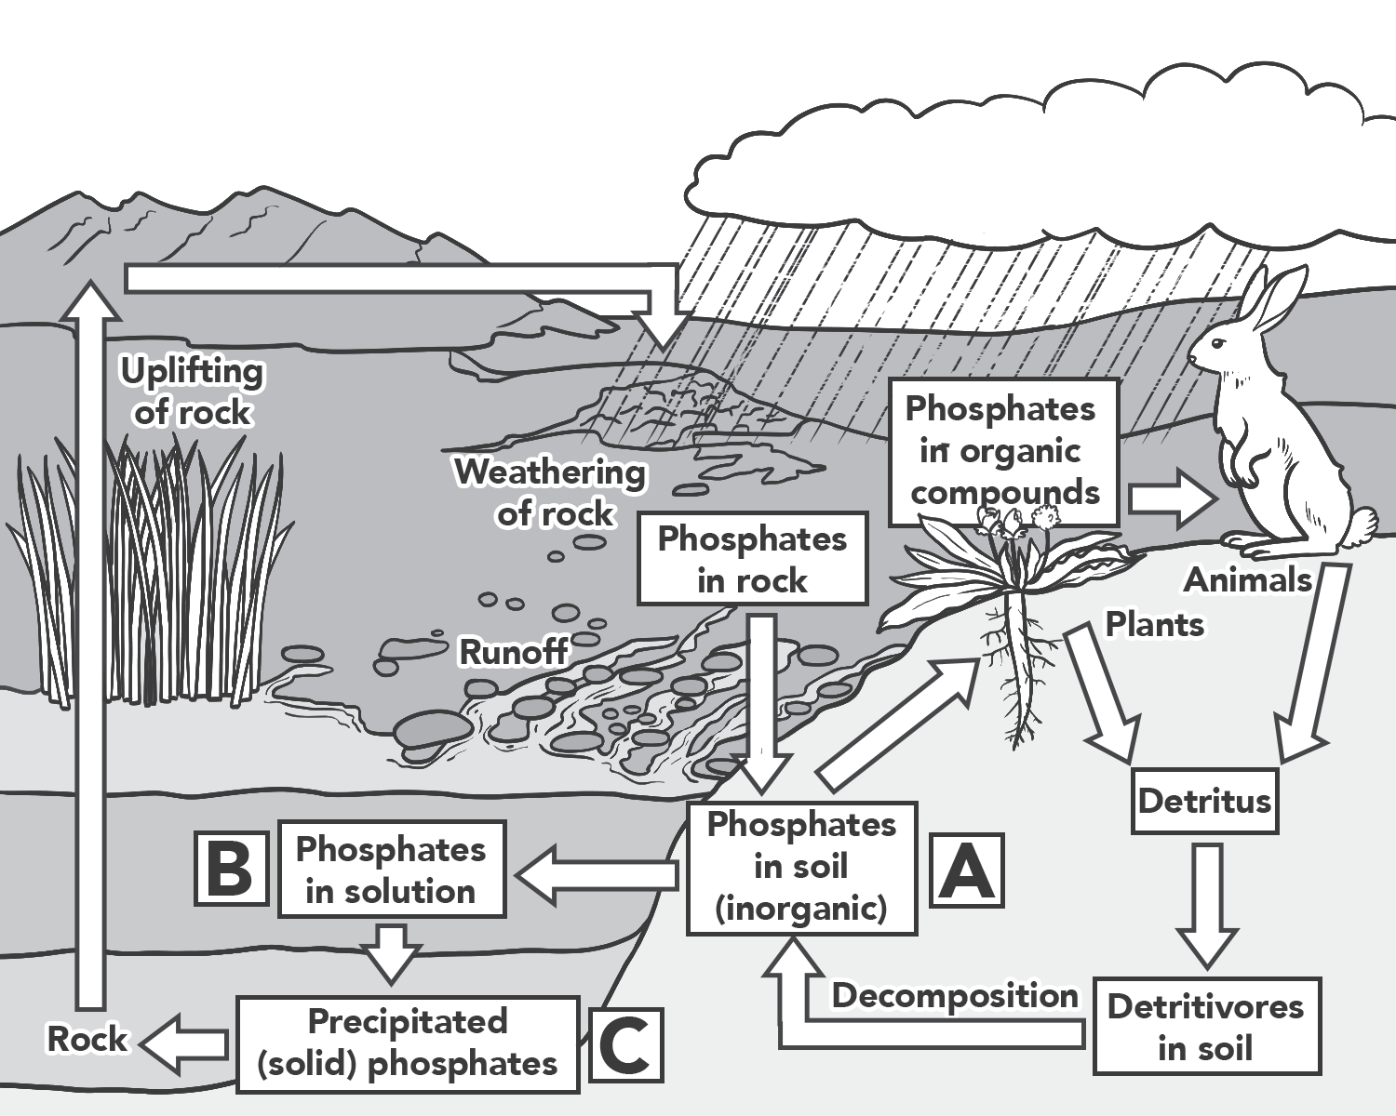
Cycling of Materials in an Ecosystem
Phosphorus moves from the short-term to the long-term cycle through mineralization and sedimentation (see Figure C) to form rocks that act as phosphorus reservoirs. It can also be moved into the long-term cycle by organic sources through preserved seabird and bat droppings called guano and in the preserved skeletons of dead organisms. Weathering or erosion of rocks containing phosphorus can release it into the soil and back into the short-term cycle.

Slide 13
Cycling of Materials in an Ecosystem
Anthropogenic Activities and Their Adverse Effects
Ecosystems are complex ecological environments that took millions of years to develop. With the way living things interact with each other and have defined roles in their environment, it can easily be seen that these are stable and self-maintaining systems. However, human activities have altered the natural workings of these systems, and the environment is finding it hard to cope with these changes. This part of the lesson will now explore how anthropogenic or human activities have brought about drastic changes in ecosystems.
Deforestation is the nonselective cutting of trees from a large tract of a forest. This is done in response to the need or demand for timber for the following purposes: construction of roads, houses, and furniture; making of paper; and converting forests into farmland or grazing areas. Deforestation can lead to loss of biodiversity and extinction of species as well as flooding and soil erosion, a decrease in the amount of atmospheric oxygen, and an increase in the amount of atmospheric carbon dioxide.

Slide 14
Cycling of Materials in an Ecosystem
Air pollution is caused primarily by burning of fossil fuels that releases huge volumes of carbon dioxide, nitrous oxides from motor vehicles, methane from agricultural activities, and chlorofluorocarbons from industrial processes. This burning of fossil fuels may lead to global warming, depletion of the stratospheric ozone layer, acid rain, and climate change.
Water pollution is caused primarily by the discharge of domestic wastewater, heavy metals, and synthetic organic compounds from industrial processes, excessive use of chemical fertilizers, and pesticides from agricultural activities into surface bodies of water. The consequences of water pollution include bioaccumulation (accumulation of toxic chemicals inside living things) and eutrophication (overloading of nutrients causing algal blooms).

Slide 15
Cycling of Materials in an Ecosystem
Soil or land degradation is the loss of the soil’s biological productivity due to poor agricultural practices and industrialization. The consequences of soil degradation include soil erosion, desertification, change in soil pH, and increased soil salinity.
The introduction of non-native or exotic species either accidentally or intentionally can lead to these species being invasive and in competition with native species. This can result in reduced species diversity, which happens when the exotic species become well established in the area. It can even sometimes lead to the extinction of native species.

Slide 16
Cycling of Materials in an Ecosystem
Mitigation Efforts
Due to a large number of ecosystems now under threat and in danger of being destroyed because of human activities, immediate actions must be taken to reduce our impact on the environment. The recent strong typhoons and the ever-increasing average air temperatures are signs that ecological balance and the natural order of things have been disrupted, and we must do something to maintain them.
Here are some strategies that can be adopted:
1. Use fewer fossil fuels.
2. Conserve energy.
3. Plant trees.
4. Change practices and processes.
5. Educate people.

Slide 17
Cycling of Materials in an Ecosystem
Activity
Directions: Write True if the statement is correct and False if it is not.
_______1. The incorporation of nitrogen into living tissue is called assimilation.
_______2. The hydrologic cycle involves two main processes: evaporation (water vapor to liquid water) and condensation (liquid water to water vapor).
_______3. Deforestation is the nonselective cutting of trees from a large tract of a forest.
_______4. Biogeochemical cycles are processes by which matter is constantly recycled or renewed using energy.
_______5. Phosphorus moves from the short-term to the long-term cycle through mineralization and denitrification to form rocks that act as phosphorus reservoirs.

Slide 18
Cycling of Materials in an Ecosystem
Answer Key
_______1. The incorporation of nitrogen into living tissue is called assimilation.
_______2. The hydrologic cycle involves two main processes: evaporation (water vapor to liquid water) and condensation (liquid water to water vapor).
_______3. Deforestation is the nonselective cutting of trees from a large tract of a forest.
_______4. Biogeochemical cycles are processes by which matter is constantly recycled or renewed using energy.
_______5. Phosphorus moves from the short-term to the long-term cycle through mineralization and denitrification to form rocks that act as phosphorus reservoirs.
True
False
True
True
False

