Slide 1


Identifying Base, Percentage, and Rate

Slide 2
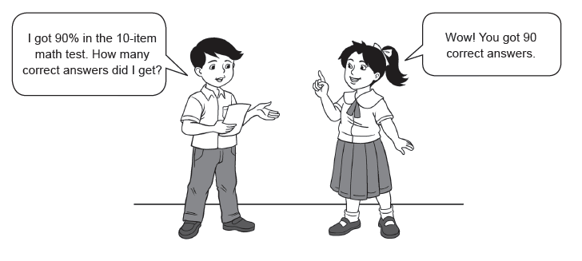
Juan just got the results of his Math test. Let us read and analyze the conversation between Juan and Sarah.
Can you explain the answer?
Is the answer of Sarah to the question of Juan correct? Why or why not?
Did Juan perform well in the Math test? Why or why not?
The situation presented above can be best solved using the knowledge of percentages. Many aspects of your life as pupils are related with or interpreted using the concept of percentages, like your class attendance, your marks or grades in your subjects, how you distribute your daily allowance, and others. Thus, mastery of this topic may help you better understand how the world works. Let’s get started!
Rex Curriculum Resource
WWW.REX.COM.PH

Slide 3
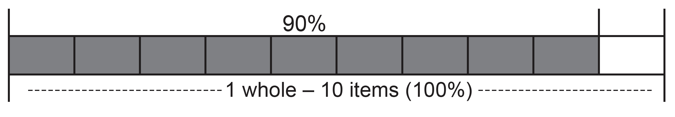
Computing your school grade is one of the many applications of percentage.
You can draw a part-whole model to solve the problem. Look at the picture below:
The model shows that the shaded part is nine-tenths or 90% of the whole. Thewhole is taken as the base, which represents 100%. Thus, if the whole is 10 units, then the shaded part is 9 units. This means that 90% is 9 out of 10 items.
You can solve the problem by converting the rate or percent to its fraction or decimal form. Here is how:
90% of 10 = 9/10 × 10 = 9 or 90% of 10 = 0.9 × 10 = 9
All percentage problems have three parts that you need to identify: base, percentage, and rate. The base represents the whole in the problem. The percentage is the part that you are comparing with the base. The rate represents the ratio of the percentage to the base.
In the given problem, the base (whole) is 10, the rate is 90%, and the percentage is 9.
Rex Curriculum Resource
WWW.REX.COM.PH

Slide 4
Study the examples to learn how to identify the parts of a percentage problem.
Example 1: Identify the rate in the given statements.
a. 20% of 10 is 2. b. 45 is 75% of 60.
Answers:
a. 20% b. 75%
Identifying the rate is not difficult. Simply look for the number with percent symbol in the statement or problem. For example, in this statement: “50% of 20 is 10,” the rate is 50%.
Example 2: Identify the percentage in the given statements.
a. 50% of 80 is 40. b. 60 is 30% of 200.
Answers:
a. 40 b. 60
It is easy to find the percentage in the statement or problem. Remember, it is
the product of the base and the rate in a given problem. In this statement, “20% of 60 is 12,” the percentage is 12, which is the product of 0.2 and 60.
Example 3: Identify the base in the given statements.
a. 15% of 60 is 9. b. 5% of 40 is 2.
Answers:
a. 60 b. 40
Determining the base in the statement or problem is easy. Remember that it
represents the whole in the statement or problem. In this statement, “80% of 40 is 32,” the base follows the word “of.” So, it is 40.
Rex Curriculum Resource
WWW.REX.COM.PH

Slide 5
KEY TAKEAWAYS
• The rate (r) tells the number of hundredths parts taken.
• The base (b) represents the whole in which the rate operates.
• The percentage (p) is the result when the base is multiplied by the base. It is the part of the base determined by the rate.
Rex Curriculum Resource
WWW.REX.COM.PH

Slide 6
Activity:
Identify the unknown in the problem. Do not solve. Just tell whether it is the base, rate, or percentage.
1. Mr. Reyes borrowed ₱20,000.00 from the bank which is payable for one year. If the interest rate is 6%, how much interest will he pay?
2. Jun receives a 5% commission on all his sales. What is his total sale if his commission is ₱2,000?
3. 25% of a number is 50. What is the number?
Rex Curriculum Resource
WWW.REX.COM.PH

Slide 7
Activity: ANSWER KEY
Identify the unknown in the problem. Do not solve. Just tell whether it is the base, rate, or percentage.
1. Mr. Reyes borrowed ₱20,000.00 from the bank which is payable for one year. If the interest rate is 6%, how much interest will he pay?
2. Jun receives a 5% commission on all his sales. What is his total sale if his commission is ₱2,000?
3. 25% of a number is 50. What is the number?
ANSWERS:
1. Percentage
2. Base
3. Base
Rex Curriculum Resource
WWW.REX.COM.PH

Slide 8


