Slide 1


Solving Problems Involving the Missing Base, Percentage, and Rate

Slide 2
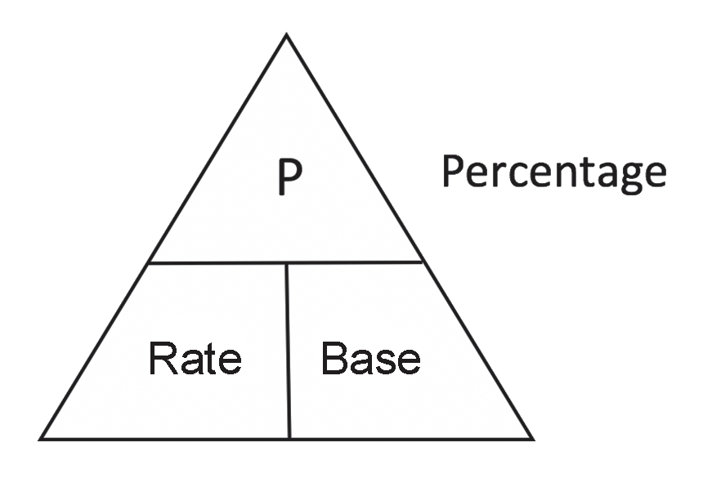
In solving problems involving base, percentage, or rate, you must understand the relationships among them. At a constant rate, the percentage is directly proportional to the base.
The unknown quantity can be identified from the given two values. For example, if the percentage is missing in the word problem, the base and the rate must be given. Some words can give hints as to what is given or missing in a word problem. As an
example, the quantity with the percent (%) symbol is the rate. The base refers to the total quantity or the whole and is usually preceded by the word of in a sentence. On the other hand, the percentage is a part of the base.
Teehan’s triangle is one of the tools that you can use to help you solve problems with unknown base, percentage, or rate.
Rex Curriculum Resource
WWW.REX.COM.PH

Slide 3
To ensure the health and safety of all in the midst of the pandemic, the teaching and learning activities in schools shifted to different modes of distance education. These include modular learning, TV- and radio-based learning, online learning, etc.
Consider the following problem:
A total of 65 parents were asked online about their preferred mode of instruction for their children in distance education. It was found out that 40% of them preferred modular learning. How many parents preferred modular learning?
What is being asked in the word problem? Can you think of a strategy to solve the problem?
Rex Curriculum Resource
WWW.REX.COM.PH

Slide 4
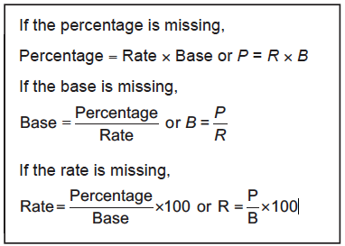
The given word problem involves finding the percentage. In the previous lesson, you have identified the base, percentage, and rate in a problem. Therefore, before solving the given problem, you must first determine the given and the missing quantity.
In the given problem, 65 is the base (B) as it refers to the total number of Parents.
40% is the rate (R). It is usually accompanied by a % symbol. Thus, the missing is the percentage (P).
One strategy to solve percentage problems is the use of Teehan’s triangle. It shows the relationship among base, percentage, and rate. If the two quantities are given, this strategy can be used to find the value of the other one.
Rex Curriculum Resource
WWW.REX.COM.PH

Slide 5
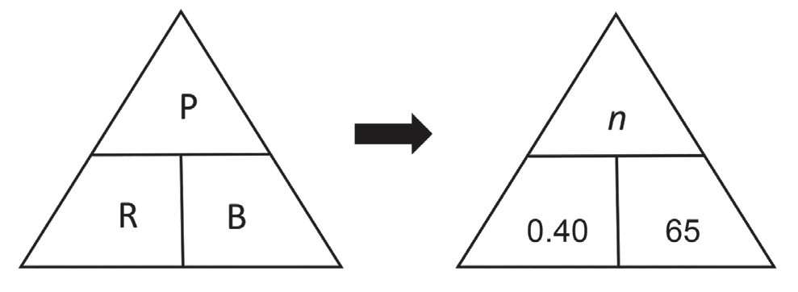
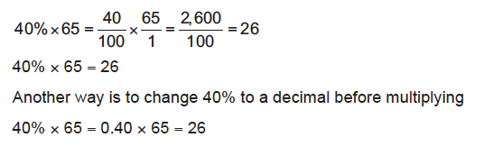
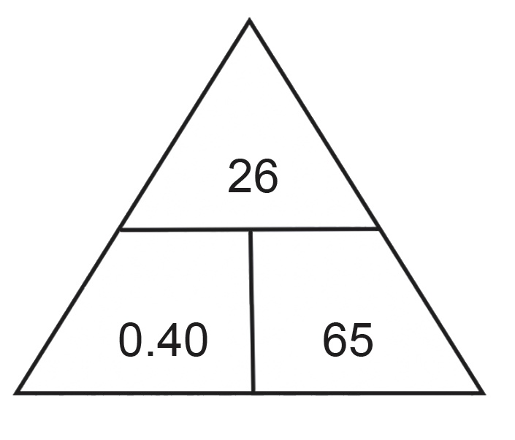
Let us analyze it using the Teehan’s triangle.
40% of 65 is the number of parents who preferred modular learning
40% × 65 = n
Study the given sample solution below on how to multiply in order to solve for the percentage.
Step 2: Key in the values inside Teehan’s triangle.
Step 3: Since the percentage is missing, use the formula based on Teehan’s triangle.
Formula: Percentage = Rate × Base
or
P = R × B
By substitution, n = 0.40 × 65
n = 26 Percentage
Step 4: Use the formula and check your answer.
P = R × B
26 = 0.40 × 65
26 = 26
Hence, 40% of 65 is 26.
There were 26 parents who preferred to use modular learning.
Use Teehan’s triangle and follow the steps below to solve the problem.
Step 1: Identify the given base, percentage, and rate in the problem.
Change the rate to decimal form.
Percentage | Rate | Base
n | 40% = 0.40 | 65
Rex Curriculum Resource
WWW.REX.COM.PH

Slide 6
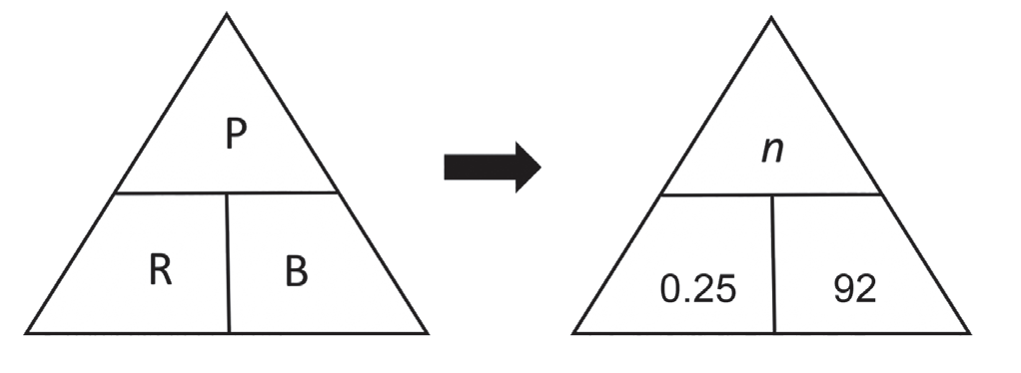
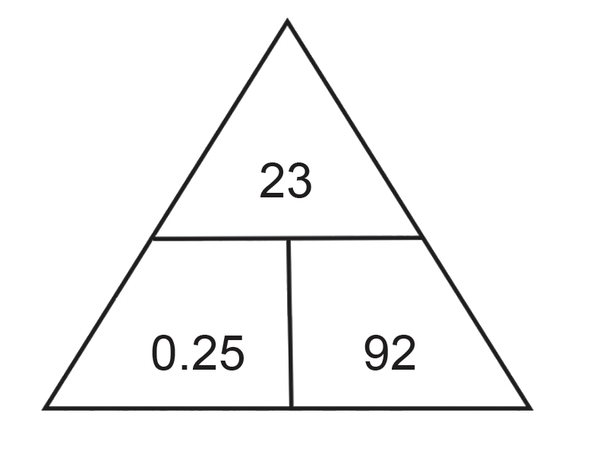
Example 1: What is 25% of 92?
Step 1: Identify the given base, percentage, and rate in the problem.
Change the rate to decimal form.
Step 2: Substitute the values in Teehan’s triangle.
Step 3: Since the percentage is missing, use the formula based on Teehan’s triangle.
Formula: Percentage = Rate × Base
Or P = R × B
By substitution, n = 0.25 × 92
n = 23 Percentage
Step 4: Use the formula and check your answer.
P = R × B
23 = 0.25 × 92
23 = 23
Hence, 25% of 92 is 23 which is the percentage.
Percentage | Rate | Base
n | 25% = 0.25 | 92
Rex Curriculum Resource
WWW.REX.COM.PH

Slide 7
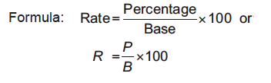
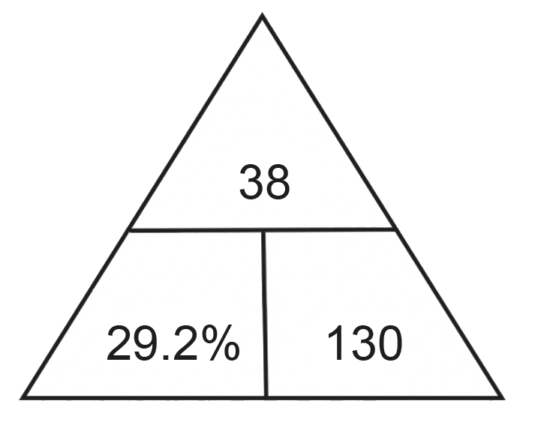
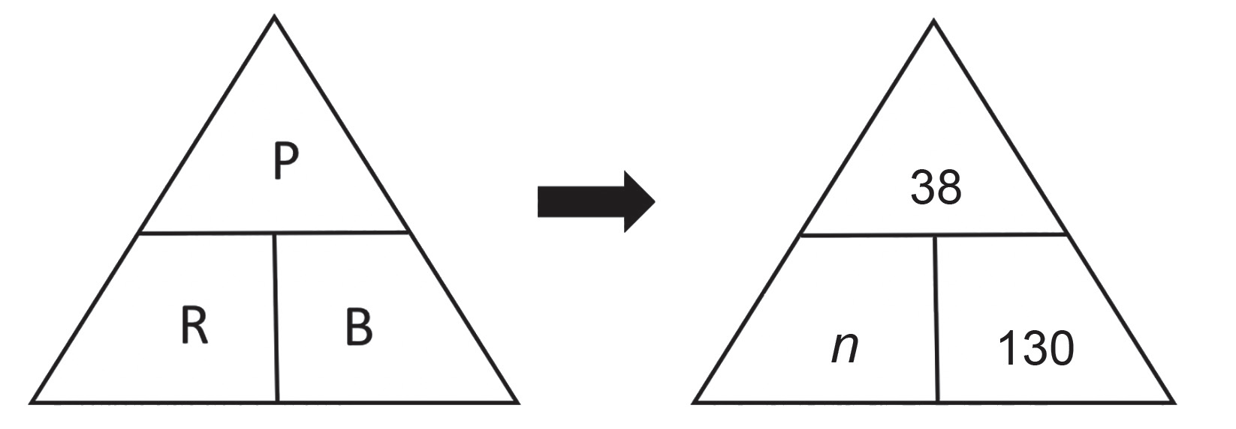
Example 2: In our school, there are 130 teachers and 38 of them are males. What percent of the teachers are male?
Step 1: Identify the given percentage, base, and rate in the problem.
Here, the unknown is the rate.
Step 2: Substitute the values in Teehan’s triangle.
Step 3: Since the rate is missing, use the formula based on
Teehan’s triangle.
(Rate is equal to the quotient of percentage and the base times 100.)
By substitution, n = 38/130 x 100
Rate => n = 29.2%
Step 4: Use the formula and check your answer.
29.2% = 29.2%
Hence, 38 is 29.2% of 130.
29.2% of the teachers in our school are males.
Percentage | Rate | Base
38 | n | 92
Rex Curriculum Resource
WWW.REX.COM.PH

Slide 8
Activity:
Copy and complete the table by finding the base, rate, or percentage.
No. | Percentage | Base | Rate
1 |  | 160 | 5%
2 | 11 | 44
3 | 15 |  | 15%
4 |  | 54 | 50%
5 | 12 | 60
Rex Curriculum Resource
WWW.REX.COM.PH

Slide 9
Activity: ANSWER KEY
Copy and complete the table by finding the base, rate, or percentage.
No. | Percentage | Base | Rate
1 |  | 160 | 5%
2 | 11 | 44
3 | 15 |  | 15%
4 |  | 54 | 50%
5 | 12 | 60
ANSWER KEY
1. 8
2. 25%
3. 100
4. 27
5. 20%
Rex Curriculum Resource
WWW.REX.COM.PH

Slide 10


