Slide 1
Calculating Speed

Slide 2
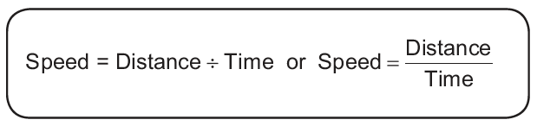
Calculating Speed
Speed Formula
Problem:
Suppose Marciano drives his car for 3 hours at a distance of 150 kilometers. What must be the speed of the car? Let us calculate the speed of the car using the speed formula. Remember that the distance he traveled is 150 kilometers for 3 hours.

Slide 3

Calculating Speed
Solution: Use the speed formula.
Therefore, the speed is 50 km/h.
In our day-to-day life, we experience the use of units for speed like meters per second (m/s), miles per hour (mph), etc. In the problem, however, we use kilometers per hour (km/h).

Slide 4
Calculating Speed
Speed is a scalar quantity that refers to “how fast an object is moving.”
A fast-moving object has a high speed and covers a long distance in a short time. On the other hand, a slow-moving object has a low speed and covers a shorter distance in the same amount of time. An object at rest has a zero speed.

Slide 5
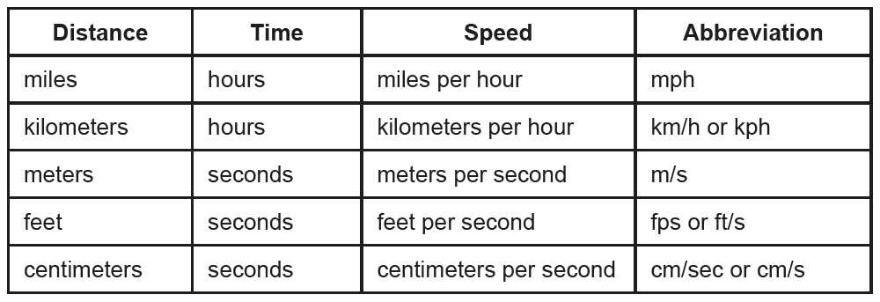
Calculating Speed
What are the common units of speed? The following table shows a list of units for speed that are commonly used and their corresponding abbreviations.
Remember also that units of measurements can be converted from one unit to another, and we cannot combine measurements unless their units are the same.

Slide 6
Calculating Speed
The succeeding examples will give you more understanding of the process of calculating speed. Moreover, you will be refreshed by the skills in conversion of units, specifically, of distance and time. Study the following examples:
Example 1: If a bus travels 120 kilometers in 2 hours, find the average speed.
Solution: Use the speed formula.
Answer: The average speed is 60 kph.

Slide 7

Calculating Speed
Example 2: Janice, a Grade 6 runner, can finish a 100-meter dash in 20 seconds.
Calculate her speed in running.
Solution: Use the speed formula.
Answer: Her running speed is 5 m/s.

Slide 8


Calculating Speed
Example 3: Find the speed in m/s, given: distance = 180 meters; time = 1.5 minutes.
Solution: Convert the given unit into the inquired unit.
(In the problem, convert 1.5 minutes into its equivalent time in seconds.)
Using the conversion factor, 1 min = 60 s,
Using the speed formula:
Answer: The speed equals 2 m/s.

Slide 9
Calculating Speed
Complete the table below by calculating the speed when distance and time are given.
Distance | Time | Speed
1. 24 km | 2 h
2. 1500 km | 2.5 h
3. 23 km | 0.5 h
4. 60 km | 3 h
5. 1800 | 0.4h

Slide 10
Calculating Speed
Key to correction
Distance | Time | Speed
1. 24 km | 2 h | 12km/h
2. 1500 km | 2.5 h | 600km/h
3. 23 km | 0.5 h | 46km/h
4. 60 km | 3 h | 20km/h
5. 1800 | 0.4h | 4500km/h

