Slide 1
Operations Involving Rational Numbers

Slide 2
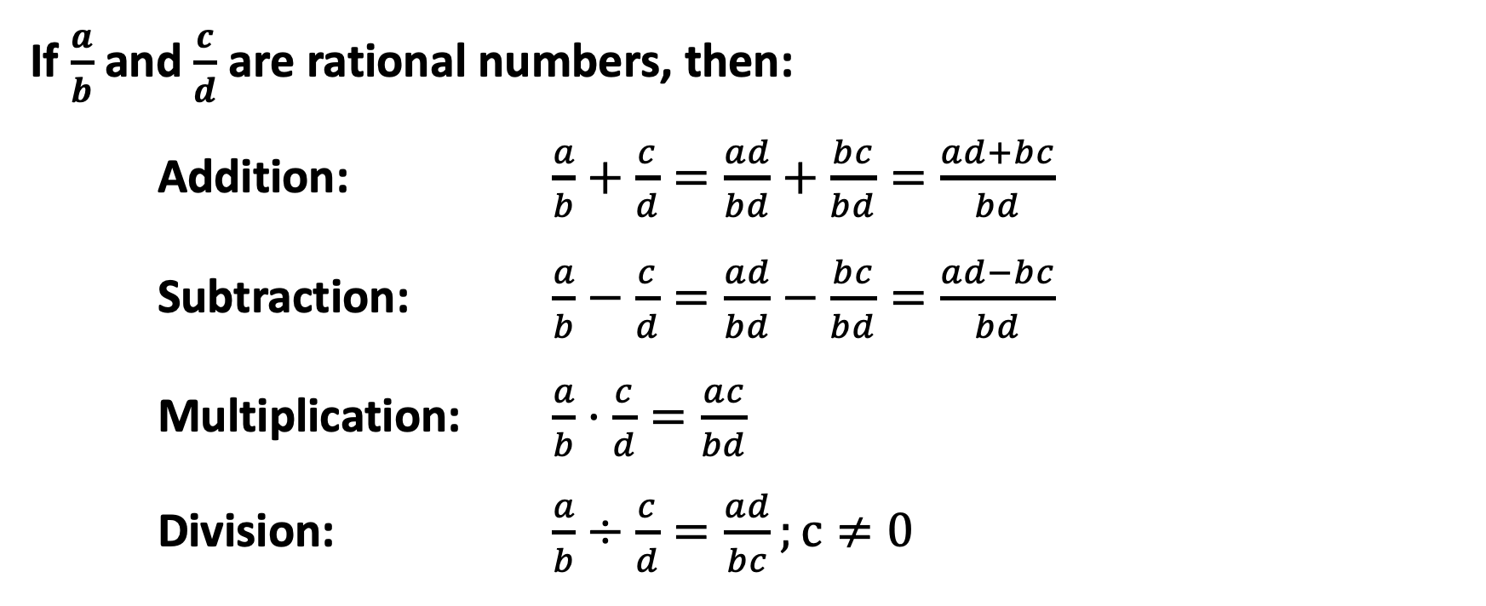
Operations Involving Rational Numbers
If $\frac{a}{b}$ and $\frac{c}{d}$ are rational numbers, then:
Addition: $\frac{a}{b}+\frac{c}{d}=\frac{ad}{bd}+\frac{bc}{bd}=\frac{ad+bc}{bd}$
Subtraction: $\frac{a}{b}−\frac{c}{d}=\frac{ad}{bd}−\frac{bc}{bd}=\frac{ad−bc}{bd}$
Multiplication: $\frac{a}{b}·\frac{c}{d}=\frac{ac}{bd}$
Division: $\frac{a}{b}÷\frac{c}{d}=\frac{ad}{bc};c≠0$

Slide 3
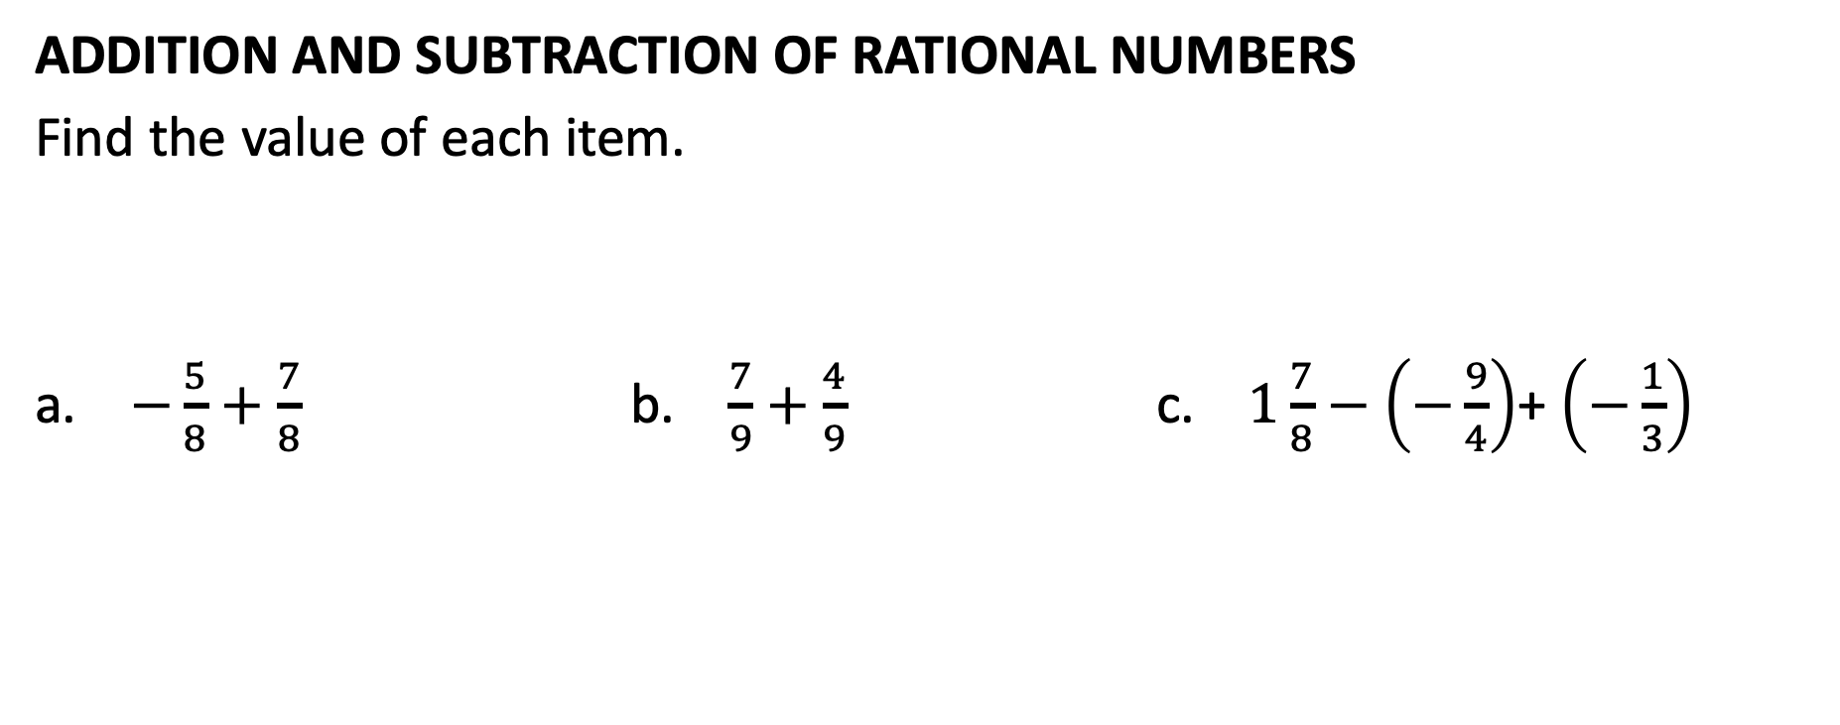
Operations Involving Rational Numbers
ADDITION AND SUBTRACTION OF RATIONAL NUMBERS
Find the value of each item.
a. $−\frac{5}{8}+\frac{7}{8}$ b. $\frac{7}{9}+\frac{4}{9}$ c. $1\frac{7}{8}−$ $\left(−\frac{9}{4}\right)$+ $\left(−\frac{1}{3}\right)$

Slide 4
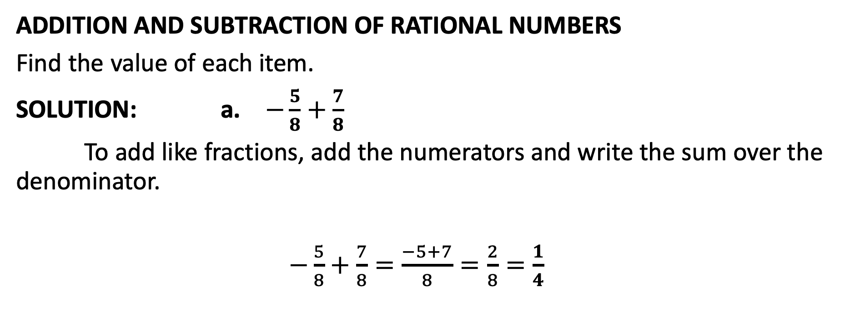
Operations Involving Rational Numbers
ADDITION AND SUBTRACTION OF RATIONAL NUMBERS
Find the value of each item.
SOLUTION: a. $−\frac{5}{8}+\frac{7}{8}$
To add like fractions, add the numerators and write the sum over the denominator.
$−\frac{5}{8}+\frac{7}{8}=\frac{−5+7}{8}=\frac{2}{8}=\frac{1}{4}$

Slide 5
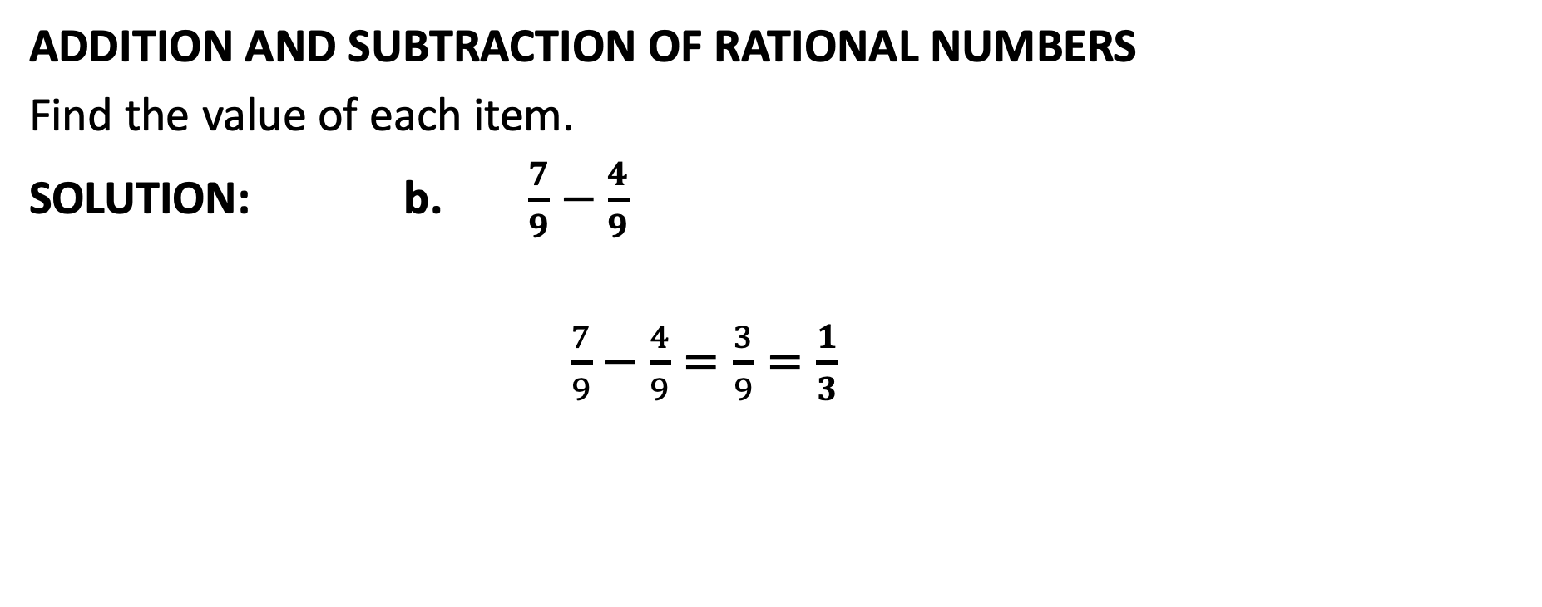
Operations Involving Rational Numbers
ADDITION AND SUBTRACTION OF RATIONAL NUMBERS
Find the value of each item.
SOLUTION: b. $\frac{7}{9}−\frac{4}{9}$
$\frac{7}{9}−\frac{4}{9}=\frac{3}{9}=\frac{1}{3}$

Slide 6
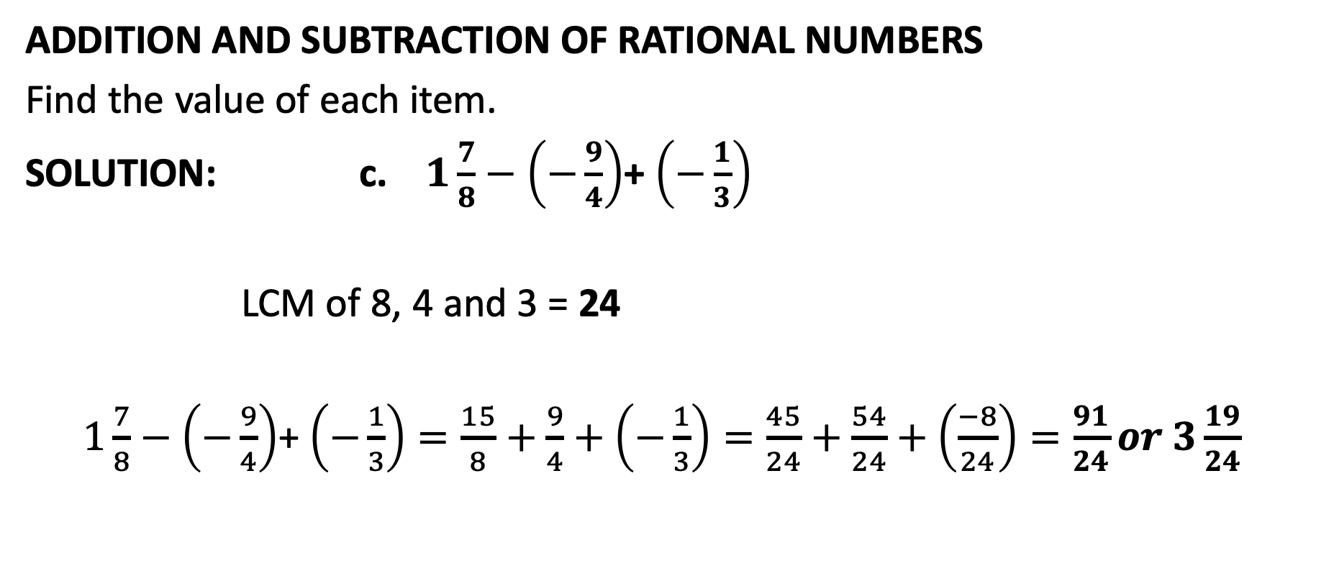
Operations Involving Rational Numbers
ADDITION AND SUBTRACTION OF RATIONAL NUMBERS
Find the value of each item.
SOLUTION: c. $1\frac{7}{8}−$ $\left(−\frac{9}{4}\right)$+ $\left(−\frac{1}{3}\right)$
LCM of 8, 4 and 3 = 24
$1\frac{7}{8}−$ $\left(−\frac{9}{4}\right)$+ $\left(−\frac{1}{3}\right)=\frac{15}{8}+\frac{9}{4}+\left(−\frac{1}{3}\right)=\frac{45}{24}+\frac{54}{24}+\left(\frac{−8}{24}\right)=\frac{91}{24}or 3\frac{19}{24}$

Slide 7
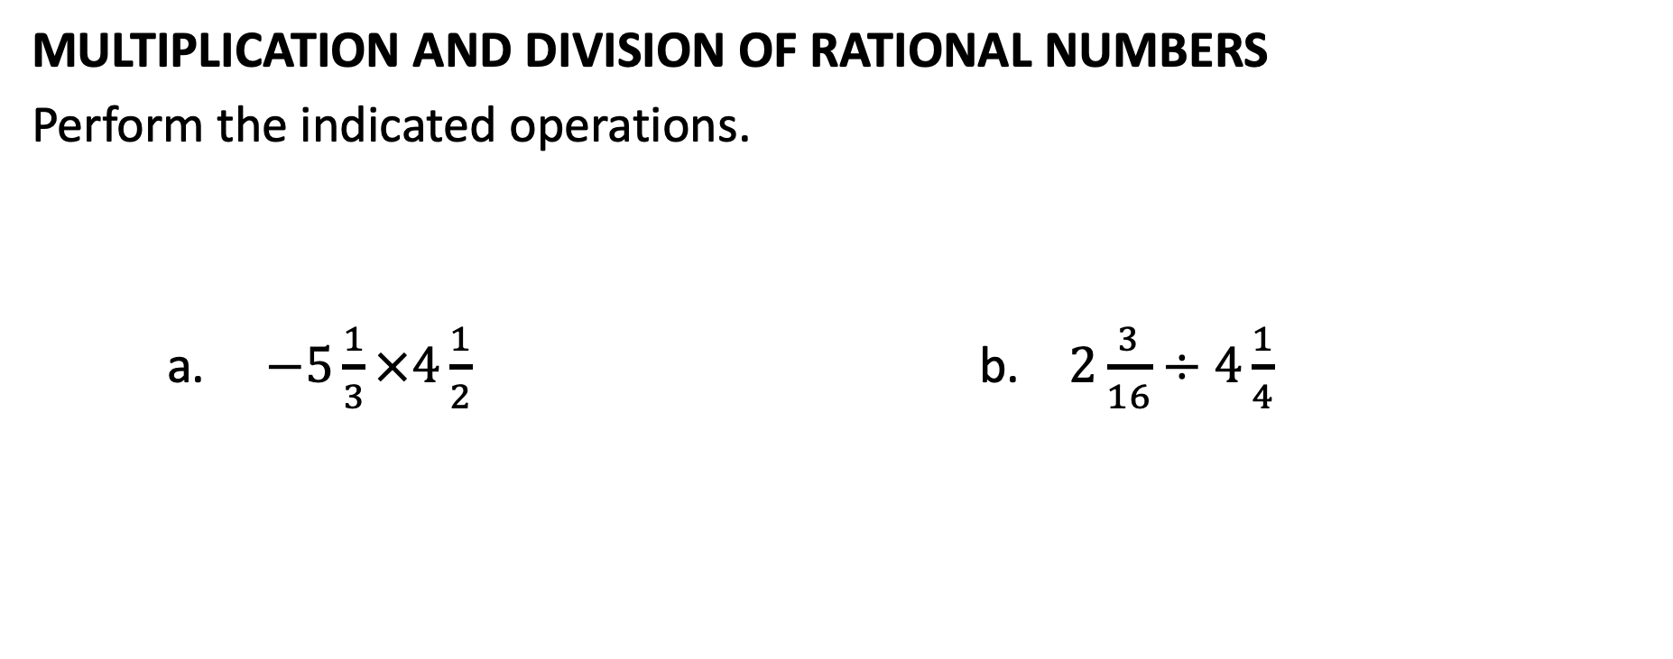
Operations Involving Rational Numbers
MULTIPLICATION AND DIVISION OF RATIONAL NUMBERS
Perform the indicated operations.
a. $−5\frac{1}{3}×4\frac{1}{2}$ b. $2\frac{3}{16}÷4\frac{1}{4}$

Slide 8

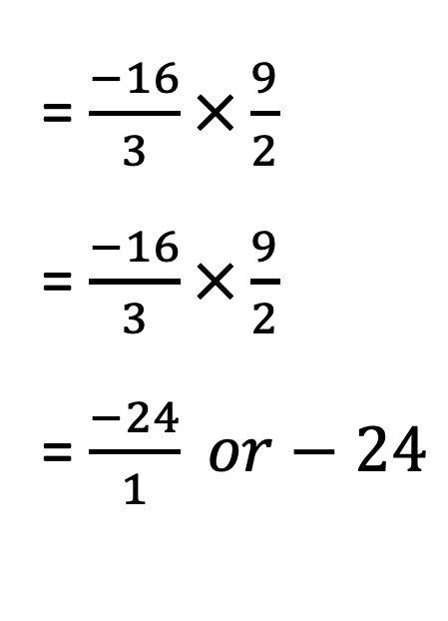
Operations Involving Rational Numbers
MULTIPLICATION AND DIVISION OF RATIONAL NUMBERS
Perform the indicated operations.
SOLUTION: a. $−5\frac{1}{3}×4\frac{1}{2}$
= $\frac{−16}{3}×\frac{9}{2}$
= $\frac{−16}{3}×\frac{9}{2}$
= $\frac{−24}{1} or−24$
Change to improper fractions.
8
3
Divide by common factor.
1
1
Multiply.

Slide 9

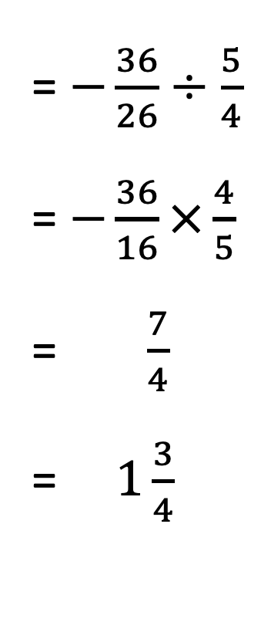
Operations Involving Rational Numbers
MULTIPLICATION AND DIVISION OF RATIONAL NUMBERS
Perform the indicated operations.
SOLUTION: b.$2\frac{3}{16}÷4\frac{1}{4}$
= $−\frac{36}{26}÷\frac{5}{4}$
= $−\frac{36}{16}×\frac{4}{5}$
= $\frac{7}{4}$
= $1\frac{3}{4}$
Change to improper fractions.
7
1
Divide by common factor.
1
1
Simplify.
Change to mixed number.

