Slide 1
Square Root

Slide 2
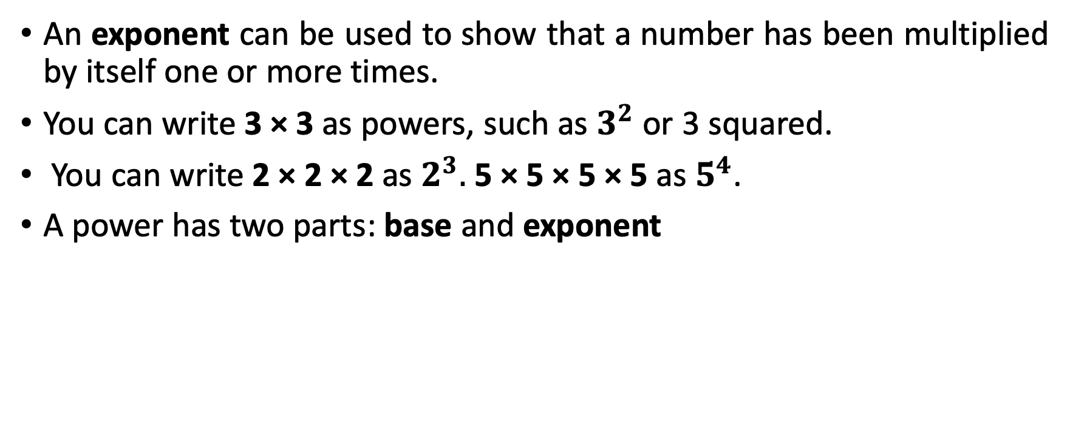

Square Root
An exponent can be used to show that a number has been multiplied by itself one or more times.
You can write 3 × 3 as powers, such as $3^{2}$ or 3 squared.
You can write 2 × 2 × 2 as $2^{3}.$5 × 5 × 5 × 5 as $5^{4}$.
A power has two parts: base and exponent
exponent
$$3^{2}$$
base

Slide 3
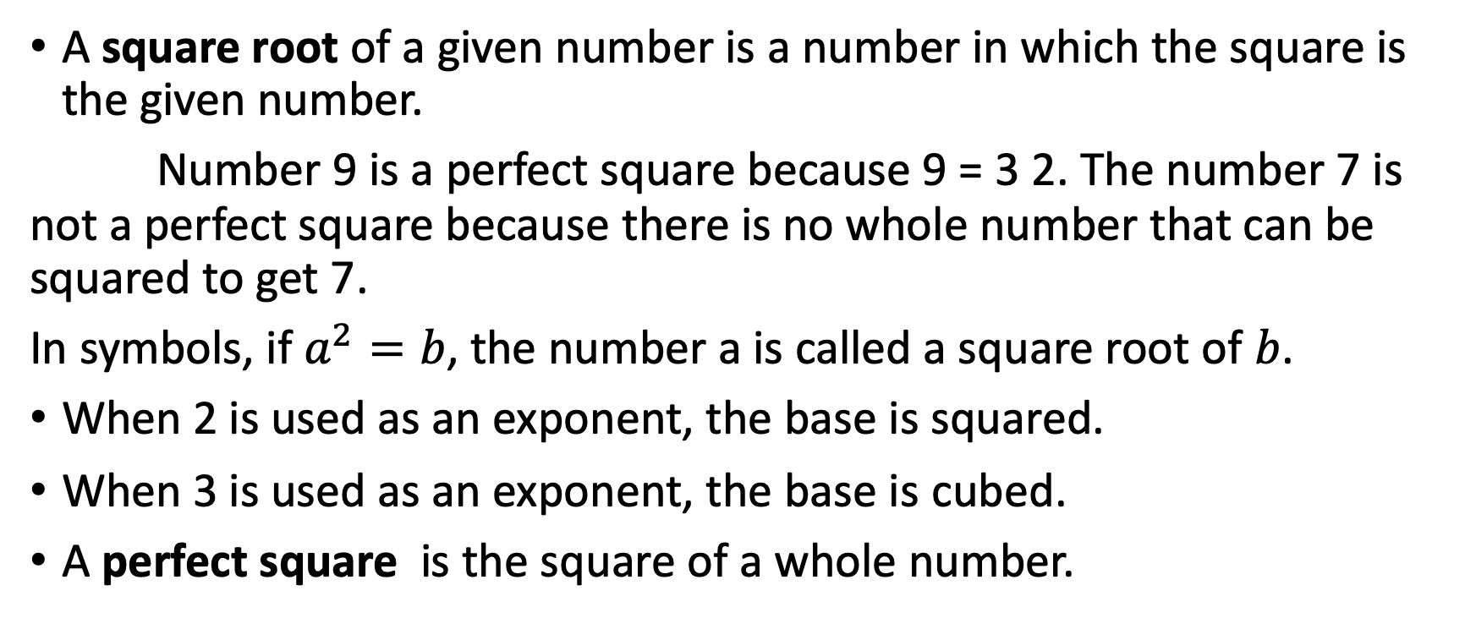
Square Root
A square root of a given number is a number in which the square is the given number.
Number 9 is a perfect square because 9 = 3 2. The number 7 is not a perfect square because there is no whole number that can be squared to get 7.
In symbols, if $a^{2}=b$, the number a is called a square root of $b$.
When 2 is used as an exponent, the base is squared.
When 3 is used as an exponent, the base is cubed.
A perfect square is the square of a whole number.

Slide 4
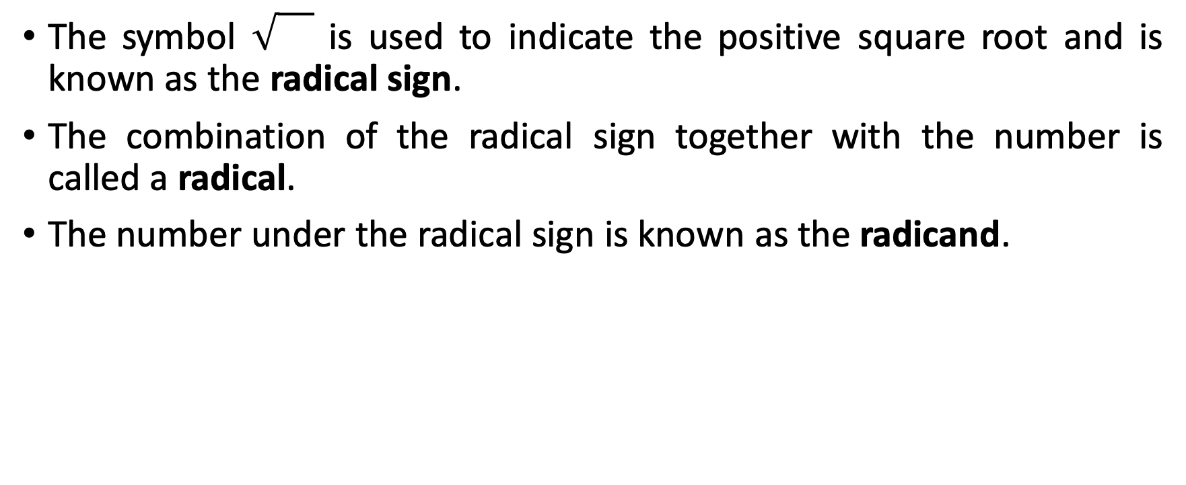
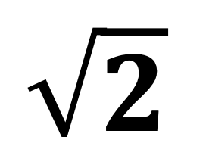
Square Root
The symbol is used to indicate the positive square root and is known as the radical sign.
The combination of the radical sign together with the number is called a radical.
The number under the radical sign is known as the radicand.
Radical sign
$$\sqrt{2}$$
radicand

Slide 5
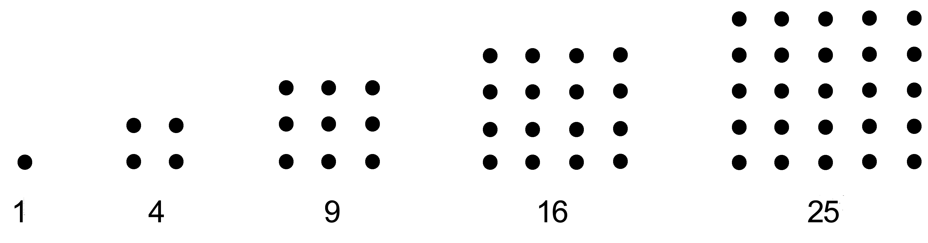
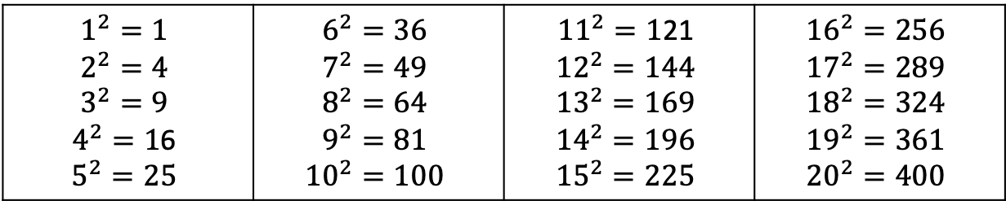
Square Root
First 20 Perfect squares
They are called perfect squares because they can be arranged into squares.
$$1^{2}=1$$ $$2^{2}=4$$ $$3^{2}=9$$ $4^{2}=1$6 $$5^{2}=25$$ | $$6^{2}=36$$ $$7^{2}=49$$ $$8^{2}=64$$ $$9^{2}=81$$ $${10}^{2}=100$$ | ${11}^{2}=1$21 $${12}^{2}=144$$ $${13}^{2}=169$$ $${14}^{2}=196$$ $${15}^{2}=225$$ | $${16}^{2}=256$$ $${17}^{2}=289$$ $${18}^{2}=324$$ $${19}^{2}=361$$ $${20}^{2}=400$$

Slide 6

Square Root
Principal Square Root
Find the principal square root.
a. $\sqrt{121}$ b. $\sqrt{\frac{49}{121}}$ c. $\sqrt{0}$

Slide 7
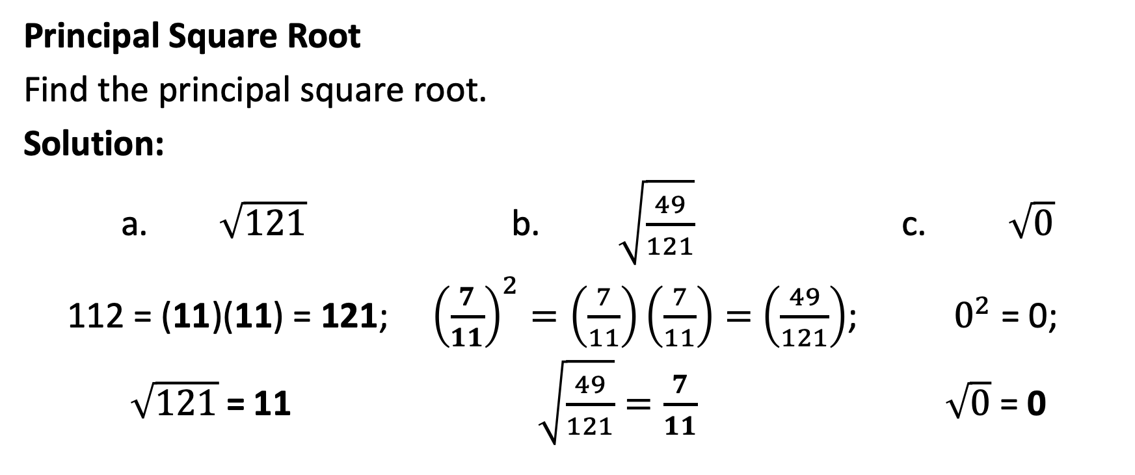
Square Root
Principal Square Root
Find the principal square root.
Solution:
a. $\sqrt{121}$ b. $\sqrt{\frac{49}{121}}$ c. $\sqrt{0}$
112 = (11)(11) = 121; ${\left(\frac{7}{11}\right)}^{2}=\left(\frac{7}{11}\right)\left(\frac{7}{11}\right)=$ $\left(\frac{49}{121}\right)$; $0^{2}$ = 0;
$\sqrt{121}$ = 11 $\sqrt{\frac{49}{121}}=\frac{7}{11}$ $\sqrt{0}$ = 0

Slide 8

Square Root
Ordering Radicals
Between which two consecutive integers does each number lie?
a. $\sqrt{12}$ b. $\sqrt{300}$

Slide 9
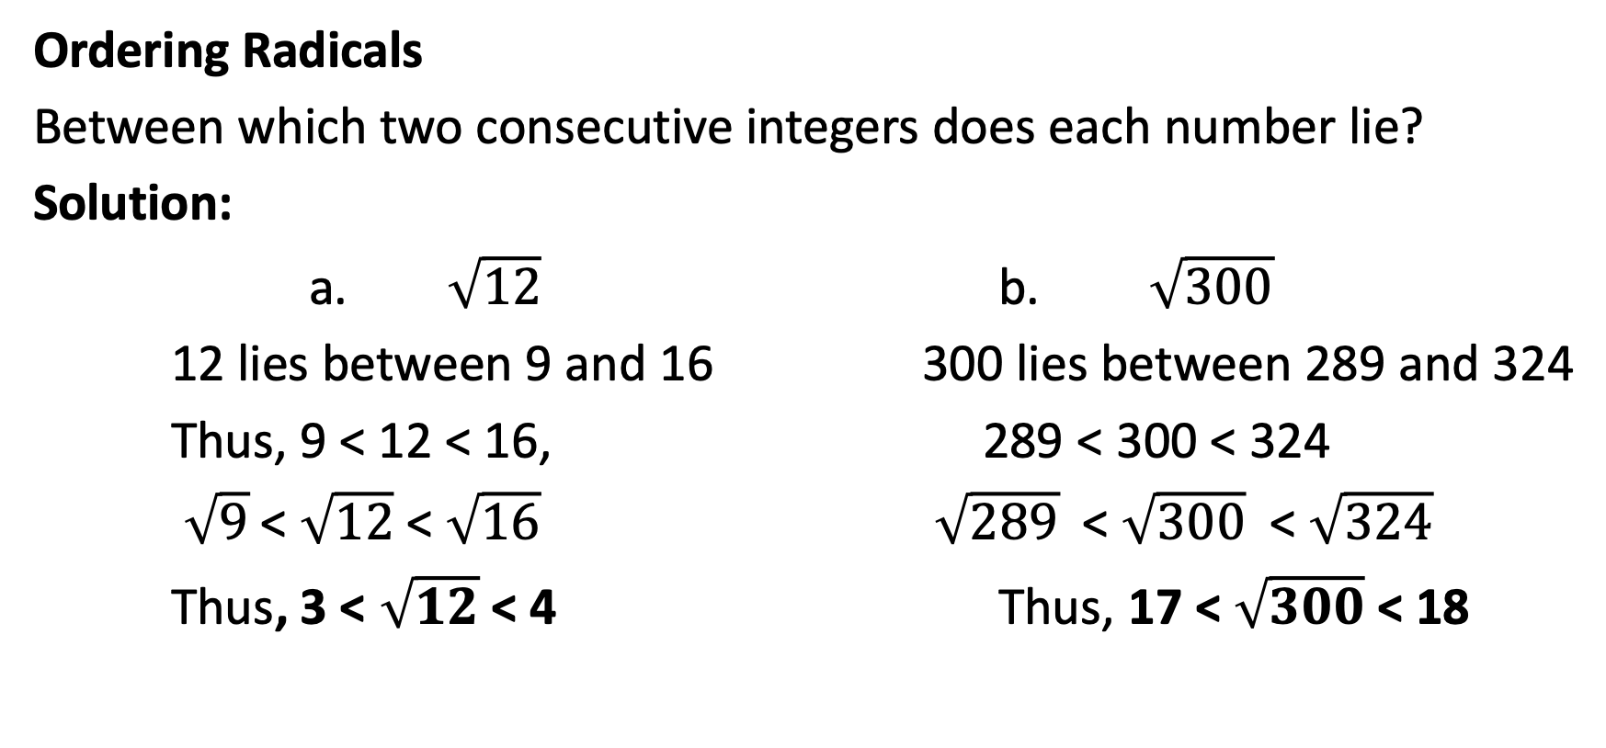
Square Root
Ordering Radicals
Between which two consecutive integers does each number lie?
Solution:
a. $\sqrt{12}$ b. $\sqrt{300}$
12 lies between 9 and 16 300 lies between 289 and 324
Thus, 9 < 12 < 16, 289 < 300 < 324
$\sqrt{9}$ < $\sqrt{12}$ < $\sqrt{16}$ $\sqrt{289}$ < $\sqrt{300}$ < $\sqrt{324}$
Thus, 3 < $\sqrt{12}$ < 4 Thus, 17 < $\sqrt{300}$ < 18

Slide 10
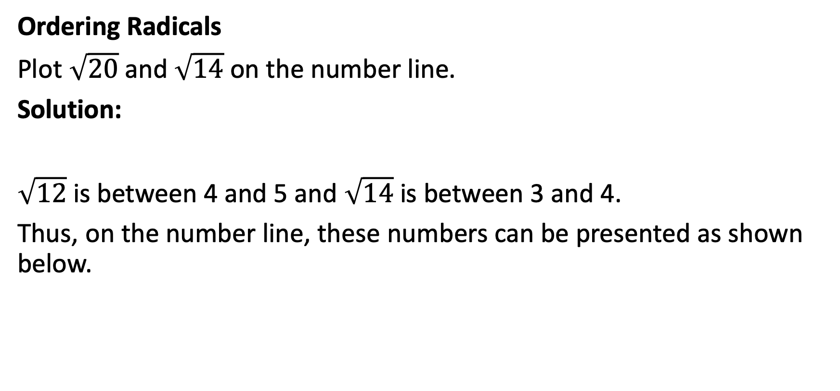
Square Root
Ordering Radicals
Plot $\sqrt{20}$and $\sqrt{14}$ on the number line.
Solution:
$\sqrt{12}$ is between 4 and 5 and $\sqrt{14}$ is between 3 and 4.
Thus, on the number line, these numbers can be presented as shown below.

Slide 11
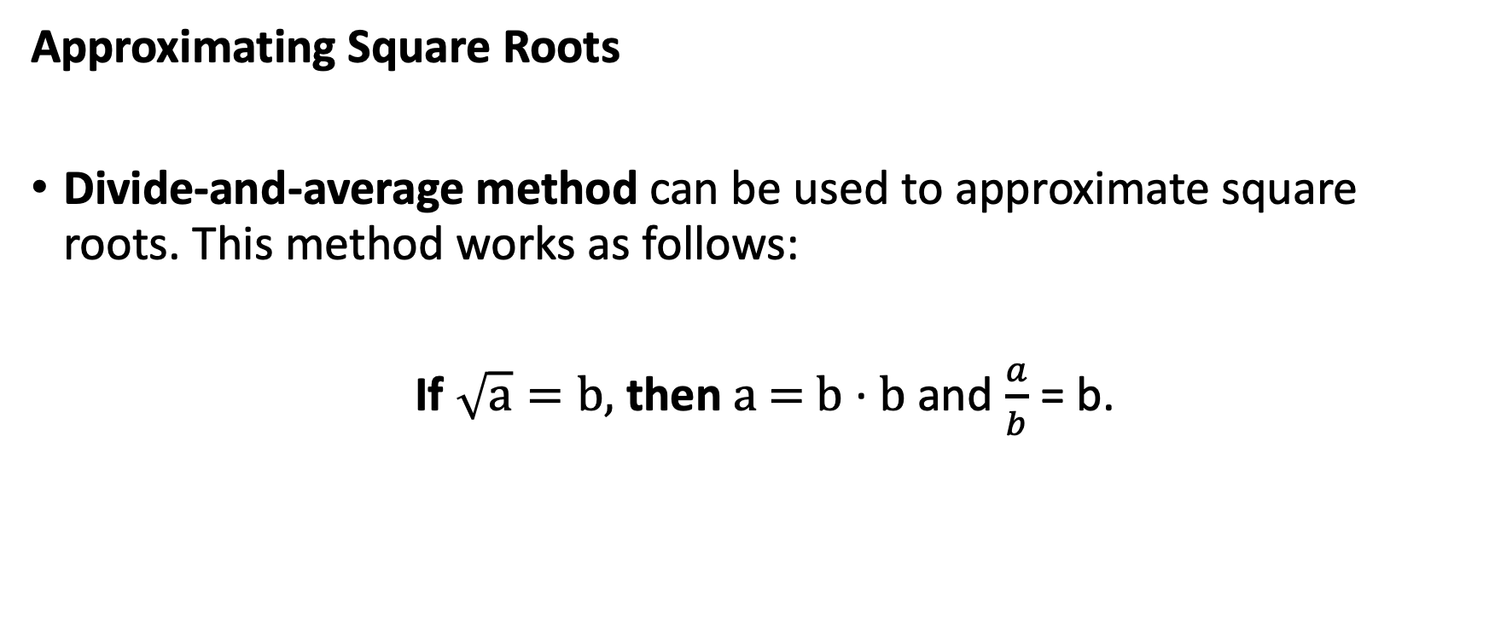
Square Root
Approximating Square Roots
Divide-and-average method can be used to approximate square roots. This method works as follows:
If $\sqrt{a}=b,$ then a = b · b and $\frac{a}{b}$ = b.

Slide 12
Square Root
Approximating Square Roots
This means that when a is divided by its square root b, the quotient is b. If we use an estimate for b that is less than b for a divisor, the quotient is greater than b. The average of the divisor and the quotient can be used as a new estimate for b.

Slide 13
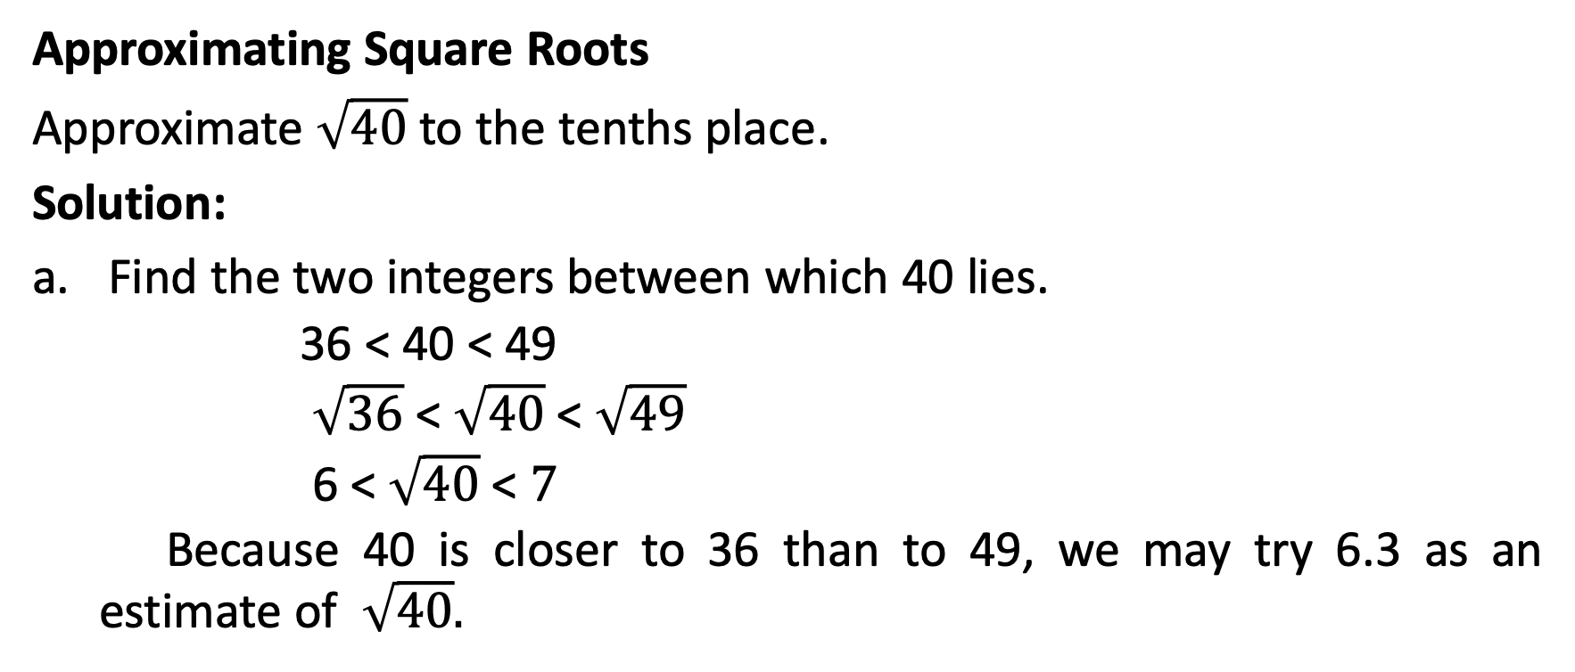
Square Root
Approximating Square Roots
Approximate $\sqrt{40}$ to the tenths place.
Solution:
Find the two integers between which 40 lies.
  36 < 40 < 49
  $\sqrt{36}$ < $\sqrt{40}$ < $\sqrt{49}$
  6 < $\sqrt{40}$ < $7$
  Because 40 is closer to 36 than to 49, we may try 6.3 as an estimate of $\sqrt{40}.$

Slide 14
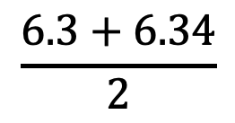
Square Root
Approximating Square Roots
Solution:
Divide 40 by the estimate 6.3.
Get the average of the divisor
  and the quotient.
  6.34
  6.3 )400.0
  378
  220
  189
  310
  252
  58
$$\frac{6.3+6.34}{2}$$
≈
6.32

Slide 15
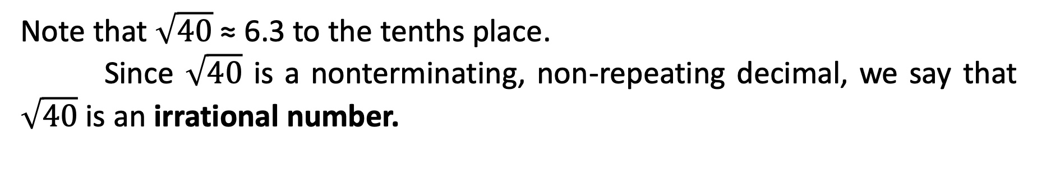
Square Root
Approximating Square Roots
Solution:
  6.32
  6.32)4,000
  3,792
  2,080
  1,896
  1,840
  1,264
  576
Use the average as the next estimate. Then, repeat steps b and c until your divisor and quotient agree in the tenths place.
Note that $\sqrt{40}$ ≈ 6.3 to the tenths place.
Since $\sqrt{40}$ is a nonterminating, non-repeating decimal, we say that $\sqrt{40}$ is an irrational number.

