Slide 1
Irrational Numbers

Slide 2
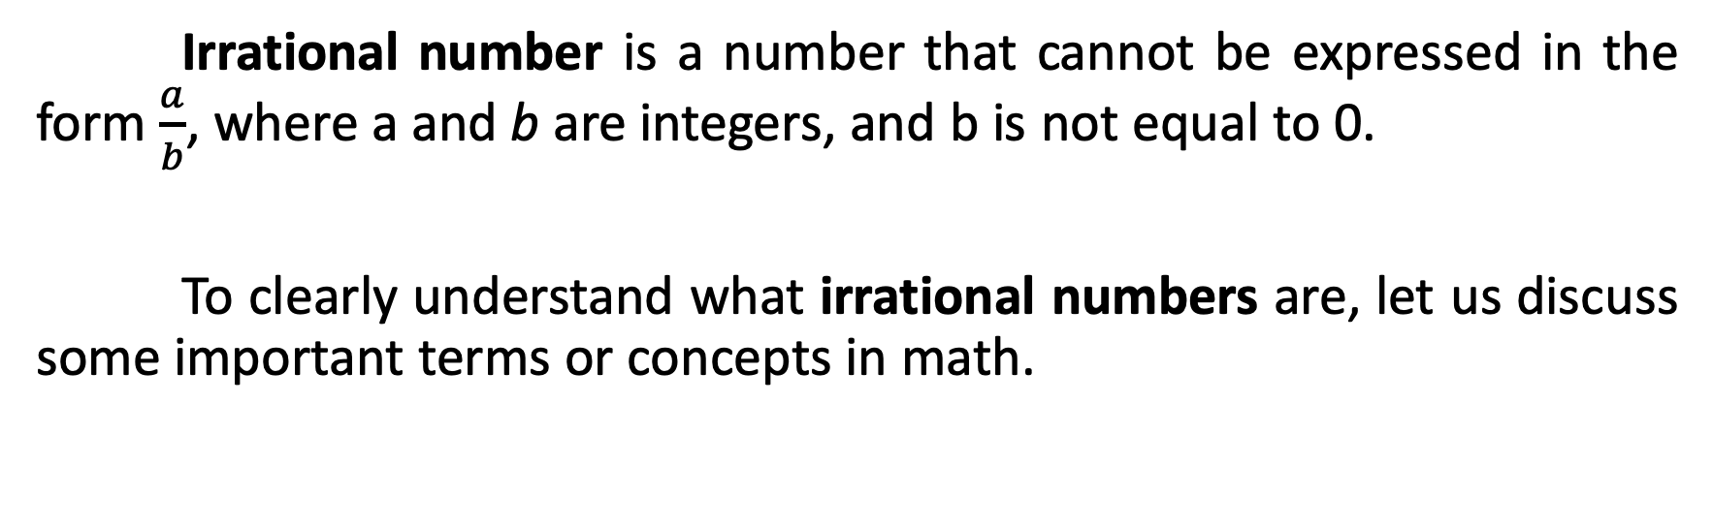
Irrational Numbers
Irrational number is a number that cannot be expressed in the form $\frac{a}{b}$, where a and b are integers, and b is not equal to 0.
To clearly understand what irrational numbers are, let us discuss some important terms or concepts in math.

Slide 3
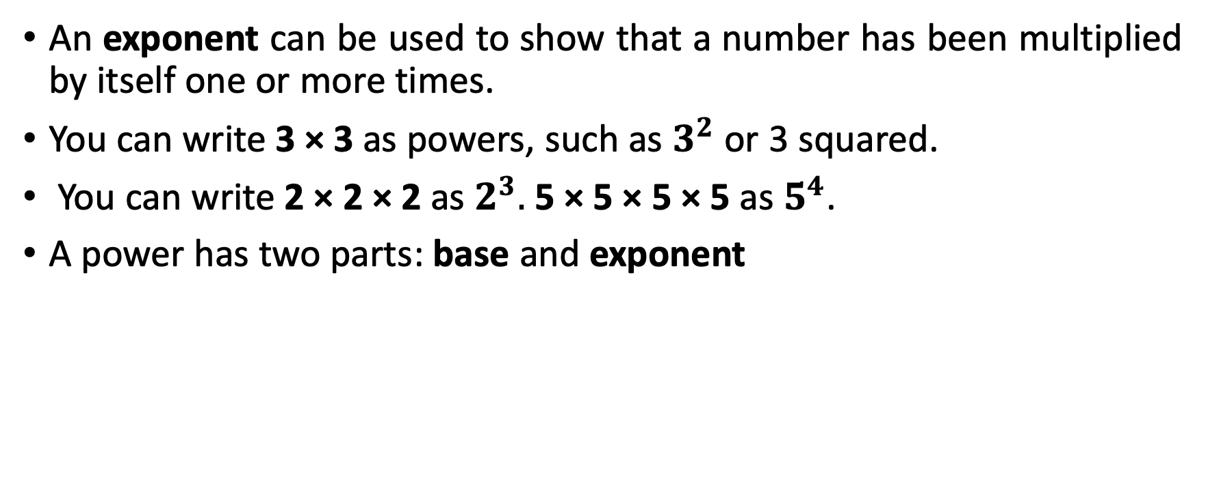

Irrational Numbers
An exponent can be used to show that a number has been multiplied by itself one or more times.
You can write 3 × 3 as powers, such as $3^{2}$ or 3 squared.
You can write 2 × 2 × 2 as $2^{3}.$5 × 5 × 5 × 5 as $5^{4}$.
A power has two parts: base and exponent
exponent
$$3^{2}$$
base

Slide 4
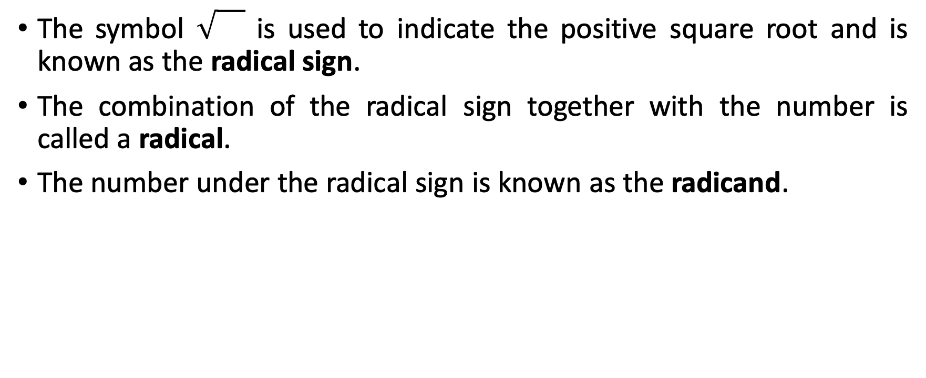
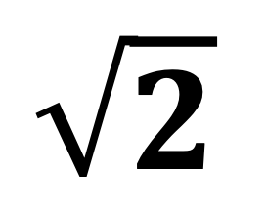
Square Root
The symbol is used to indicate the positive square root and is known as the radical sign.
The combination of the radical sign together with the number is called a radical.
The number under the radical sign is known as the radicand.
Radical sign
$$\sqrt{2}$$
radicand

Slide 5
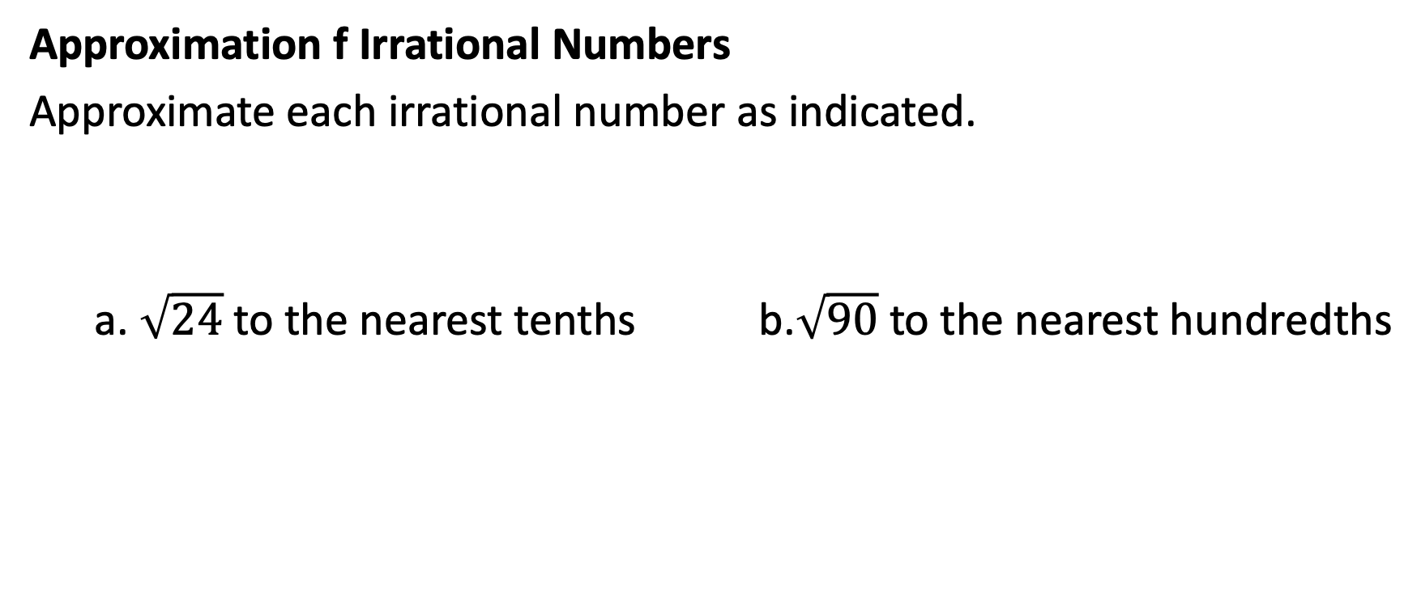
Irrational Numbers
Approximation f Irrational Numbers
Approximate each irrational number as indicated.
a. $\sqrt{24}$to the nearest tenths b.$\sqrt{90}$ to the nearest hundredths

Slide 6
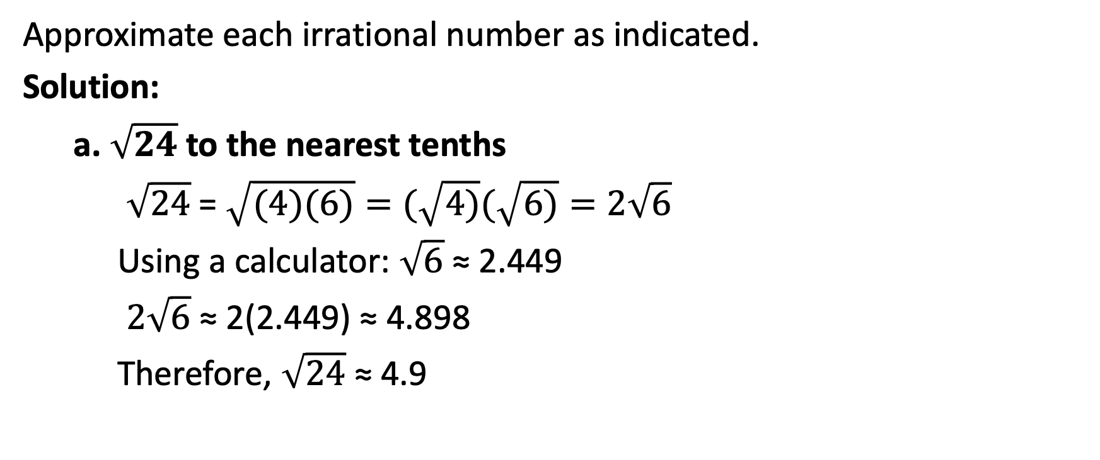
Irrational Numbers
Approximate each irrational number as indicated.
Solution:
a. $\sqrt{24}$to the nearest tenths
$\sqrt{24}$= $\sqrt{(4)(6)}=(\sqrt{4)}(\sqrt{6)}=2\sqrt{6}$
Using a calculator: $\sqrt{6}$ ≈ 2.449
$2\sqrt{6}$ ≈ 2(2.449) ≈ 4.898
Therefore, $\sqrt{24}$ ≈ 4.9
You can use a calculator or a table of square roots to find a decimal approximation of an irrational square root.

Slide 7
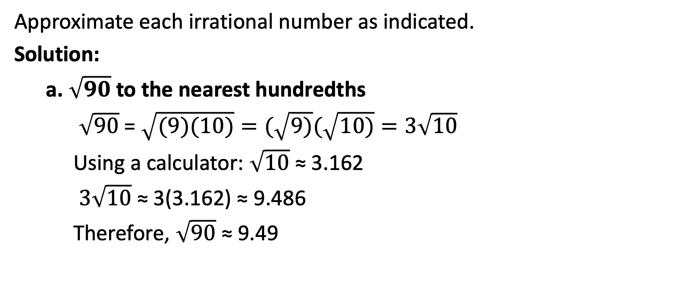
Irrational Numbers
Approximate each irrational number as indicated.
Solution:
a. $\sqrt{90}$to the nearest hundredths
$\sqrt{90}$= $\sqrt{(9)(10)}=(\sqrt{9)}(\sqrt{10)}=3\sqrt{10}$
Using a calculator: $\sqrt{10}$ ≈ 3.162
$3\sqrt{10}$ ≈ 3(3.162) ≈ 9.486
Therefore, $\sqrt{90}$ ≈ 9.49
You can use a calculator or a table of square roots to find a decimal approximation of an irrational square root.

