Slide 1
Conversion of Measurements

Slide 2
Conversion of Measurements
Conversion of units is the process of converting units of measurements to another unit for the same quantity.
Conversion can be done from one Metric unit to another Metric unit, from an English unit to another English unit, or from a Metric unit to an English unit, or vice versa.

Slide 3
Conversion of Measurements
There is a way to convert units of measurements and that is to multiply them to a fraction equivalent to 1 using the values in our conversion table.
A conversion table is where we see equivalents of different units of measurements to another unit of measurement.
The conversion table is used in changing a given unit of measurement to another unit of measurement.

Slide 4
Conversion of Measurements
Conversion Table
Metric Measurement to Metric Measurements
Length
1 centimeter | = | 10 millimeters
1 meter | = | 100 centimeters
1 kilometer | = | 1,000 meters
1 decimeter | = | 10 centimeters
1 dekameter | = | 1,000 centimeters

Slide 5
Conversion of Measurements
Conversion Table
Metric Measurement to Metric Measurements
Weight
1 centigram | = | 10 grams
1 gram | = | 100 grams
1 kilogram | = | 1,000 grams
1 decigram | = | 10 centigrams
1 dekagram | = | 1,000 centigrams

Slide 6
Conversion of Measurements
Conversion Table
Metric Measurement to Metric Measurements
Fluid Volume
1 centiliter | = | 10 milliliters
1 liter | = | 100 centiliters
1 kiloliter | = | 1,000 liters
1 deciliter | = | 10 centiliters
1 dekaliter | = | 1,000 centiliters

Slide 7
Conversion of Measurements
Conversion Table
English Measurement to English Measurement
Length
1 foot | = | 12 inches
1 yard | = | 3 feet
1 mile | = | 1,760 yards
Weight
1 pound | = | 16 ounces
1 ton | = | 2,000 pounds

Slide 8
Conversion of Measurements
Conversion Table
English Measurement to English Measurement
Fluid Volume
1 tablespoon | = | 3 teaspoons
1 fluid ounce | = | 2 tablespoons
1 cup | = | 8 fluid ounces
1 cup | = | 2 cups
1 quart | = | 2 pints
1 gallon |  | 4 quarts

Slide 9
Conversion of Measurements
Conversion Table
System to System Conversion
Length
1 inch | = | 2.54 centimeter
1 meter | = | 3.28 feet
1 mile | = | 1.61 kilometers
1 foot | = | 0.30 meters
1 yard | = | 0.91 meters

Slide 10
Conversion of Measurements
Conversion Table for Time
1 second | = | 1,000 milliseconds
1 minute | = | 60 seconds
1 hour | = | 60 minutes
1 day | = | 24 hours
1 month | = | 30 days
1 year |  | 365 days

Slide 11
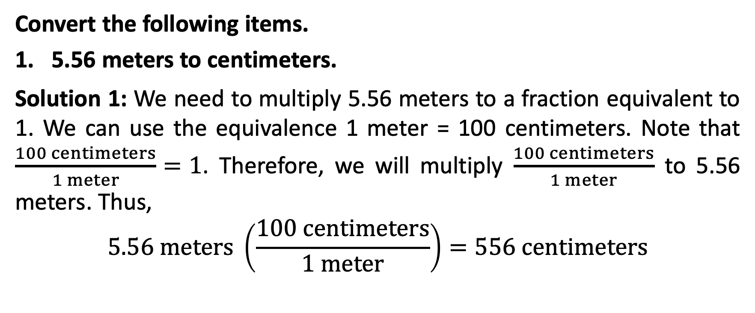
Conversion of Measurements
Convert the following items.
5.56 meters to centimeters.
Solution 1: We need to multiply 5.56 meters to a fraction equivalent to 1. We can use the equivalence 1 meter = 100 centimeters. Note that $\frac{100 centimeters}{1 meter}=1$. Therefore, we will multiply $\frac{100 centimeters}{1 meter}$ to 5.56 meters. Thus,
$$5.56 meters \left(\frac{100 centimeters}{1 meter}\right)=556 centimeters$$

Slide 12
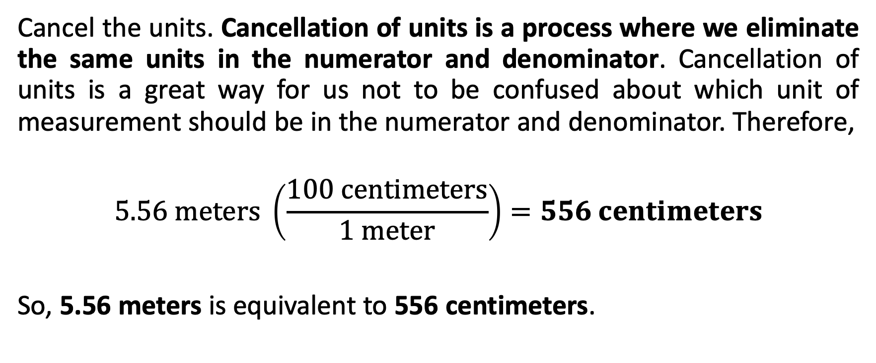
Conversion of Measurements
Cancel the units. Cancellation of units is a process where we eliminate the same units in the numerator and denominator. Cancellation of units is a great way for us not to be confused about which unit of measurement should be in the numerator and denominator. Therefore,
$$5.56 meters \left(\frac{100 centimeters}{1 meter}\right)=556 centimeters$$
So, 5.56 meters is equivalent to 556 centimeters.

Slide 13
Conversion of Measurements
5.56 meters to centimeters.
Solution 2:
We can also use the technique in multiplying or dividing numbers by a multiple of 10. Since 5.56 will be multiplied to 100, we can move the decimal point 2 places to the right. Thus, the answer is 556 centimeters.

Slide 14
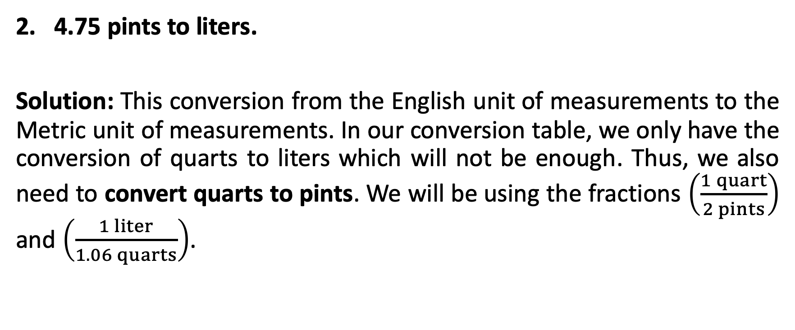
Conversion of Measurements
4.75 pints to liters.
Solution: This conversion from the English unit of measurements to the Metric unit of measurements. In our conversion table, we only have the conversion of quarts to liters which will not be enough. Thus, we also need to convert quarts to pints. We will be using the fractions $\left(\frac{1 quart}{2 pints}\right)$ and $\left(\frac{1 liter}{1.06 quarts}\right)$.

Slide 15
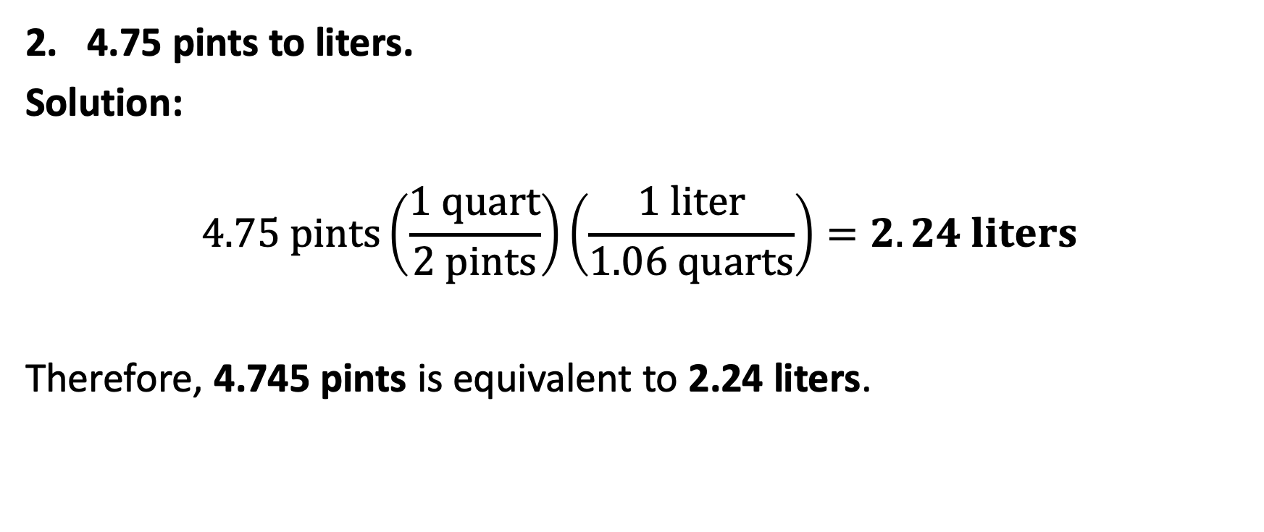
Conversion of Measurements
4.75 pints to liters.
Solution:
$$4.75 pints\left(\frac{1 quart}{2 pints}\right)\left(\frac{1 liter}{1.06 quarts}\right)=2.24 liters$$
Therefore, 4.745 pints is equivalent to 2.24 liters.

Slide 16
Conversion of Measurements
3 months to seconds.
Solution: Need to do a series of conversions since there is no direct conversion of months to seconds. In this case, we need to convert months to days, days to hours, hours to minutes, and minutes to seconds.

Slide 17
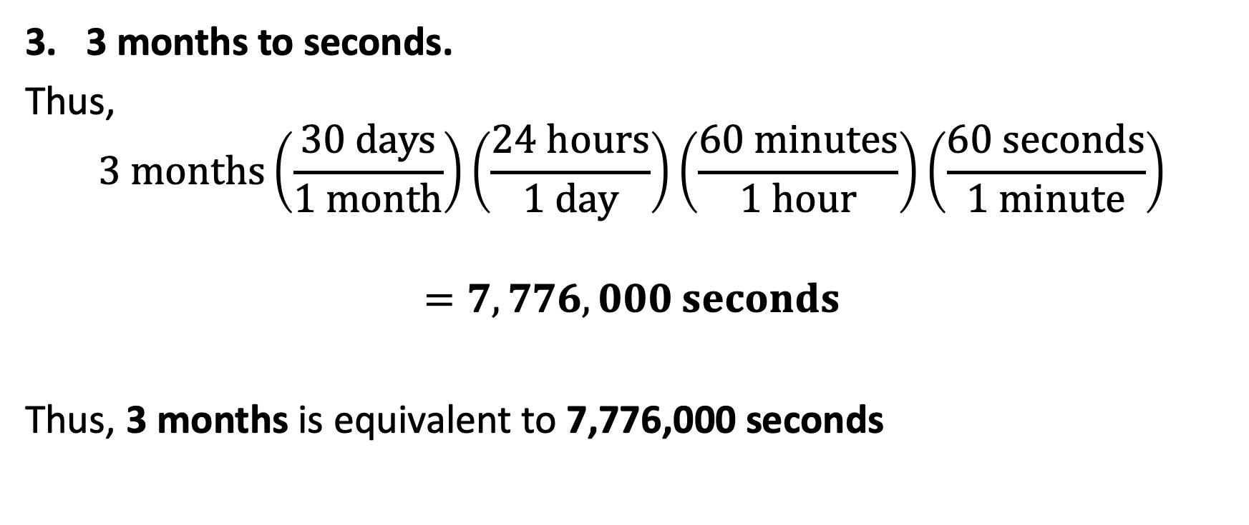
Conversion of Measurements
3 months to seconds.
Thus,
$$3 months\left(\frac{30 days}{1 month}\right)\left(\frac{24 hours}{1 day}\right)\left(\frac{60 minutes}{1 hour}\right)\left(\frac{60 seconds}{1 minute}\right)$$
$$=7,776,000 seconds$$
Thus, 3 months is equivalent to 7,776,000 seconds

Slide 18
Conversion of Measurements
3 months to seconds.
Thus,
$$3 months\left(\frac{30 days}{1 month}\right)\left(\frac{24 hours}{1 day}\right)\left(\frac{60 minutes}{1 hour}\right)\left(\frac{60 seconds}{1 minute}\right)$$
$$=7,776,000 seconds$$
Thus, 3 months is equivalent to 7,776,000 seconds

Slide 19
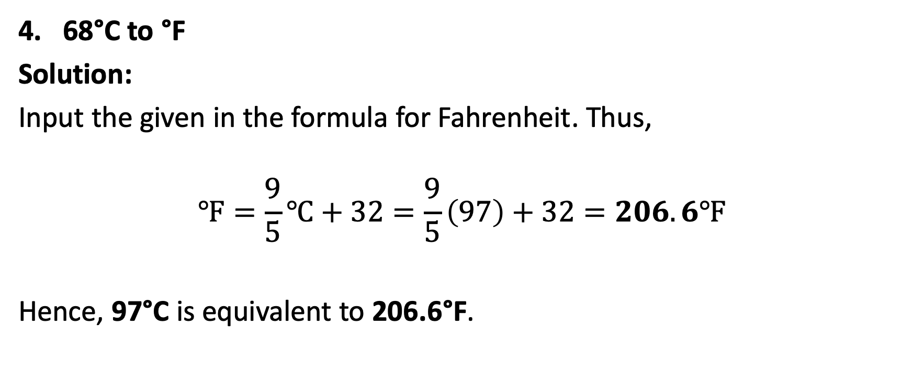
Conversion of Measurements
68°C to °F
Solution:
Input the given in the formula for Fahrenheit. Thus,
$$℉=\frac{9}{5}℃+32=\frac{9}{5}\left(97\right)+32=206.6℉$$
Hence, 97°C is equivalent to 206.6°F.

