Slide 1
Problems Involving Units of Measurement

Slide 2
Problems Involving Units of Measurement
We can use the concept of conversion of units in solving word problems involving measurements. To convert from one unit to another, multiply the given measure by 1 (in fractional form of the necessary units).

Slide 3
Problems Involving Units of Measurement
Polly made 5 gallons of ice cream mixture. If he will put the ice cream mixtures in pint containers, how many pint containers will he need?
If we think about it, we just need to convert gallons into pints to answer the problem. We can also use conversion of units in solving some word problems. All we have to do is to apply our knowledge in conversion of units to these problems.

Slide 4
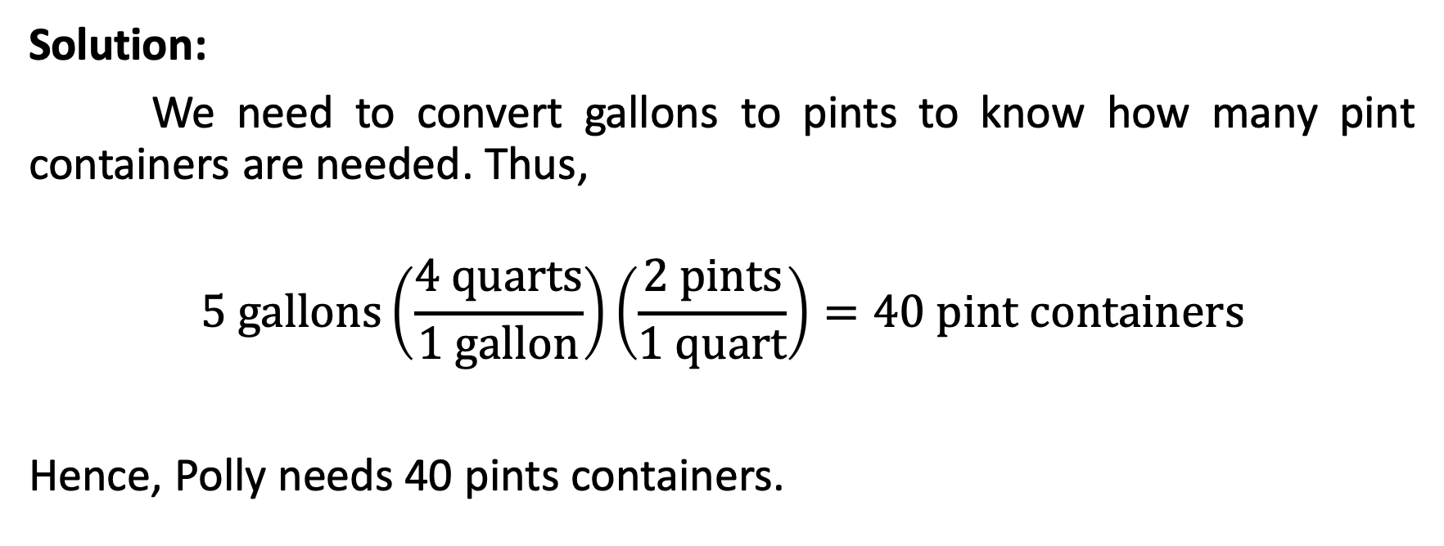
Problems Involving Units of Measurement
Solution:
We need to convert gallons to pints to know how many pint containers are needed. Thus,
$$5 gallons\left(\frac{4 quarts}{1 gallon}\right)\left(\frac{2 pints}{1 quart}\right)=40 pint containers$$
Hence, Polly needs 40 pints containers.

Slide 5
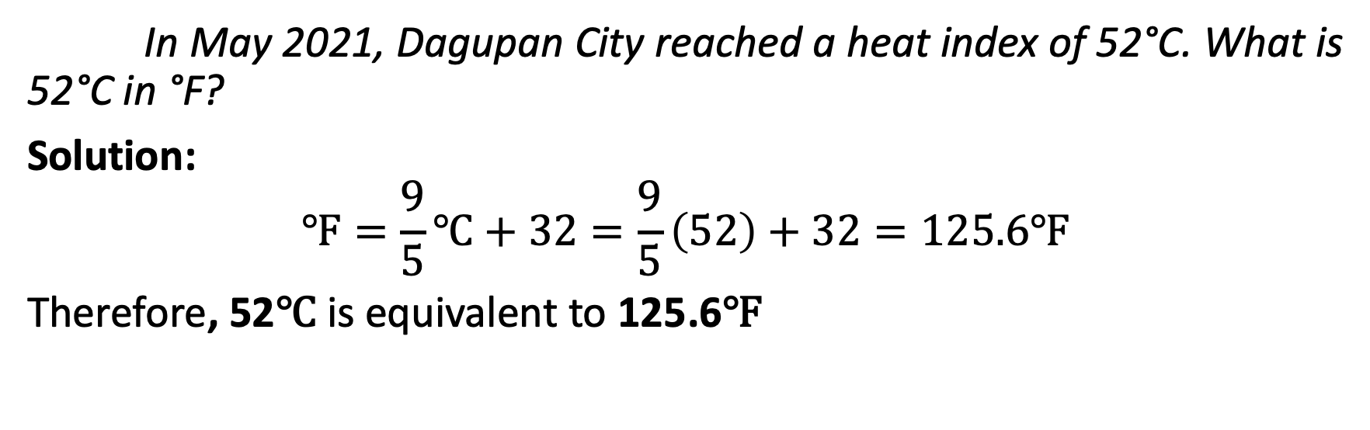
Problems Involving Units of Measurement
In May 2021, Dagupan City reached a heat index of 52°C. What is 52°C in °F?
Solution:
$$℉=\frac{9}{5}℃+32=\frac{9}{5}\left(52\right)+32=125.6℉$$
Therefore, 52℃ is equivalent to 125.6℉

Slide 6
Problems Involving Units of Measurement
Tommy, Amy, and Marian were grouped together in a Biology class. Their task was to plant a sunflower seed in their respective homes and compare the height of the sunflower plants after a month.
After a month, they compared their measurements. Tommy’s sunflower is 9.5 inches high, Amy’s sunflower stands 25 centimeters high, and Marian’s sunflower measures 1 foot high. Whose sunflower has the highest growth? Lowest growth?

Slide 7
Problems Involving Units of Measurement
Solution:
To solve this problem, we need to put all of the measures into one unit of measurement. For discussion purposes, we are going to convert everything into inches. Tommy’s sunflower height will not be converted anymore since it is already in inches.
Note that you can also convert the measurements to centimeters or feet.

Slide 8
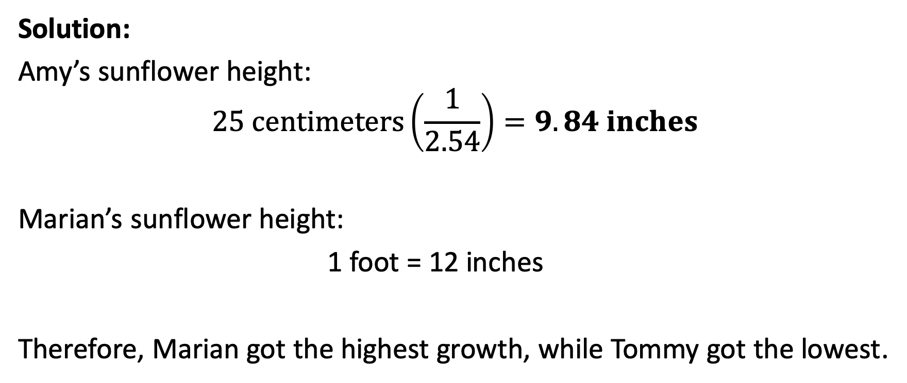
Problems Involving Units of Measurement
Solution:
Amy’s sunflower height:
$$25 centimeters\left(\frac{1}{2.54}\right)=9.84 inches$$
Marian’s sunflower height:
1 foot = 12 inches
Therefore, Marian got the highest growth, while Tommy got the lowest.

