Slide 1
Cylinder, Cone, and Sphere

Slide 2
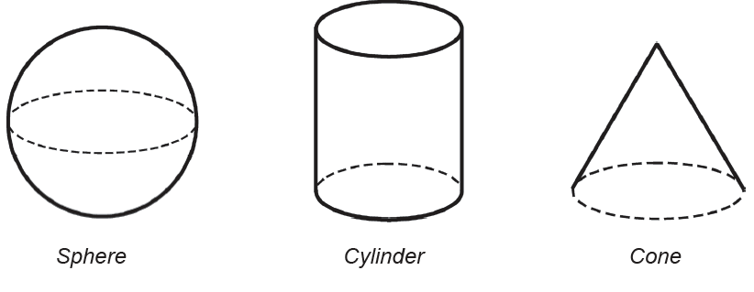
Cylinder, Cone, and Sphere
Some solid figures are not polyhedrons. It is because not all their faces are polygonal regions.
Examples of solid figures that are not polyhedrons are sphere, cylinder, and cone. A sphere is a solid figure that has a curved surface that is made up of points that are equidistant to the center. A cylinder is similar to a prism except that the bases are circular regions. It has one curved surface and two curved edges. A cone is like a pyramid with a circular base. It has one curved surface, one curved edge, and one vertex that is also called the apex.

Slide 3
Activity
Choose the letter of the correct answer:
1. Which statement accurately describes a sphere?
a) A sphere has a curved surface made up of points equidistant to the center.
b) A sphere has a circular base and one curved surface.
c) A sphere has two curved edges and one vertex.
d) A sphere has triangular bases and rectangular lateral faces.
2. How many curved surfaces does a cylinder have?
a) One c) Three
b) Two d) Four
3. What is the shape of the bases of a cylinder?
a) Triangular c) Circular
b) Rectangular d) Hexagonal
4. How is a cone different from a pyramid?
a) A cone has a curved surface and one curved edge, while a pyramid has triangular faces and straight edges.
b) A cone has triangular bases, while a pyramid has a circular base.
c) A cone has one curved surface, one curved edge, and one vertex, while a pyramid has straight faces and vertices.
d) A cone has two curved surfaces, while a pyramid has one curved surface.
5. What is another term for the vertex of a cone?
a) Base
b) Apex
c) Edge
d) Lateral face

Slide 4
Activity: Answer Key
Choose the letter of the correct answer:
1. Which statement accurately describes a sphere?
a) A sphere has a curved surface made up of points equidistant to the center.
b) A sphere has a circular base and one curved surface.
c) A sphere has two curved edges and one vertex.
d) A sphere has triangular bases and rectangular lateral faces.
2. How many curved surfaces does a cylinder have?
a) One c) Three
b) Two d) Four
3. What is the shape of the bases of a cylinder?
a) Triangular c) Circular
b) Rectangular d) Hexagonal
4. How is a cone different from a pyramid?
a) A cone has a curved surface and one curved edge, while a pyramid has triangular faces and straight edges.
b) A cone has triangular bases, while a pyramid has a circular base.
c) A cone has one curved surface, one curved edge, and one vertex, while a pyramid has straight faces and vertices.
d) A cone has two curved surfaces, while a pyramid has one curved surface.
5. What is another term for the vertex of a cone?
a) Base
b) Apex
c) Edge
d) Lateral face

