Slide 1
Surface Area of Cylinders

Slide 2
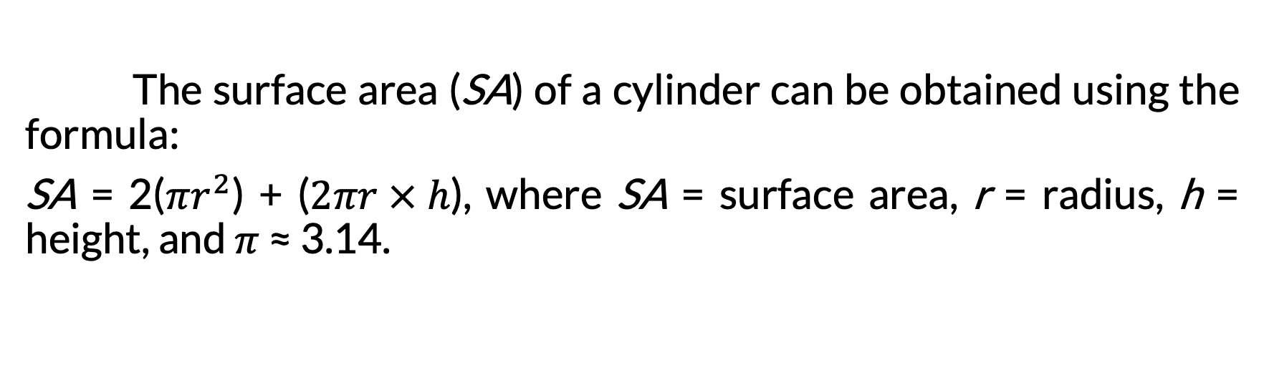
Surface Area of Cylinders
The surface area (SA) of a cylinder can be obtained using the formula:
SA = 2($πr^{2}$) + ($2πr × h$), where SA = surface area, r = radius, h = height, and $π$ ≈ 3.14.

Slide 3
Surface Area of Cylinders
Look around your house for any cylindrical object (e.g., tin can, toilet paper, water bottle, etc.). Observe that these cylindrical objects generally have three surfaces: the top, the bottom, and the curved surfaces. If you cut and unroll the curved surface, a rectangle is formed.

Slide 4
Surface Area of Cylinders
Determine the relationship between the area of the rectangle and the area of the curved surface. Measure the dimensions—length, width, and diameter. Determine the relationship between the length of the rectangle and the circumference of the base.

Slide 5
Surface Area of Cylinders
The surface area (SA) of a cylinder is equal to the sum of the areas of its two circular bases and the rectangle that forms its curved surface (also known as lateral face).

Slide 6
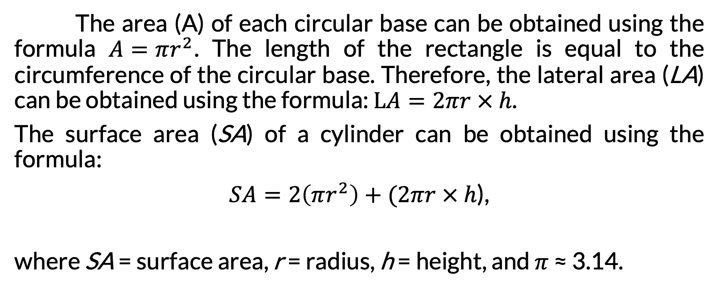
Surface Area of Cylinders
The area (A) of each circular base can be obtained using the formula $A=πr^{2}$. The length of the rectangle is equal to the circumference of the circular base. Therefore, the lateral area (LA) can be obtained using the formula: $LA=2πr × h$.
The surface area (SA) of a cylinder can be obtained using the formula:
$SA=2\left(πr^{2}\right)+(2πr × h$),
where SA = surface area, r = radius, h = height, and $π$ ≈ 3.14.

Slide 7

Surface Area of Cylinders
Find the surface area of the cylinder. Use 3.14 for $π$.
Given: r = 4 cm, h = 6 cm, and $π$ ≈ 3.14

Slide 8
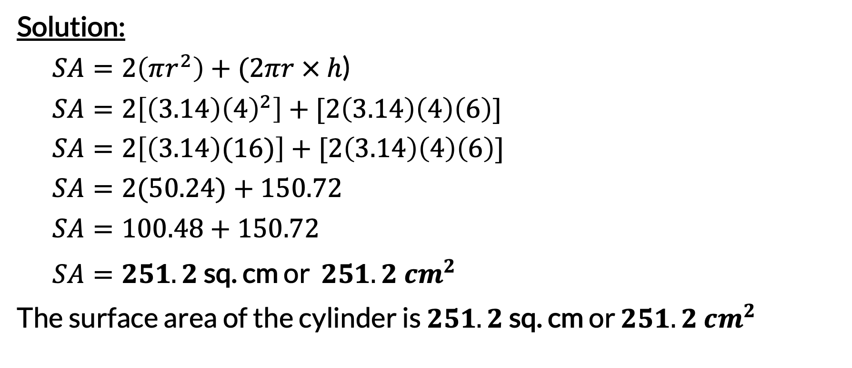
Surface Area of Cylinders
Solution:
  $SA=2\left(πr^{2}\right)+(2πr × h$)
  $$SA=2\left[\left(3.14\right){\left(4\right)}^{2}\right]+[2\left(3.14\right)\left(4\right)\left(6\right)]$$
  $$SA=2\left[\left(3.14\right)(16)\right]+[2\left(3.14\right)\left(4\right)\left(6\right)]$$
  $$SA=2(50.24)+150.72$$
  $$SA=100.48+150.72$$
  $SA=251.2$ sq. cm or $251.2 {cm}^{2}$
The surface area of the cylinder is $251.2$ sq. cm or $251.2 {cm}^{2}$

Slide 9


Surface Area of Cylinders
If the diameter (d) of the circular base of a cylinder is 12 centimeters and the height of the cylinder is 14 centimeters, what is the surface area of the cylinder? Use 3.14 for $π$.
Given: d = 12 cm, h = 14 cm, and $π$≈ 3.14
Note: The radius (r) is half the diameter (d) of the circular base.
r = d ÷ 2
= 12 ÷ 2
= 6 cm

Slide 10
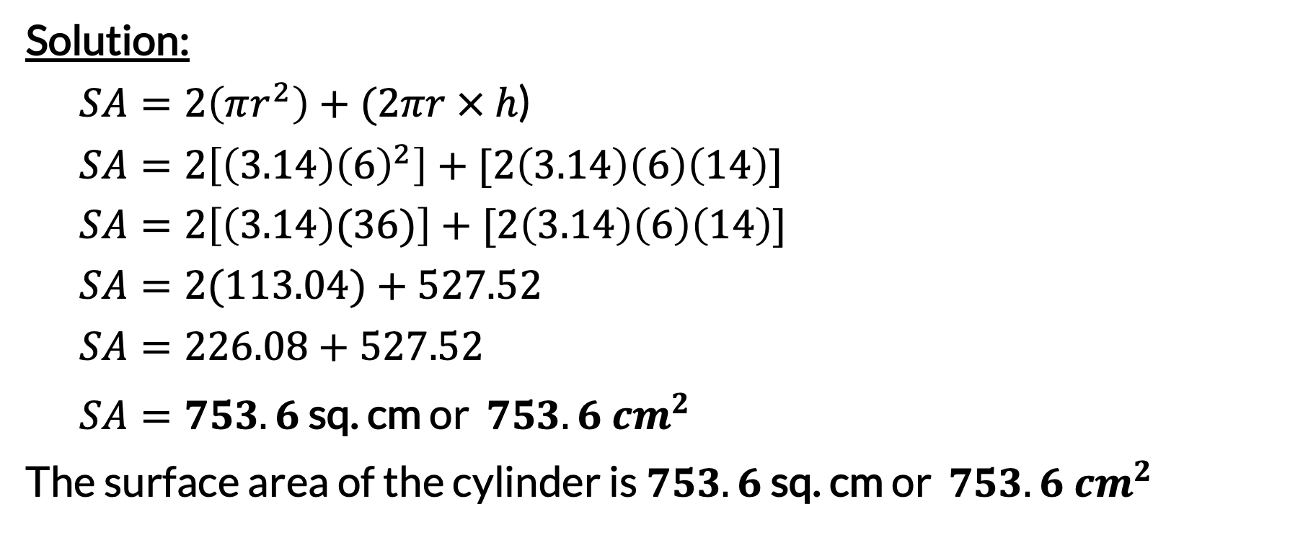
Surface Area of Cylinders
Solution:
  $SA=2\left(πr^{2}\right)+(2πr × h$)
  $$SA=2\left[\left(3.14\right){\left(6\right)}^{2}\right]+[2\left(3.14\right)\left(6\right)\left(14\right)]$$
  $$SA=2\left[\left(3.14\right)(36)\right]+[2\left(3.14\right)\left(6\right)\left(14\right)]$$
  $$SA=2(113.04)+527.52$$
  $$SA=226.08+527.52$$
  $SA=753.6$ sq. cm or $753.6 {cm}^{2}$
The surface area of the cylinder is $753.6$ sq. cm or $753.6 {cm}^{2}$

