Slide 1
Surface Area of Square and Rectangular Pyramids

Slide 2
Surface Area of Square and Rectangular Pyramids
The Monastery of Transfiguration in Malaybalay City, Bukidnon is one example of a square pyramid found in the Philippines.

Slide 3
Surface Area of Square and Rectangular Pyramids
Pyramid is a solid figure with a polygonal base and triangular lateral faces.
If the vertex is directly over the center of the base, it is called a right pyramid.

Slide 4
Surface Area of Square and Rectangular Pyramids
The perpendicular distance between the vertex and the base is called the height of the pyramid.
The height of any of its lateral faces is called the slant height of the pyramid.
Height
Slant height

Slide 5
Surface Area of Square and Rectangular Pyramids
A regular pyramid is a right pyramid with a regular polygon (e.g., equilateral triangle, square, etc.) as its base. The lateral faces of a regular pyramid form identical isosceles triangles.

Slide 6
Surface Area of Square and Rectangular Pyramids
Surface Area of a Cube
The figures below show the net of a square pyramid.
Net of Square Pyramid
Square Pyramid
Area of the Base
Lateral Area

Slide 7
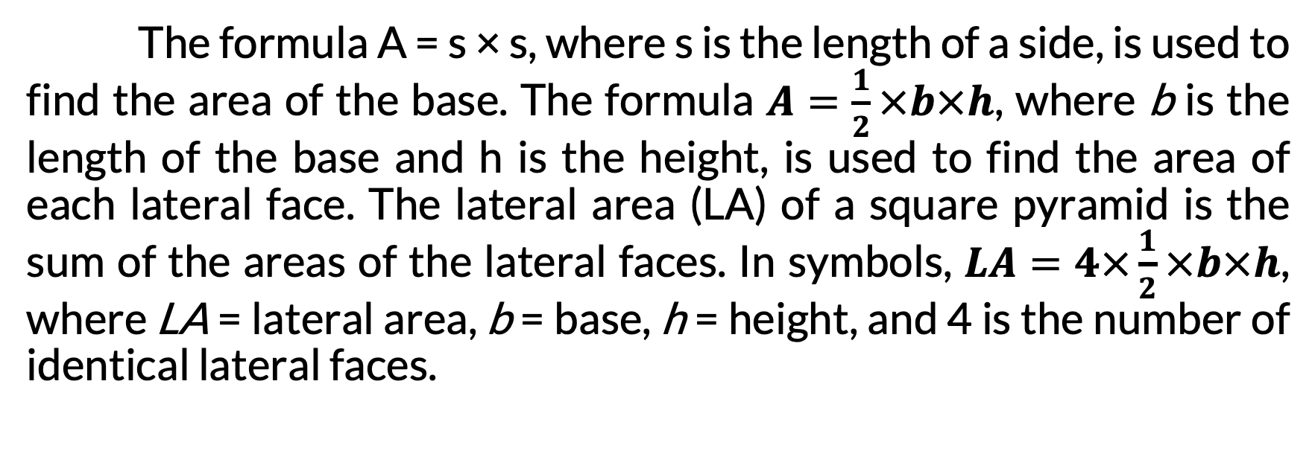
Surface Area of Square and Rectangular Pyramids
The formula A = s × s, where s is the length of a side, is used to find the area of the base. The formula $A=\frac{1}{2}×b×h$, where b is the length of the base and h is the height, is used to find the area of each lateral face. The lateral area (LA) of a square pyramid is the sum of the areas of the lateral faces. In symbols, $LA=4×\frac{1}{2}×b×h$, where LA = lateral area, b = base, h = height, and 4 is the number of identical lateral faces.

Slide 8
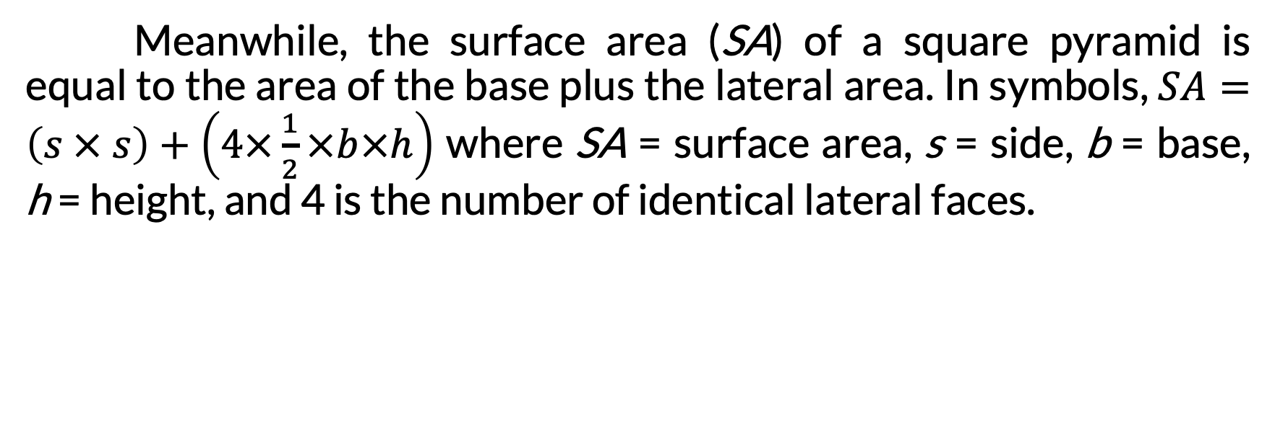
Surface Area of Square and Rectangular Pyramids
Meanwhile, the surface area (SA) of a square pyramid is equal to the area of the base plus the lateral area. In symbols, $SA=\left(s × s\right)+\left(4×\frac{1}{2}×b×h\right)$ where SA = surface area, s = side, b = base, h = height, and 4 is the number of identical lateral faces.

Slide 9
Surface Area of Square and Rectangular Pyramids
Study the figure on the left. Find the
lateral area (LA) and
surface area (SA) of the square pyramid.
Given: s = 3 ft, b = 3 ft, and h = 6 ft
Note: There are 4 identical lateral faces.

Slide 10

Surface Area of Square and Rectangular Pyramids
Solution:
  Lateral Area
    $$LA=4×\frac{1}{2}×b×h$$
    $$LA=\frac{4×1×3×6}{2}$$
    $$LA=\frac{72}{2}$$
    $$LA=36 sq. ft or 36 {ft}^{2}$$

Slide 11
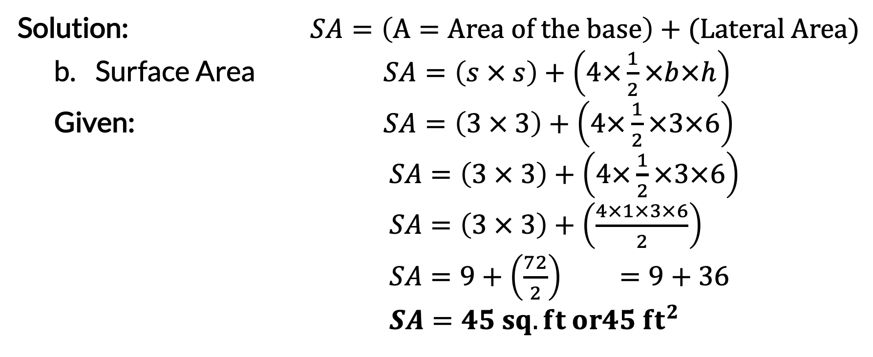

Surface Area of Square and Rectangular Pyramids
Solution: $SA=\left(A=Area of the base\right)+(Lateral Area)$
  Surface Area $SA=\left(s × s\right)+\left(4×\frac{1}{2}×b×h\right)$
  Given: $SA=\left(3 × 3\right)+\left(4×\frac{1}{2}×3×6\right)$
  $SA=\left(3 × 3\right)+\left(4×\frac{1}{2}×3×6\right)$
  $SA=\left(3 × 3\right)+\left(\frac{4×1×3×6}{2}\right)$
  $SA=9+\left(\frac{72}{2}\right) =9+36$
  $SA=45 sq. ft or45 {ft}^{2}$
s = 3 ft, b = 3 ft, and h = 6 ft
Answers: The lateral area of the square pyramid is 36 sq. ft or 36${ft}^{2}$, while the surface area is 45 sq. ft or 45${ft}^{2}$.

Slide 12
Surface Area of Square and Rectangular Pyramids
Surface Area and Lateral Area of a Rectangular Pyramid
The following figures show the net of a rectangular pyramid.
Net of a Rectangular Pyramid
Rectangular Pyramid Area of the Base Lateral Area

Slide 13
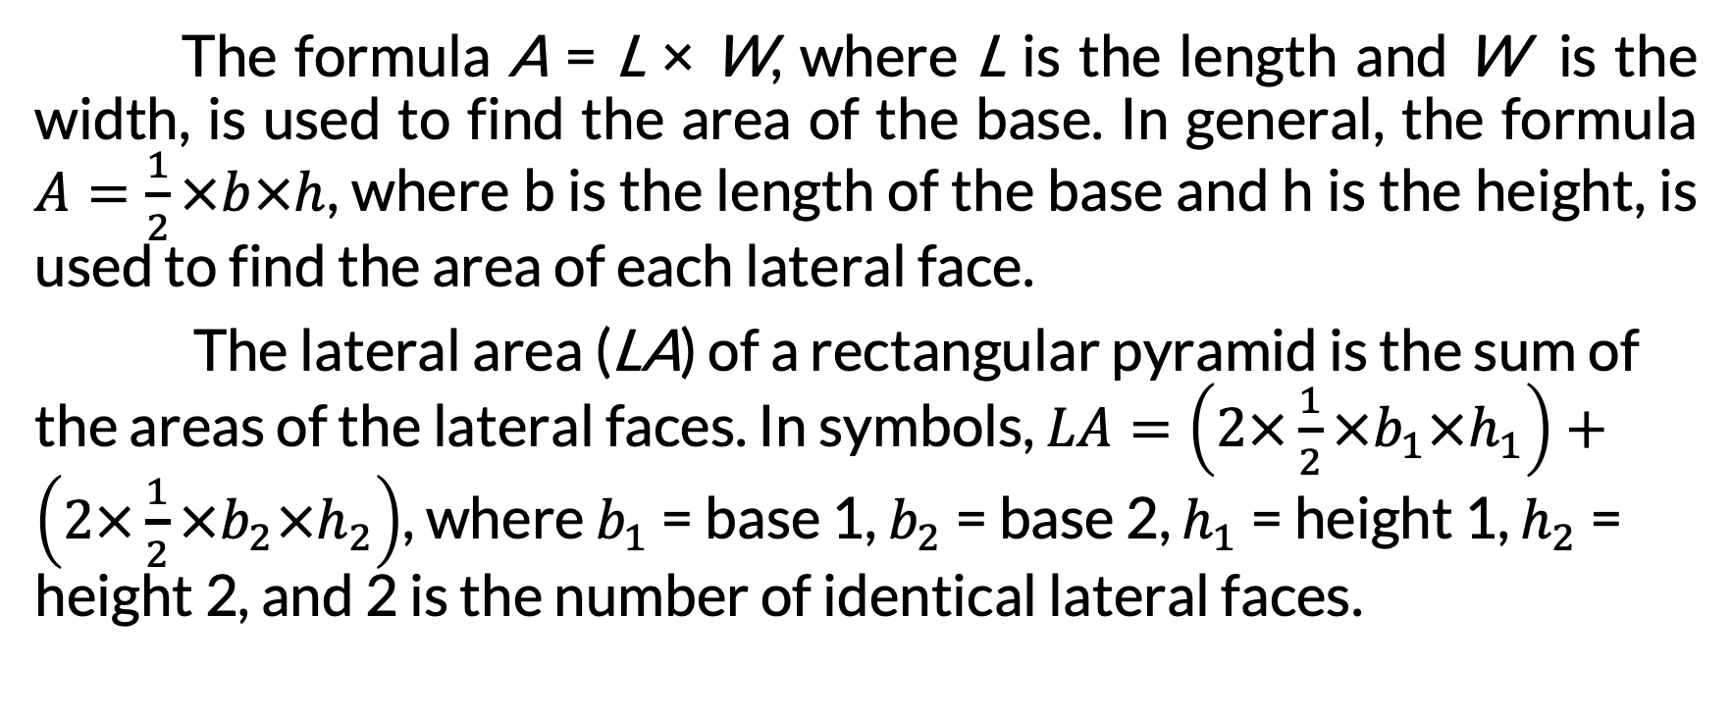
Surface Area of Square and Rectangular Pyramids
The formula A = L × W, where L is the length and W is the width, is used to find the area of the base. In general, the formula $A=\frac{1}{2}×b×h$, where b is the length of the base and h is the height, is used to find the area of each lateral face.
The lateral area (LA) of a rectangular pyramid is the sum of the areas of the lateral faces. In symbols, $LA=\left(2×\frac{1}{2}×b_{1}×h_{1}\right)+\left(2×\frac{1}{2}×b_{2}×h_{2}\right)$, where $b_{1}$ = base 1, $b_{2}$ = base 2, $h_{1}$ = height 1, $h_{2}$ = height 2, and 2 is the number of identical lateral faces.

Slide 14
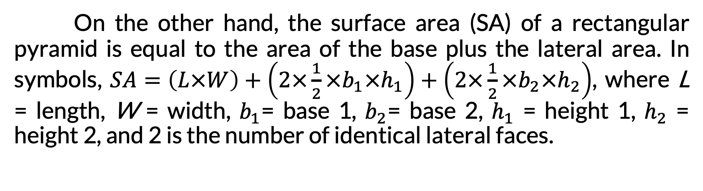
Surface Area of Square and Rectangular Pyramids
On the other hand, the surface area (SA) of a rectangular pyramid is equal to the area of the base plus the lateral area. In symbols, $SA=\left(L×W\right)+\left(2×\frac{1}{2}×b_{1}×h_{1}\right)+\left(2×\frac{1}{2}×b_{2}×h_{2}\right)$, where L = length, W = width, $b_{1}$= base 1, $b_{2}$= base 2, $h_{1}$ = height 1, $h_{2}$ = height 2, and 2 is the number of identical lateral faces.

Slide 15
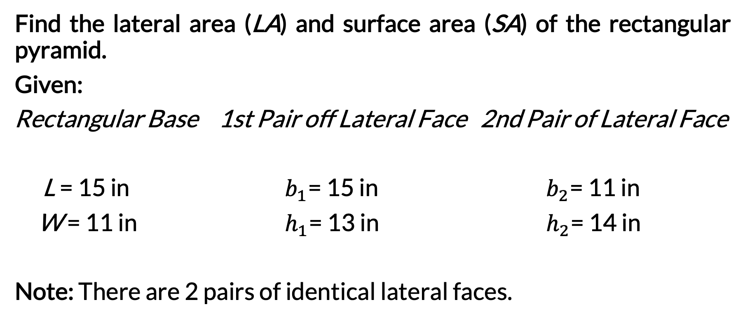
Surface Area of Square and Rectangular Pyramids
Find the lateral area (LA) and surface area (SA) of the rectangular pyramid.
Given:
Rectangular Base 1st Pair off Lateral Face 2nd Pair of Lateral Face
L = 15 in $b_{1}$= 15 in $b_{2}$= 11 in
W = 11 in $h_{1}$= 13 in $h_{2}$= 14 in
Note: There are 2 pairs of identical lateral faces.

Slide 16
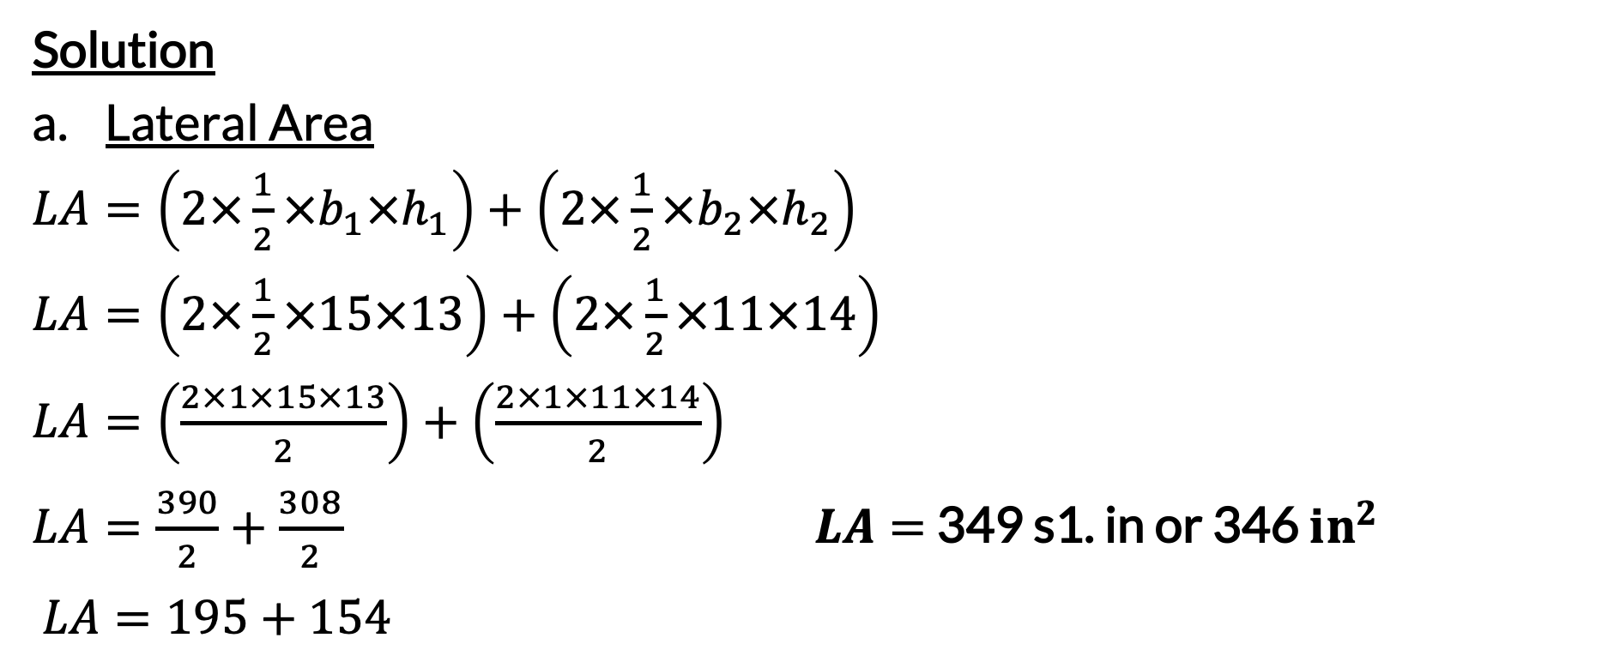
Surface Area of Square and Rectangular Pyramids
Solution
Lateral Area
$LA=\left(2×\frac{1}{2}×b_{1}×h_{1}\right)+\left(2×\frac{1}{2}×b_{2}×h_{2}\right)$
$LA=\left(2×\frac{1}{2}×15×13\right)+\left(2×\frac{1}{2}×11×14\right)$
$LA=\left(\frac{2×1×15×13}{2}\right)+\left(\frac{2×1×11×14}{2}\right)$
$LA=\frac{390}{2}+\frac{308}{2}$ $LA=$ 349 s1. in or 346 ${in}^{2}$
$LA=195+154$

Slide 17
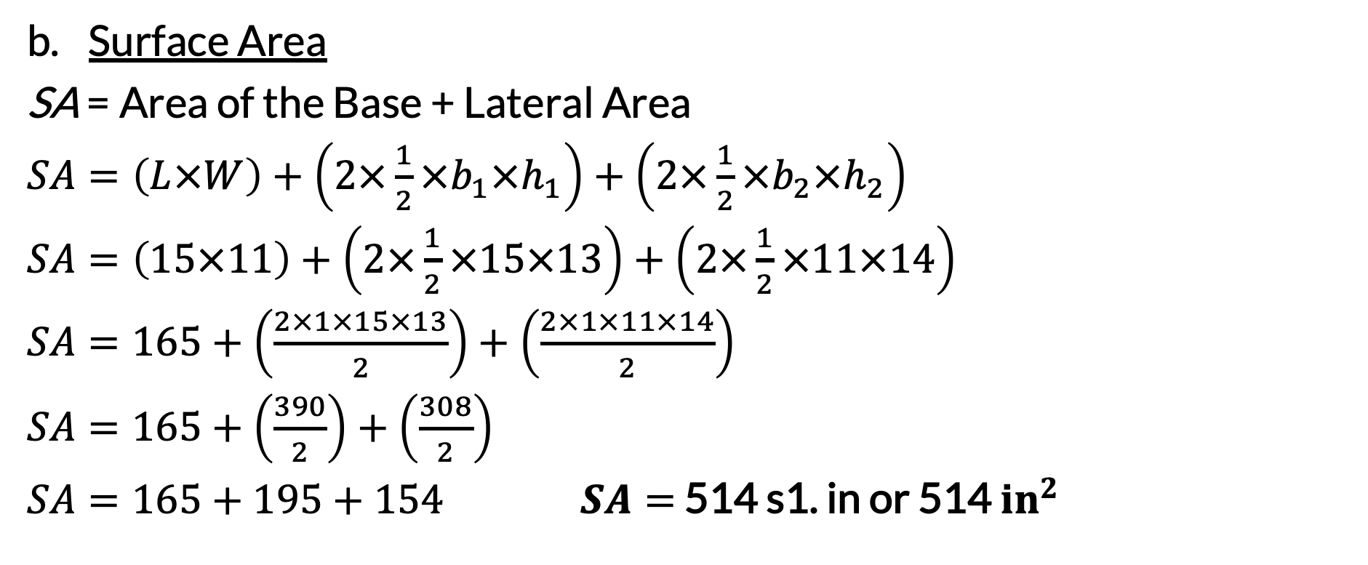
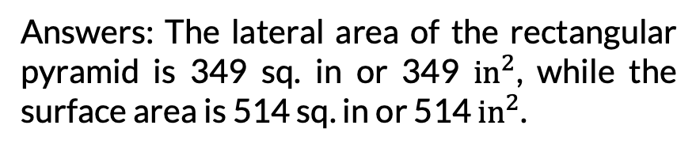
Surface Area of Square and Rectangular Pyramids
Surface Area
SA = Area of the Base + Lateral Area
$SA=\left(L×W\right)+\left(2×\frac{1}{2}×b_{1}×h_{1}\right)+\left(2×\frac{1}{2}×b_{2}×h_{2}\right)$
$SA=\left(15×11\right)+\left(2×\frac{1}{2}×15×13\right)+\left(2×\frac{1}{2}×11×14\right)$
$SA=165+\left(\frac{2×1×15×13}{2}\right)+\left(\frac{2×1×11×14}{2}\right)$
$SA=165+\left(\frac{390}{2}\right)+\left(\frac{308}{2}\right)$
$SA=165+195+154$ $SA=$ 514 s1. in or 514 ${in}^{2}$
Answers: The lateral area of the rectangular pyramid is 349 sq. in or 349 ${in}^{2}$, while the surface area is 514 sq. in or 514 ${in}^{2}$.

