Slide 1
Sets and Venn Diagram

Slide 2
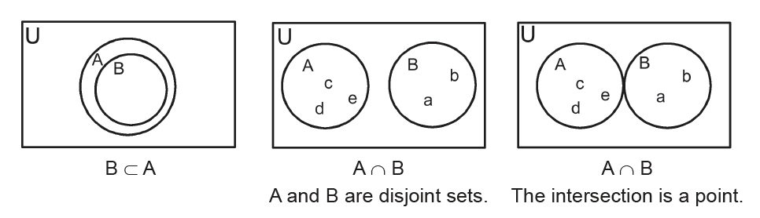
Sets and Venn Diagram
Venn diagrams are very useful in showing the relationship between sets. The Venn diagram consists of a rectangle that represents the universal set and a circle or circles inside the rectangle which represent the set or sets being considered in the discussion. It is understood that the elements in the set are inside the circle that represents the set.

Slide 3
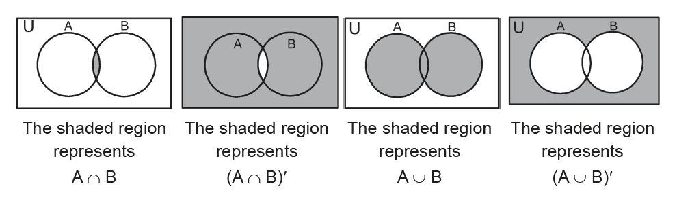
Sets and Venn Diagram
Venn diagrams are very useful in showing the relationship between sets. The Venn diagram consists of a rectangle that represents the universal set and a circle or circles inside the rectangle which represent the set or sets being considered in the discussion. It is understood that the elements in the set are inside the circle that represents the set.

Slide 4
Sets and Venn Diagram
Example 1: Venn Diagram
Given: U = {Arnold, Ben, Carlos, Dennis, Efren, Fred, Gerald, Henry, Isaac, Joseph}
A = {Arnold, Carlos, Dennis, Henry}
B = {Carlos, Dennis, Joseph}
Use a Venn diagram to represent:
a. A ∪ B c. A − B e. B′ g. A′ ∩ B′
b. A ∩ B d. A′ f. (A ∩ B)′ h. (A ∪ B)′

Slide 5
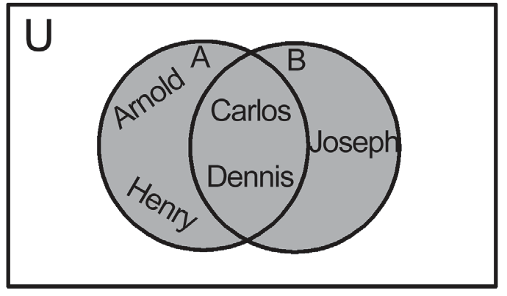
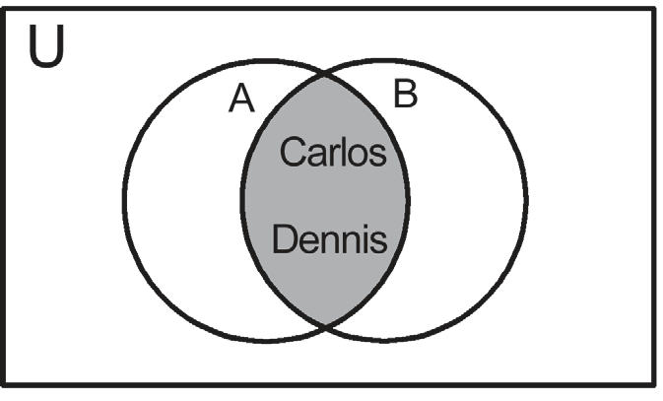
Sets and Venn Diagram
Solution:
a. A ∪ B = {Arnold, Carlos, b. A ∩ B = {Carlos, Dennis}
Dennis, Henry, Joseph}

Slide 6
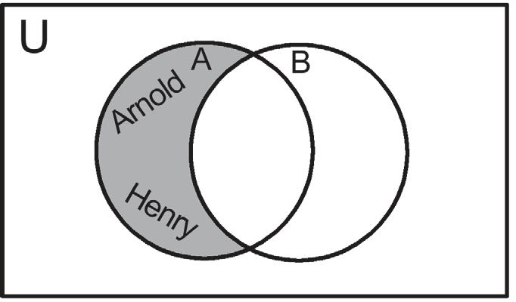
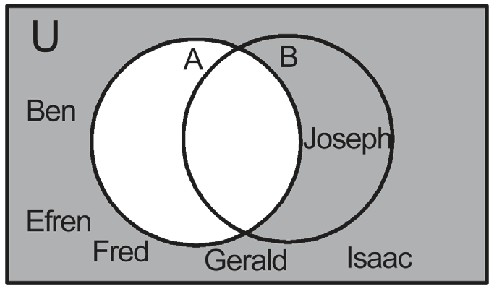
Sets and Venn Diagram
Cont.
c. A − B = {Arnold, Henry} d. A′ = {Ben, Efren, Fred, Gerald,
Joseph, Isaac}

Slide 7
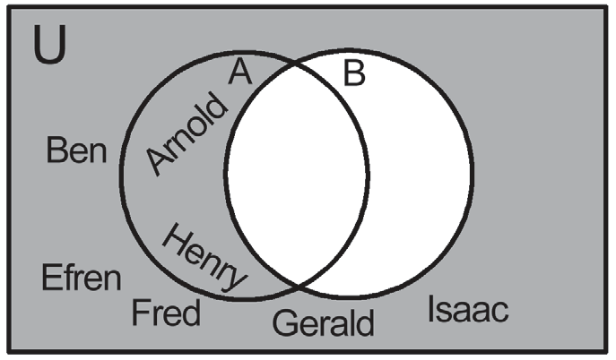
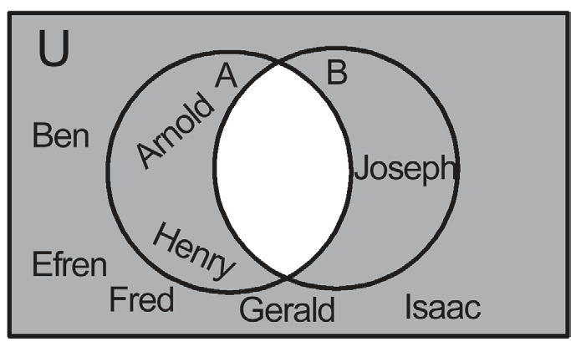
Sets and Venn Diagram
Cont.
e. B′ = {Arnold, Ben, Efren, Fred, f. A ∩ B = {Carlos, Dennis}
Gerald, Henry, Isaac} (A ∩ B)′ = {Arnold, Ben, Efren,
Fred, Gerald, Henry, Isaac, Joseph}

Slide 8
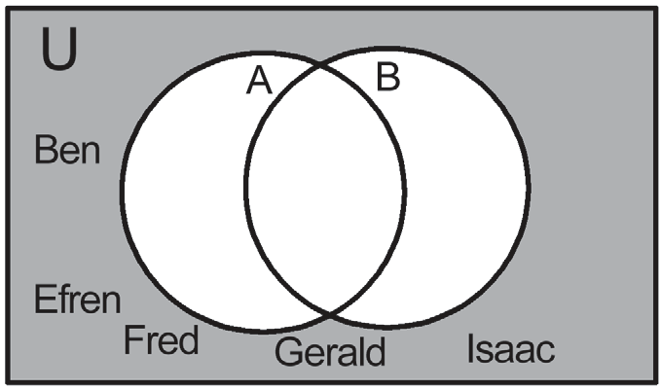
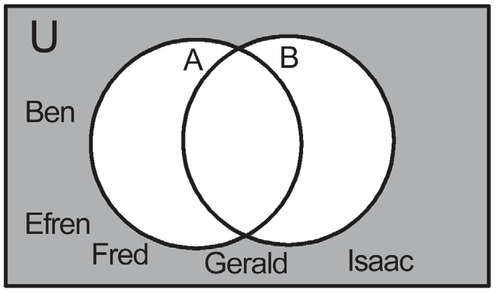
Sets and Venn Diagram
Cont.
g. A′ ∩ B′ = {Ben, Efren, Fred, h. A ∪ B = {Arnold, Carlos, Dennis, Henry, Joseph}
Gerald, Isaac} (A ∪ B)′ = {Ben, Efren, Fred, Gerald, Isaac}

Slide 9
Sets and Venn Diagram
Example 2: Application of Venn Diagram
Given: U = {Arnold, Ben, Carlos, Dennis, Efren, Fred, Gerald, Henry, Isaac, Joseph}
A = {Arnold, Carlos, Dennis, Henry}
B = {Carlos, Dennis, Joseph}
C = {Dennis, Gerald, Joseph}
Use a Venn diagram to represent the following:
a. A ∪ B ∪ C b. B ∪ C c. A ∩ C d. (A ∩ C) − B

Slide 10
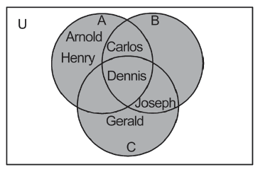
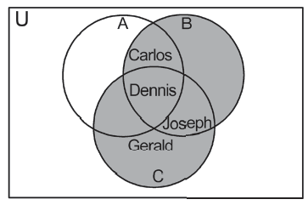
Sets and Venn Diagram
Solution:
a. A ∪ B ∪ C = {Arnold, Carlos, b. B ∪ C = {Carlos, Dennis, Gerald,
Dennis, Gerald, Henry, Joseph} Joseph}

Slide 11
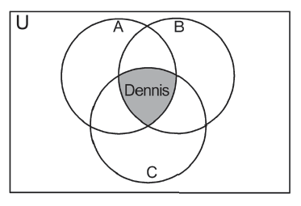
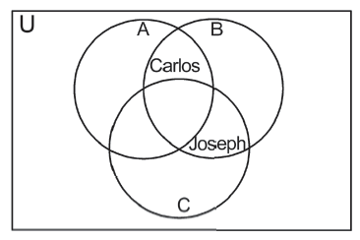
Sets and Venn Diagram
Solution:
c. A ∩ C = {Dennis} d. (A ∩ C) − B = { }

Slide 12
Sets and Venn Diagram
Example 3: Application of the Venn Diagram
Out of 50 students, 20 are members of the math club and 34 are members of the glee club. If 8 are in both clubs, how many students are in (a) neither of the clubs and (b) either club?

Slide 13
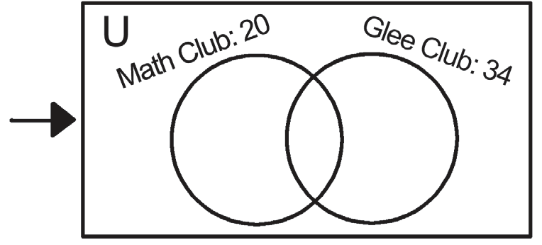
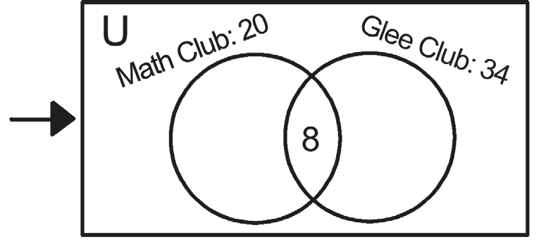
Sets and Venn Diagram
Solution:
Draw the universal set for the 50 students
with two overlapping circles and label it with the
total in each.
Because 8 students belong to both clubs,
put “8” in the overlap.

Slide 14
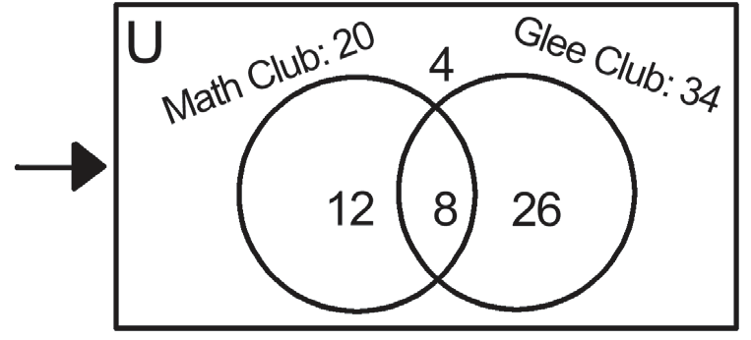
Sets and Venn Diagram
Cont.
This shows that a total of 12 + 8 + 26 or
46 students are in either math club or glee
club. This leaves 4 students unaccounted for
so these students must be the ones that are in
neither club.
Thus,
a. there are 4 students that are in neither of the clubs.
b. there are 46 students that are in either club.

Slide 15
Sets and Venn Diagram
Example 4: Application of Union and Intersection
Given that n(U) = 50, n(A) = 25, and n(B) = 20.
a. Find the greatest value of n(A ∩ B).
b. Find the least value of n(A ∩ B).
c. Find the greatest value of n(A ∪ B).
d. Find the least value of n(A ∪ B).

Slide 16
Sets and Venn Diagram
Solution:
a. The greatest value of n(A ∩ B) is n(B) = 20.
b. The least value of n(A ∩ B) is 0. The greatest value of n(A ∪ B) occurs when A
and B are disjoint sets and the least value occurs when B is a subset of A.
c. The greatest value of n(A ∪ B) is n(A) + n(B) = 25 + 20 = 45.
d. The least value of n(A ∪ B) is n(A) = 25.

Slide 17
Sets and Venn Diagram
Try It
HAIR Company offers two brands of shampoo: brand H and brand S. 100 people were surveyed and their brand preferences are as follows:
50 people like brand H.
35 people like brand S.
a. What is the maximum number of people who like both H and S?
Answer: 35
b. What is the minimum number of people who like both H and S?
Answer: 0
c. What is the minimum number of people who do not like any of the brands?
Answer: 15

