Slide 1




Subsets of a Line

Slide 2

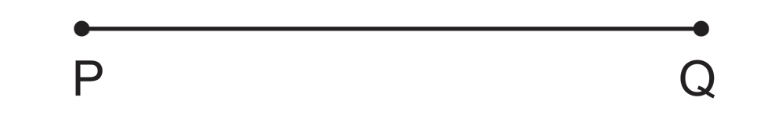
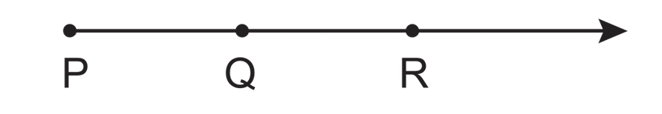
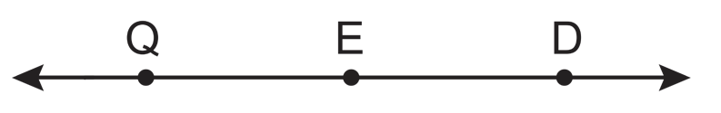
Subsets of a Line
Definition
The segment with endpoints P and Q, denoted by PQ, is the set consisting of distinct points P and Q and all points in between P and Q.
Ray PQ is the set of points consisting of PQ and all points R such that Q is between P and R. P is called the endpoint of the ray. The symbol PQ is used to name ray PQ.
Example: Terms Related to Lines
Point E is between Q and D. Which of the following is true?
a. Q, E, and D are collinear.
b. QD and DQ are the same.
c. EQ is the same as ED.
Solution:
Draw the figure.
a. True
b. True
c. False
Rex Curriculum Resource
WWW.REX.COM.PH

Slide 3
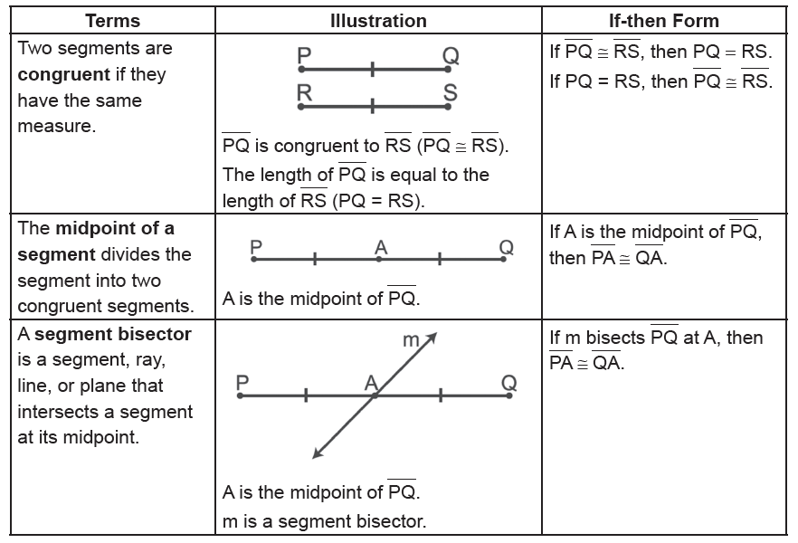
Subsets of a Line
Definition
Rex Curriculum Resource
WWW.REX.COM.PH

Slide 4
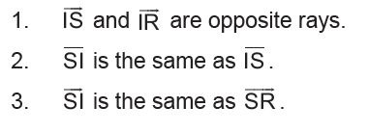
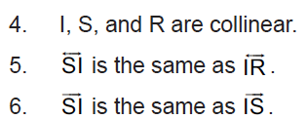
Activity:
Determine whether the following statements are true or false. Write T if it is true and write F if it is false.
If point I is between S and R, then:
Rex Curriculum Resource
WWW.REX.COM.PH

Slide 5
Activity: ANSWER KEY
Determine whether the following statements are true or false. Write T if it is true and write F if it is false.
If point I is between S and R, then:
ANSWER KEY
1. T
2. T
3. F
4. T
5. T
6. F
Rex Curriculum Resource
WWW.REX.COM.PH

Slide 6


