Slide 1
The Real Number System

Slide 2
The Real Number System
All elements in each subset are also elements in the set of real numbers.

Slide 3
The Real Number System
Subsets of Real Numbers
Name | Description | Examples
Natural Numbers, N | N = {1, 2, 3, 4, 5, ...} These numbers are used for counting. | 2, 3, 5, 8, 17
Whole Numbers, W | W = {0, 1, 2, 3, 4, ...} These numbers are formed by adding 0 to the set of natural numbers. | 0, 2, 3, 5, 8, 17
Integers, Z | Z = {..., −4, −3, −2, −1, 0, 1, 2, 3, 4, ...} They are formed by adding the negatives of the natural numbers to the set of whole numbers. | −19, −8, −5, −3, −2, 0, 2, 3, 5, 8, 17

Slide 4
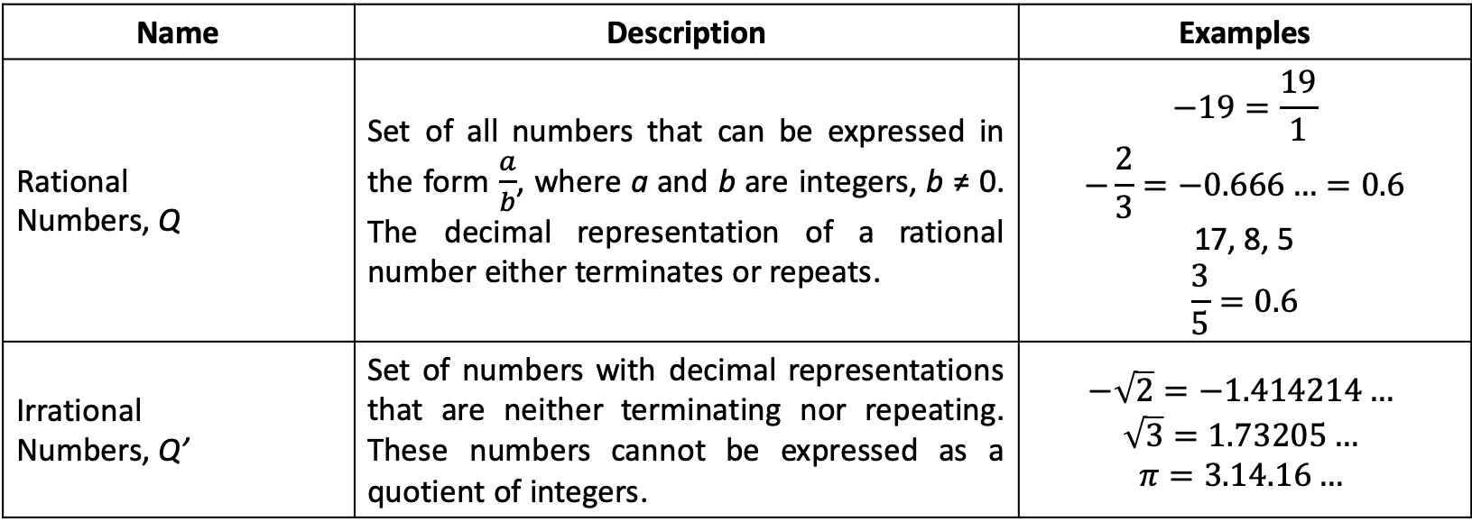
The Real Number System
Subsets of Real Numbers
Name | Description | Examples
Rational Numbers, Q | Set of all numbers that can be expressed in the form $\frac{a}{b}$, where a and b are integers, b ≠ 0. The decimal representation of a rational number either terminates or repeats. | $$−19=\frac{19}{1}$$ $$−\frac{2}{3}=−0.666…=0.6$$ 17, 8, 5 $$\frac{3}{5}=0.6$$
Irrational Numbers, Q’ | Set of numbers with decimal representations that are neither terminating nor repeating. These numbers cannot be expressed as a quotient of integers. | $$−\sqrt{2}=−1.414214…$$ $$\sqrt{3}=1.73205…$$ $$π=3.14.16…$$

Slide 5
The Real Number System
To indicate that the set of natural numbers (N) is a subset of the set of whole numbers (W), we write, N ⊆ W and read it as “N is a subset of W.” Likewise, N ⊆ W ⊆ Z ⊆ Q ⊆ Q′.

Slide 6
The Real Number System
Subsets of the Set of Real Numbers on the Number Line
Natural Numbers
Whole Numbers
Integers
Rational Numbers
Irrational Numbers

Slide 7
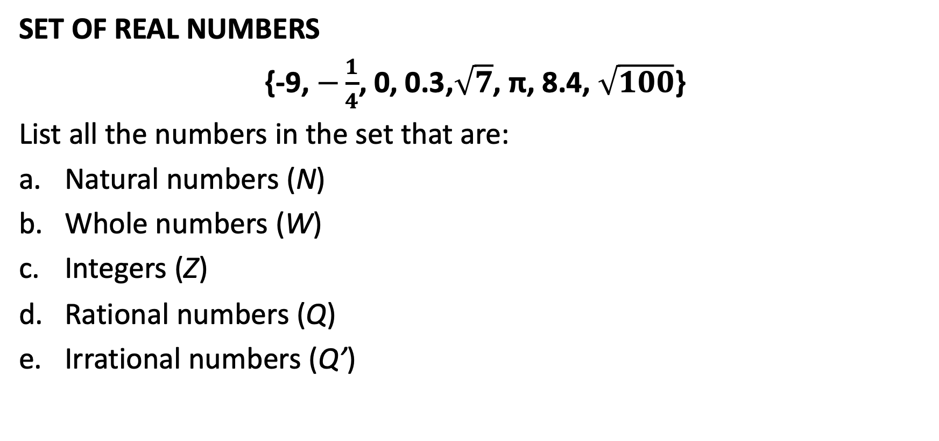
The Real Number System
SET OF REAL NUMBERS
{-9, $−\frac{1}{4}$, 0, 0.3,$\sqrt{7}$, π, 8.4, $\sqrt{100}$}
List all the numbers in the set that are:
Natural numbers (N)
Whole numbers (W)
Integers (Z)
Rational numbers (Q)
Irrational numbers (Q’)

Slide 8
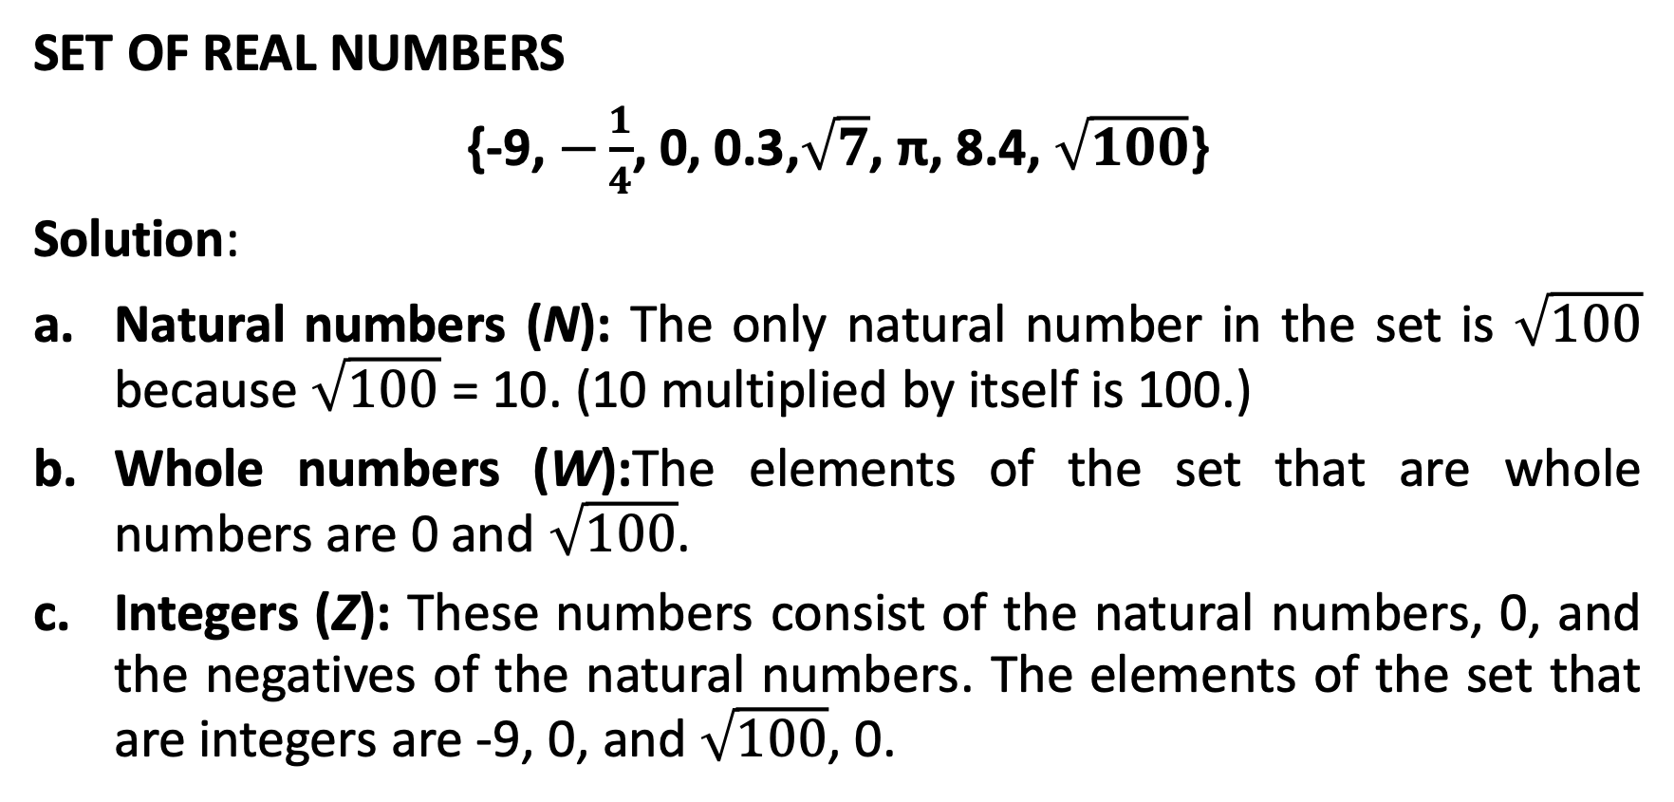
The Real Number System
SET OF REAL NUMBERS
{-9, $−\frac{1}{4}$, 0, 0.3,$\sqrt{7}$, π, 8.4, $\sqrt{100}$}
Solution:
Natural numbers (N): The only natural number in the set is $\sqrt{100}$ because $\sqrt{100}$ = 10. (10 multiplied by itself is 100.)
Whole numbers (W):The elements of the set that are whole numbers are 0 and $\sqrt{100}$.
Integers (Z): These numbers consist of the natural numbers, 0, and the negatives of the natural numbers. The elements of the set that are integers are -9, 0, and $\sqrt{100}$, 0.

Slide 9
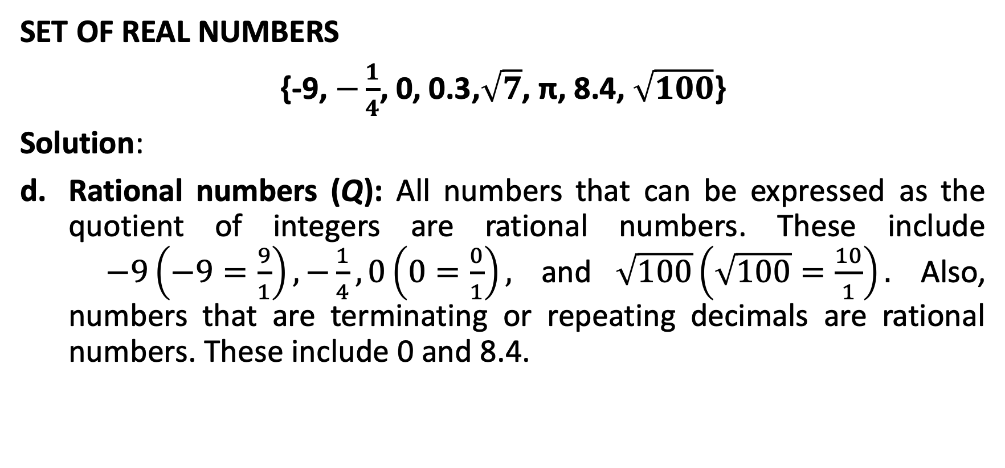
The Real Number System
SET OF REAL NUMBERS
{-9, $−\frac{1}{4}$, 0, 0.3,$\sqrt{7}$, π, 8.4, $\sqrt{100}$}
Solution:
Rational numbers (Q): All numbers that can be expressed as the quotient of integers are rational numbers. These include $−9\left(−9=\frac{9}{1}\right),−\frac{1}{4},0\left(0=\frac{0}{1}\right),$ and $\sqrt{100}\left(\sqrt{100}=\frac{10}{1}\right).$ Also, numbers that are terminating or repeating decimals are rational numbers. These include 0 and 8.4.

Slide 10
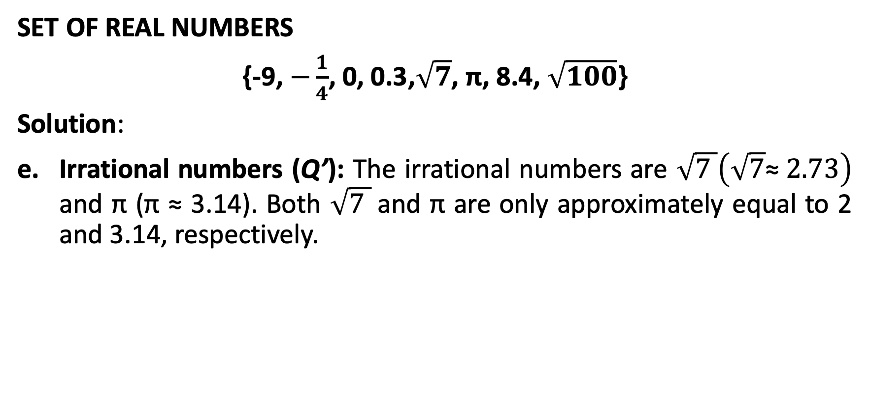
The Real Number System
SET OF REAL NUMBERS
{-9, $−\frac{1}{4}$, 0, 0.3,$\sqrt{7}$, π, 8.4, $\sqrt{100}$}
Solution:
Irrational numbers (Q’): The irrational numbers are $\sqrt{7 }\left(\sqrt{7}\text{≈ }2.73\right)$ and π (π $\text{≈}$ 3.14). Both $\sqrt{7 }$and π are only approximately equal to 2 and 3.14, respectively.

Slide 11
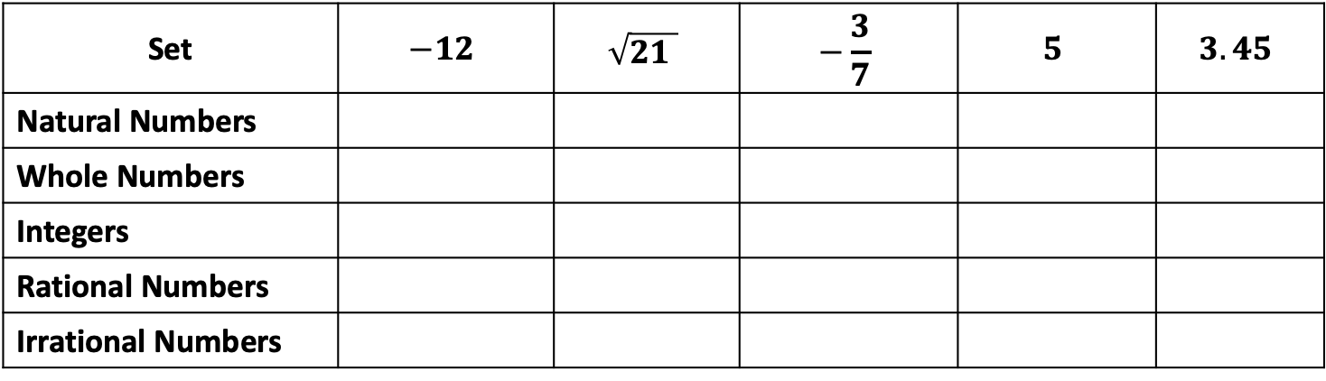
The Real Number System
SET OF REAL NUMBERS
Check the set(s) of real numbers to which each number belongs.
Set | $$−12$$ | $$\sqrt{21 }$$ | $$−\frac{3}{7}$$ | $$5$$ | $$3.45$$
Natural Numbers
Whole Numbers
Integers
Rational Numbers
Irrational Numbers

Slide 12
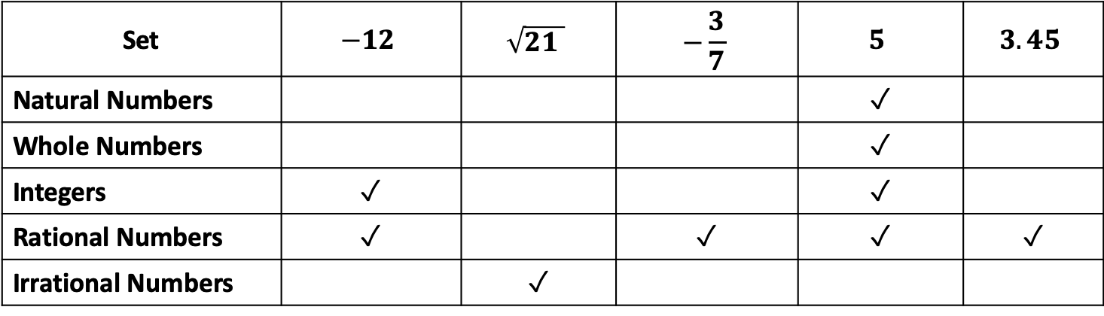
The Real Number System
SET OF REAL NUMBERS
Check the set(s) of real numbers to which each number belongs.
Solution:
Set | $$−12$$ | $$\sqrt{21 }$$ | $$−\frac{3}{7}$$ | $$5$$ | $$3.45$$
Natural Numbers |  |  |  | ✓
Whole Numbers |  |  |  | ✓
Integers | ✓ |  |  | ✓
Rational Numbers | ✓ |  | ✓ | ✓ | ✓
Irrational Numbers |  | ✓

Slide 13
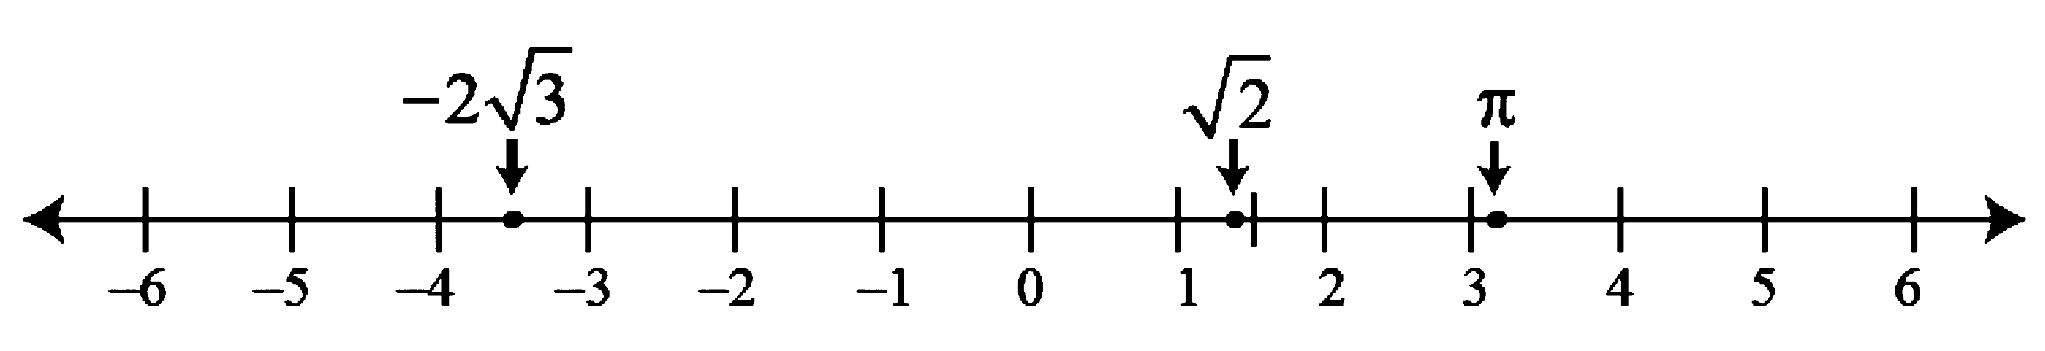

The Real Number System
ARRANGING REAL NUMBERS ON THE NUMBER LINE
On a number line, approximate the location of $\sqrt{2}$, $−2\sqrt{3}$, and π.
Solution:
Use a calculator to approximate the given irrational numbers.

