Slide 1
Problems Involving Real Numbers

Slide 2
Problems Involving Real Numbers
Real-life Application
Solve for what is being asked in each problem.
Electrons have a charge of -1. Protons have a charge of +1. The total charge of an atom is the sum of its electron charges and its proton charges. Find the total charge of an atom with 16 protons and 18 electrons.

Slide 3
Problems Involving Real Numbers
Real-life Application
Solve for what is being asked in each problem.
Solution:
Represent 16 protons as +16 and 18 electrons as -18. To find the total charge, add +16 and -18.
(+16) + (-18) = -2

Slide 4
Problems Involving Real Numbers
Real-life Application
Solve for what is being asked in each problem.
Find the difference in altitude between a mountain 3,900 feet high and a valley 785 feet below sea level.

Slide 5
Problems Involving Real Numbers
Real-life Application
Solve for what is being asked in each problem.
Solution:
Land that is below sea level is considered to have a negative altitude. Hence, the valley is said to have an altitude of -785 ft. The difference in altitudes between the mountain and the valley is found by subtracting -785 ft from 3,900 ft.
3,900 ft - (-785 ft) = 4,685 ft

Slide 6
Problems Involving Real Numbers
Real-life Application
Solve for what is being asked in each problem.
Ions are atoms or groups of atoms with positive or negative charges. An aluminum ion has a charge of +3 while a chloride ion has a charge of -1. Find the total charge of 22 chloride ions and 4 aluminum ions.

Slide 7
Problems Involving Real Numbers
Real-life Application
Solve for what is being asked in each problem.
Solution:
= 22 × (-1) + 4 × (+3)
= -22 + 12
Total Charge = -10
Therefore, the total charge of 22 chloride ions and 4 aluminum ions is -10.

Slide 8
Problems Involving Real Numbers
Real-life Application
Solve for what is being asked in each problem.
Tom played golf at an amusement park. His scores for the first five holes were -1, +1, -2, -1, and -2. What was his mean (average) score for these holes?

Slide 9
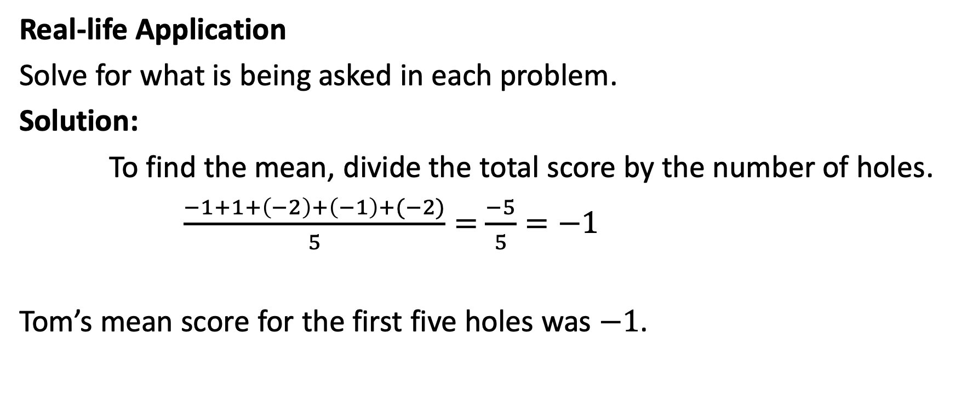
Problems Involving Real Numbers
Real-life Application
Solve for what is being asked in each problem.
Solution:
To find the mean, divide the total score by the number of holes.
$\frac{−1+1+\left(−2\right)+\left(−1\right)+(−2)}{5}=$ $\frac{−5}{5}=−1$
Tom’s mean score for the first five holes was $−1$.

