Slide 1
Heat and Temperature at the Molecular Level

Slide 2
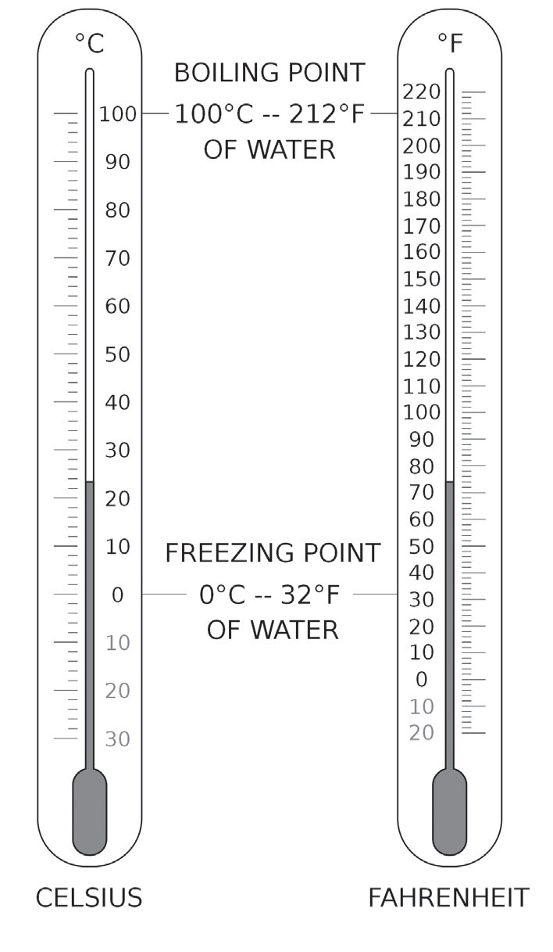
Heat and Temperature at the Molecular Level
Temperature
Temperature describes the degree of hotness and coldness of a body
Temperature can be defined as the measure of the average kinetic energy of molecules. Objects with the same temperature are in thermal equilibrium. This means that the net heat transfer between the objects is 0.
The instrument used in measuring temperature is the thermometer.The common thermometer consists of a glass tube with a thin column of colored alcohol or mercury.
Similar to other properties, temperature requires standard measurements. There are three main temperature scales used in the world—Celsius, Fahrenheit, and Kelvin.

Slide 3
Heat and Temperature at the Molecular Level
Temperature Scales | Symbols | Proponents | Descriptions
Celsius | °C | Anders Celsius | most commonly used • assigned 0°C as the temperature at which pure water freezes and 100°C as the temperature at which pure water boils
Fahrenheit | °F | Daniel Gabriel Fahrenheit | The basis is the freezing point and boiling point of water. • widely used in the US
Kelvin | K | William Thomson, First Baron Kelvin | uses the concept of absolute zero, which is the lowest possible temperature • not measured in degrees

Slide 4


Heat and Temperature at the Molecular Level
Formulas to use in converting temperature
Temperature Conversion | Formula
Celsius to Fahrenheit
Fahrenheit to Celsius
Celsius to Kelvin | K = ºC + 273

Slide 5
Heat and Temperature at the Molecular Level
Examples:
The temperature of a patient suffering from Severe Acute Respiratory Syndrome (SARS) is 106°F.
If Celsius and Kelvin thermometers were used separately for the measurement, what values would be recorded?
Solution:
a. Use the formula, ºC = (ºF-32) 5 to convert degree Fahrenheit to degree Celsius:
9
ºC = ºF 32 5 = (106-32) 5 = 41.1 ºC
b. Use the formula, K = °C + 273, for converting degree Celsius to Kelvin:
K = °C + 273 = 41.1 °C + 273 = 314 K

Slide 6
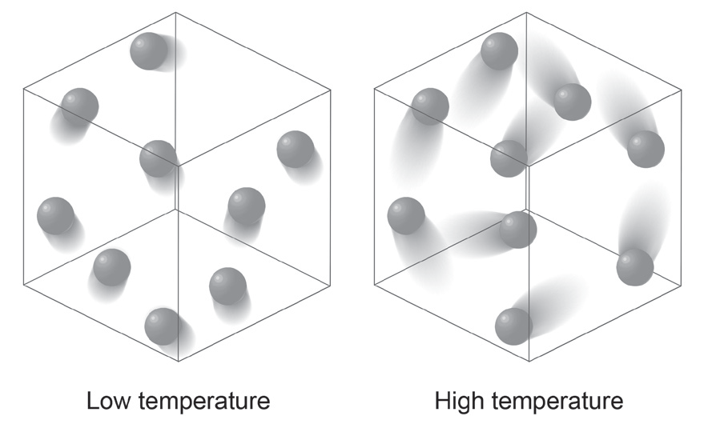
Heat and Temperature at the Molecular Level
Heat
Heat can be defined as the thermal energy that is being transferred from one object to another because of temperature difference, ΔT. Heat will always flow from hotter objects to colder objects. When an object is heated, energy is actually given off to the object.
It is important to remember that once heat energy touches another object, it is eventually converted into internal energy.
Internal energy is defined as the total energy contained in a substance.
When a substance absorbs heat, its molecules gain kinetic energy, and they move at a greater speed. The faster they move, the hotter the substance becomes. It is said to have gained internal energy. Heat is then a measure of the change in the total internal energy of a body. If the substance gives off heat, its internal energy decreases. Internal energy is also proportional to the temperature of a substance. The higher the temperature, the greater the internal energy. If the substance gives off heat, the temperature also decreases.

Slide 7
Heat and Temperature at the Molecular Level
The most common unit used for expressing heat is the unit calorie.
Calorie - the amount of heat required to change the temperature of 1 gram of water by 1°C.
A kilocalorie is 1,000 calories. For food energy, the unit is also in calories, but it is written with a capital C.
1 food calorie is 1,000 calories, or 1 calorie is 1 kilocalorie.
Another unit of heat is joule, named after the English physicist James Prescott Joule. He discovered that heat and mechanical energy are interrelated and that transformations from one to the other occur in a fixed proportion, which he called the mechanical equivalent of heat, whose presently accepted result is 1 calorie = 4.1868 joules.

Slide 8
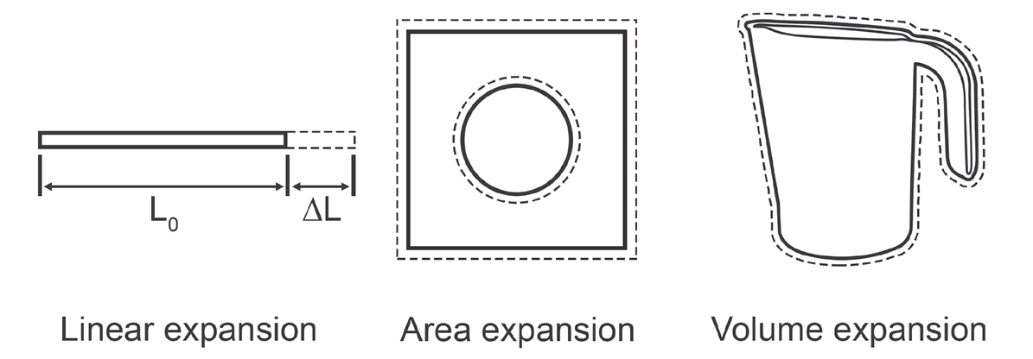
Heat and Temperature at the Molecular Level
Thermal Expansion
The more heat is absorbed, the greater is the increase in the temperature. This will make the molecules move faster, and as a result, the molecules tend to move farther apart. This phenomenon is known as thermal expansion. As the object cools down, its molecules contract.
ΔL = αL0ΔT

Slide 9
Heat and Temperature at the Molecular Level
For linear expansion, when a solid is subjected to an increase in temperature, ΔT, its increase in length, ΔL, is very nearly proportional to its initial length, Lo, multiplied by ΔT. This can be represented by the equation:
ΔL = αL0ΔT
The proportionality constant, α, called the coefficient of linear expansion, is dependent on the nature of the substance.
Example:
A copper bar 80.0 centimeters long at 15.0°C. What is the increase in length when it is heated to 35.0°C?
Given:
L0 = 80.0 cm Ti = 15.0°C Tf = 35.0°C α = 17 × 10–6/°C
Solution:
ΔL = αL0ΔT = (17 × 10−6/°C) (80.0 cm) (35.0°C − 15.0°C)
ΔL = 2.72 × 10−2 cm is the increase in length of a copper bar when heated from 15.0°C
to 35.0°C.

Slide 10

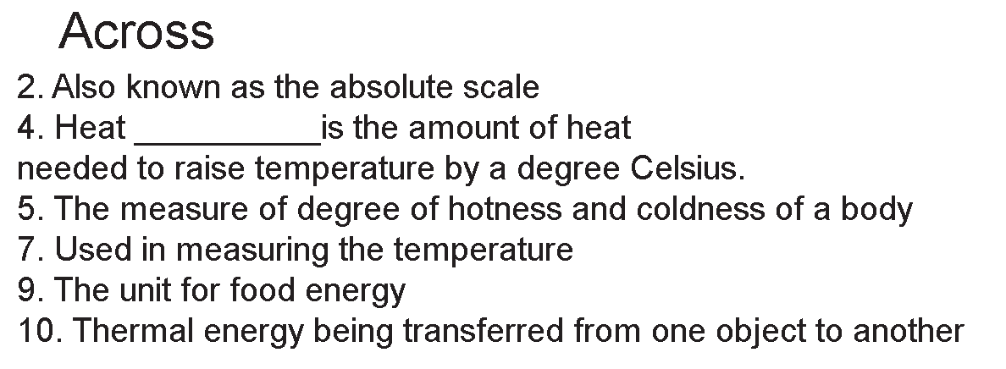
Heat and Temperature at the Molecular Level
Directions: Complete the crossword puzzle.

Slide 11
Heat and Temperature at the Molecular Level
Answer Key:
Across:
2. Kelvin
4. capacity
5. temperature
7. thermometer
9. calorie
10. heat
Down:
1. calorimeter
3. Fahrenheit
6. Celsius
8. Joule

