Slide 1
Phase Changes

Slide 2
Phase Changes
In general, materials can exist in several states of matter. The state of matter is often referred to as phase. When a material changes from one state to another, this is called a phase change. There are different phase changes a material can undergo. These phase changes will be classified into those that release energy and those that require energy.
Table 5. Phase Changes That Require an Increase in Energy
 | DESCRIPTION | EXAMPLE
Melting | It is a phase change from solid to liquid. | Ice starts to melt when it absorbs heat. It causes the ice to increase its temperature breaking the bonds on its molecules until it completely melts and turns into water.
PHASE CHANGE

Slide 3
Phase Changes
Vaporization | It is a phase change from liquid to gas that only occurs when the temperature of the material is at its boiling point. | Water turns into steam after it reaches its boiling point. Steam is the gaseous form of water at its boiling point.
Evaporation | It is also a phase change from liquid to gas that occurs when the liquid phase is below its boiling point. It only happens at the surface of the liquid. | Water on your skin turns into water vapor after coming out of a bath. Water vapor is the gaseous form of water below its boiling point.
Sublimation | It is a phase change from solid to gas. | Dry ice (solid carbon dioxide) undergoes phase change directly into gas. Another good example is a mothball which also changes directly from solid to gas.

Slide 4
Phase Changes
Table 6. Phase Changes That Require the Release of Energy
PHASE CHANGE | DESCRIPTION | EXAMPLE
Condensation | It is a phase change from gas to liquid. | Formation of water droplets on a glass of ice-cold drink illustrates condensation. When water vapor in the air hits the glass’ cold surface, it condenses and changes to liquid water.
Freezing | It is a phase change from liquid to solid. | When you place water in a freezer, it will turn to ice after some time. The water reaches its freezing point, which is the temperature for a liquid to turn into a solid.

Slide 5
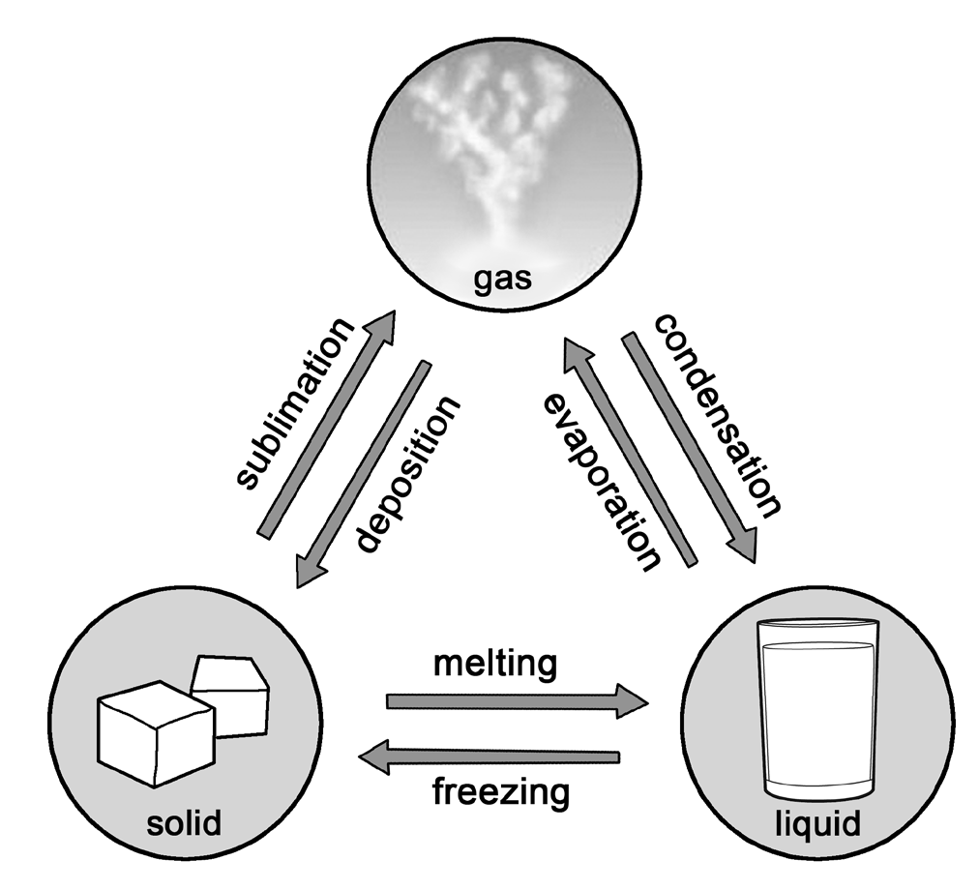
Phase Changes
The different phase changes discussed in Tables 5 and 6 can be summarized in illustration on the right. It shows that water can undergo all of the phase changes mentioned. It is important to remember that when a substance or material changes its phase, it also changes the arrangement and behavior of its molecules.
If ice undergoes sublimation and changes into gas, the arrangement of its molecules changes. From being closely packed and slowly moving, it now has more spaces between particles which allow them to move rapidly in random directions. On the other hand, if water vapor condenses and turns into water droplets, the gas molecules of vapor slow down and start to move toward each other, decreasing the space between them.

Slide 6
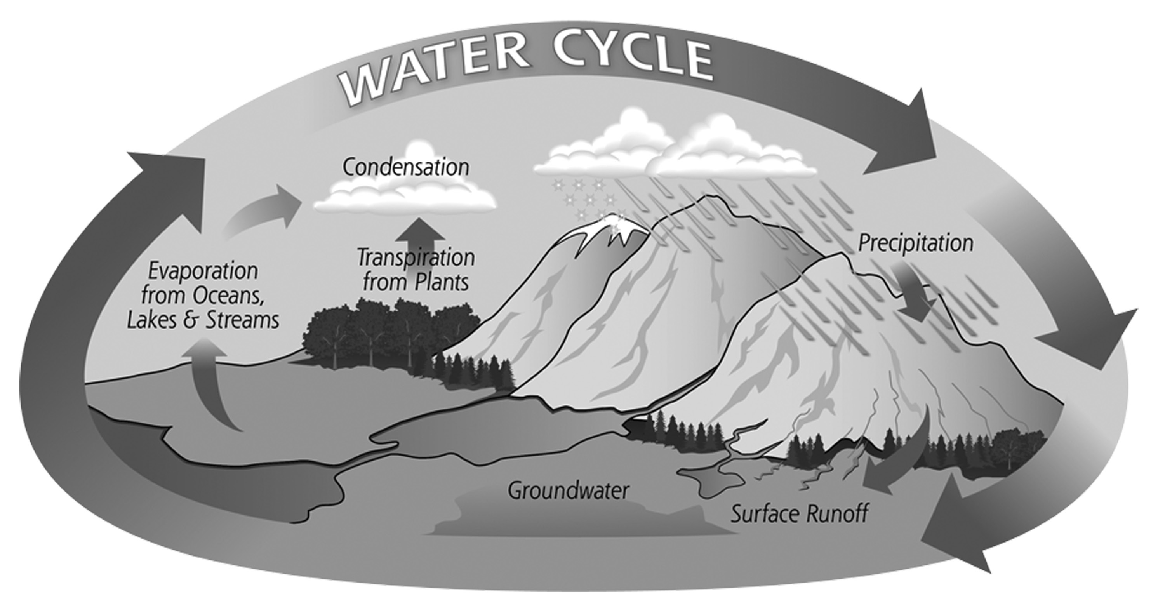
Phase Changes
The examples given for the phase changes mentioned above show that water can exist in all three states of matter. In natural phenomena such as the formation of rain droplets through the water cycle, you will see how water behaves in its different states. illustartion shows how water undergoes several phase changes in the water cycle.
In illustration, water from the Earth’s water forms, such as oceans, lakes, rivers, and the like, undergoes evaporation (liquid to gas), which turns it into water vapor. Take note that evaporation occurs even if the temperature is below the boiling point of water (100°C). The water vapor will then condense (gas to liquid) into the atmosphere forming clouds. When these clouds become heavy, rain (liquid precipitate) or snow (solid precipitate) will fall back to the ground.

Slide 7
Phase Changes
Activity
Directions: Match the phase change in Column A with the corresponding process in Column B. Give the letter of the correct answer.
Column A
Column B
____1. Solid to gas
____2. Gas to liquid
____3. Solid to liquid
____4. Gas to solid
____5. Liquid to gas
____6. Liquid to solid
A. Condensation
B. Deposition
C. Freezing
D. Melting
E. Sublimation
F. Vaporization

Slide 8
Phase Changes
Answer Key
Column A
Column B
____1. Solid to gas
____2. Gas to liquid
____3. Solid to liquid
____4. Gas to solid
____5. Liquid to gas
____6. Liquid to solid
A. Condensation
B. Deposition
C. Freezing
D. Melting
E. Sublimation
F. Vaporization
E
A
D
B
F
C

