Slide 1
Doing Scientific Investigations

Slide 2
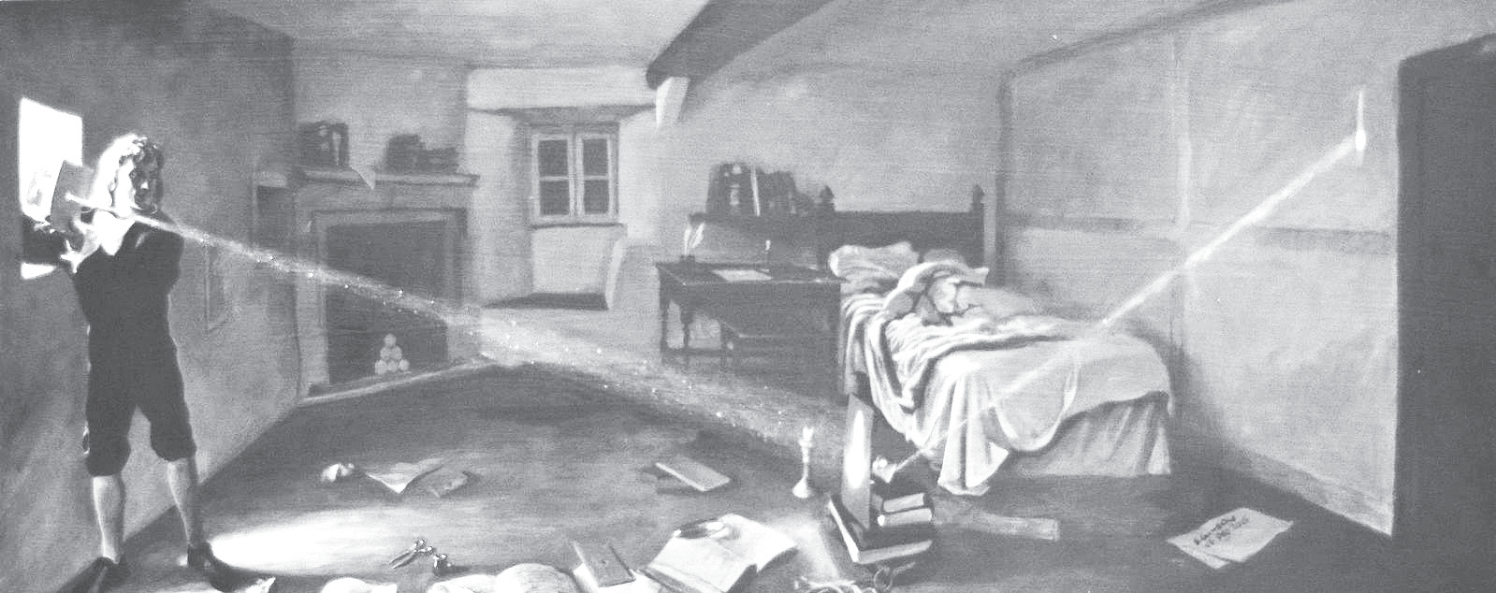
Doing Scientific Investigations
Scientific Method
is an orderly process of empirical investigation that is focused on solving a problem.
It is the key to unlocking the bodies of knowledge by helping researchers organize their thoughts and procedures and make them confident of their findings generated from experiments.
Isaac Newton
Father of Physics,
demonstrated his theory of the composition of light through his famous experiment, the Experimentum Crucis, in the 1660s.
His experiment was repeatedly conducted in a dark room and proved that light consists of rays with different capabilities of being refracted.

Slide 3
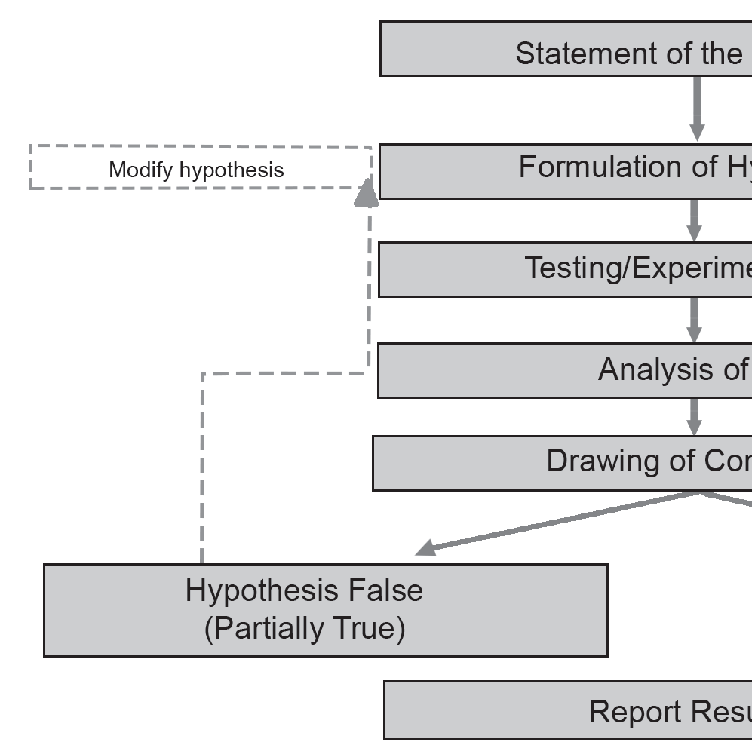
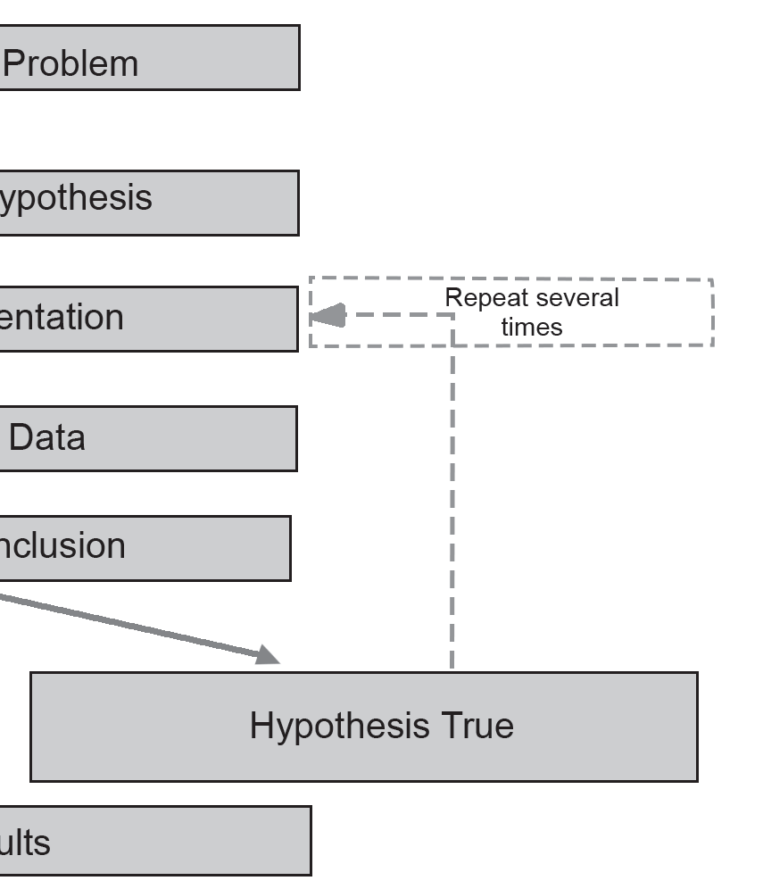
Doing Scientific Investigations
Components of a Scientific investigation

Slide 4
Doing Scientific Investigations
1. Statement of the Problem
The process of doing scientific investigations starts with an observation. We use our five senses to observe our surroundings. Your observation can be on anything, as long as it is something you really want to know about. From there, you can come up with a question that may be stated as a research problem. Choosing a problem to be solved also requires preliminary steps to ensure a successful investigation. First and foremost, you should have existing knowledge of the problem. You can build this knowledge by conducting research. Collect information from print and multimedia, interviews, and further observations in the environment.
This step answers the following questions:
What questions do you have about your observation?
What do you want to know?
Example:
After seeing a video on coffee grounds being added to plant, you start to wonder how coffee grounds affect the growth of plants.
Research problem: How do coffee grounds affect the growth of plants?

Slide 5
Doing Scientific Investigations
2. Formulation of Hypothesis
Once the problem is identified and a testable question has been proposed, you can now formulate the hypothesis. A hypothesis is a simple statement that presents the possible solution to the problem. A hypothesis should be based on knowledge and research and should also be testable. It can be an overall statement about the observation (descriptive hypothesis) or a guess about what caused the pattern in the observation (explanatory hypothesis).
A hypothesis may be stated in two ways:
• Null hypothesis (Ho) – a hypothesis that states no relationship between variables
• Alternative hypothesis (Ha) – a hypothesis that states a relationship between variables; it always disagrees with the null hypothesis.

Slide 6
Doing Scientific Investigations
Although the alternative hypothesis states the relationship between two variables (the coffee grounds and the plant growth), it fails to show what kind of relationship exists. To clearly show the relationship, you may state your alternative hypothesis in the following manner:
Ha2 : A < B There is a negative relationship between A and B.
Here, the < suggests that the less A is involved, the better is B.
Ha3 : A > B There is a positive relationship between A and B.
Here, the > suggests that the more B is involved, the better is A.
Let us have some examples. See how a hypothesis can be stated in different ways.
Example 1 | Ho: Earth is flat. | Ha: Earth is round.
Example 2 | Ho: Toddlers grow taller if they drink more milk. | Ha: Toddlers will not grow taller if they drink more milk.
Example 3 | Ho: Studying with music increases test scores. | Ha: Studying with music does not affect test scores.

Slide 7
Doing Scientific Investigations
3. Testing the Hypothesis and Gathering of Data
At this point, you are ready to test your hypothesis by conducting an experiment. An experiment is a set of manipulations or specific observations of nature. It is considered the most important part of the scientific method. It is done to answer the research question or to investigate the research problem.
There are three types of experiments: controlled, natural, and field experiments.
a. Controlled experiments generally compare the results obtained from an experimental sample against a control sample. Under this type, the observer tests the hypothesis by looking for changes brought about by alteration to a variable.
A variable is a characteristic, number, or quantity that increases or decreases over time or takes different values in different situations. It is anything that you can change or control in an experiment.

Slide 8
Doing Scientific Investigations
There are three kinds of variables in an experiment:
i. Controlled variables are variables that are kept constant. They do not receive any treatment.
ii. Independent variables are the factors that you change or alter during the experiment. These variables cause a corresponding effect on other variables.
iii. Dependent variables are the variables that you observe, and they are considered the response to an independent variable.
Research problem: How do coffee grounds affect the growth of plants?
In performing the experiment for this, here are the variables:
Controlled variables: These variables need to be kept constant to make sure that the plants’ growth is only affected by coffee grounds.
• the amount of water and sunlight received by the plants
• temperature
• the amount and type of soil
• the size of the pot where the plants have been planted
Independent variables: the amount or presence of coffee grounds
Dependent variables: the growth of the plant in terms of height and the number of leaves

Slide 9
Doing Scientific Investigations
b. Natural experiments or quasi-experiments are those that solely rely on observations of variables of the system under study. Here, the observer does not manipulate any variable but simply collects all the possible data to determine the factors affecting a particular phenomenon. One good example of a natural experiment is finding out the effects of social distancing on the spread of COVID-19.
c. A field experiment is named to draw a contrast with laboratory experiments. It examines the real world using the scientific method. It is often used in social sciences, such as political sciences, economics, and psychology. Economists use a field experiment to analyze discrimination in the labor market, education, and health care programs. This experiment can also be used to determine how the exposure to various media outlets affects voting behavior.
To genuinely test the hypothesis, the experiment should be a fair test, a phrase that describes a scientifically valid experiment. Fair testing occurs when you change only one factor at a time while keeping other conditions the same.
When you design an experiment, it is advised that you also state a prediction. A prediction is a forecast of future events based on past observations

Slide 10
Doing Scientific Investigations
4. Analyzing and Presenting Data
Data obtained from experiments should be analyzed and presented systematically. The data may be presented using a table for easy interpretation. If the data are placed in a table, it is easy to make comparisons, see patterns and trends, and show the relationship of the two factors, which will serve as the basis for drawing a conclusion.
5. Drawing a Conclusion
A conclusion is a summary of the experiment results and a statement of how the results match the hypothesis. There are two options for a conclusion—to reject the hypothesis or to accept it.
If a good conclusion has been tested often enough and has showed valid and reliable results each time, it then becomes a theory, a scientifically accepted fact. A theory that has been tested and confirmed by various experiments becomes a scientific law, which is a statement or principle that is universally accepted.
6. Reporting of Findings
Once the data have been analyzed and the conclusion has been drawn, the next step is to share the results. This stage is important in perpetuating the body of knowledge gained in conducting the scientific method.

Slide 11
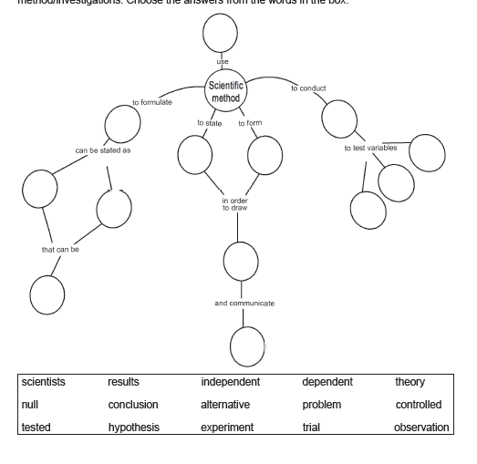
Doing Scientific Investigations
Directions: Complete the concept map to summarize your understanding of the scientific
method/investigations. Choose the answers from the words in the box.
scientists
results
independent
dependent
theory
null
conclusion
Alternative
problem
controlled
tested
hypothesis
experiment
trial
observation

Slide 12
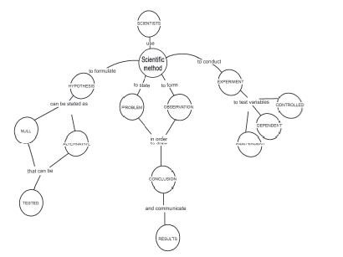
Doing Scientific Investigations
Answer Key:

