Slide 1
Concentration of Solutions

Slide 2
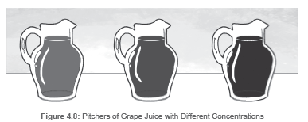
Concentration of Solutions
The three pitchers of grape juice have diff erent colors. In pitcher A, it is lighter in color, and as you go along the pitchers, the color becomes darker. These pitchers represent the concentration of the solution. The concentration of solution pertains to the measure of how much solute is dissolved in a specific amount of solvent or solution. Solutions can be described qualitatively as diluted or concentrated.
In Figure 4.8, the diluted solution is in pitcher A. A diluted solution means that it is a solution that contains less amount of solute. Meanwhile, pitcher C in Figure 4.8 is the concentrated solution. A concentrated solution is a solution that contains a large amount of solute. In laboratory setups, the concentration of solutions is often described quantitatively. The description used depends on the type of solution analyzed and the reason for describing it. Mathematically, the concentration of a solution depends on the type of solution. You can measure the mass of a solute or solvent in grams. You can also measure the volume of a solute or solvent in milliliters or liters. In this manner, you can report the concentration of solutions as the percent of solute in the solution by volume or mass.

Slide 3

Concentration of Solutions
• Percent by Mass
Concentration expressed by percent by mass is a ratio of a measured amount of solute to a measured amount of solution. In this formula, the mass of the solution equals the mass of
the solute plus the mass of the solvent.
Mathematically, it uses the formula:

Slide 4
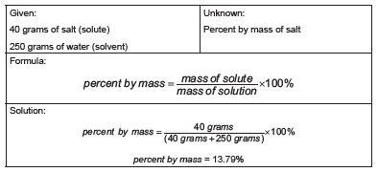
Concentration of Solutions
Examples:
1. You are in a laboratory, and you examine a solution that contains 40 grams of salt dissolved in 250
grams of water. What is the percent by mass of salt in the solution?
The percent by mass of salt is equal to 13.79%.The mass of the solution is the sum of the mass of the solute and the mass of the solvent. We need to remember that every 1 mL of water contains 1 gram of water.

Slide 5
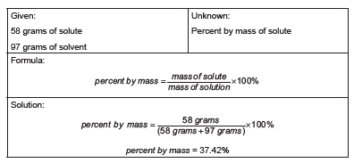
Concentration of Solutions
2. Janus is studying a certain solution. If the amount of solute is equal to 58 grams and the amount of
solvent is 97 grams, what will be the percent by mass of the solute?

Slide 6

Concentration of Solutions
• Percent by Volume
The percent by volume usually describes solutions in which both solute and solvent are liquids.
The volume of the solution is the sum of the volume of the solute and the volume of the solvent.
Mathematically, we use this formula to compute for percent by volume:

Slide 7
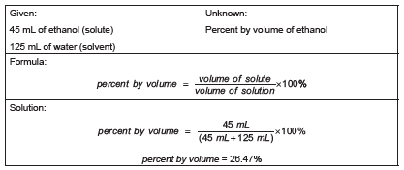
Concentration of Solutions
Examples:
1. What is the percent by volume of ethanol in a solution that contains 45 milliliters of ethanol dissolved in 125 milliliters of water?

Slide 8
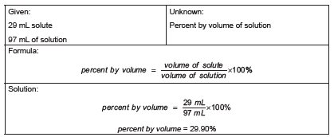
Concentration of Solutions
2. A certain solution has a volume of 97 milliliters. If the volume of the solute is equivalent to 29 milliliters,
what will be its percent by volume?
The given provided is already the volume of the solution. Therefore, we will not add the two volumes.

Slide 9
Concentration of Solutions
Directions: Compute for what is asked. Box your final answer.
1. A solution consists of 168.4 milliliters of ethyl alcohol dissolved in 519.2 milliliters of water. What is the
volume percent of the solution?
Given: | Required:
Formula:
Solution:

Slide 10

Concentration of Solutions
Answer Key:
Given: 168.4 milliliters of ethyl alcohol 519.2 milliliters of water | Required: Percent of the solution
Formula:
Solution:
Percent by volume =
Percent by volume =
168.4 ml
168.4ml + 519.2 ml
x
100%
24.49 %

