Slide 1
Saturated and Unsaturated Solutions

Slide 2
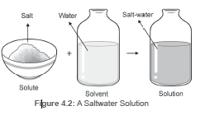
Saturated and Unsaturated Solutions
Solutions are composed of two components—the solute and the solvent.
Solvent is the component of a solution that dissolves the other component.
It comprises the bulk of the solution. Meanwhile, the solute is the component of the solution that dissolves in the solvent.
Water is the solvent in the solution as it is the dissolving medium. The salt is the solute as it is the component that is dissolved.

Slide 3
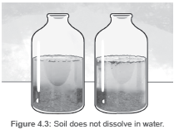
Saturated and Unsaturated Solutions
Solutions are formed when solutes dissolve in a solvent and form a single phase that appears uniform throughout. Solutions are often seen to be clear and transparent. Filtration is not appropriate to use when separating the components of a solution because the particles are too small and will only pass through the filter.
Materials that readily dissolve in a solvent are described as soluble. Example: salt and sugar in water.
Sand does not dissolve in water and creates a murky mixture therefore, it is classified as insoluble.

Slide 4
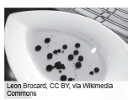
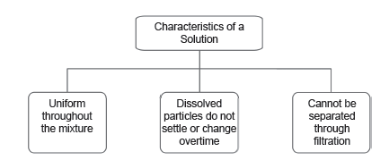
Saturated and Unsaturated Solutions
Immiscible liquids are liquids that do not mix together. Meanwhile, liquids that are able to mix together are known as miscible liquids.
Examples of miscible liquids:
water and ethanol, vinegar and water, and lemon juice and water
characteristics of solutions
A Vinegar and Oil Mixture

Slide 5
Saturated and Unsaturated Solutions
Solubility of Solutes
Solubility is the ability of the solute to be dissolved.
Different factors that affect solubility
1. Nature of solute and solvent
2. Pressure
3. Temperature
4. Particle Size
5. Mechanical Stirring

Slide 6
Saturated and Unsaturated Solutions
A saturated solution is a solution that contains the maximum amount of solute that can dissolve in a provided amount of solvent at a certain temperature. A solution that can still dissolve more solute is called an unsaturated solution.
Solubility changes with temperature. Some substances become more soluble with the increasing temperatures. This is the reason some solutions become supersaturated.A supersaturated solution contains more dissolved solute than a saturated solution given the same temperature. A supersaturated solution may remain unchanged for a long time if it is not disturbed. The supersaturated solution started to cool down through time, resulting in more solute that the solution could no longer
dissolve.

Slide 7
Saturated and Unsaturated Solutions
Directions: Complete the following statements by providing the missing words. Write your answers in the space provided.
1. Liquids that have the ability to mix together are called __________ liquids.
2. Solutions are __________ mixtures because you can only see one phase.
3. The ability of a solute to dissolve is known as __________.
4. ________ solutions are solutions that can still dissolve the solute.
5. A solid solute is considered __________ if it has the inability to dissolve.
6. A __________ is the dissolving medium in a solution.

Slide 8
Saturated and Unsaturated Solutions
Answer Key:
1. miscible
2. homogeneous
3. solubility
4. Unsaturated
5. insoluble
6. solvent

