Slide 1
Compounds - Acids and Bases

Slide 2
Compounds - Acids and Bases
Compounds - are pure substances made up of two or more elements united chemically.
- are made up of atoms of different elements
Some of the common compounds that are necessary for our daily lives are the following:
1. Water (H2O) – This is the most abundant compound on Earth. It is indispensable to humans, animals, and plants. It is a means of carrying nutrients to the cells of the body. It removes wastes produced by cellular processes. It is also used for drinking, cleaning, washing, cooking, and other activities at home.
2. Sodium chloride (NaCl) – It is commonly called salt. It is used to add flavor to our food.
3. Calcium carbonate (CaCO3) – It is also known as a limestone. It has been used as a building material since early civilization. It is a component of mortar.
4. Hydrochloric acid (HCl) – This is an acid found in the stomach that aids in digestion.

Slide 3
Compounds - Acids and Bases
Acids
Acids are compounds that contain hydrogen, which, when dissolved in water, break loose a hydrogen ion (H+). The presence of hydrogen ion gives acids the following characteristics:
1. Acids have a sour taste similar to the taste of citrus fruits. Do not taste to test the presence of acid. Some can produce painful burns.
2. In industries, there are very strong acids that are corrosive. They should, therefore, be handled with care.
3. Acids are electrolytes. They produce hydrogen ions that can conduct electricity when dissolved in water.
4. Acids neutralize bases, forming water and salt from the reaction.

Slide 4
Compounds - Acids and Bases
There are different acids; some are even present in your body. In your stomach, hydrochloric acid helps digest food. Acid is also found in your teeth. This acid is produced by the bacteria that feed on the carbohydrates left in your mouth. Remember to gargle or brush your teeth after eating, especially sweets. There are other places in your body where bacteria produce acids. These bacteria live in areas that are constantly moist, like your armpit. Sweat keeps these areas moist, which causes body odor in some people.
Acids are also important compounds in industries. Sulfuric acid (H2SO4) is widely used for manufacturing plastics, detergents, batteries, and metals. Nitric acid (HNO3) is used to manufacture explosives, rubber, dyes, pharmaceuticals, and phosphoric acid (H3PO4) for fertilizers, animal feeds, detergents, and ceramics. Acetic acid (CH3COOH) is used to manufacture plastics and food supplements, such as lysine and fungicide.

Slide 5
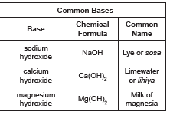
Compounds - Acids and Bases
Bases
Bases, also called alkaline substances, have their characteristics when dissolved in water.
1. Solutions of bases have a bitter taste. Remember that tasting bases can be hazardous since some are corrosive.
2. Solutions of bases feel slippery on the skin.
3. Bases neutralize acids, forming water and salt from the reaction.

Slide 6
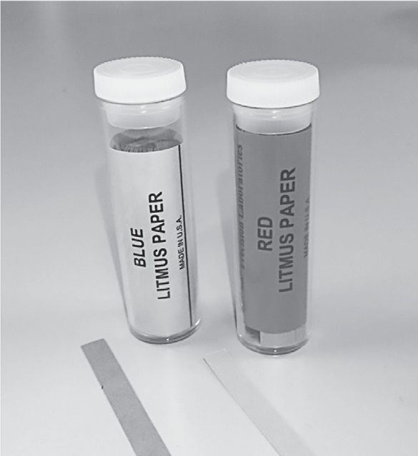
Compounds - Acids and Bases
Determining Compounds through Indicators
Most pure substances are compounds. There are millions of compounds around us. Many concerns about air and water pollutions are often related to the chemistry of acids, bases, and salts.
To identify one from the other, you need to use indicators. Indicators are substances whose colors are affected by acids and bases. An example of an indicator is the litmus paper.
Acids change a blue litmus paper to red.
Bases change a red litmus paper to blue.
Other examples of indicators are phenolphthalein, thymol blue, and methyl orange.

Slide 7
Compounds - Acids and Bases
Safety in Handling Acids and Bases
Acids and bases are both caustic, that is, in concentrated solutions, they can damage living tissues and nonliving things. When an acid or a base is accidentally spilled, the best way to reduce or prevent harm is to neutralize the substance with its opposite. An acid can be neutralized by a base, and a base can be neutralized by an acid. For example, milk of magnesia [Mg(OH)2], which is a suspension of magnesium hydroxide in water, is used as an antacid and an antidote when a strong acid is swallowed.
Acids and bases with high concentrations can cause serious burns.
Hydrochloric acid ( HCl ) is used to remove excess mortar from bricks in construction and to remove hardened deposits from toilet bowls at homes. It can cause severe burns if not properly handled.
Sodium hydroxide ( NaOH ) is used to open clogged kitchen and toilet pipes, sinks, and drains. It is poisonous and can cause severe eye and skin damage and burns. It is also harmful and fatal when swallowed.

Slide 8
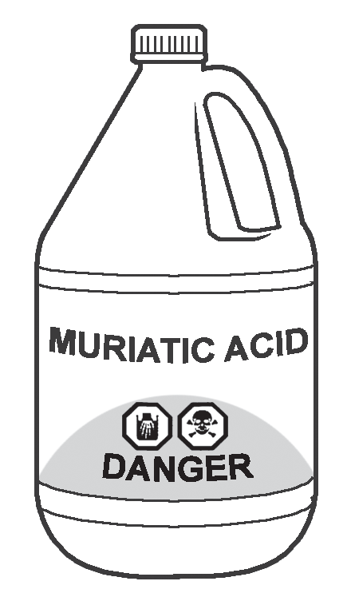
Compounds - Acids and Bases
How can you be safe in handling acids and bases?
Read product labels of common acids and bases properly for safety.
Product labels contain signal words—Caution, Warning, and Danger. Caution appears on products that are less harmful to you.
Warning means a product has more serious effects than the one with a “Caution” label.
Danger means that the product is poisonous or corrosive and should be used with extreme care.
Pay attention to these signal words.
Follow the directions in the product labels that tell you how to use the products safely and correctly. It is important to make it a habit to read product labels before using the products at home or in school for your safety. It is also important to know the proper way of storing these materials.
Muriatic
Acid with Warning
Signs

Slide 9
Compounds - Acids and Bases
Activity
Directions: Classify whether each material contains an acid or a base. Write A for acid or B for base in the space before each number.
____1. vinegar
____2. muriatic
____3. soap
____4. lye
____5. sweat

Slide 10
Elements- Metals and Nonmetals
Answer Key:
1. A
2. A
3. B
4. B
5. A

