Slide 1
Heterogeneous Mixtures

Slide 2
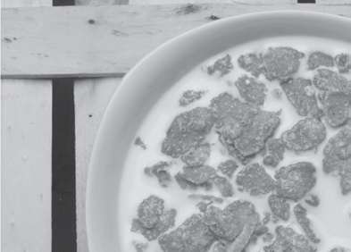
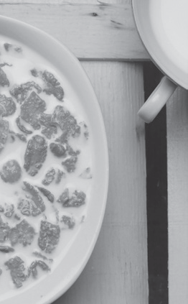
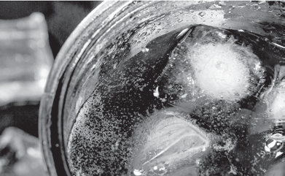
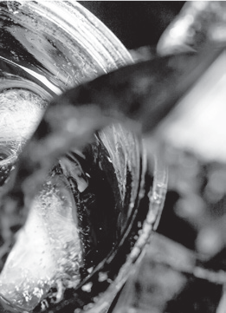
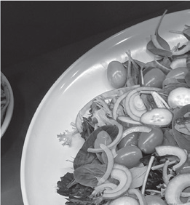
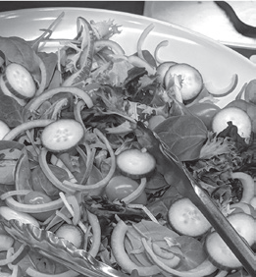
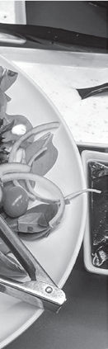
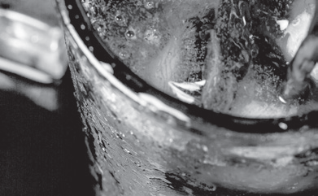
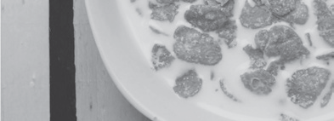
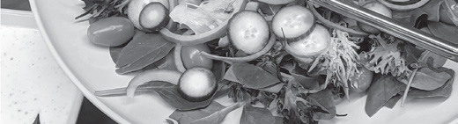
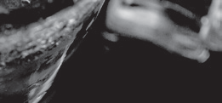
Heterogeneous Mixtures
Heterogeneous mixture
mixture in which you can identify the different components
exhibits two or more phases
cereals with milk
soda with ice
tossed salad

Slide 3
Heterogeneous Mixtures
Types of Heterogeneous Mixtures
Suspension
A suspension is a type of heterogeneous mixture that has large particles. These particles are big enough to be seen. As time passes by, you will see these particles settle at the bottom of the container. You can also separate these particles through filtration.
Colloid
A colloid is a type of heterogeneous mixture whose particle size is intermediate. This means that the particle size of colloids is in between the particle size of solutions (small particle size) and that of suspensions (large particle size). These particles are dispersed throughout the mixture.
Examples : mayonnaise, milk, and whipped cream

Slide 4
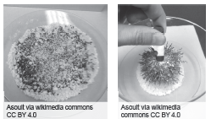
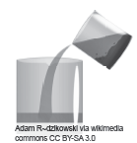
Heterogeneous Mixtures
Ways of Separating Mixtures
Magnetic Separation
One possible way of separating components of a mixture is through the use of magnets. In this method, the metallic substances will be attracted to the magnet, leaving the nonmetallic substances.
Decantation
Mixtures can also be formed with two immiscible liquids. Immiscible liquids are insoluble liquids. In this type of mixture, decantation is the easiest way to separate the components. Decantation is the process wherein one component of the mixture is poured off. To decant means “to pour off.” For immiscible liquids, after their separation based on their density, you can transfer or pour off the liquid or the less dense liquid on top to another container. Aside from two liquids, a mixture of solid and liquid can also undergo decantation. You employ this when you are washing rice grains. You remove the excess water from the rice grains by decanting them.

Slide 5
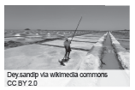
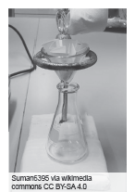
Heterogeneous Mixtures
Evaporation
If you put salt water in an open container under the Sun, the water evaporates, leaving the salt behind. The process is called evaporation. This method is applied if only one component of the mixture is to be recovered and the other component can be discarded.
Filtration
If you have a mixture consisting of a solid solute that is insoluble in the liquid solvent, you can use filtration to separate these components. This method is particularly useful if the insoluble solids are small particles and do not tend to settle upon standing.
Filtration is a process used to separate solids from liquids or gases using a medium, known as a filter, that allows fluid to pass through but not the solid components.

Slide 6
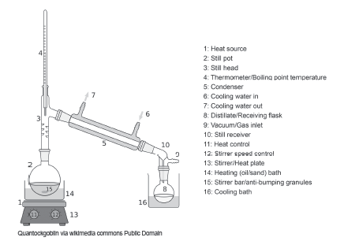
Heterogeneous Mixtures
Distillation
In distillation, a mixture of liquid is heated in a flask. This process involves the boiling points of two or more liquids. Boiling point is the temperature at which a liquid boils and turns into vapor.
The liquid with the lower boiling point evaporates first.
Then, it condenses, and it will be collected. Evaporation is the process wherein a liquid turns into gas. Meanwhile, condensation is the process when gas turns into liquid. The liquid with a higher boiling point and any solid particles are left behind. Distillation is used in the purification of water and the separation of the components of crude oil.

Slide 7
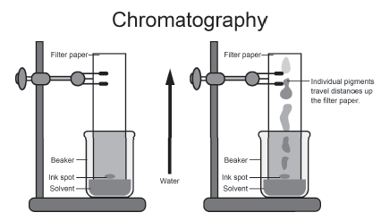
Heterogeneous Mixtures
Chromatography
Chromatography is a process that scientists use to separate many liquid mixtures. During this process, a solution dissolves quickly and travels up toward a solid material. The separated substances form bands of color called chromatograms. Colors separate in chromatography because of the different sizes of each molecule. Food scientists study chromatograms to discover what coloring a food contains.

Slide 8
Heterogeneous Mixtures
Activity
Directions: Write the missing word to complete each statement. Write your answer in the space provided.
1. The bands of colors found during the process of chromatography are known as _____________.
2. The process of separating mixtures using a medium, known as a filter, is known as ____________.
3. In decantation, the ____________ liquid will move below the less dense liquid.
4. ____________ substances are attracted to a magnet, while the nonmetallic substances remain in the container during magnetic separation.
5. In ________, mixtures are heated up so that the liquid will evaporate and the solid particles remain.

Slide 9
Heterogeneous Mixtures
Answer Key
1. chromatograms
2. filtration
3. denser
4. Metallic
5. evaporation

