Slide 1
Different Methods of Separating Mixtures

Slide 2
Different Methods of Separating Mixtures
1. Manual separation
        is the method used for sorting different substances in a coarse mixture.
Examples:
Pebbles and sand , building blocks and eggs
Bigger components can be easily separated through handpicking or manual separation.

Slide 3
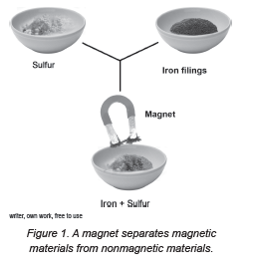
Different Methods of Separating Mixtures
2. Magnetic separation of a mixture of solids
A mixture of magnetic and nonmagnetic materials can be separated.

Slide 4
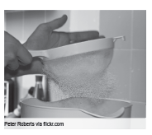
Different Methods of Separating Mixtures
3. Sieving
    it is a way of separating particles of varying sizes. A fine mesh screen or sieve can be used, depending on the components that you want to separate.
Example:
Construction workers use a fine mesh screen to separate stones from sand in a load of gravel.
Removing lumps from the flour mixture.

Slide 5
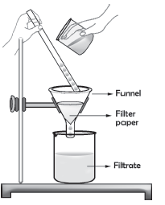
Different Methods of Separating Mixtures
4. Filtration
is a method used to separate a mixture of liquid and tiny particles of solid that have not been dissolved.
The solid particles that are left behind are called residue, while the liquid that passes through the filter paper is called the filtrate.

Slide 6
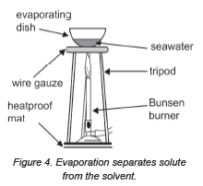
Different Methods of Separating Mixtures
5. Evaporation
is a technique used to separate the soluble solids from the solutions.
Example:
Salt making makes use of evaporation to separate salt from seawater.

Slide 7
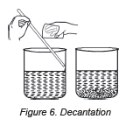
Different Methods of Separating Mixtures
6. Sedimentation
  is the process of settling down heavier components of the mixture. The settled components are the sediments.
Decantation
is the process of pouring the liquid out of the container without disturbing the sediment.
Example: oil and water mixture

Slide 8
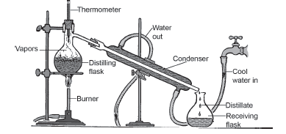
Different Methods of Separating Mixtures
7. Distillation
is a method that may be used to separate two liquids with different boiling points.
Example: separating alcohol and water

Slide 9
Different Methods of Separating Mixtures
8. Flotation
works for things that are less dense than another substance.
Example:
pencil shavings and water
rice bran and water

Slide 10
Different Methods of Separating Mixtures
Separating mixtures is important because most of the substances we use daily were once parts of mixtures that were separated so we can use them. The substance must be separated from the mixture so that it is in its usable form.

Slide 11
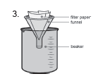


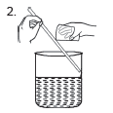
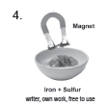
Different Methods of Separating Mixtures
Direction: Study each picture and identify the separation technique.

Slide 12
Different Methods of Separating Mixtures
Answer key:
1. sedimentation
2. decantation
3. filtration
4. magnetic separation
5. distillation

