Slide 1
The Parts of a Compound Light Microscope

Slide 2
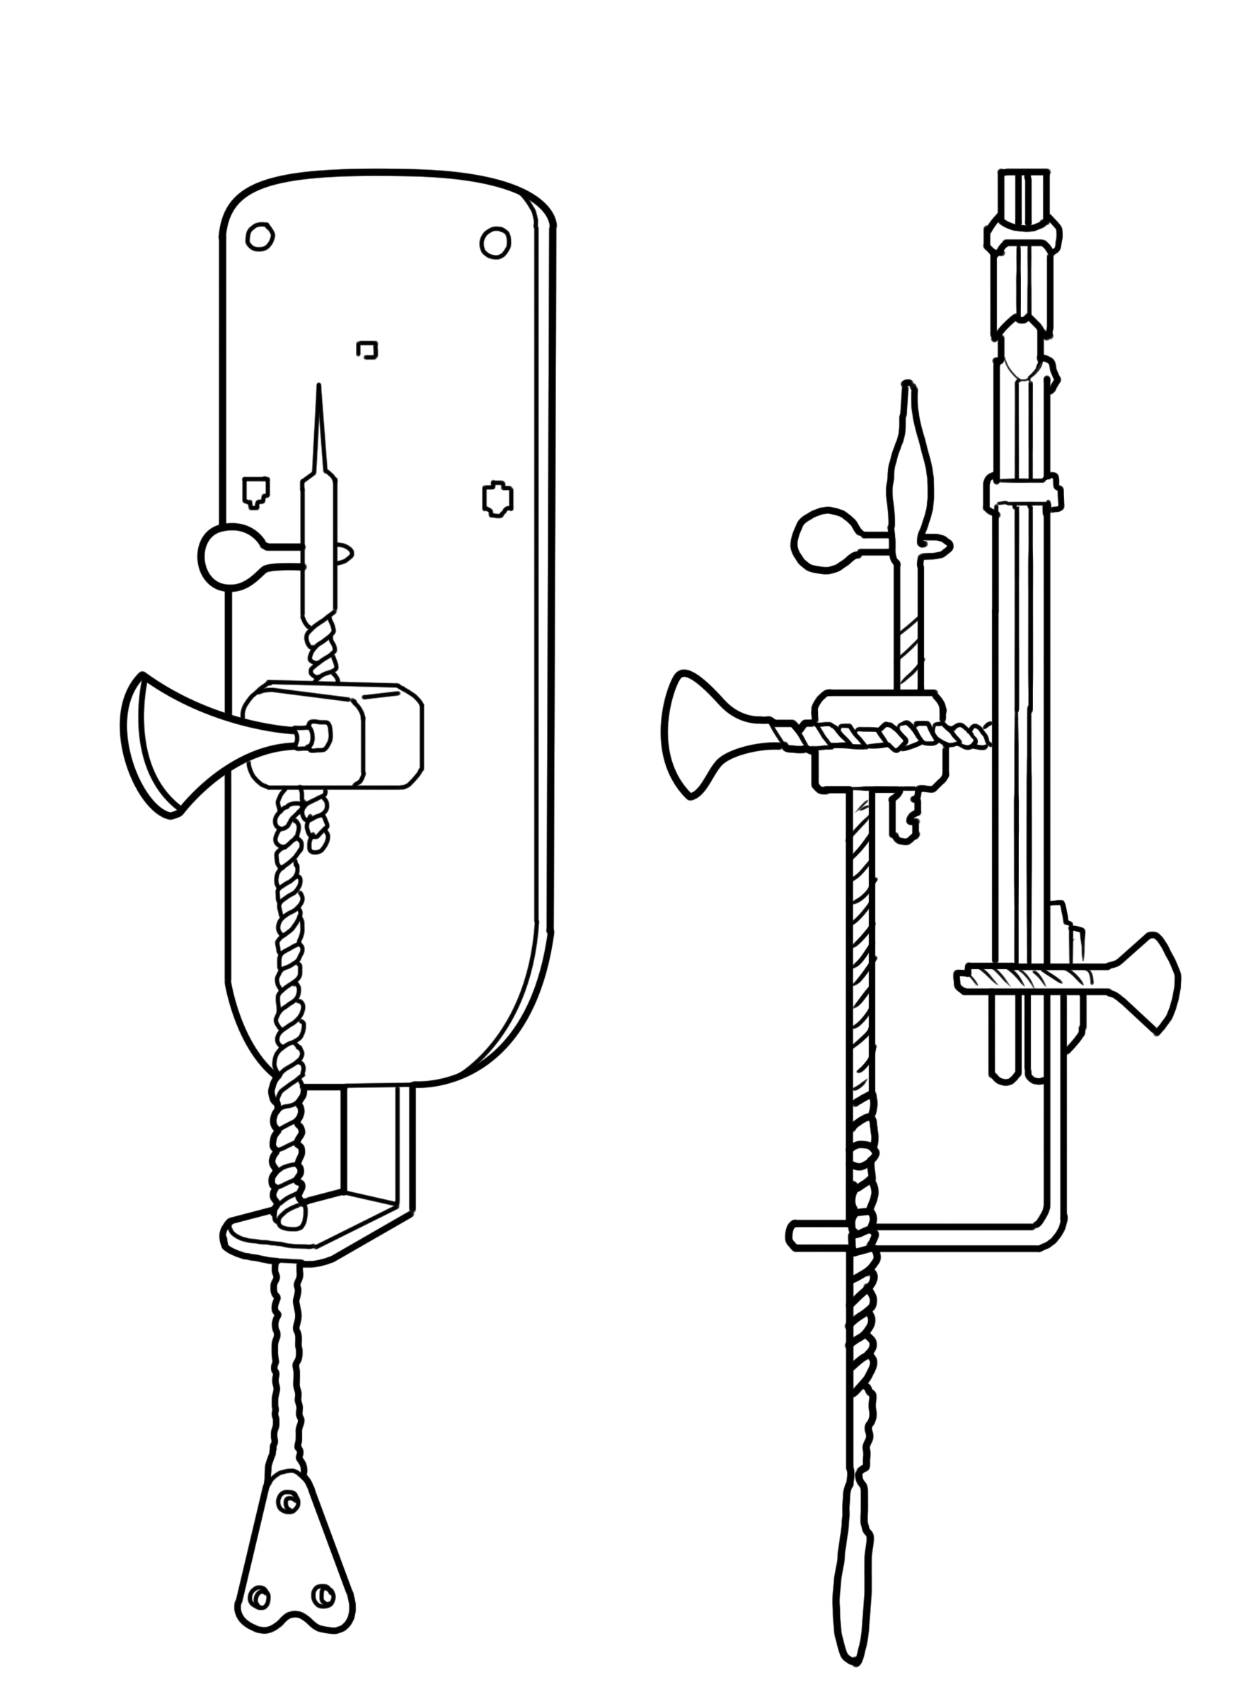
The Parts of a Compound Light Microscope
The microscope is an optical instrument that became popular when Anton Van Leeuwenhoek invented the first simple microscope. Simple because his microscope consists only of a single lens similar to a magnifying glass. Using this, Leeuwenhoek made several breakthroughs in the field of biology, which included his discovery of tiny living creatures in a drop of rainwater. Leeuwenhoek described these tiny living creatures as “animalcules.”
The compound light microscope (CLM) differs from a simple microscope because it consists of several lenses that can enlarge or magnify the image of an object or an organism several hundred times its actual size. The first compound microscope was invented by Zacharias Jansen in 1590.

Slide 3
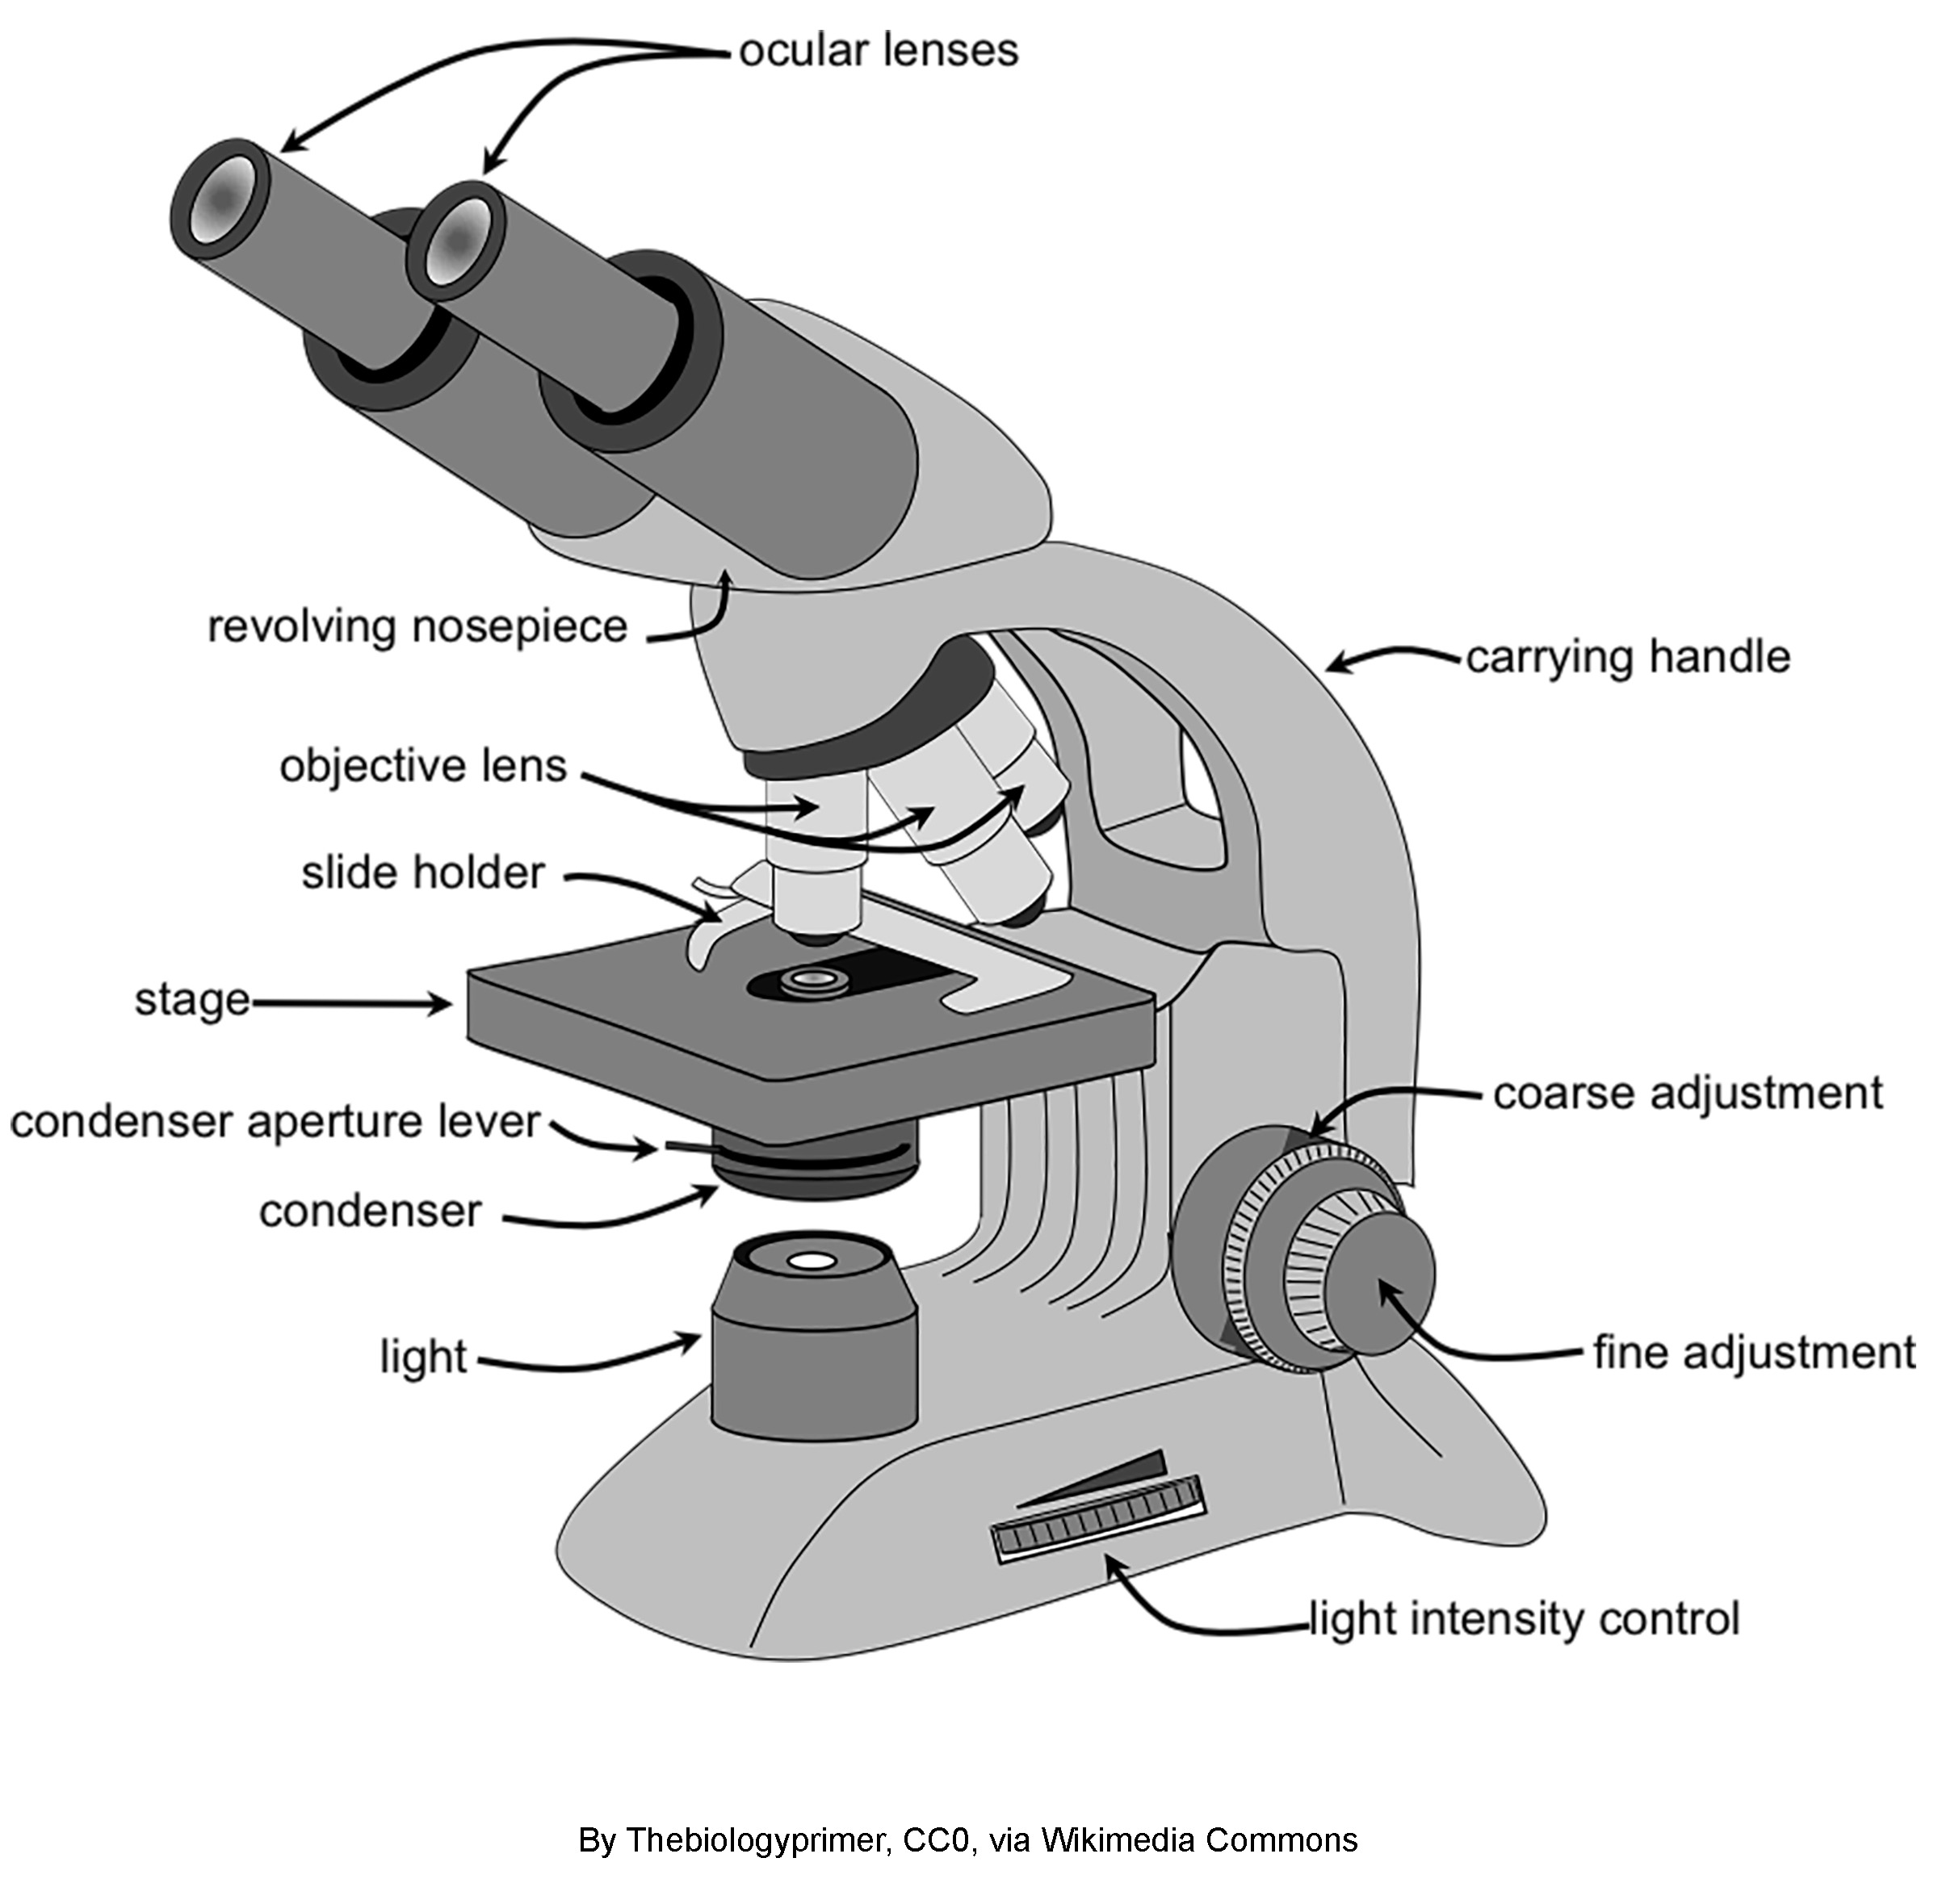
The Parts of a Compound Light Microscope
This CLM consists of parts clustered into three categories: the illuminating parts, the magnifying parts, and the mechanical parts.
The illuminating parts are the parts of the microscope that provide light so the specimen can be seen.
The magnifying parts are those that enlarge the specimen. These parts consist of lenses with varying magnifications.
The mechanical parts are the parts of the microscope that support, adjust, connect, and move other parts.

Slide 4
The Parts of a Compound Light Microscope
Parts of a Compound Light Microscope
Ocular or eyepiece is the part where the observer peeps through. The eyepiece has a lens whose magnification varies—10x or 12x.
Objectives are the most important magnifying parts of a microscope. Most compound microscopes have four objectives:
– Scanner has a magnification of 4x. The scanner enlarges the object/specimen to be observed and, at the same time, locates the position of the object/specimen.
– Low power objective (LPO) enlarges the object or specimen 10x.
– High power objective (HPO) enlarges the object 40x, 43x, or 45x.
– Oil immersion objective (OIO) enlarges the specimen 100x.
NOTE: Some microscopes do not have a scanner. In this case, the LPO also serves as the scanner.

Slide 5
The Parts of a Compound Light Microscope
Mirror reflects the light upward or the bulb that will serve as the artificial light source.
Condenser concentrates the light being reflected by the mirror.
Diaphragm (plate or iris diaphragm) regulates the amount of light being transmitted to the object/specimen.
Base is the part that supports the entire weight of the microscope.
Pillar connects the base and the body of the microscope.
Arm supports the body tube and the part that is held when carrying the microscope from one place to another.
Stage is the square-shaped part where the specimen is placed for observation. It has a pair of metallic clips. The hole at the center of the stage is called the aperture.
Stage clips hold the slide being observed firmly in place.
Inclination joint tilts the microscope to fit to eye level.
Draw tube holds the ocular or eyepiece.
Body tube connects the lenses of the objectives and the ocular.

Slide 6
The Parts of a Compound Light Microscope
Adjustment knobs consist of large and small screws that move the microscope up and down to bring the lenses in the ocular and objectives at a proper working distance to each other. Working distance means the distance between the slide and the objective lens that allows for the specimen to be in focus.
– Coarse adjustment knob is the large knob that moves the body tube faster to focus the specimen.
– Fine adjustment knob is the smaller knob that is used to get a sharp focus of the specimen being viewed.
• Revolving nosepiece is a rotating disc that holds the different objectives and allows for the shifting from one objective to the next.
• Dust shield protects the lenses in the objectives from dust.

Slide 7
The Parts of a Compound Light Microscope
Activity
Directions: Match each part of a CLM in column I with its function in column II. Write the letter of your answer in the space provided before the number.
I
II
____1. stage A. supports the entire weight of the microscope
____2. diaphragm B. hold the slide firmly in place
____3. mirror C. move the body tube up and down
____4. nosepiece D. where the specimen is placed for viewing
____5. high power objective E. concentrates the light being reflected upward
____6. ocular/eyepiece F. regulates the amount of light passing through
____7. base G. a rotating disc that holds the objectives
____8. adjustment knobs H. reflects the light upward
____9. condenser I. where the observer peeps through.
____10. stage clips J. enlarges the specimen 40x, 43x, or 45x

Slide 8
The Parts of a Compound Light Microscope
Answer Key
I
II
____1. stage A. supports the entire weight of the microscope
____2. diaphragm B. hold the slide firmly in place
____3. mirror C. move the body tube up and down
____4. nosepiece D. where the specimen is placed for viewing
____5. high power objective E. concentrates the light being reflected upward
____6. ocular/eyepiece F. regulates the amount of light passing through
____7. base G. a rotating disc that holds the objectives
____8. adjustment knobs H. reflects the light upward
____9. condenser I. where the observer peeps through.
____10. stage clips J. enlarges the specimen 40x, 43x, or 45x
D
F
H
G
J
I
A
C
E
B

