Slide 1
Asexual Reproduction

Slide 2
Asexual Reproduction
Asexual reproduction is a mode of reproduction that involves only one parent. That parent produces one or more new offspring. Since all the characteristics come from one parent, all offspring are identical copies of the parent.
Asexual reproduction has five main kinds:
■
Fission Budding Fragmentation Regeneration
Parthenogenesis
■
■
■
■
WWW.REX.COM.PH

Slide 3
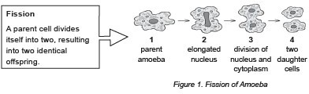
Asexual Reproduction
Fission
Fission makes one or more new offspring out of the parent. The new organism can remain attached to the parent, or it can break away. This is a simple process. Usually, a cell just needs to grow twice its previous size and then split into two. An example of an organism that reproduces through fission is the amoeba. Amoebas have bodies consisting of a single cell. When observed through a microscope, the amoeba looks like a tiny splash of colorless jelly with a dark speck inside it. Note that amoebas are considered animal-like organisms, but they are not actual animals due to their single-celled bodies.
WWW.REX.COM.PH

Slide 4
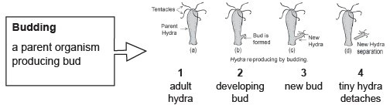
Asexual Reproduction
Budding
This type of asexual reproduction is where the new offspring grows out of the body of the parent. Here, the offspring starts growing as a small body on one side of the parent organism. The young organism continues to grow in size while still attached to the parent.
It remains attached until it matures. After maturation, it detaches itself from its parent and lives as an independent organism. This form of reproduction is common among hydras.
Hydra is a freshwater organism related to jellyfish.
WWW.REX.COM.PH

Slide 5
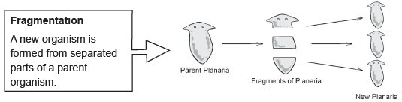
Asexual Reproduction
Fragmentation
In fragmentation, the parent breaks into pieces, and each piece forms a new individual.
Planarians are an example of an animal that reproduces through fragmentation.
Planarias are small aquatic flatworms. They are freshwater animals that move in a smooth wave-like manner. They are free living and can live in fresh water or very damp soil.
WWW.REX.COM.PH

Slide 6
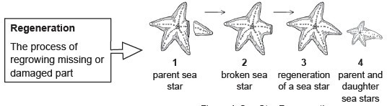
Asexual Reproduction
Regeneration
In regeneration, the animal loses a body part and can grow a replacement for that part.
If the lost body part has enough parts from the parent, it will grow into a whole new organism. An example of an animal that reproduces through regeneration is a sea star.
WWW.REX.COM.PH

Slide 7
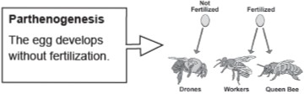
Asexual Reproduction
Parthenogenesis
This is a kind of asexual reproduction where the egg develops without fertilization. This process occurs in bees, wasps, ants, aphids, and many other insects.
WWW.REX.COM.PH

Slide 8
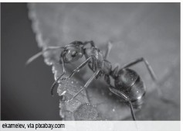
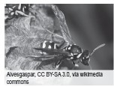
Asexual Reproduction
The fertilized eggs of bees, wasps, and ants will develop into females.
A female that reproduces using parthenogenesis does not need a partner. Her eggs develop into identical copies. The unfertilized eggs, however, result in male offspring.
Parthenogenesis has also been observed in a few vertebrates or animals with backbones. When the females are isolated from the males, animals like hammerhead sharks and Komodo dragons reproduce via parthenogenesis.
WWW.REX.COM.PH

Slide 9
Asexual Reproduction
Asexual reproduction in animals has advantages and disadvantages, as identified in the table below.
Advantages | Disadvantages
All the good traits of the organism are transferred to the offspring. | All negative traits will also pass on to the offspring.
The offspring are exact copies of the parent, keeping the lineage of the organisms intact. | Every animal looks the same.
The process requires less energy and less effort. | The organisms cannot adapt easily to changing environments.
Only one parent animal is needed to reproduce. | There is a huge competition for food and space among the organisms.
WWW.REX.COM.PH

Slide 10


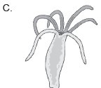


Asexual Reproduction
Directions.
Match the name of the organism in Column A with its corresponding picture in Column B.
Column A Column B
A.
B.
1. Sea star
2. Bee
C.
3. Ant
4. Hydra
D.
E.
5. Amoeba
WWW.REX.COM.PH

Slide 11
Asexual Reproduction
Answer Key:
1. E
2. B
3. D
4. C
5. E
WWW.REX.COM.PH

Slide 12


