Slide 1


Sexual Reproduction

Slide 2
Sexual Reproduction
Sexual reproduction requires cells from two parents. Just like in human reproduction,
it occurs when a new individual is formed by fertilization or the fusion of two sex cells or gametes. The female gamete is called an egg, while the male gamete is called sperm. The process produces a fertilized egg called a zygote. The zygote undergoes a process and grows into a new animal. As the fertilized egg grows, it is called an embryo. An embryo has traits from both its parents. It is not identical to either parent.
WWW.REX.COM.PH

Slide 3
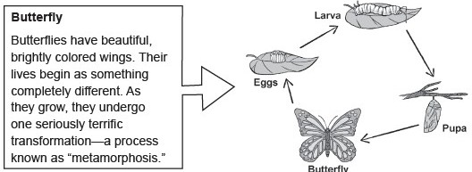
Sexual Reproduction
Examples of animals that reproduce sexually and their life cycle.
WWW.REX.COM.PH

Slide 4
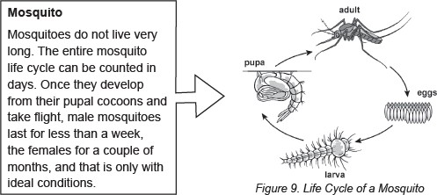
Sexual Reproduction
WWW.REX.COM.PH

Slide 5
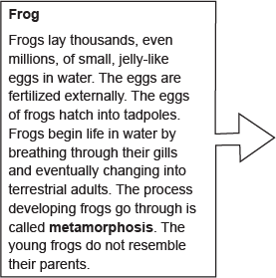
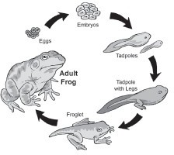
Sexual Reproduction
Metamorphosis refers to a change that an animal goes through as it grows older. The change must be significant or big—the animal changes from one form to a very different form.
WWW.REX.COM.PH

Slide 6
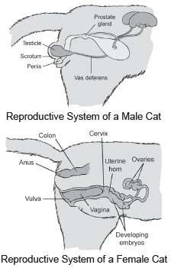
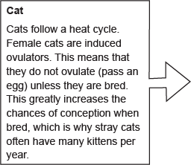
Sexual Reproduction
WWW.REX.COM.PH

Slide 7
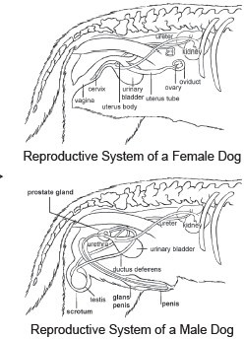
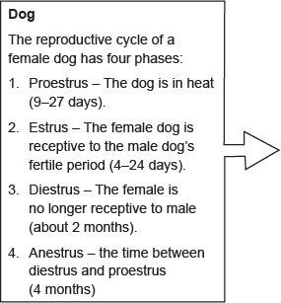
Sexual Reproduction
These reproductive organs work together to allow fertilization and produce offspring to provide for the continuity of animal existence.
WWW.REX.COM.PH

Slide 8
Sexual Reproduction
Two types of fertilization
Internal fertilization occurs inside the female’s body, with the male delivering the sperm into the female. Animals like pigs, dogs, cows, and birds undergo internal fertilization.
However, the female animal, at some point, must expel the growing young.
External fertilization takes place outside the female’s body. The eggs from the female animal and the sperm from the male animal are released into watery environments. Then, fertilization takes place there. Most aquatic animals, such as fish and frogs, reproduce through external fertilization. For animals with external fertilization, at an appropriate developmental stage, the eggs hatch, and the new young simply swim away.
WWW.REX.COM.PH

Slide 9
Sexual Reproduction
Examples of the modes of development after fertilization among animals
Viviparity
This could be observed in most mammals (animals with backbones and hair or fur and produce milk), such as cats, dogs, goats, and native animals like the tarsier and the tamaraw. This type of development occurs inside the mother’s body. The nutrients carried in the mother’s blood nourish the young, and the young are born alive. The newborns usually look like their parents. Some young animals can live independently, while some animals give parental care to their babies after birth.
WWW.REX.COM.PH

Slide 10
Sexual Reproduction
Oviparity
In oviparous animals, the development of the embryo occurs outside the mother’s body. The parent animals, such as chickens or turtles, lay eggs that contain the embryo. Then, the embryo gets nourished by the egg yolk until the egg hatches. Those that hatch from eggs like birds, fishes, reptiles, amphibians, insects, and spiders develop into young animals that look like their parents.
Ovoviviparity
In ovoviviparous animals, the development of an embryo occurs inside an egg within the mother’s body until it hatches. Some species of fish and reptiles reproduce this way. Guppies and garter snakes have eggs with shells that hatch as they are laid, making them look like they are born alive.
WWW.REX.COM.PH

Slide 11
Sexual Reproduction
Advantages and disadvantages of Sexual reproduction
Advantages | Disadvantages
It produces variation in the offspring . | Time and energy are needed to fi nd a mate.
The offspring can adapt to new environments due to variation. | Population growth is slow.
Disease is less likely to affect all the individuals in a population. | It requires a male and a female animal.
It makes the possibility of birth defects less. | The best qualities of the parent are not always inherited by the offspring.
WWW.REX.COM.PH

Slide 12
Sexual Reproduction
Directions: Complete the sentences below. Write your answer on the blank provided.
How does reproduction in animals vary?
The reproductive system of living things is designed for the (1) of more species of their own kind.
All animals reproduce to ensure the (2) of their species. Male and female reproductive organs are (3) in animals with a few differences
Each part of the reproductive system of animals plays an important role in the (4)
of the offspring.
The main reproductive organs in male animals are the (5) , which produce the male sex cells called sperm, and the sex hormones called (6) .
WWW.REX.COM.PH

Slide 13
Sexual Reproduction
Answer Key:
reproduction/production
existence/survival
the same/similar
reproduction/production
testes/testis/testicles
testosterone
WWW.REX.COM.PH

Slide 14


