Slide 1
Sexual Reproduction in Plants

Slide 2
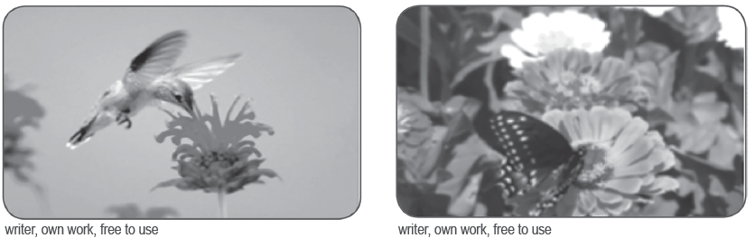
Sexual Reproduction in Plants
Flowering plants carry out sexual reproduction and can reproduce from seeds. Pollination, fertilization, seed formation, and germination are the processes involved in the life cycle of a flowering plant.
Most flowers have male and female parts. The male part is the stamen, which includes the anther. The anther makes pollen that has the male sex cells. The female part of a flower is the pistil, which includes the stigma, style, and ovary. The pistil makes the female sex cells or eggs. The ovary stores the eggs. To reproduce, flowering plants combine the male and female sex cells.

Slide 3
Sexual Reproduction in Plants
Plants need to get the pollen, which contains the male sex cells, to the pistil (carpel) of another flower. Pollination is the first step in the process of sexual reproduction in flowering plants. It occurs when pollen grains are transferred from the anther of one flower to the stigma of the same flower or another flower of the same kind. The brightly colored flowers depend on certain types of animals to transfer their pollen.
Pollinators are animals that carry pollen from one flower to another. For instance, bees suck up nectar, writer, own work, free to use which is a sugary liquid inside a flower. If the bees touch the anther, pollen sticks to their hairy bodies. When the bees transfer to the next flower, the pollen falls from the bees onto the stigma of the pistil. A gust of wind can also blow pollen from an anther to a pistil.

Slide 4
Sexual Reproduction in Plants
Types of Pollination
Pollination may occur in two ways: self-pollination and cross-pollination.
 | Self-pollination | Cross-pollination
Flowers that are involved | Pollen grains may be transferred from the anther to the stigma of the same flower or another flower of the same plant. | Pollen grains may be transferred from the anther of one flower to the stigma of another flower of another plant of the same kind.
Importance | Pollinators like insects, birds, or wind are not needed/essential. | Better quality of plants may form when the good qualities from the two-parent plants are combined.

Slide 5
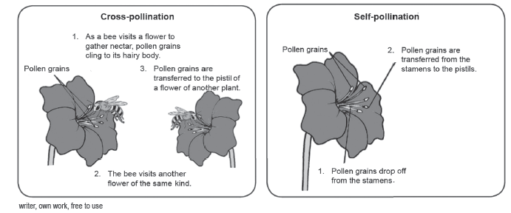
Sexual Reproduction in Plants
Many plants favor cross-pollination. It is a process whereby the pollen must be transferred to the stigma of another plant if sexual reproduction is to take place. It is where the flowers depend on their pollinators. Self-pollination occurs when the pollen is transferred from the anther to the stigmas of the same flower or the stigmas of another flower of the same plant.

Slide 6
Sexual Reproduction in Plants
Agents of Pollination
People may not be aware that one-third of all the food we eat depends on bees for pollination. Most of the animals that transfer pollen from flower to flower are insects. These flowers are called insect-pollinated flowers. The insects are attracted to the color and scent of the flowers. The flowers provide food for the insects, which visit them. At the base of the petals, there are sacks, which contain a sugary substance called nectar.
There are flowers that are small and not easily seen since they do not need to attract insects and other animal pollinators. They do not produce nectar and have no scent. Most trees and grasses have wind-pollinated flowers.

Slide 7
Sexual Reproduction in Plants
Indicators/ Conditions | Wind Pollination | Insect Pollination
Structures of Flowers | 1. small, dull-colored, and without scent | 1. big, brightly colored, fragrant to attract insects
 | 2. Anthers are hanging out of the flowers, making it easy for pollen grains to be shaken free and carried away. | 2. have anthers that are kept intact inside the flower
 | 3. large and feathery stigma that enables them to catch pollen grains being blown | 3. have sticky stigma that can catch pollen grains
How Flowers Are Pollinated | 4. As filament sways when the wind blows, pollen grains are shaken free. | 4. Pollen grains stick to the insect’s hairy body as it visits the flower to gather nectar.
 | 5. As the wind blows, pollen grains could land on the stigma of another flower. | 5. Pollen grains are transferred to the stigma of the same or another flower that insects visit.
Examples of Plants | 6. corn, rice, pine, grass | 6. sunflower, santan, fruit-bearing trees

Slide 8
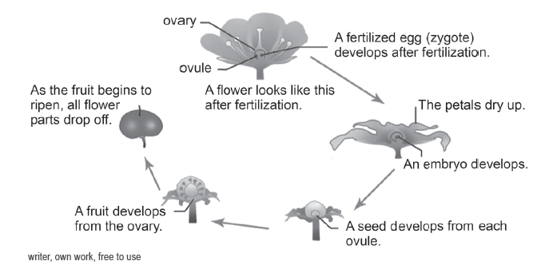
Sexual Reproduction in Plants
When all the ovules have been fertilized, the rest of the flower parts also change. After fertilization, most of the flower parts, like the petals, sepals, style, and stigma, usually wither and fall off, except the ovary, since there is no need for them anymore. The fertilized ovules develop into seeds. The ovary enlarges and gradually becomes the fruit. It is for this reason that the fruit is sometimes referred to as the enlarged ovary.

Slide 9
Sexual Reproduction in Plants
Germination of Seeds
It is not enough that flowering plants can produce fruits and seeds and are dispersed. There must be some favorable conditions present for the seeds to germinate. The right temperature, enough water, and good soil are needed so that seeds may germinate and grow. To germinate means to start to grow.
Stages of Seed Germination
In the beginning stage, the seed takes up water quickly, which results in puffiness and softening of the seed coat. This stage is referred to as imbibition. It starts the growth process by activating the enzymes. The seed activates its internal composition and starts to breathe, produce proteins, and absorbs the stored food. This is a delayed phase of seed germination.

Slide 10
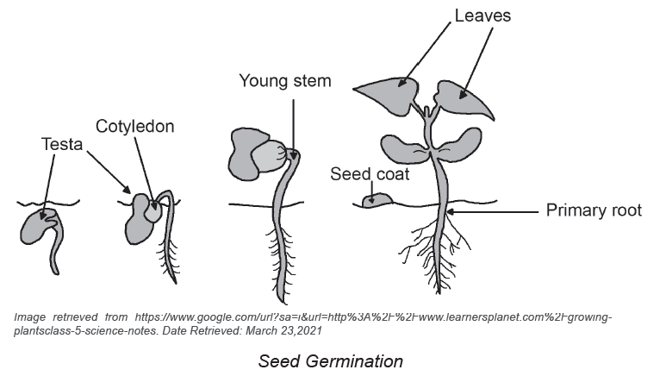
Sexual Reproduction in Plants
  By rupturing the seed coat, the radicle emerges to form a primary root. The seed starts absorbing underground water. Shortly, the radicle and the plumule shoot start growing upward.
  In the final stage of seed germination, seeds divide to give rise to the seedling.

Slide 11
Sexual Reproduction in Plants
Conditions Necessary for Seed Germination
Water: Seeds are extremely dry and need to take a large amount of water. Water helps by providing necessary hydration for the growing embryo.
Oxygen: It is an essential source of energy required for seed growth. Oxygen can be found in the pores of soil particles.
Temperature: For a seed to germinate, it requires a moderate temperature of
around 25–30°C. Some seeds need lower or higher temperatures between 5°C and 40°C.
Light: This can act as an environmental trigger. Many seeds do not germinate
until sunlight falls on them.

Slide 12
Sexual Reproduction in Plants
Activity
Directions: Help the bee navigate the reproduction process in flowering plants. Arrange the events in the correct order. Write numbers 1–6 in the correct box.
Seed is dispersed
to a new location.
Plant grows and
eventually bears
flowers.
A bee visits the
flower and its
body rubs off on
pollen.
Enough moisture,
air, and water are
available. The
seed germinates.
The bee visits
another flower,
and the pollen
transfers to the
stigma.
The flower dies,
and the seed pod
develops. Some
plants develop a
fruit with seeds.

Slide 13
Sexual Reproduction in Plants
Answer Key
Seed is dispersed
to a new location.
Plant grows and
eventually bears
flowers.
A bee visits the
flower and its
body rubs off on
pollen.
1
3
4
Enough moisture,
air, and water are
available. The
seed germinates.
The bee visits
another flower,
and the pollen
transfers to the
stigma.
The flower dies,
and the seed pod
develops. Some
plants develop a
fruit with seeds.
2
5
6

