Slide 1
Asexual Reproduction in Plants

Slide 2
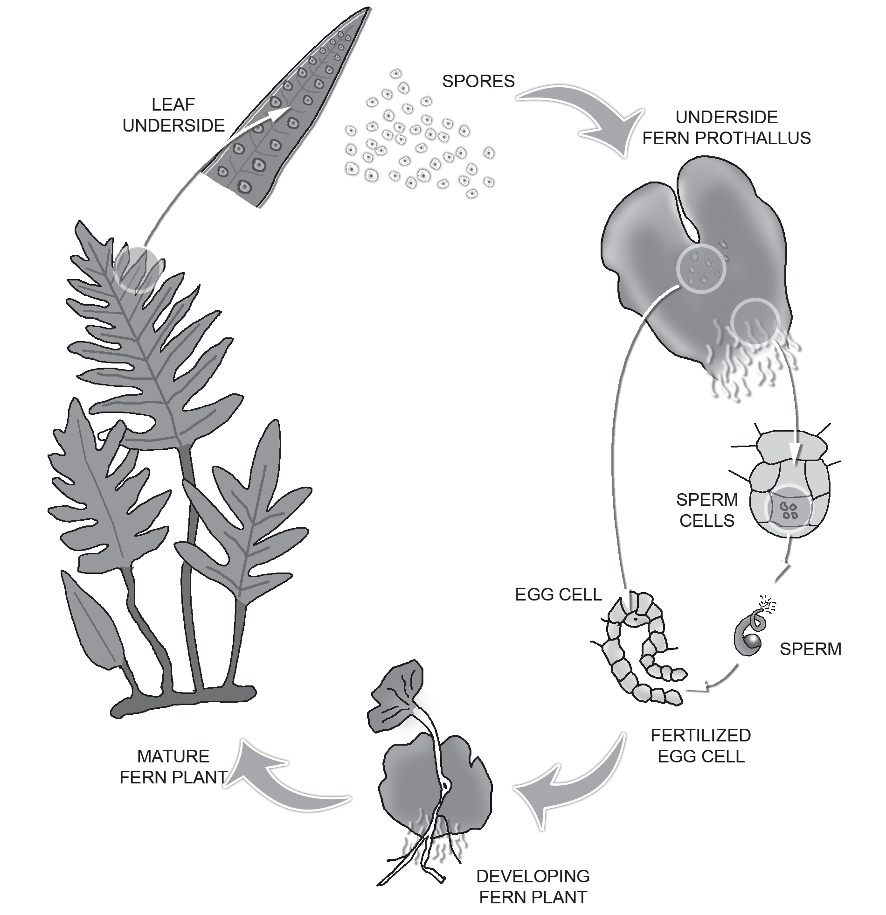
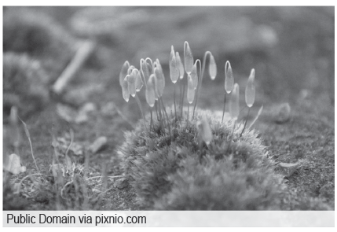
Asexual Reproduction in Plants
Mosses and ferns reproduce by asexual reproduction through the process called spore formation. Spores are asexual reproductive bodies. Each spore is protected by a hard covering to withstand unfavorable conditions, such as the high temperature and low humidity. With favorable conditions, a spore germinates and develops into a new plant.
In spore formation, the parent plant produces hundreds of reproductive units called spores packed in a spore case. When the spore case of the plant bursts, these spores travel in the air and land on food or soil. Here, they germinate and produce new plants.

Slide 3
Asexual Reproduction in Plants
There are special methods to reproduce certain plants without seeds. It is called vegetative propagation. In this method of reproduction, some plants can grow new plants from their vegetative parts, such as stems, roots, and leaves. It is advantageous because the plants do not have to rely on insects, birds, and wind for pollination and seed dispersal to happen. It ensures the passing of desirable qualities of the old plants to the young plants. This kind of reproduction has two kinds: natural vegetative propagation and artificial vegetative propagation.
Natural Vegetative Propagation
In natural vegetative reproduction, plants reproduce from their plant parts, such as stems, underground stems, leaves, and roots.
Cuttings are plants that grow by stem cuttings from mature stems of the parent plant. When stem cuttings are planted, roots develop on them, giving rise to new plants. Examples of these plants are sugarcane, cassava, santan, gumamela, bougainvillea, rose, sampaguita, fortune plant, and other ornamental plants in the garden.

Slide 4
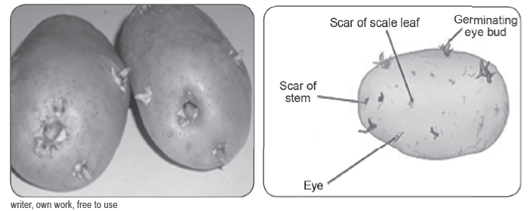
Asexual Reproduction in Plants
Some plants grow from the specialized fleshy part that grows as the underground stem. Here are some means by which new plants grow from vegetative parts.
Tubers are underground stems swollen with stored food. Potato is an example of a tuber. In potatoes, the “eyes” or buds grow into roots and shoot to produce a new Moss plants: Asexual reproduction plant. If a potato is cut into pieces, each piece that contains an eye can be planted and will grow into a new potato plant.

Slide 5
Asexual Reproduction in Plants
Bulbs are specialized underground stems swollen with fleshy leaf bases. Lilies, garlic, and onions grow from bulbs.
Rhizomes are thick and fleshy creeping stems that grow either above or just below the surface of the ground. Crabgrass and ginger grow from rhizomes.
Stolon is a creeping plant stem that can grow a stem and several rootlets. Spider plants, crabgrass, and native violets are examples of plants that grow from stolons.

Slide 6
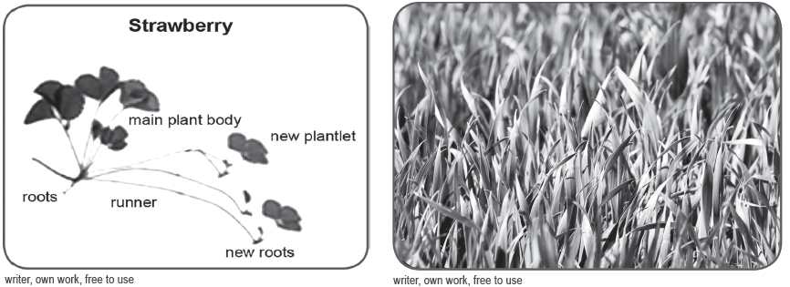
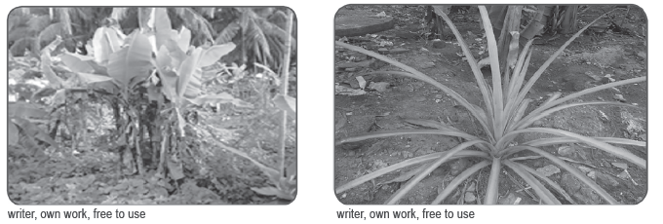
Asexual Reproduction in Plants
Runners are specialized stolons with stems that run along the surface of the ground. When these stolons touch the ground, they produce roots and, eventually, develop new plants. Examples of these are strawberries, ivy, and lawn grasses.
Suckers are upright shoots that grow from buds found at the base of stems of parent plants. The banana, bamboo, pineapple, and bird of paradise are some examples of plants that can reproduce from suckers.

Slide 7
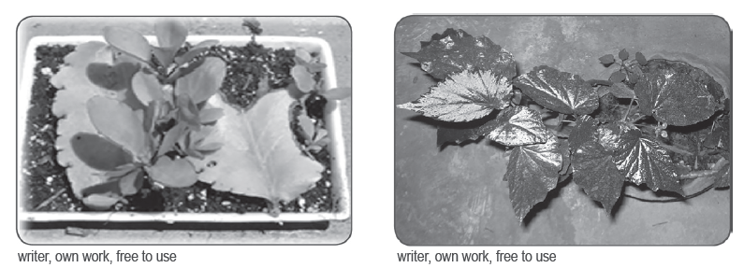
Asexual Reproduction in Plants
Leaves of katakataka, begonia, and African violet are thick and fleshy. Usually, there are buds found on the edge of the leaf. When the leaves fall off from the mature plant, the buds grow and develop into new plants. It is amazing to look at the new plants growing along the edge of the mature katakataka plant and a new plant growing from the cut leaf of begonia that is planted on the ground.

Slide 8
Asexual Reproduction in Plants
Artificial Vegetative Propagation
Artificial vegetative propagation is also called cloning. Vegetative propagation produces the next generation that is genetically identical to the parent. Such an organism that is genetically identical to the parent is called a clone. In the case of plants with advantageous characteristics, the characteristics can be preserved by producing clones. This is particularly useful to agriculturists and horticulturists to get the best crop and uniform yield every time.
There are various ways of carrying out artificial propagation of plants. Some traditional methods used in artificial vegetative reproduction are cuttings, grafting, marcotting, layering, and budding. Tissue culture is a method that is a product of recent technology.
Some seed plants and other ornamental plants can grow new varieties through artificial vegetative reproduction.
FACTS:
Have you ever heard of the coconut variety known as macapuno?
Macapuno is the product of cloning a coconut tree produced by a Filipino
scientist, Emerita de
Guzman, Ph.D.

Slide 9
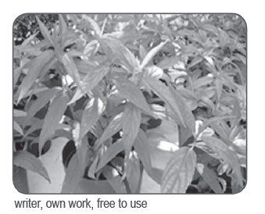
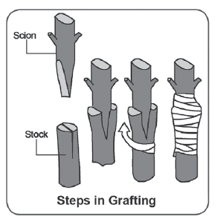
Asexual Reproduction in Plants
Cuttings
Any part of a plant, such as a stem, leaf, or root that has been removed from a plant to produce new plants is called cutting. There are three kinds of cuttings : leaf cutting, stem cutting, and root cutting.Cutting is the most used method in producing new plants. Vegetables and ornamental plants are usually propagated through cuttings. Stem cuttings from the parent plant can be directly planted in good soil or grow roots in a container filled with water and later transplanted in the soil.
Grafting
Grafting is the most widely used artificial method of propagating plants. It is done by cutting a stem from one plant and attaching it to the stump of another plant. Usually, the portion of the stem cut from a tree has many buds. This is called the scion. The stump to which the scion is inserted is called the stock. Santol, mango, lanzones, calamansi, pomelo, and some ornamental plants are propagated through this method.

Slide 10
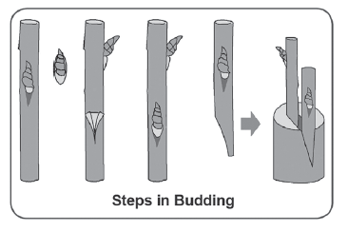
Asexual Reproduction in Plants
Budding
This method is done by making a “T”-shaped cut in the stem of the parent plant. Then a scion, a mature bud cut from another plant, is inserted underneath the bark of the parent plant that serves as the stock. The scion must be bound securely to the stock. When the bud grows, it is cut from the parent plant and planted in a new location. Fruit-bearing trees like mango and santol may be propagated by budding.
Marcotting
This method can be used to propagate any woody plant. It is the method preferred for plants that have difficulty growing roots and used to make new plants just in case the plant is already old. A classic example is the chico.

Slide 11
Asexual Reproduction in Plants
Marcotting is done through these steps:
Remove a portion of the bark of a chosen healthy stem of any woody plant.
Wrap the cut bark with good soil using the husk and plastic held tightly in place with tape or string. The role of the soil is to provide moist, favorable conditions so that roots will start growing.
Wrap with aluminum foil to give shade to the branch being marcotted and to ensure that moisture is not lost in the process.
Water the branch regularly until roots grow from the cut.
When the roots become mature, cut the rooted branch, and plant it in a new location.

Slide 12
Asexual Reproduction in Plants
Layering
Layering encourages new roots to form on branches still attached to the parent plant. The parent supplies the layer, that is the new plant, with water and nutrients to enable the roots to grow.
Layering is done by following these steps:
1. Choose a young, healthy shoot growing low on the plant to be layered.
2. Using a shovel, loosen the soil and dig a shallow hole where the shoot or layer will be buried.
3. Bury the shoot or layer in the hole. Cover the hole with soil. Place a rock on top to hold the layer in place.
4. Keep the soil damp during the process to ensure that there is moisture for the layer.
5. When roots have grown on the buried stem, cut it from the parent plant and transfer it to a new location.

Slide 13
Asexual Reproduction in Plants
Activity
Directions: Identify the method of vegetative plant propagation being described in each sentence. Choose from the options inside the box.
Grafting Runners
Bulbs
Rhizomes Cutting
_____1. A specialized stolons with stems that run along the surface of the ground.
_____2. The most used method in producing new plants.
_____3. Is a specialized underground stems swollen with fleshy leaf bases. Artificial Vegetative Propagation
_____4. The most widely used artificial method of propagating plants.
_____5. Thick and fleshy creeping stems that grow either above or just below the surface of the ground.

Slide 14
Asexual Reproduction in Plants
Answer Key
1. Runners
2. Cutting
3. Bulbs
4. Grafting
5. Rhizomes

