Slide 1
Asexual and Sexual Reproduction

Slide 2
Asexual and Sexual Reproduction
Reproduction is the process of creating new organisms from existing individuals. This is the basis of heredity and the process that enables species to perpetuate and thrive.
Sexual Reproduction
An organism exists as the result of reproduction. There is a wide range of reproductive methods employed by different species to perpetuate themselves. These reproductive methods are broadly grouped into two distinct types: sexual and asexual reproduction. Sexual reproduction is a process that involves the union of sex cells or gametes. The gametes come from two parents of opposite sexes the male that produces the sperm (male gamete) and the female that produces the egg cell or ovum (female gamete). In humans, the sperm is relatively motile and has a flagellum. On the other hand, the ovum is nonmotile and relatively large in comparison to the male gamete. Gametes or sex cells are produced by a type of Cell division called meiosis.

Slide 3
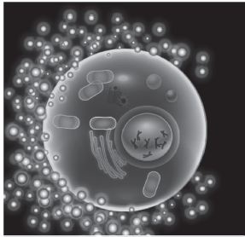
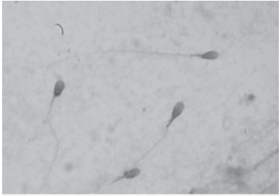
Asexual and Sexual Reproduction
KDS444, CC BY-SA 3.0, via Wikimedia Commons
Bobjgalindo, CC BY-SA 4.0, via Wikimedia Commons
Human Egg Cell
Sperm Cell
The chromosomes are tightly packed in the nucleus of a cell. Humans have 46 chromosomes. Half of these chromosomes (23) are donated by the father, and the other half is donated by the mother. Hence, humans have a diploid (2N) number of chromosomes or two sets of homologous chromosomes. The chromosomes contain the genes that determine the hereditary characteristics.

Slide 4
Asexual and Sexual Reproduction
Process of Fertilization
Fertilization is the union of the male and female gametes to produce a fertilized egg called a zygote. It is considered the defining process in sexual reproduction. There are two mechanisms by which fertilization can take place: external and internal fertilization. In external fertilization, a watery or moist environment is needed so the gametes will not dry out. Both the male and the female cluster into the same area to simultaneously release their gametes into the surrounding. This process is called spawning. Sometimes, the process is initiated by the release of a chemical by a mate, and this stimulates other mates to release
their gametes. Amphibians , like frogs and toads, and fi shes are examples of animals that exhibit external fertilization.

Slide 5
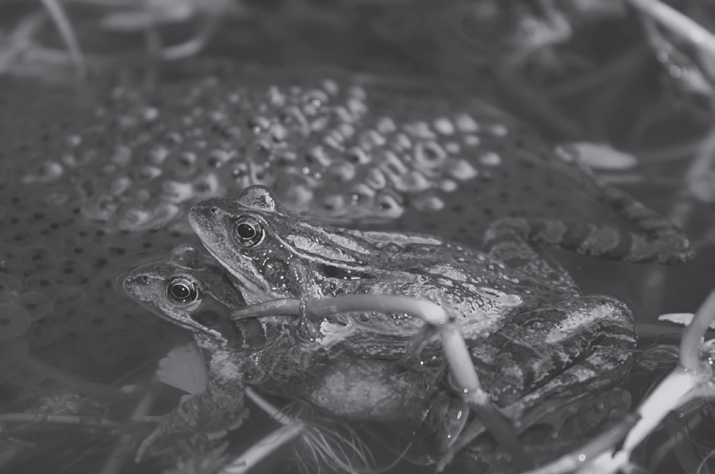
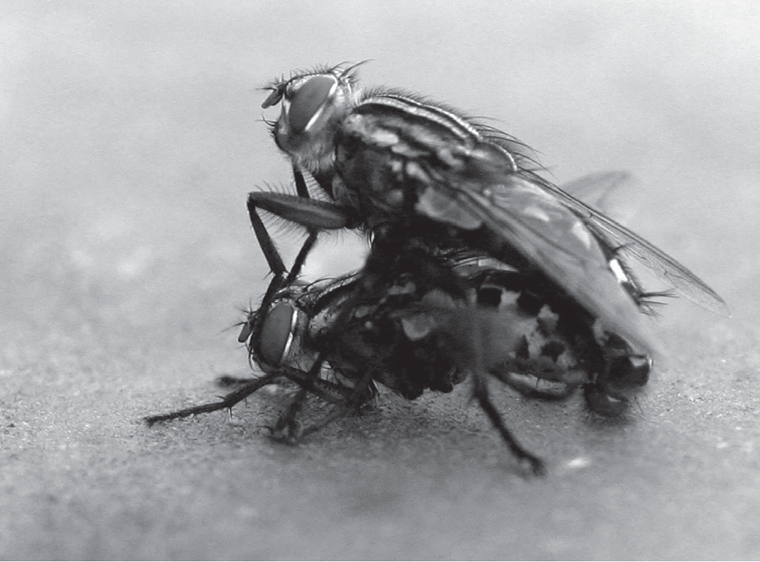
Asexual and Sexual Reproduction
External fertilization is advantageous since it results in the production of a large number of offspring. The disadvantage is that exposure to environmental hazards greatly reduces the chance of the zygote to survive and reach adulthood. The frogs in the picture exhibit external fertilization and external development. The female lays its egg in a suitable place. Then, the male fertilizes the egg, and the zygotes undergo development on their own.
Thomas Brown, CC BY 2.0, via Wikimedia Commons
De-okin (talk) 19:09, 27 August 2008 (UTC), CC BY-SA 3.0, via Wikimedia Commons
Spawning Frogs
Mating Hoverflies

Slide 6
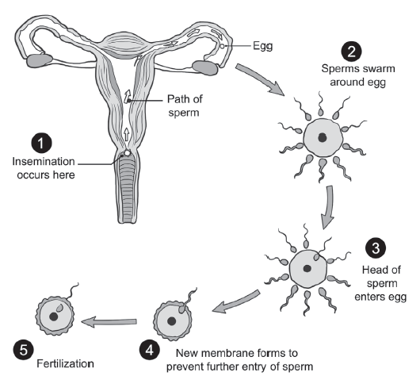
Asexual and Sexual Reproduction
In internal fertilization, the egg is fertilized within the female reproductive tract in a process called copulation (also called sexual intercourse or mating). Development of the fertilized egg or zygote happens in many different ways. The hoverflies exhibit internal fertilization and external development. The zygote becomes enclosed in a structure called egg. The eggs are laid, and the zygote develops outside the mother’s womb.
Events in the Process of Fertilization in theHuman Female

Slide 7
Asexual and Sexual Reproduction
Mammals, including humans, exhibit internal fertilization and internal development. The sperm is introduced and left within the female reproductive tract. The offspring develops inside the mother’s womb and is born alive. Internal development is a protective mechanism. It ensures and increases the chances of the zygote’s survival since the mother supplies everything that the zygote needs for its development. Picture above shows the events in the process of fertilization in a Human Female.
During fertilization, the haploid sperm and the haploid egg unite. The zygote that is formed is a diploid organism , just like its parents. Thus, the offspring produced by this union will have the characteristics of both parents, but they will not be identical to either of them.

Slide 8
Asexual and Sexual Reproduction
Asexual Reproduction
Asexual reproduction does not involve the union of gametes. It is a method wherein an individual produces offspring without the involvement of another individual of the same species. The offspring produced asexually are genetically similar or exact copies of the parents (clones). Asexual reproduction is the primary method of reproduction exhibited by unicellular organisms, such as bacteria and archaea (prokaryotes), animal-like protists and yeasts, and some invertebrates. Methods of asexual reproduction include budding, binary fission, fragmentation, spore formation, and parthenogenesis.

Slide 9
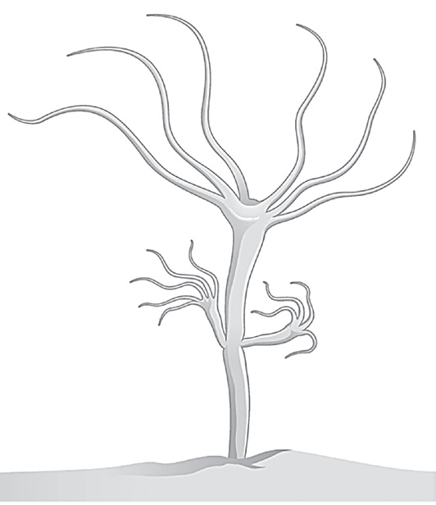
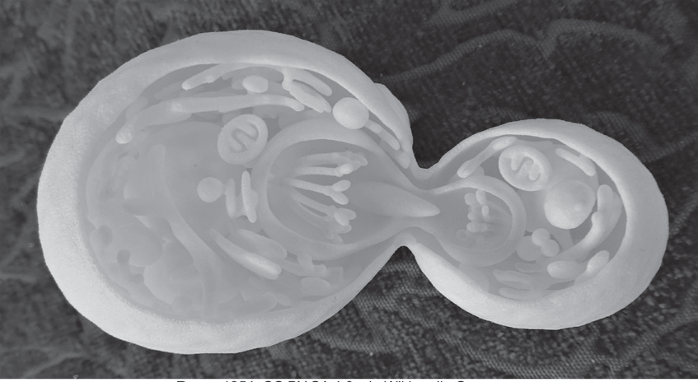
Asexual and Sexual Reproduction
Methods of Asexual Reproduction
Budding is a form of asexual reproduction in which a new organism develops from an outgrowth called bud that grows in a specific site in the body of a matured or older species. Buds develop due to repeated cell division. Buds form if the food is abundant in the area where the organism lives. The new organism will only detach from the parent organism when it is mature and ready to live by itself. Budding is observed among yeast cells (Saccharomyces cerevisiae) and in multicellular animals like the Hydra.
Budding in Yeast
Budding in Hydra
CNX OpenStax, CC BY 4.0, via
Wikimedia Commons
Rosser1954, CC BY-SA 4.0, via Wikimedia Commons

Slide 10
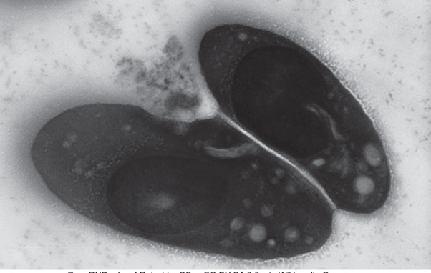
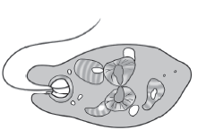
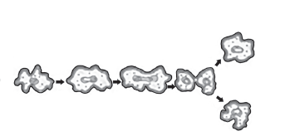
Asexual and Sexual Reproduction
Binary fission is the simplest form of asexual reproduction and is most commonly observed among single celled organisms. It involves the replication of the genetic material and the subsequent division or splitting of the cell into two genetically identical daughter cells. Binary fission may be transverse, wherein the cell divides across a short axis or longitudinal, in which the cell divides across a long axis or random (no axis involved).
Transverse Binary
Fission in Paramecium
Longitudinal Binary Fission in Euglena
Random Binary
Fission in Amoeba

Slide 11
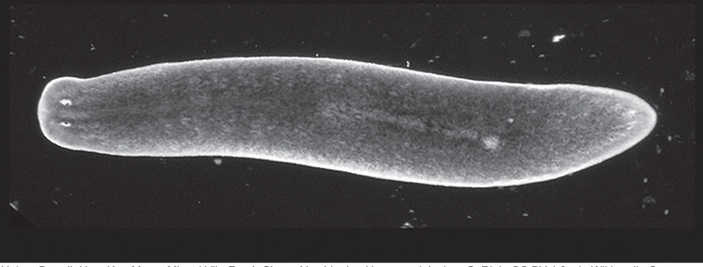
Asexual and Sexual Reproduction
Fragmentation is an asexual process that involves the development of new organisms from fragments of the parent organism. The body of Planaria (Dugesia sp.) is cut into different fragments, and each can develop into a new organism. Some animals have the self-cutting ability to escape predators. This is called autotomy.
Fragments of Planaria can develop into new organisms.
Holger Brandl, HongKee Moon, Miquel Vila-Farré, Shang-
Yun Liu, Ian Henry, and Jochen C. Rink, CC BY 4.0, via
Wikimedia Commons

Slide 12
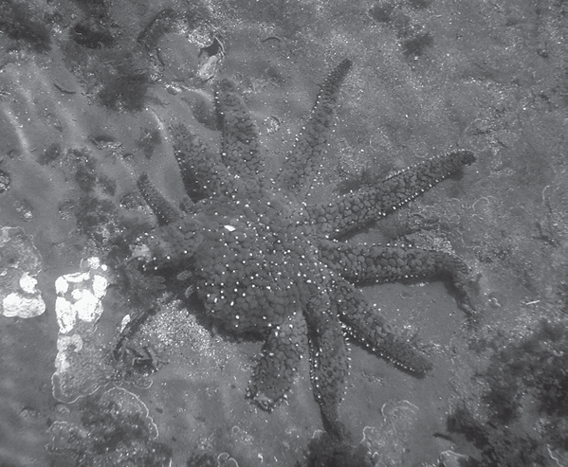
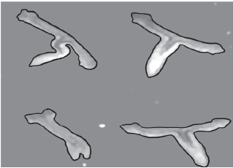
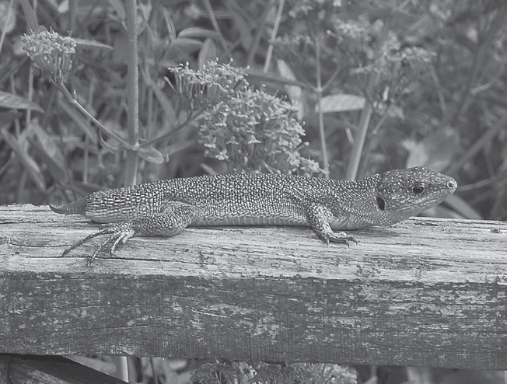
Asexual and Sexual Reproduction
Regeneration is the ability to replace any lost or missing part of the body. This is a process that takes place in organisms like starfish and lizards. The more complex the organism is, the more difficult the regeneration process can happen. The starfish fragments (autotomizes) its arms, which is an adaptation that serves as a means of escaping predators. New arms develop from the former self-cut parts.
A Starfish
Emerging from a Cut Part
Planaria Emerging from Cut Parts
A Lizard with a New
Emerging Tail

Slide 13
Asexual and Sexual Reproduction
Spore formation or sporulation. Spores are unicellular structures that are capable of germinating into an individual. They have resistant structures that are adapted for dispersal and survival for a long period when environmental conditions are unfavorable. They are formed in various ways and with quite different outcomes. Some multicellular plants, such as the ferns and mosses, exhibit a complex life cycle referred to as alternation of generation. Spore formation forms a part of their life cycles.

Slide 14
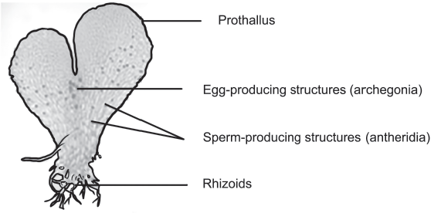
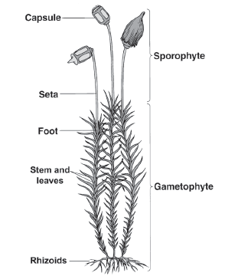
Asexual and Sexual Reproduction
In ferns, spores are haploid structures that grow and develop into a multicellular gameteproducing plant (gametophyte) called a prothallus. The union of the gametes gives rise to the development of the leafy, spore-producing (sporophyte) fern plant that is commonly seen.
The Prothallus of a Fern
In mosses, spores are haploid structures that grow and develop into haploid male and female moss plants that are gamete -producing (gametophytes). The archegonium is the female sex organ, while the antheridium is the male sex organ. Fertilization takes place in the presence of water. The union of the egg and sperm gives rise to the development of the diploid sporophyte, which is a slender stalk with a capsule that can produce haploid spores by meiosis.
The Moss Plant with the Sporophyte and Gametophyte Stages

Slide 15
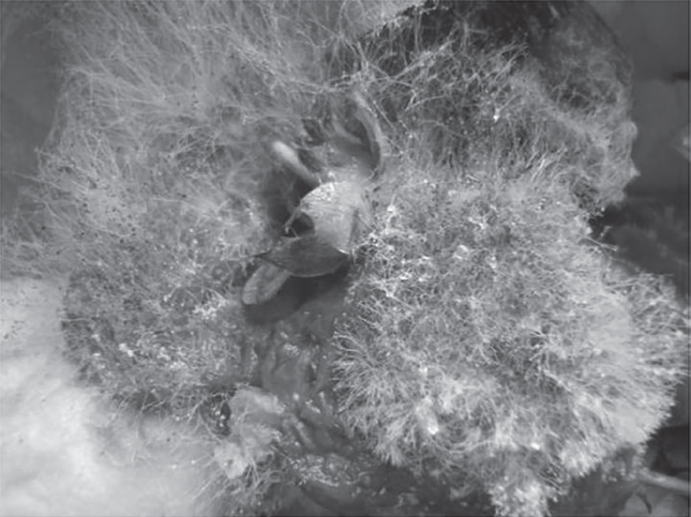
Asexual and Sexual Reproduction
Fungi form different kinds of spores. As a matter of fact, among fungi, any part of the body that can form into a new individual is called a spore. Spores can be formed sexually and asexually. Asexual spores are formed in two ways by fragmentation of the existing hyphae and by the development of a swelling (called sporangium) at the tip of a specialized hypha. Successive cell divisions within the sporangium give rise to numerous spores that can be dispersed, which later on will germinate into new organisms.
Eric McKenzie, CC BY 3.0 AU, via Wikimedia Commons
The fungus Rhizopus produces
spores at the tip of a specialized hypha.

Slide 16
Asexual and Sexual Reproduction
Natural Vegetative Propagation
Natural vegetative propagation is common among herbaceous and woody plants. It involves structural modifications of any plant parts that can contribute to the survival and expansion of the population of the plant species. The new plants that emerged by this method are clones of the original plant. Natural means of vegetative propagation include the following:
Runners/Stolons – slender prostrate branches with nodes and internodes that grow above the ground. The nodes develop roots and buds that grow into a new plant.
Examples of plants with stolons are strawberry and grass plants.
Suckers – new stems that grow from the root base of the existing plant. These new stems develop into new plants.
Examples of plants that propagate through suckers are bananas, dandelions, and rose plants.

Slide 17
Asexual and Sexual Reproduction
Tubers – swollen parts of an underground stem with pits or “eyes” where buds grow and develop into new plants.
  Examples are potato es and tubers that may also come from swollen roots (called root tubers), sweet potato, yam, carrot, and cassava.
Corms – short, vertical, underground stems with nodes and internodes where buds grow and develop into new plants.
Examples are taro, cocoyam, and arrowhead.
Rhizomes – long, horizontal underground stems with nodes and internodes. An
Example of a rhizome is ginger.

Slide 18
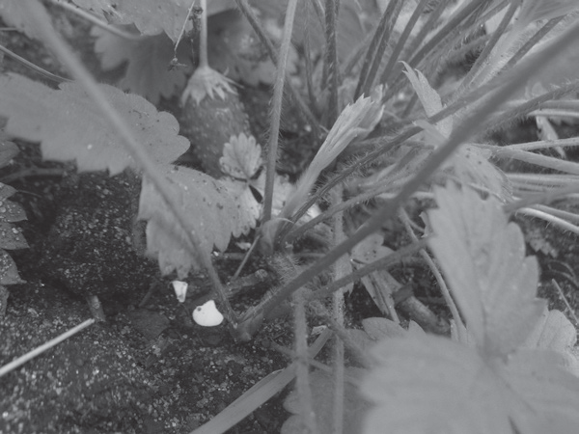
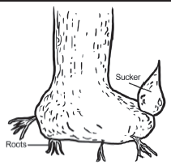
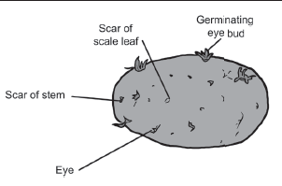
Asexual and Sexual Reproduction
Bulbs – short, underground stems with fleshy leaves (called scales) that store food.
Examples are tulip and onion.
Notches – structures found at the margins of some leaves where new tiny buds emerge. The buds develop into new plants that detach from the notch.
Examples are Begonia and B sryop shyllum.
Erutuon, CC BY-SA 2.0 via Flicker.com
Runners from
Strawberry
Sucker from
Banana Plant
Tubers
(Potato)

Slide 19
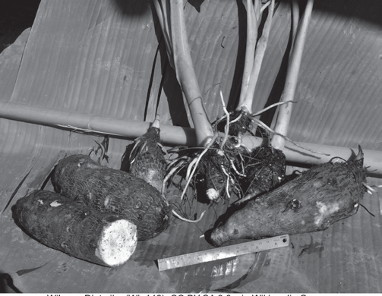
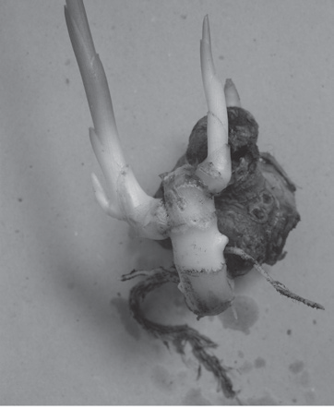
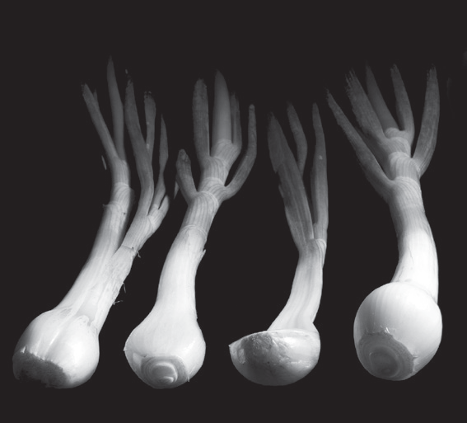
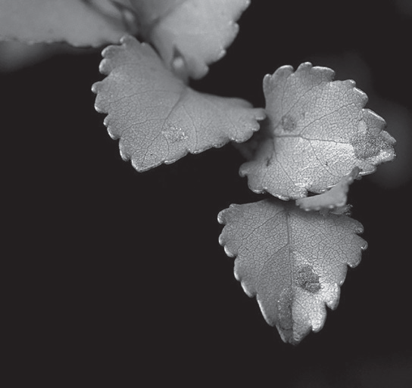
Asexual and Sexual Reproduction
Wibowo Djatmiko (Wie146), CC BY-SA 3.0, via Wikimedia Commons
Olli Salmela, (Dacnoh), CC BY-SA 3.0, via Wikimedia Commons
By 2happy, CC0 via stockvault.net
CC0 Public Domain via Pxhere.com
Corms (Taros)
Rhizomes (Ginger)
Bulbs (Onions)
Notches

Slide 20
Asexual and Sexual Reproduction
Artificial Vegetative Propagation
Aside from the natural method of vegetative propagation, artificial methods of propagation are also being done by horticulturists to produce plants that are identical to the parent plant. The following are some of the known methods:
Cutting is the simplest method of artificial vegetation. A part of the plant is cut off from the mother plant and placed in a new environment where it can grow into a new plant. Plant parts that are used may be matured shoots cut at an angle, stems containing nodes and internodes, underground stems (tubers, corms, and rhizomes) cut into small pieces, and cuttings from the leaves and roots. As these cut parts are placed in moist soil or immersed in water before being planted in the soil, they develop roots. Subsequently, new plants emerge that begin an independent existence.

Slide 21
Asexual and Sexual Reproduction
In layering, a shoot or branch from a parent plant is bent close to the ground enough to be covered with moist soil. After some time, the buried branch or shoot produces roots and develops into a new plant. This plant can then be separated and planted in another place.
Grafting is the most commonly used method of artificial propagation to improve the variety of fruits. It is a form of regeneration. In grafting, two plants are used to develop a new plant that contains the combined traits of the parent plants.

Slide 22
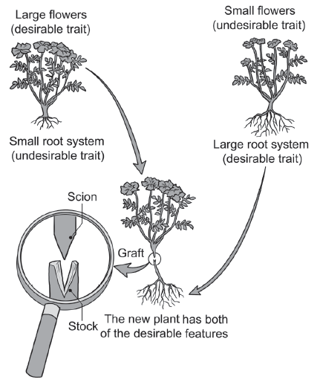
Asexual and Sexual Reproduction
One plant called scion with a desirable characteristic is cut and attached above the also cut stem of the second rooted plant called the stock with another desirable characteristic. Wax is applied to cover the part where the grafting is done to avoid infection. After some time, the two plants are joined as one plant. When the grafted plants produce flowers and seeds, the new plants that will be produced carry the characteristics of the two parents.
Steps in Grafting

Slide 23
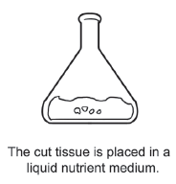
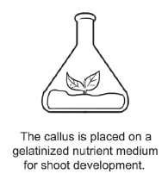
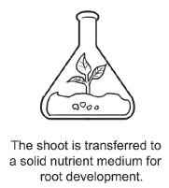
Asexual and Sexual Reproduction
In the tissue culture technique, a piece of plant part containing meristematic tissue (a tissue made up of actively dividing cells) of the desired plant is cut and sterilized. Then, the tissue is placed in a container with a suitable liquid nutrient medium. The nutrient medium stimulates the meristem cells to divide rapidly to form a mass of tissue called callus. The callus is then placed in another gelatinized nutrient medium and then exposed to light. The exposure to light and the components of the second medium initiate the growth of the shoot. When the shoot develops, it is removed and placed in another solid nutrient medium that would initiate the development of the roots. Finally, the newly developed plant is transferred to the soil.
Steps in Tissue Culture

Slide 24
Asexual and Sexual Reproduction
Sexual Reproduction vs. Asexual Reproduction
Reproduction
Asexual Reproduction
Sexual Reproduction
Organisms in isolation can increase their population even in the absence of a mate.
In the absence of variations, there is little chance for the offspring to quickly adapt to changing environments that can cause their extinction.
When the environmental conditions are favorable, meaning, there is an adequate food supply, conductive and adequate shelter, favorable climate, etc., organisms use the asexual method so their populations grow exponentially so as to exploit the resources and conditions important for their survival
Organisms that reproduce sexually produce a smaller number of offspring, and the entire reproductive process tales a longer period of time.
The variations in the genetic makeup provide the offspring with greater and better chances of surviving and adapting to the changing environment.
Important advantage of the sexual method of reproduction is that it reduces the effects of harmful mutations or changes in the genetic makeup.

Slide 25
Asexual and Sexual Reproduction
Activity
Directions: Classify the following organisms according to their methods of asexual reproduction. Write your answers in the space provided below.
1. yeast _______________
2. Planaria _______________
3. Euglena _______________
4. starfish _______________
5. Hydra _______________
6. Amoeba _______________
7. ferns _______________
8. lizard _______________
9. brittle star _______________
10. Paramecium _______________

Slide 26
Asexual and Sexual Reproduction
Answer Key
1. yeast _______________
2. Planaria _______________
3. Euglena _______________
4. starfish _______________
5. Hydra _______________
6. Amoeba _______________
7. ferns _________________________
8. lizard _______________
9. brittle star _______________
10. Paramecium _______________
budding
binary fission
fragmentation
spore formation/ spoluration
binary fission
regeneration
regeneration
regeneration
budding
binary fission

