Slide 1
Meiosis

Slide 2
Meiosis
Meiosis is a type of cell division, which produces daughter cells that have half the chromosome number as the parent cell.
It consists of two divisions: meiosis I and meiosis II.
Meiosis I halves the number of chromosomes from diploid to haploid number. This stage is also called reductional division.
Meiosis II, on the other hand, is similar to mitosis. Both meiosis I and meiosis II are subdivided into four stages.

Slide 3
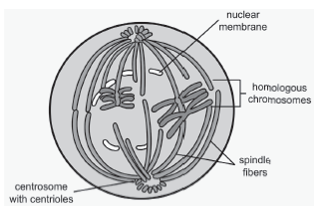
Meiosis
MEIOSIS I:
Prophase 1
After the interphase in which the cell’s DNA is copied, prophase I occurs.
Chromosomes start to coil and shorten.
The nuclear membrane disintegrates.
Homologous chromosomes pair by a process called synapsis. Homologous chromosomes have the same size, shape, and location of centromere and carry the genes controlling the same trait.
Through synapsis, crossing-over or the exchange of genetic materials between homologous chromosomes occurs. This results in countless different combinations of traits present in future sex cells, which account for genetic variation among organisms.

Slide 4
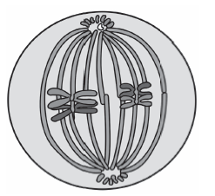
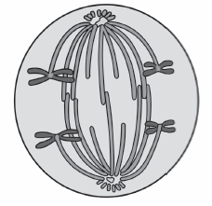
Meiosis
Metaphase I
Homologous chromosomes align at the equatorial plate. This alignment is a random process such that the number of paternal (from the father) and maternal (from the mother) chromosomes are dependent on how the homologous chromosomes align themselves at the equatorial plate.
The chromosomes in pairs are attached to the spindle fibers.
Anaphase I
Homologous chromosomes separate.
The chromosomes, still with two chromatids, move toward opposite poles of the cell.

Slide 5
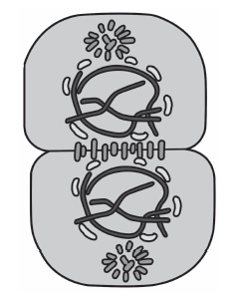
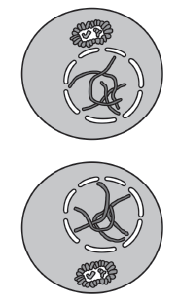
Meiosis
Telophase I
The chromosomes reach opposite poles.
In most organisms, the nuclear membrane forms.
Telophase, the last stage of meiosis I
Cytokinesis
This is followed by cytokinesis or the division of the cytoplasm. The daughter cells are now haploid, but their chromosomes are still duplicated.
Cytokinesis
Between meiosis I and meiosis II, a period of rest called interkinesis may occur, but no DNA replication occurs.

Slide 6
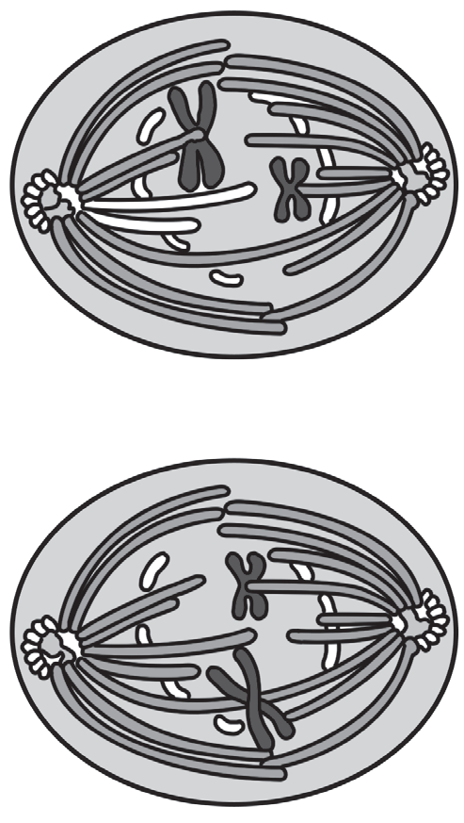
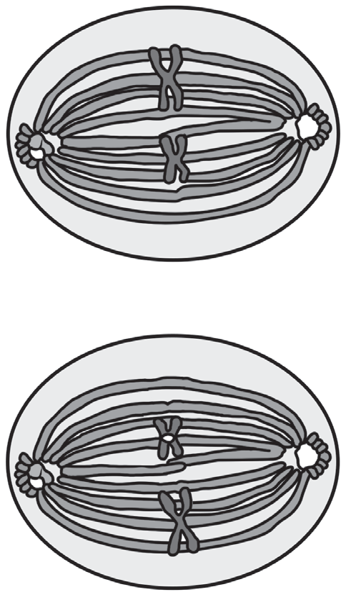
Meiosis
MEIOSIS II:
Prophase II
The nuclear membrane disintegrates.
New spindle fibers are formed around chromosomes.
Metaphase II
The chromosomes (consisting of sister chromatids) align at the equatorial plate
Their centromeres are attached to the spindle fibers.
Prophase II, the first stage of meiosis II
Metaphase II, the second stage of meiosis II

Slide 7
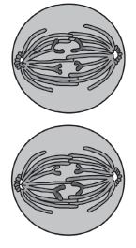
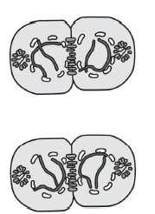
Meiosis
Anaphase II
The sister chromatids separate and move to opposite poles of the cell.
Each chromatid becomes an individual chromosome.
Telophase II
Nuclear membrane forms around each set of chromosomes.
Spindle fibers disappear.
When the telophase II of meiosis II is finished, the cytoplasm of each cell divides during cytokinesis. After cytokinesis produces, four daughter cells, which are haploid, are produced.

Slide 8
Meiosis
Importance of Meiosis
Meiosis is involved in the formation of sex cells, in maintaining the constant chromosome number of a certain kind of organism or species, and in the occurrence of genetic variation.
1. Sex cell formation
Meiosis is the main event involved in the process of sex cell or gamete formation called gametogenesis. In males, gamete formation is called spermatogenesis, which produces sperm cells. In females, it is called oogenesis, which produces egg cells.
2. Chromosome constant number
Sperm cell and egg cell are haploid before fertilization. In humans, the haploid set is equal to 23 chromosomes. The combination of these sex cells with the haploid number of chromosomes will produce a zygote with the same number of chromosomes as the parent, that is, 46 chromosomes. Meiosis, therefore, ensures that the chromosome number of organisms stays constant generation after generation.
3. Genetic variation
The process of meiosis is an important event because it produces genetic variation among sexually reproducing organisms. This explains why no two individuals are identical. Due to crossing-over, which happens during prophase I, and an independent assortment of chromosomes, which occurs during metaphase I, numerous unique combinations of genes can be produced in the resulting zygote.

Slide 9
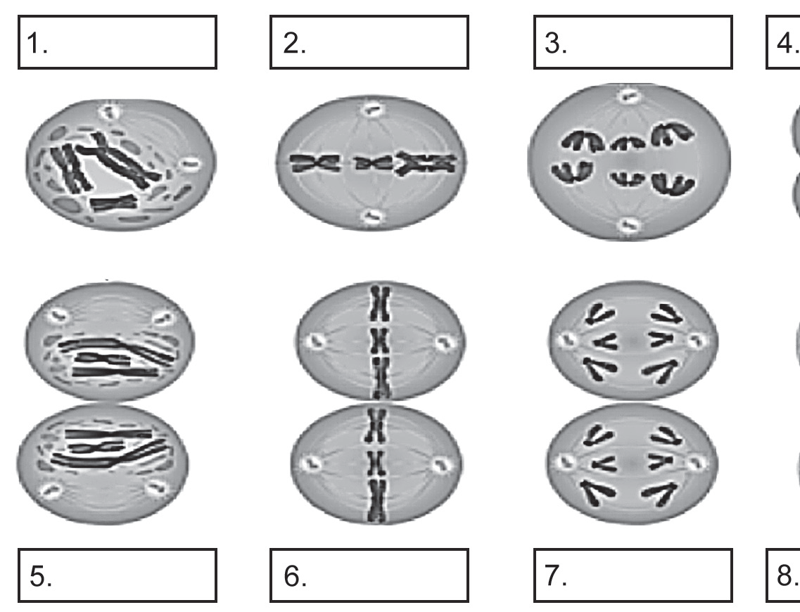
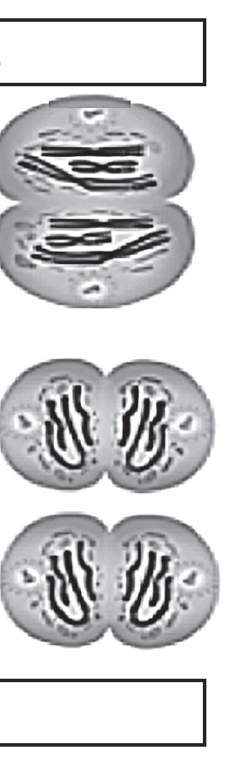
Meiosis
Activity
Directions: Study the different events in each stage of meiosis, as shown in the pictures below. Label each stage of meiosis.

Slide 10
Meiosis
Answer Key
1. Prophase I
2. Metaphase I
3. Anaphase I
4. Telophase I
5. Prophase II
6. Metaphase II
7. Anaphase II
8. Telophase II

