Slide 1
Cell Cycle and Mitosis

Slide 2
Cell Cycle and Mitosis
Cell Cycle
All organisms reproduce. This characteristic is not limited to organisms. Reproduction also happens at the cellular level. As one of the tenets of the cell theory states, all cells come from preexisting cells.
This is made possible by the process of cell division. Through cell division, the cell divides and multiplies. This can lead to the growth of organisms.
The growth of organisms follows a cycle. This life cycle has three stages. First, an organism must be formed. Second, it grows and develops. Third, the organism dies. This cycle can be compared with the cell cycle. Every cell has its life cycle. A cell cycle consists of a series of events that occur from the completion of one division until the beginning of the next division.

Slide 3
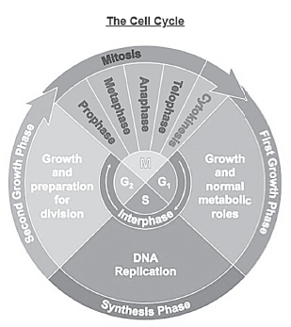
Cell Cycle and Mitosis
The first three stages in the figure (G 1, S, and G 2 phases) comprise the phase known as interphase.
Interphase is also known as the resting stage. Contrary to this name, the cell is not really resting but is actively preparing for cell division. Interphase is the longest part of the cell cycle where growth and development of the cell occur. A cell spends most of its time in interphase. The major events during the interphase
G1 (or Gap 1) phase
• It is the stage during which the cell undergoes rapid growth.
• Organelles are formed, and proteins are produced.
• Cells that are not dividing (muscle and nerve cells) remain at this stage throughout their life. Some authorities prefer to designate this situation as the G0 phase. Meanwhile, cancer cells never enter the G0 phase, instead, they undergo uncontrolled, rapid cell division.

Slide 4
Cell Cycle and Mitosis
S (or Synthesis) phase
• During this phase, the DNA, which is the main component of the chromosomes inside the nucleus of the cell, undergoes replication.
G2 (or Gap 2) phase
• Preparations for cell division happen during this phase.
• By the end of this phase, the volume of the cell has roughly doubled.
The last stage of the cell cycle is the M phase, where M stands for mitosis. During this stage, the cell undergoes division.

Slide 5
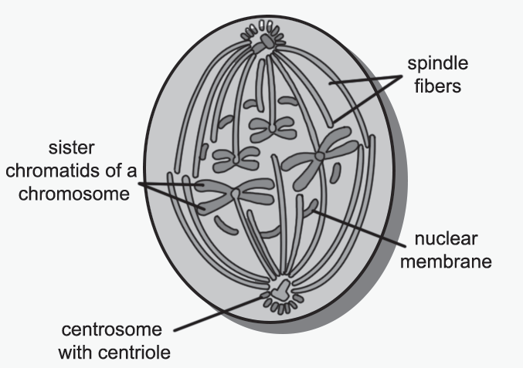
Cell Cycle and Mitosis
MITOSIS
Mitosis is a type of cell division, which results in each daughter cell having the same number of chromosomes as the parent cell. It consists of four phases: prophase, metaphase, anaphase, and telophase.
Prophase
• DNA supercoils and chromosomes become dense and visible under the microscope
• Chromosomes, which are comprised of genetically identical sister chromatids, are joined at the centromere, the part of the chromosome that links the sister chromatids together.
• Paired centrosomes, the organelles located near the nucleus, move to the opposite poles of the cell, and start to form spindle fibers, filaments that move chromosomes, or microtubules, hollow cylinders for chromosome segregation.
• The nuclear membrane starts to break down and disintegrates.

Slide 6
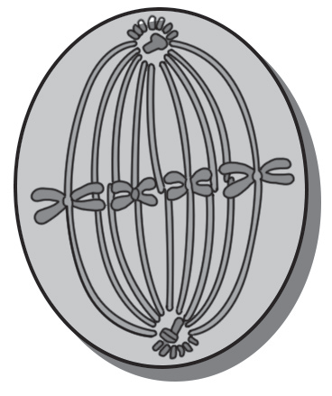
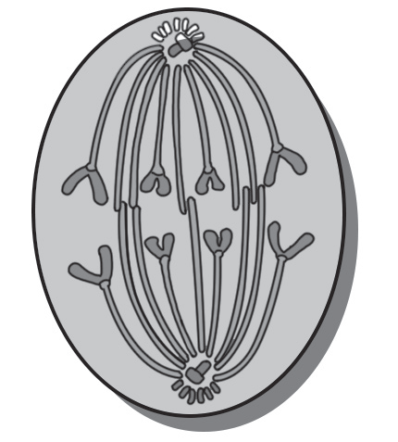
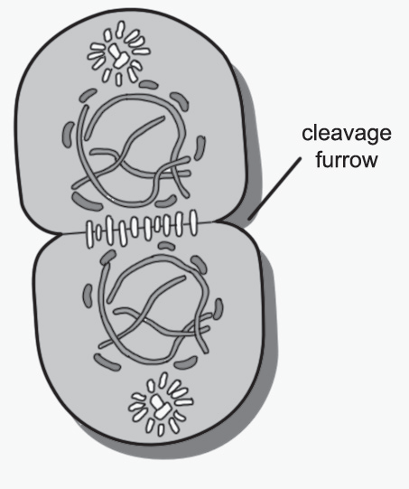
Cell Cycle and Mitosis
Metaphase
• Chromosomes move and align themselves at the equator of the cell
• Each chromosome is attached to the spindle by a structure in the centromere called the kinetochore.
Anaphase
• The sister chromatids of each chromosome start to separate and move toward opposite poles
• Once the chromatids separate, each is then considered an individual chromosome.
Telophase
• The chromatids (now called chromosomes) are located at opposite poles.
• Nuclear membrane forms around the chromosomes which start to uncoil
• The spindle fibers dissolve and disappear.

Slide 7
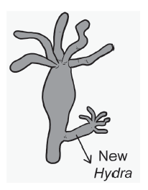
Cell Cycle and Mitosis
2. Replacement of cells
This happens when the original cell is injured or damaged. New cells are formed to replace the damaged ones. The healing of wounds happens because the worn-out cells or dead cells are replaced with new cells through mitosis. When old cells die, stem cells replenish them by consistently dividing to guarantee that the body continues to operate.
3. Asexual reproduction
Many single-celled and some multi-celled organisms use mitosis for asexual reproduction. This comprises reproduction through fragmentation, as in Planaria, and reproduction through budding, as in Hydra.

Slide 8
Cell Cycle and Mitosis
After the division of the nucleus (karyokinesis), the cytoplasm divides by cytokinesis. Cytokinesis in animal cells happens through cleavage furrow formation, which starts at the exterior of the cell, moving inward until the cell is divided into two cells. In the plant cells, cytokinesis starts at the middle of the cell and moves outward by a process called cell plate formation. After the division of the cytoplasm, two daughter cells are produced having the same set of chromosomes as the parent cell. Most of the new cells begin a period of growth or go back to interphase again.
Importance of Mitosis
Mitosis is essential for growth and development, cell replacement, and asexual reproduction.
1. Growth and development
One of the processes that contribute to the organism’s growth is mitosis. Although not evident in the picture, it is mitosis that enables the growth of the embryo (the term applied to the unborn child until the end of the seventh week, following conception) to the baby, to the boy, to the young teenager. This growth continues and occurs throughout the life of an organism, including plants, animals, and fungi. The original chromosomal set is preserved.

Slide 9
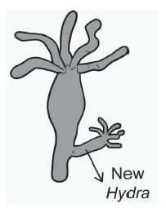
Cell Cycle and Mitosis
2. Replacement of cells
This happens when the original cell is injured or damaged. New cells are formed to replace the damaged ones. The healing of wounds happens because the worn-out cells or dead cells are replaced with new cells through mitosis. When old cells die, stem cells replenish them by consistently dividing to guarantee that the body continues to operate.
3. Asexual reproduction
Many single-celled and some multi-celled organisms use mitosis for asexual reproduction. This comprises reproduction through fragmentation, as in Planaria, and reproduction through
budding, as in Hydra.

Slide 10
Cell Cycle and Mitosis
Activity
A. Directions. Write True if the statement is correct, or False if it is incorrect.
_______ 1. Cells in your body, the body cells, do not contain genetic materials.
_______ 2. Interphase is a stage of mitosis.
_______ 3. The longest stage of the cell cycle is the interphase.
_______ 4. During anaphase, the chromosomes are aligned in the middle of the equator.
_______ 5. The chromatids are attached to each other to the centromere.
B. Why do you think cells need to reproduce?
____________________________________________________________________________________________
____________________________________________________________________________________________
____________________________________________________________________________________________

Slide 11
Cell Cycle and Mitosis
Answer Key
A.
1. False
2. False
3. True
4. False
5. True
B. Cells need to reproduce for different reasons. Cells need to reproduce to replace the worn-out cells; for growth; and as a means to multiply (for some unicellular or multicellular organisms).

