Slide 1
Physical Change and Chemical Change

Slide 2
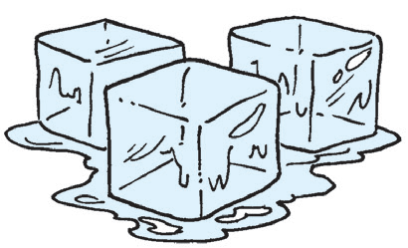
Physical Change
A paper folded into a different form is still paper. Clay shaped into a pot is still clay. A piece of cloth cut into small pieces is still the same cloth. A metal painted with different color is still a metal. The ice cubes left in the bowl for several minutes that had melted into liquid water is still water.
Below are other examples of physical change.

Slide 3
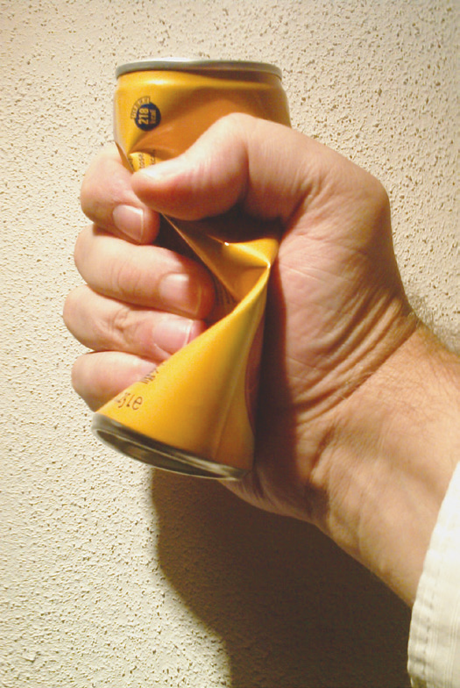
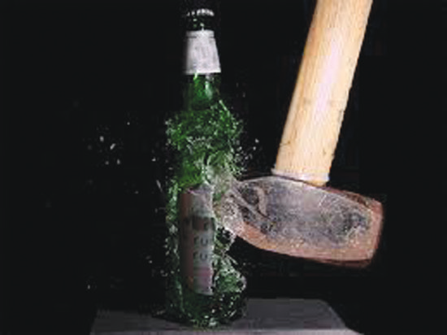
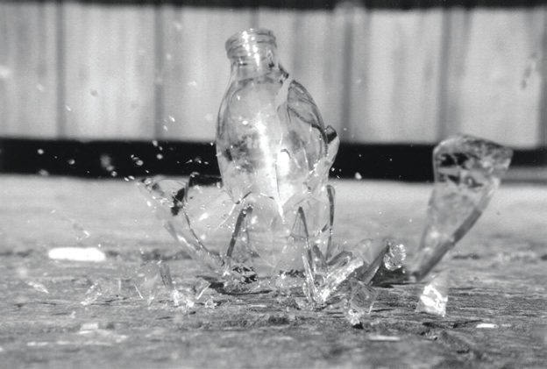
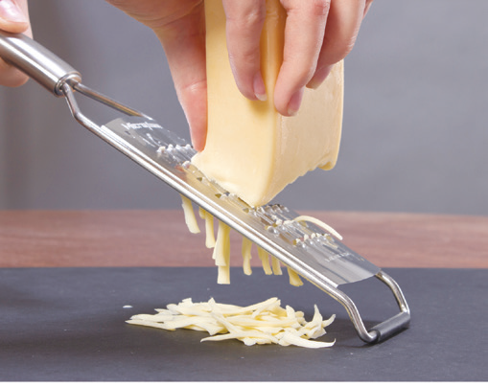
Examples of physical change: crushing can, breaking a bottle, and grating cheese

Slide 4
A physical change is a change in the physical properties of matter. It can be a change in size, shape, and form. A change in phase, like from one phase to another, is called phase change, and it is also considered as a physical change. An example of this is the changing of ice cubes to water.
This will be discussed in the next lesson.

Slide 5
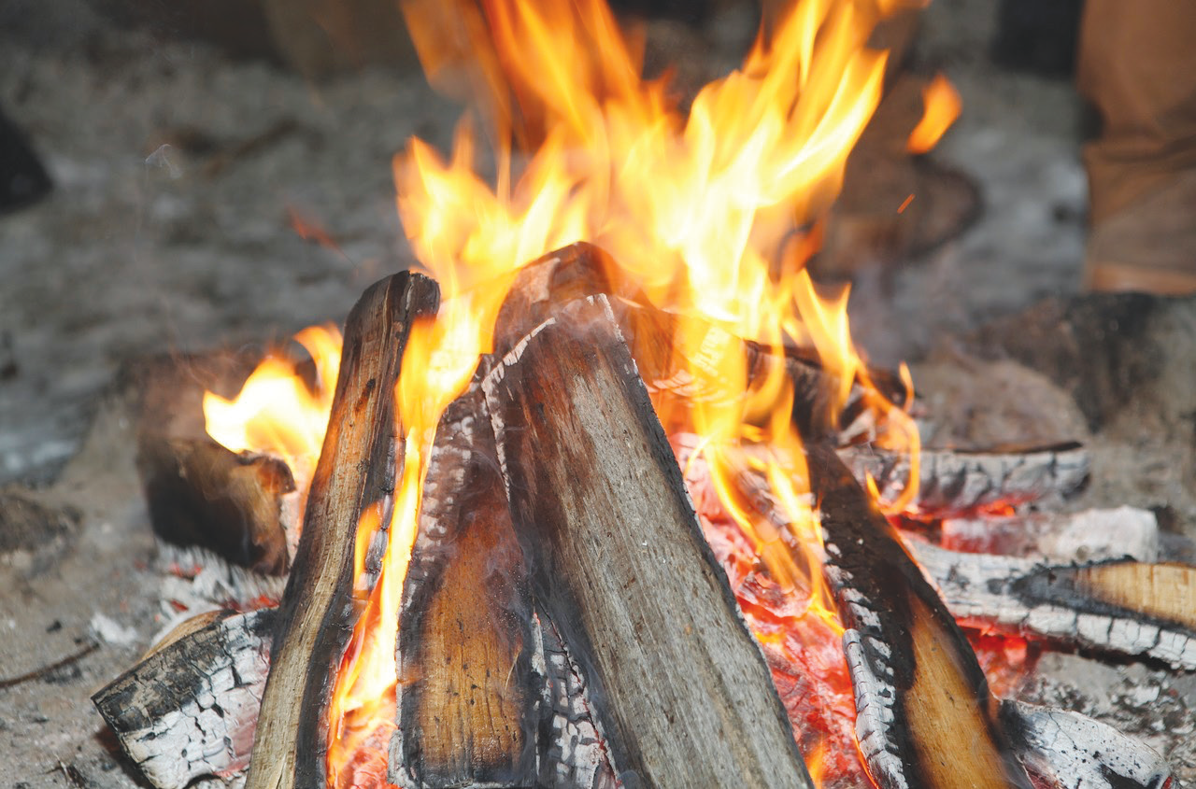
Chemical Change
The properties or composition of matter can change. When substance breaks down and loses its properties and a new substance is formed, we say that a chemical change has taken place.
Heat may be or may not be applied in order for chemical change to happen. Look at the burning wood in the picture. After the wood has been burned, does it still have the same properties as the unburned wood?
When a piece of wood is burned, it loses its
characteristics because a new substance is formed.
Burning causes the pieces of wood to change into ashes.
The molecules of the ashes are different from those of the
unburned wood. Examples of chemical changes are rusting
of iron, roasting a marshmallow, explosion of fireworks,
and rotting of food.
Burning wood

Slide 6
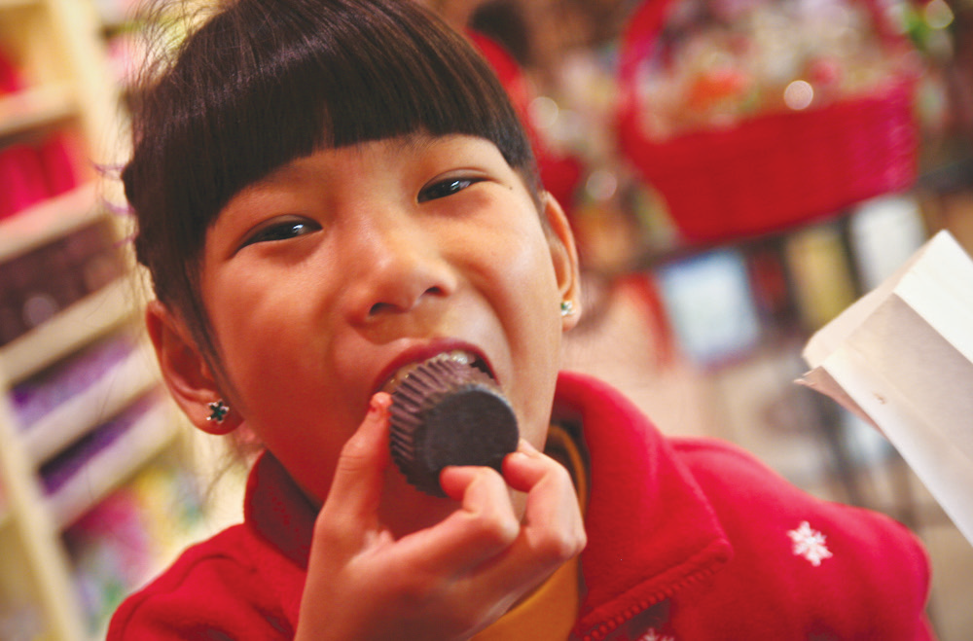
Sometimes, both physical and chemical changes occur together. For example, when a person eats chocolate and then digests it, physical and chemical changes occur. When a person chews the chocolate and breaks it into smaller pieces, it is physical change. No new substances have been formed.
Once acted upon by saliva and other digestive
juices, the chocolate breaks down into other simpler
substances which will be absorbed by the blood. This is
chemical change.
A child eating chocolate

