Slide 1
Physical Changes in Matter

Slide 2
Physical Changes in Matter
Example:
the butter left in the warm room melted, and when you tasted it, it still tasted the same. The ice cubes placed in the basin of water melted, making the water cool, and, still, it was water: from solid ice cubes to liquid water.
the salt water. When all the water evaporated and you tasted the residue, it was still salty. Describing the modeling clay, changing its shape does not change it.
Physical changes - changes in the observable properties of a material without the formation of new material are called Physical changes

Slide 3
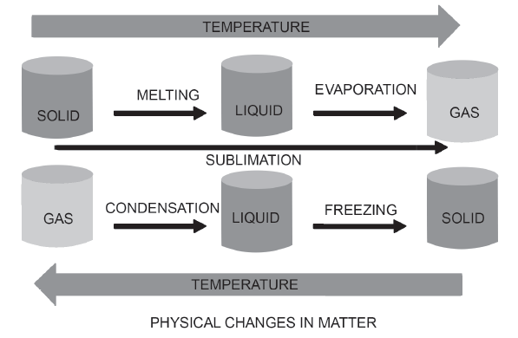
Physical Changes in Matter

Slide 4
Physical Changes in Matter
The shows that temperature can bring about physical changes in matter. An increase in temperature can cause solids to change their state into liquid. A decrease in temperature can cause liquids to turn into solids.
Water exists in three forms: solid, liquid, and gas.The water changes its state into solid, liquid, or gas, but it is still water. Freezing, melting, and evaporation are examples of physical changes.
    Example of Solid:
    When you put the water inside the freezer, it is turned into a solid ice cube in the process called freezing.
    Example of Liquid:
    When the ice cubes in your activity were mixed with tap water at room temperature, they were changed into liquid. This process is called melting.

Slide 5
Physical Changes in Matter
Example of Gas:
When the liquid water is subjected to heat, it turned into gas. This process is called evaporation.
The opposite of evaporation is condensation. It happens when a gas material is changed to liquid.
Sublimation- This change from solid to gas without undergoing the liquid phase.
Example: Moth balls small white balls that your mother puts in the cabinet to keep cockroaches away. What you will notice is just the smell, but there is no wet area left when all these white balls disappear. These physical changes happen due to just one condition: it is the difference in temperature where the materials are exposed.

Slide 6
Physical Changes in Matter
Physical change can happen when you bend, press, cut, or hammer the materials. When bent, pressed, cut, or hammered, materials may change their size, shape, texture, and other physical properties.
There is no new material formed, only their physical characteristics were changed. Materials that can be pressed, folded, and hammered are called malleable materials. This property is called malleability. Malleability is the property of a material to be hammered into thin and flimsy sheets. To be able to cut these materials, they have to transform into very thin wires. Materials that can be cut and made into thin wires are called ductile. Ductility is the property of matter, particularly metals, that can be drawn to make wires.
:

Slide 7

Physical Changes in Matter
Directions: Study the given puzzle below. Look for 10 words that refer to the different ways on how to change the physical properties of materials.

Slide 8
Physical Changes in Matter
Answer Key
1. Pressing
2. Hammering
3. Freezing
4. Stretch
5. Cutting
6. Mix
7. Folding
8. Evaporation
9. Bending
10.Tearing

