Slide 1
The Circulatory System

Slide 2
The Circulatory System
The circulatory system’s main function is to transport materials, such as glucose, hormones, and oxygen gas, to trillions of body cells that make up our bodies. It also collects metabolic wastes from the cells, such as carbon dioxide, and brings them to specific organs for excretion. The circulatory system works as an intricate highway that extends throughout the entire body, supplying the tissue cells with the materials they need to survive. It is composed of the heart, which is a muscular pumping organ; the blood tissue, which is a circulating medium transporting important materials; and a closed system of blood vessels the arteries, veins, and capillaries.
The Heart
The heart is a muscular organ that pumps blood to the different parts of the body. It is in the middle of our chest, with its apex slightly tilted toward the left. Its base lies just below the second ribs, and it is protected by a sac known as the pericardium. Your heart is as big as your clenched fist.

Slide 3
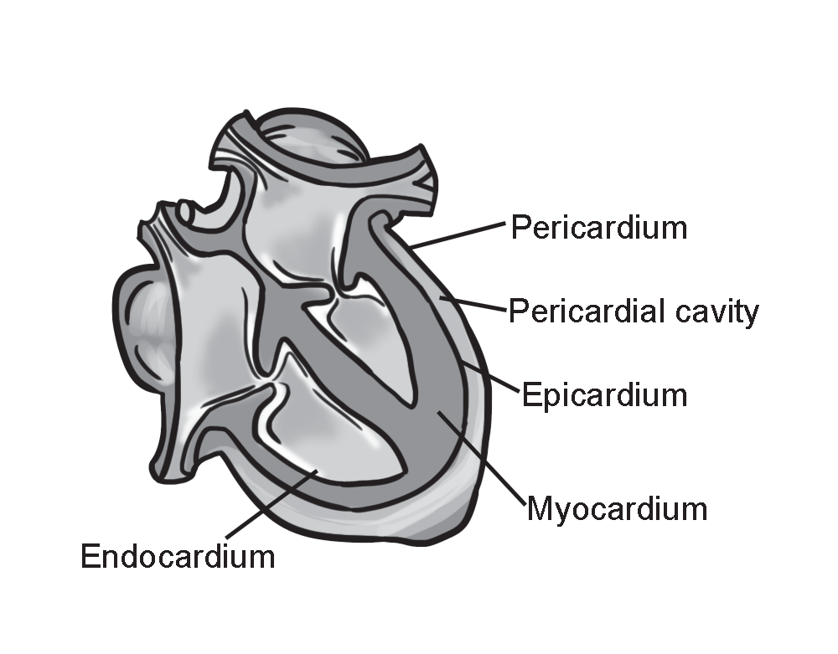
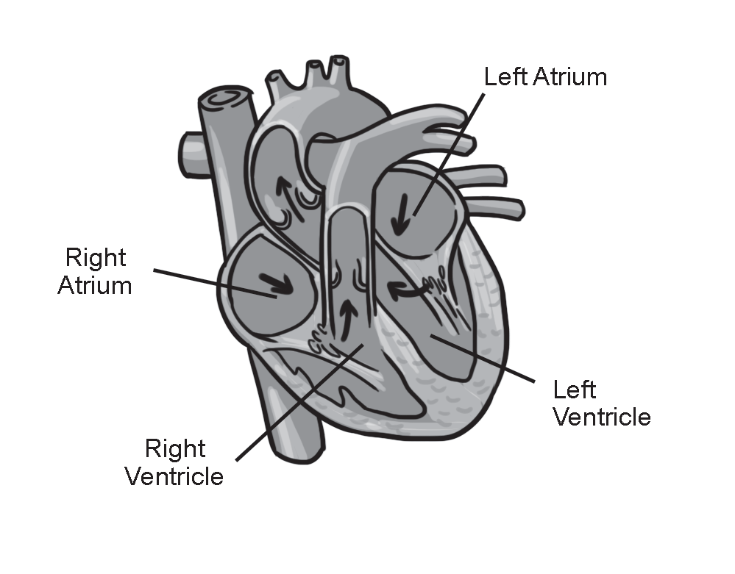
The Circulatory System
The Chambers of the Heart
The muscle called the septum divides the heart into four chambers. The right atrium receives oxygen-poor blood from the superior and inferior vena cava, the left atrium receives oxygen-rich blood from the pulmonary veins, the right ventricle pumps oxygen-poor blood to the lungs for oxygenation, and the left ventricle pumps oxygenrich blood toward the aorta.

Slide 4
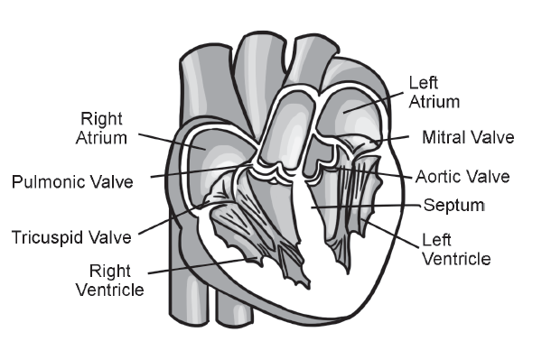
The Circulatory System
The Valves of the Heart The valves inside our heart prevent blood from flowing backward and ensure that blood flows in a one-way direction. When the ventricles contract, the tricuspid and bicuspid valves [atrioventricular (AV) valves] are closed. When the ventricles relax, the pulmonary and aortic semilunar valves are closed.
Tricuspid valve facilitates the flow of oxygen-poor blood from the right atrium toward the right ventricle.
Bicuspid valve facilitates the flow of oxygen-rich blood from the left atrium toward the left ventricle.
Pulmonary semilunar valve facilitates the flow of oxygen-poor blood from the right ventricle toward the pulmonary artery.
Aortic semilunar valve facilitates the flow of oxygen-rich blood from the left ventricle toward the aorta.

Slide 5
The Circulatory System
The Cardiac Cycle
Diastole Phase: All the heart chambers are relaxed. The right atrium receives deoxygenated blood from the vena cava. The left atrium receives oxygenated blood from the pulmonary veins. At this point, the AV valves are open, allowing blood to flow freely into the ventricles while the semilunar valves are closed. This only lasts about 0.4 second.
Systole Phase of the Atria: The sinoatrial (SA) node located within the walls of the right atrium sends an electric impulse that signals the atria to contract for about 0.1 second. The contraction completely fills the ventricles with blood. At this point, the AV valves are open, while the semilunar valves are closed.
Systole Phase of the Ventricles: The right ventricle receives impulses from the Purkinje fibers and contracts, forcing blood to the lungs via the pulmonary artery. The contraction of the left ventricle forces oxygenated blood out of the heart via the aorta. At this point, the semilunar valves are open, while the AV valves are closed.

Slide 6
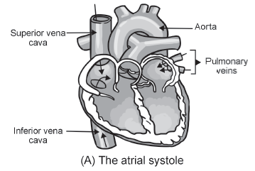
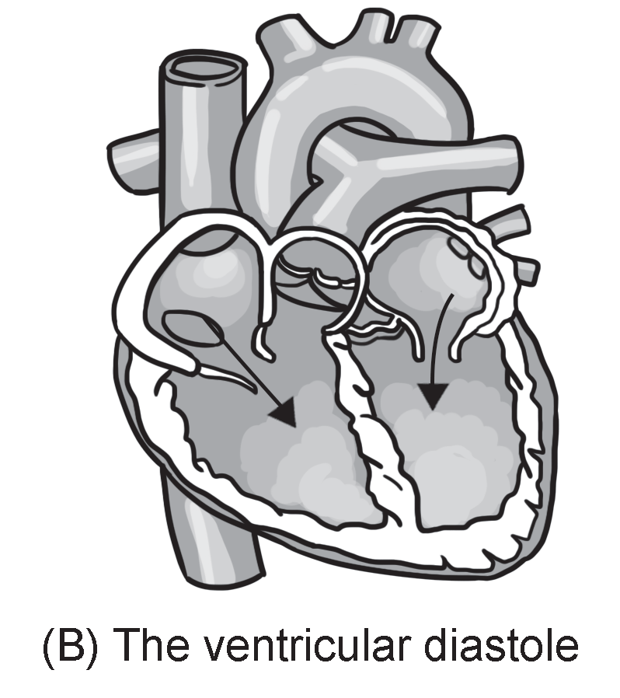
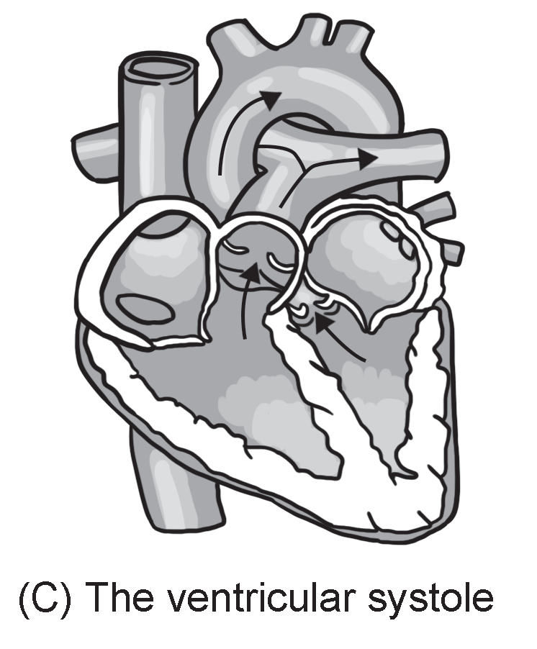
The Circulatory System
Phases of the Cardiac Cycle

Slide 7
The Circulatory System
Heartbeat and Sounds
The heartbeat is produced by the contraction of the heart muscles initiated by rhythmical electric impulses from the SA node or pacemaker, which maintains and sets the rate at which the heart contracts.
As blood from the vena cava fills the right atrium, the SA node sends signals through a relay point called the AV node, causing the contraction of the right and left atria.
AV node branches into the bundle of His and the Purkinje fibers that spread all over the ventricles. Signals from these fibers trigger the strong contraction of the ventricles, forcing blood from the right ventricle into the lungs and the left ventricle into the aorta.

Slide 8
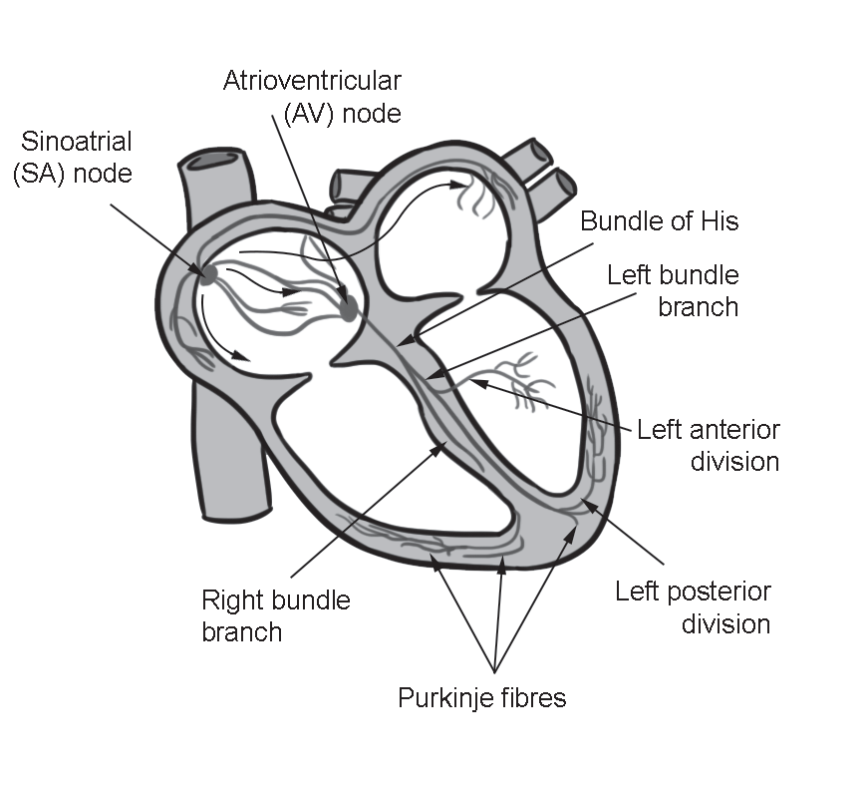
The Circulatory System
Heartbeat sounds are heard due to the turbulence created by the blood flow inside it, specifically when the valves close. A normal heart sound is typically described as “lub-dub.” The first sound, “lub” (S1), has a softer pitch and is longer in duration, which is produced from the vibrations of the closing of the atrioventricular valves. The second sound, “dub” (S2), has a higher pitch and is shorter in duration, which is produced by the vibrations of the closing of the semilunar valves.

Slide 9
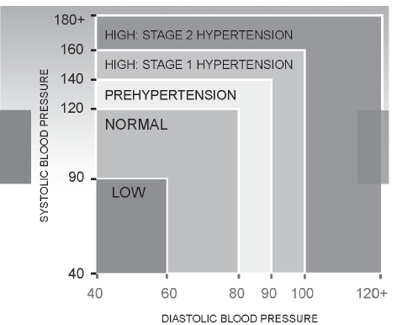
The Circulatory System
Blood pressure (BP) is the force exerted by the circulating blood on the walls of the blood vessels given in two numbers. In a sample BP of 120/80 (read as 120 over 80), 120 is the systolic pressure exerted when blood is ejected into arteries during the contraction of our heart muscles, while 80 is the diastolic pressure exerted within the arteries between heartbeats. Your BP is measured using an instrument called a sphygmomanometer. BP moves blood from the heart to the different blood vessels that cause the arteries to rhythmically stretch or bulge, which is felt as a pulse.

Slide 10
The Circulatory System
Blood Vessels
You may have observed the greenish-looking tubes underneath your skin on the upper palm of your hand. You may be wondering what these structures are called or what could be flowing inside them. These networks of muscular tubes are called blood vessels through which blood is distributed throughout our body.
Pulmonary arteries convey oxygen-poor blood from the right ventricle to the lungs for oxygenation.
Pulmonary veins convey oxygen-rich blood from the lungs back to the left atrium of the heart.
Arteries convey oxygen-rich blood from the heart toward the tissue cells, starting from the aorta, the largest artery where pressure is highest, into the smallest called the arterioles.
Veins convey oxygen-poor blood from all parts of the body toward the heart. The largest
vein is the vena cava divided into two parts: the superior and inferior vena cava, where pressure is the lowest. The smallest vein is called the venule. The valves and the contractions of muscles that surround them facilitate the blood flow in the veins.

Slide 11
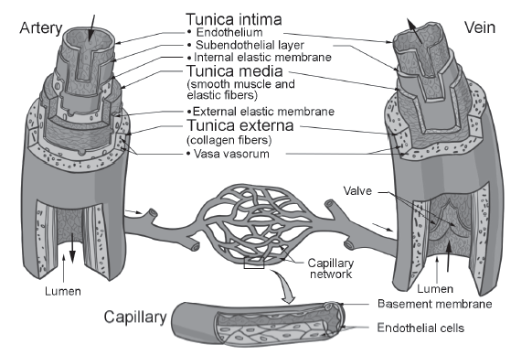
The Circulatory System
Capillaries form the connection between the arterioles and the venules. They are responsible for the exchange of materials, such as gases, nutrients, and waste products of metabolism, between the blood and tissue cells.
Structures of the Blood Vessels

Slide 12
The Circulatory System
The Blood
Did you know that blood comprises 8% of the human body weight and that an average adult has about 5 liters of blood? Blood is a liquid tissue. It is the circulating medium of the circulatory system that transports materials, fights infections, and is responsible for blood clotting. It has two components: the plasma and the formed elements (also called corpuscles) that are suspended in the plasma.
Plasma is the liquid component of the blood, which consists of about 92% water, 8% blood proteins, and trace amounts of inorganic materials.
Corpuscles, also known as blood cells, include the erythrocytes or red blood cells,leukocytes or white blood cells, and thrombocytes or blood platelets. Blood cells are synthesized in the red bone marrow of fl at and long bones.

Slide 13
The Circulatory System
The Blood Clotting Process
Blood comes out from a cut, releasing the plasma and blood corpuscles. The thrombocytes disintegrate upon contact with air, which causes the change of the inactive blood protein thromboplastinogen to thromboplastin.
Thromboplastin plus calcium ions will catalyze the conversion of prothrombin to thrombin. Thrombin catalyzes the change of fibrinogen to fibrin threads.

Slide 14
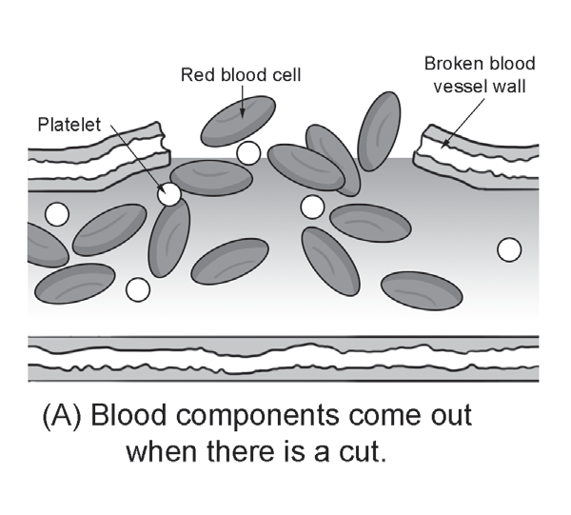
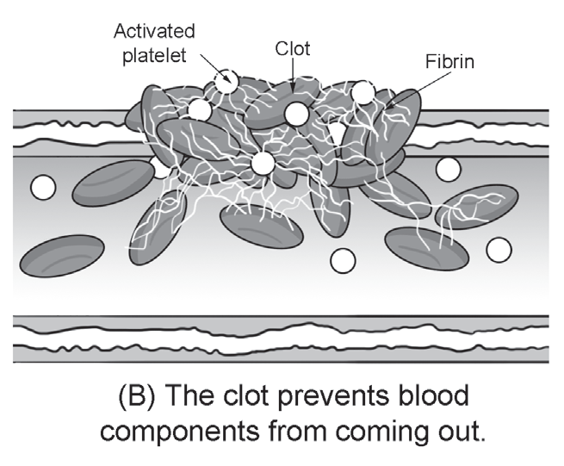
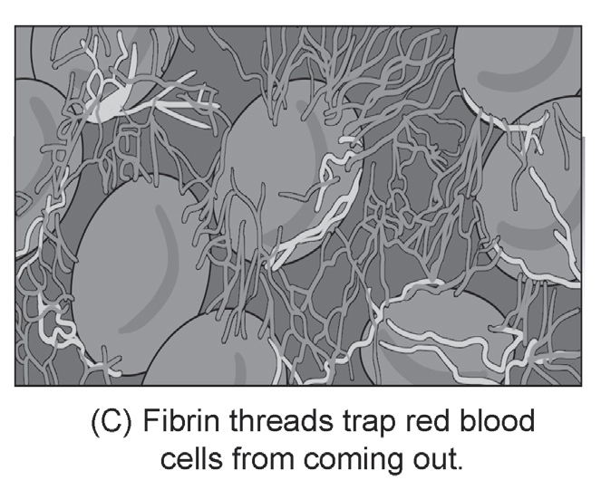
The Circulatory System
Fibrin threads form a network over the injured part and seal it to prevent more blood cells from coming out until a red mass (clot) of connective tissue forms on top of it.
After some time, the clot shrinks, and a straw-colored fluid called serum exudes out of the injured part. This serum is the blood plasma, which lacks blood protein fibrinogen in it.
The Blood Clotting Process

Slide 15
The Circulatory System
Comparison among Erythrocytes, Leukocytes, and Thrombocytes
Blood Cells | Structure | Life Span | Functions
Erythrocytes | biconcave in shape, elastic, and non-nucleated | approximately 120 days | transport gases (oxygen and carbon dioxide) throughout the body
Leukocytes | indefinite shapes (amorphous) and nucleated | 13 to 20 days | defend the body against infectious diseases and foreign materials by phagocytosis and/or secreting antibodies
Thrombocytes | irregular in shape and nonnucleated | 9 to 12 days | prevents blood loss through blood clotting

Slide 16
The Circulatory System
Activity
Directions: Identify what is being described in each statements. ‪Choose the letter of the correct answer from the options inside the box.‬
A. Aortic semilunar valve
D. Plasma
E. Left ventricles
B. Bicuspid valve
C. Blood
_______1.They pump oxygen rich blood toward the aorta
_______2. It facilitates the flow of oxygen-rich blood from the left atrium toward the left ventricle.
_______3. It facilitates the flow of oxygen-rich blood from the left ventricle toward the aorta.
_______4. A liquid component of the blood, which consists of about 92% water, 8% blood proteins, and trace amounts of inorganic materials.
_______5. It is the circulating medium of the circulatory system that transports materials, fights infections, and is responsible for blood clotting.

Slide 17
The Circulatory System
Answer Key
_____ 1.They pump oxygen rich blood toward the aorta
_____ 2. It facilitates the flow of oxygen-rich blood from the left atrium toward the left ventricle.
_____ 3. It facilitates the flow of oxygen-rich blood from the left ventricle toward the aorta.
_____ 4. A liquid component of the blood, which consists of about 92% water, 8% blood proteins, and trace amounts of inorganic materials.
_____ 5. It is the circulating medium of the circulatory system that transports materials, fights infections, and is responsible for blood clotting.
E
B
A
D
C

