Slide 1
Classifying Vertebrates

Slide 2
Classifying Vertebrates
Vertebrates
are animals with backbones.
are considered the most diverse and successful chordates.
➢
They are generally equipped with two pairs of appendages or external body parts, which they use for movement or locomotion. In addition, they have well-developed organ systems and an endoskeleton that supports their entire bodies. The endoskeleton is the skeleton inside the body that provides structural support and protection for an organism’s internal organs and tissues. The presence of the backbone and the endoskeleton is the most distinguishing features of vertebrates.
WWW.REX.COM.PH

Slide 3
Classifying Vertebrates
The vertebrates are further classified into several classes.
Class Agnatha
Class Chondrichthyes Class Osteichthyes Class Amphibia
Class Reptilia Class Aves Class Mammalia.
●
●
●
●
●
●
●
WWW.REX.COM.PH

Slide 4
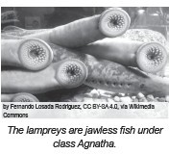
Classifying Vertebrates
The
class Agnatha
is composed of jawless fi shes with cartilaginous skeleton. This class is
where the primitive fish-like species belong. The representative organisms for this class are the lampreys and hagfishes. Lampreys have round mouths that are toothed and well adapted for bloodsucking. They lack paired appendages, such as the fins and jaws. This characteristic gave the name of their class. They also have the notochord as a supporting tissue that resembles the spinal cord and the vertebral column combined.
WWW.REX.COM.PH

Slide 5
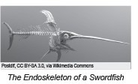
Classifying Vertebrates
Class Chondrichthyes and class Osteichthyes
Those that are classified under class Chondrichthye are cartilaginous fishes whose skeletons are made up of cartilage. Its name is derived from the Greek word chondros, which means cartilage, and ichthyes, which means fish. Sharks, skates, and stingrays have fexible endoskeletons composed of cartilaginous tissues, making them the representative examples of this class. Sharks have powerful jaws and are highly agile swimmers. However, they are known to have poor eyesight. To compensate for this, they have a keen sense of smell that they can use for hunting prey. Sharks have a lateral line system located along the sides of their bodies. This lateral line system contains rows of pressure-sensitive cells that enable them to detect other swimming animals within the vicinity.
WWW.REX.COM.PH

Slide 6
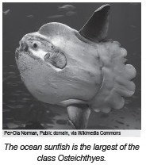
Classifying Vertebrates
Class Osteichthyes
Osteichthyes - derived from the Greek word osteon which means bone, is a class involving bony fishes
➢
Example: Milkfish, catfish, tuna, seahorse,
ocean sunfish – largest Osteichthyes member.
Unlike the sharks and the stingrays, these fi shes have a rigid and tough endoskeleton made of calcium and phosphate. They have jaws and mouths that are lined with sharp teeth, a keen sense of smell, good eyesight, and the lateral line system in their bodies similar to that of the sharks.
WWW.REX.COM.PH

Slide 7
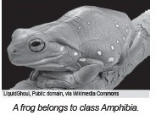
Classifying Vertebrates
Class Amphibia
The word Amphibia is derived from the Greek word:
Amphi - which means double, and bio, which means life.
Literally, the word Amphibia means double life because amphibians spend a portion of their life cycle in water and another part in land.
Example: frogs, toads, and salamanders
They tend to spend most of their time on land, but when they spawn, they go back to the water to lay eggs since their eggs will dry up quickly on land.
Amphibian eggs are not covered in hard shells like the ones that are present
in reptilian and avian eggs. Amphibians are ectotherms or cold-blooded animals. Their body temperature is affected by the environment’s temperature. In addition, most of the amphibian skin is smooth and slimy as their skin secretes mucus
that protects them from drying up when they are on land. They can also breathe through their skin, a process called cutaneous respiration.
WWW.REX.COM.PH

Slide 8
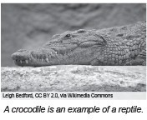
Classifying Vertebrates
Class Reptilia
Reptilia, derived from the Latin word repere, which means to creep, is a class of vertebrates characterized by dry, tough, hard, and heavy keratinized scales resistant to wear and tear.
The reptile’s thick and tough skin forms a barrier to excessive water loss in the environment.
Reptiles do not need a watery environment when they lay eggs since their eggs are covered by shells, unlike the eggs of amphibians.
However, just like the amphibians, reptiles are also ectothermic animals. To stabilize their body temperature, reptiles tend to gear toward external heat sources, such as basking under the sun or lying on warm rocks or areas in an open field. Reptiles, like snakes, crocodiles, tortoises, and lizards, are mostly terrestrial. That means they spend most of their time on land. However, there are also reptiles that are adapted in water, such as turtles and sea snakes.
WWW.REX.COM.PH

Slide 9
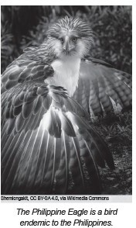
Classifying Vertebrates
Class Aves
Its name is derived from the Latin word avis, which means bird.
Birds are egg-laying animals; therefore, they are also oviparous.
Shells cover their eggs just like those of the reptiles.
The feathers that cover their bodies help them maintain a constant body temperature.
Most birds are capable of flight, such as the eagles, hawks, sparrows, and falcons. However, there are also flightless birds, such as the penguins and ostriches.
Birds are known to be territorial, constructing nests for their eggs and feeding their young. Unlike the amphibians and the reptiles, birds are considered endothermic or warm-blooded. They have a stable body temperature and can regulate their internal temperature as well.
WWW.REX.COM.PH

Slide 10
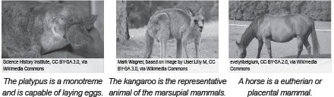
Classifying Vertebrates
Class Mammalia
The term Mammalia is derived from the Latin word mamma, which means breast.
Mammals are characterized by their fur and mammary glands that nourish their young with milk. mammals are considered endothermic; therefore, they are warm-blooded animals as well. Mammals can be further classified as monotremes, the egg-laying mammals; marsupials that nurture their young through a pouch-like structure in their bodies; and the eutherians, known as the placental mammals. Eutherians nurture their young in a structure known as the placenta. Unlike birds and reptiles, mammals give birth to live young since mammals are viviparous. Mammals have varying habitats as there are terrestrial and aquatic mammals. Those that live on land include horses, dogs, cats, carabaos, and the like. On the other hand, some mammals live in the sea, such as dolphins and whales. In addition to this, some mammals are capable of flight, such as bats.
WWW.REX.COM.PH

Slide 11
Classifying Vertebrates
Directions: Match the column A with column B. Write the letter of the answer on the space provided before each number.
Column A
1. has a beak and feathers that cover their bodies
2. has gills, fins, and lateral line
3. has dry scaly skins
4. warm-blooded animals with fur and mammary glands
5. has moist skin and lives on land and water
Column B
mammal
reptile
amphibian
fish
bird
WWW.REX.COM.PH

Slide 12
Classifying Vertebrates
Answer Key:
1. e
2. d
3. b
4. a
5. c
WWW.REX.COM.PH

Slide 13


