Slide 1
Classifying Invertebrates

Slide 2
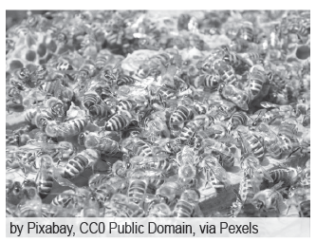
Classifying Invertebrates
The invertebrates are animals that do not have vertebral columns or backbones. These animals range from very tiny mites to giant squids. In addition, invertebrates are also known to be the largest group in the animal kingdom. In fact, scientists say that 97% of all animals are considered to be invertebrates due to their fast reproduction. Insects such as ants and bees lay eggs that can develop even without fertilization. Like the vertebrates, they are classified based on their body structure, life cycle, and evolutionary history.
Invertebrates are classified into several phyla; these include the phylum Porifera, phylum Cnidaria, phylum Platyhelminthes, phylum Nematoda, phylum Mollusca, phylum Annelida, phylum Arthropoda, and phylum Echinodermata.
The bees are invertebrates and social animals.

Slide 3
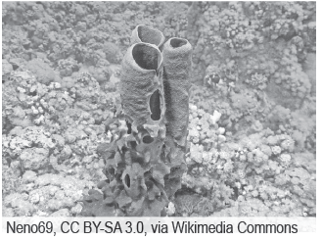
Classifying Invertebrates
The first classification of invertebrates is the phylum Porifera. Phylum Porifera belongs to Kingdom Animalia, characterized as pore-bearing species known as sponges and considered the lowest multicellular group in the kingdom. Sponges are sessile marine animals by which one end is attached to any solid object while the other end is open. Sessile organisms are fixed in one place. Sponges are also described as filter feeders because the bacteria and tiny particles carried by the water currents are trapped by the flagellated cells that line the body pores and are taken up from the water as food.
The sponges are the
Representative animals of the phylum Porifera.

Slide 4
Classifying Invertebrates
Flagellated cells that line the body pores and are taken up from the water as food. The flagellated cells are composed of tail-like projections that increase their surface area. The sponges’ bodies are supported by an endoskeleton called the spicules. The spicules are composed of silica, calcium carbonate, or the spongin. The composition of their spicules is used by taxonomists as basis for classifying them into different classes.

Slide 5
Classifying Invertebrates
Another classification under the invertebrates is the phylum Cnidaria. Cnidaria is a phylum in the Kingdom Animalia composed of numerous aquatic species that exhibit radial symmetry. Radial symmetry is the arrangement of body parts around a central axis. This characteristic equips animals with top and bottom surfaces only. In comparison to poriferans, cnidarians are more complex as their cells are organized into tissues that perform muscular, digestive, nervous, and reproductive functions. Their digestive system is saclike, with only one opening that functions as both the mouth and the anus.
Cnidarians are named due to the presence of tentacles that contain stinging cells called the cnidocytes. Cnidocytes are used for protection and capturing food. Two body forms exist among cnidarians—the solitary or colonial polyp form and the umbrella-shaped and free swimming medusa form.

Slide 6
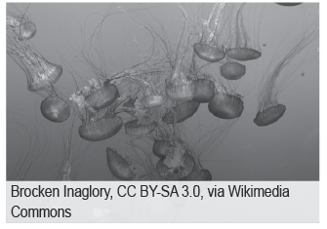
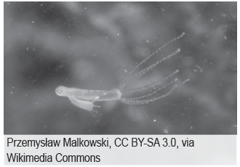
Classifying Invertebrates
The polyp form is sessile. It has a tubular body with its end attached to any solid object and an upper end that bears the mouth, which The sponges are the representative animals of the phylum Porifera. Which surrounded by rings of tentacles.
The medusa form is umbrella-shaped with the mouth located at the center of the body and facing downward. Rows of tentacles line the margins of the umbrella-shaped body.

Slide 7
Classifying Invertebrates
Another group of invertebrates is classified under phylum Platyhelminthes. Platyhelminthes is a group of soft and flat-bodied invertebrates commonly known as flatworms or tapeworms. They are usually found in both aquatic and terrestrial habitats. Unlike the invertebrates, members of this phylum exhibit bilateral symmetry.
Bilateral symmetry is an anatomical structure in which identical parts of the body appear at the body’s midline. However, this does not mean that the internal organs are placed in symmetry. Aside from being bilaterally symmetrical, they also exhibit cephalization.

Slide 8
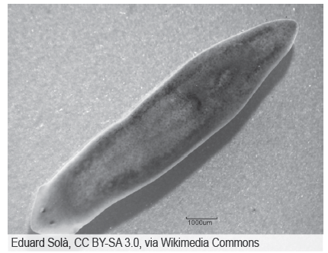
Classifying Invertebrates
Cephalization is the process in which the concentration of nervous and sensory tissues is in the head. This only means that flatworms have a distinct head and tail region. The head end of these organisms contains sensory structures that can detect light and collect nervous tissue, enabling them to respond quickly to stimuli. In comparison to sponges and cnidarians, they have tissue layers that give rise to the animals’ various organs and systems. Lastly, unlike vertebrates, the hydrostatic skeleton that relies on water pressure supports their body instead of an exoskeleton.
The planaria is a representative
animal of the Platyhelminthes.

Slide 9
Classifying Invertebrates
The next group of invertebrates belongs to phylum Nematoda, a classification of invertebrates that includes parasitic species and is commonly known as roundworms. Just like flatworms, they are bilaterally symmetrical and exhibit cephalization as well. They have slender and cylindrical bodies that taper on both ends. The entire body is covered with a cuticle and supported by a fluid filled cavity known as the pseudocoelom. It contains the internal organs and functions as the hydrostatic skeleton.
The water’s pressure in the cavity enables the worm to maintain its rounded shape and allows the worm to move in a rolling manner, like the waves passing from the head to the tail end of the worm. These parasitic organisms can enter and live inside a person’s digestive tract by eating undercooked meals and improperly prepared raw food.

Slide 10
Classifying Invertebrates
Mollusca is another group of invertebrates characterized by their soft bodies usually covered with shells. They are dioecious and are bilaterally symmetrical. Dioecy is a characteristic in which organisms can be grouped as male or female based on their reproductive organs. A mollusk body has two distinctive regions. The first one is called the head and foot region, which is used in locomotion. The second one is called the visceral mass. The visceral mass is the largest part that contains the different internal organs. The mantle, a thick fold of tissue that secretes the shell, covers the mollusk’s entire body.

Slide 11
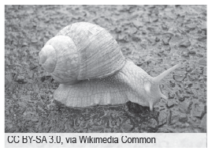

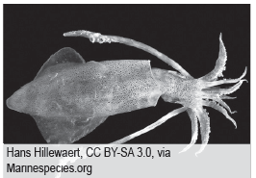
Classifying Invertebrates
Mollusks are heterotrophs, and they exhibit various modes of obtaining nutrients. Some mollusks are carnivores, while some are herbivores. However, there are also scavengers, and some are parasites. Most mollusks have mouths that contain the radula, which they use in scraping food from the surface they are onto. Filter feeders, such as clams, oysters, and mussels, lack the radula; therefore, they obtain food through filter feeding. The images below show some of the representative animals of phylum Mollusca.
A snail has a single shell.
Clams have two shells.
A squid lacks a shell.

Slide 12
Classifying Invertebrates
The next kind of invertebrates belongs to phylum Annelida, characterized by their cylindrical, ring-like, segmented bodies. The name “annelids” is derived from the Latin word annulus, which means ring. Each segment contains organ systems and is partitioned by a layer of tissue called the septum.Annelids have a complete and tubular digestive system running the entire length of the body. They exhibit bilateral symmetry with the entire flexible muscular body covered with a thick layer of cuticle. Annelids can swim, crawl, and burrow into the ground because of their highly muscular bodies and the very fine, bristle-like setae covering the body.

Slide 13
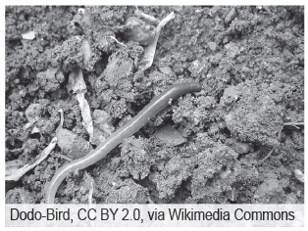
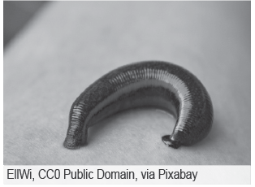
Classifying Invertebrates
The setae also support the worm in its burrow. The representative animals for the phylum Annelida are the earthworms and leeches.
An earthworm
A leech

Slide 14
Classifying Invertebrates
Arthropoda is another group of invertebrates that exhibit bilateral symmetry and cephalization. They have segmented bodies specialized in performing specific functions. Arthropods are considered the most successful, numerous, diverse, and widespread among all the animals.
Phylum Arthropoda is generally subdivided into five subphyla: Trilobitomorpha, Chelicerata, Crustacea, Myriapoda, and Hexapoda. The following are some of the classes that belong to the five subphyla: Insecta (from subphylum Hexapoda), Arachnida (from subphylum Chelicerata), and Chilopoda, and Diplopoda (from subphylum Trilobitomorpha). The insects belong to the class Insecta and are considered the most abundant of the arthropods. They are diverse and widespread among land animals since they can be found in all types of habitats.

Slide 15
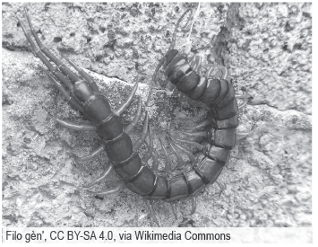
Classifying Invertebrates
Compared to the other arthropods, insects have three pairs of jointed legs in the adult stage of their life cycle. Most insects have bodies that are divided into the head, thorax, and abdomen. The head bears the eyes, a pair of antennae, and the mouthparts adapted for piercing, biting, sucking, and chewing. The thorax bears three pairs of appendages and the wings on its side. The abdomen bears the internal organs.
The other arthropods are classified based on the number of their appendages. Arachnids have four pairs of jointed legs, and they include spiders and scorpions. The chilopods include the centipede with one pair of legs per segment, while the diplopods include the millipede with two pairs of legs per segment. Finally, we have the crustaceans, including the shrimps, lobsters, and crabs, which have five pairs of legs.
The centipede is an arthropod under class Chilopoda.

Slide 16
Classifying Invertebrates
The last group of the invertebrates belong to phylum Echinodermata. Echinoderms are known as animals with a spiny skin. They are chiefly marine animals and exhibit radial symmetry. An endoskeleton consisting of a series of plates composed of lime or calcium carbonate called the ossicles supports an echinoderm’s body.
One feature of echinoderms is the presence of a water vascular system that extends outside the body, forming the tube feet. These tube feet are used for feeding, attachment, and locomotion. Unlike the insects, they do not exhibit cephalization as they lack a distinct head and tail region.

Slide 17

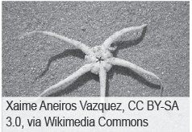
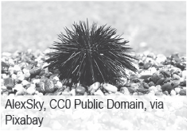
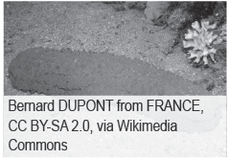
Classifying Invertebrates
Echinoderms are dioecious. Aside from this, echinoderms, such as sea stars, can reproduce asexually through fragmentation and regeneration. The echinoderms’ representative animals include the sea stars, commonly known as starfish, brittle stars, sea urchins, and sea cucumbers.
Sea star
Brittle star
Sea urchin
Sea cucumber

Slide 18
Classifying Invertebrates
Activity
Directions: Complete the table with the correct answers. Be guided accordingly in each column.
Invertebrate Phyla | Descriptions/Distinguishing Features
1. | They have cylindrical bodies that are divided into ring-like segments.
Echinodermata | 2.
3. | This phylum is known to be composed of the simplest animals.
Nematoda | 4.
5. | They are composed of body segments, such as the head, thorax, and the abdomen.

Slide 19
Classifying Invertebrates
Answer Key
Invertebrate Phyla | Descriptions/Distinguishing Features
1. Annelida/ Annelids | They have cylindrical bodies that are divided into ring-like segments.
Echinodermata | 2. Composed of spiny bodies/ Radially symmetrical
3. Porifera/Sponges | This phylum is known to be composed of the simplest animals.
Nematoda | 4. Also known as roundworms/ Some are parasitic
5. Arthropoda/ Arthropods | They are composed of body segments, such as the head, thorax, and the abdomen.

