Slide 1
Interactions of Organisms in an Ecosystem

Slide 2
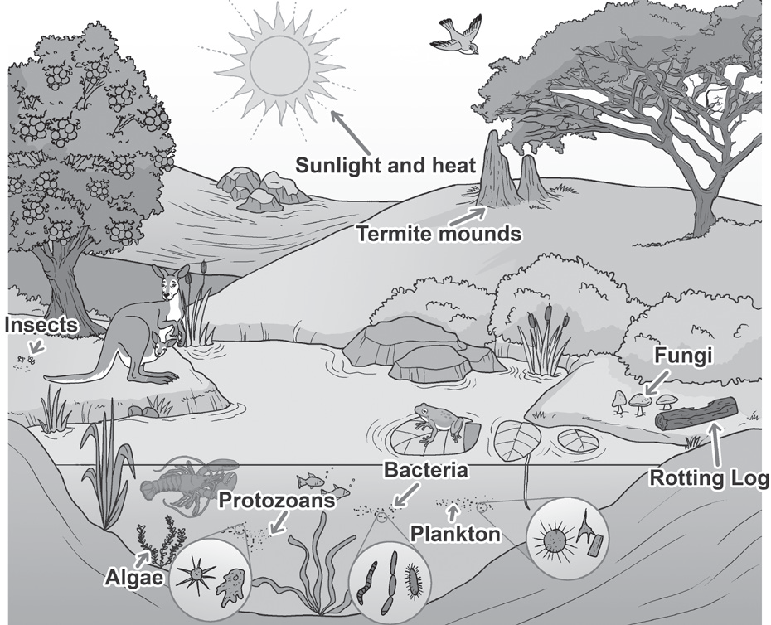
Interactions of Organisms in an Ecosystem
Ecosystem refers to a place with living and nonliving things interacting with each other to survive. An ecosystem also refers to a group of living organisms interacting with their environment. Every member of the ecosystem is connected and depends on each other.
Examples of large ecosystems include forests and oceans. On the other hand, both a garden and a pond are considered small ecosystems.
Organisms in an ecosystem

Slide 3
Think of your home as a very simple ecosystem. In it, you and your family, as well as your pets and plants, are all living things (biotic). You also need the nonliving things (abiotic) in your home like food, water, air, and furniture. Hence, in an ecosystem, living things meet their needs by interacting with both living and nonliving things. Without food, water, and air, living things cannot survive.
Interactions of Organisms in an Ecosystem
In an ecosystem, living things meet their needs by interacting with both living and nonliving things. Without food, water, and air, living things cannot survive.
Living things live together and interact with the environment. Every living thing makes up the species of an organism. The same species of organisms, which lives in a specific area, forms a population.
Example
Several roses that grow together in a garden form a population of roses. All livings things that live in that same garden form a community. The interaction of living things of different species in the community also describes an ecosystem.

Slide 4
Interactions of Organisms in an Ecosystem
Different Types of Interactions among Living Things
Ecosystem is also described as the total sum of all interactions that exist among organisms and their environment. These interactions can either be harmful or beneficial to the species living together.
Examples of relationships among organisms in an ecosystem.
1. Symbiosis
A symbiotic relationship involves two or more species living together in the same environment. Mutualism, commensalism, and parasitism are three types of symbiotic relationships.
Mutualism is the relationship of two organisms where they both benefit from each other. A clownfish has a symbiotic relationship with sea anemones. The clownfish, with its territorial behavior, chases away the predators of anemones, while the anemones protect the clownfish with their stinging cells.

Slide 5
Interactions of Organisms in an Ecosystem
Commensalism is a relationship between two species in which one organism benefits while the other organism is neither benefited nor harmed.
The orchid makes its food and does not take anything from the tree. It simply benefits from the tree by getting the much needed sunlight. The tree does not benefit and is not harmed from the interaction.
Parasitism is a relationship where one organism (parasite) benefits and the other (host) is harmed but not killed outright. It is usually advantageous for the parasite not to kill its host because the parasite lives on or in the body of its host. An example of a parasitic relationship happens when fleas live on the fur of a dog.

Slide 6
Interactions of Organisms in an Ecosystem
Cooperation
Cooperation is a type of interaction where organisms cooperate for their survival. Here, every member of the species works together so that life continues.
Take the colony of ants as an example. The working colony of ants shows cooperation as they dig huge nests, use each other’s bodies to form rafts or bridges, and the like. Members of the colony include the queen, worker ants, soldier ants, and drones; and each member has a specific task to do.
Deep inside the nest of an ant colony, the queen lives to produce eggs. A worker ant is tasked to collect food, dig tunnels, and take care of the baby ants, while a soldier ant protects the nest from other ants belonging to a different colony. Male ants, called drones, usually have wings and fl y to start new colonies.

Slide 7
Interactions of Organisms in an Ecosystem
For the colony to survive, it needs all the different members to do their jobs. The worker ants cannot produce eggs, so they need The queen. The queen cannot collect food or protect the nest, so it needs the workers and the soldiers.
Competition
When populations or different species in an ecosystem consume the same resources, the resources can become limited, and competition exists.
Animals compete for resources, food, space, and hiding places to avoid predators and to protect their young, territories, or nest sites. When animals compete against each other, they sometimes harm other animals.

Slide 8
Interactions of Organisms in an Ecosystem
Plants also have ways of competing for soil nutrients, water, or access to sunlight. Some plants secrete inhibiting or growth suppressing chemicals into the soil to inhibit the growth of or kill other nearby plants.
Predation
It is the consumption of one living organism, plant, or animal by another. It is also known as a predator–prey relationship. The predator hunts and consumes, while the prey is the victim. Spiders like orb weavers capture and eat insects, such as crickets, trapped in the web.Predation regulates population growth and promotes natural selection by removing the unfit from a population. When predators are removed or reduced, the prey population increases, and their habitat becomes packed or overcrowded.

Slide 9
Interactions of Organisms in an Ecosystem
In a food chain, plants are the food producers, while animals are the consumers. Consumers can be herbivores, carnivores, and omnivores.
    Herbivores or animals that eat plants are the primary consumers or first order consumers.
      Examples of herbivores include rabbits, deer, cows, and goats.
    Carnivores eat other animals to sustain themselves. Carnivores, such as lions and tigers, are predators that hunt for their food known as prey.
    Omnivores are animals that eat both producers and consumers.

Slide 10
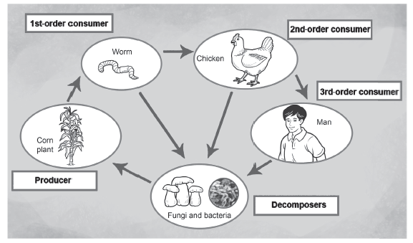
Interactions of Organisms in an Ecosystem
Plants use the energy from the Sun to change water and carbon dioxide into sugar called glucose. When animals eat plants, the energy from digested glucose is transferred to the animals.
Example of a Food Chain

Slide 11
Interactions of Organisms in an Ecosystem
The energy is transferred from the producer as it is eaten by the first-order or primary consumer, which is the worm. The worm is eaten by the secondary consumer, which is the chicken; and the chicken is eaten by the tertiary consumer (or final consumer), which is the human. In this example of a food chain, the energy from the producer (corn plant) is transferred to the tertiary consumer (human).
Furthermore, notice that the arrows from the animals are pointing to the decomposers. These are organisms that can break down the bodies of dead plants and animals. Bacteria and fungi are common decomposers.
When living things die without being eaten, they can be decomposed. As the organism decays, its remaining energy is returned to the soil. This energy will be used by plants or producers growing on that soil. As plants grow, they produce more energy with the help of the Sun. When these plants are consumed by other consumers, the energy is recycled once again.

Slide 12
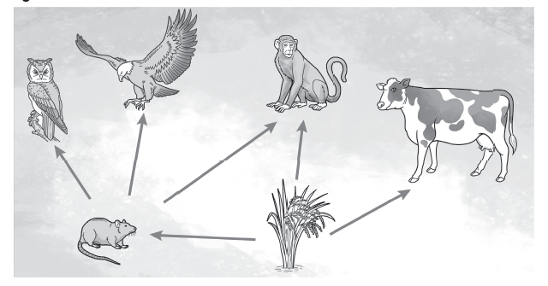
Interactions of Organisms in an Ecosystem
Example of a Food Web
In this food web, the rice plant is the producer, which is eaten by the primary consumers (rat, monkey, and cow). The energy from the rice plant is transferred to secondary consumers like the eagle, the owl, and the monkey after they consumed the rat. The monkey could be a primary or a secondary consumer since it can eat both plants and animals.
The food web is an important part of the ecosystem. It is needed to maintain a delicate balance in the environment. Each part of the food web works to keep the population size of an organism in check. If any member of the web is damaged or destroyed, the entire ecosystem will be affected.

Slide 13
Interactions of Organisms in an Ecosystem
Food chains are important in the survival of species. A community with a decreasing population of producers is a problem. Also, an increasing population of carnivores makes it harder to hunt for food since there is high competition. Maintaining balance is essential in an ecosystem. To have balance, the eating relationship and the fl ow of energy must continue, and this flow of energy can be mapped in a food web.
B. Food Web
When several food chains are linked to each other, they form a food web. A food web is a diagram that connects all feeding patterns and relationships.

Slide 14
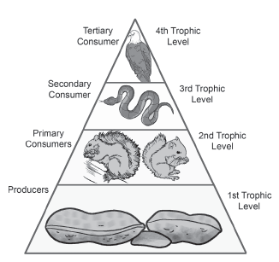
Interactions of Organisms in an Ecosystem
Energy Pyramid
In a food web, the amount of energy received by each animal in each step of a food chain decreases. This decrease in the amount of energy is shown in an energy pyramid. An energy pyramid is a diagram that shows the amount of energy stored in each living thing in a food chain. The base of the pyramid has the greatest amount of energy, and it is occupied by the producers.
The trophic level is a step in the food pyramid that shows the food an organism consumes to survive. Living things use the energy from consuming the organisms from the lower tropic level. The energy in each trophic level decreases from bottom to top. This is because a big portion of that energy is converted to heat in every usage.

Slide 15
Interactions of Organisms in an Ecosystem
Activity
A. For each column, provide sentences taken from the previous discussion to show the difference between beneficial and harmful relationships. Follow the example listed to help you complete this exercises.
Beneficial Interactions | Harmful Interactions
Mutualism is a symbiotic relationship between two organisms that both benefit from each other. | Competition can be a harmful interaction. When organisms compete against each other, they sometimes harm other organisms.

Slide 16
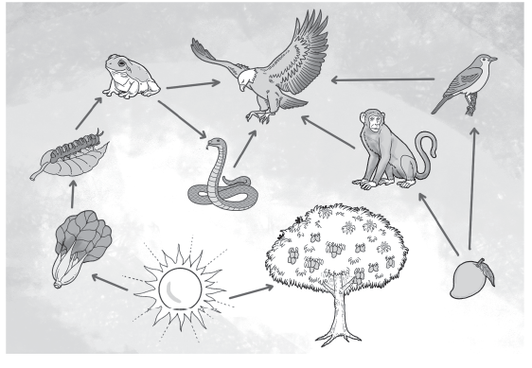
Interactions of Organisms in an Ecosystem
B. Briefly answer the following questions:
1. How is the energy from the pechay transferred to the Philippine Eagle?
2. Why is the mango tree important in our ecosystem?

Slide 17
Interactions of Organisms in an Ecosystem
Answer Key
A. Answers may vary. Suggested answers include the following:
Beneficial relationships include interactions that help both organisms to grow and survive and do not harm both interacting organisms. Harmful relationships include interactions that harm one of the organisms or cause death to one of the organisms.
B. Answers may vary. Suggested answers include the following:
The energy from the pechay was transferred to the caterpillar upon consumption. Some of this energy was transferred to the Philippine Eagle when it consumed the frog that ate the caterpillar.
Without the mango tree in the ecosystem, the mango fruit will not be part of the food chain.

