Slide 1
Interactions among Living Things and Nonliving Things in Estuaries

Slide 2
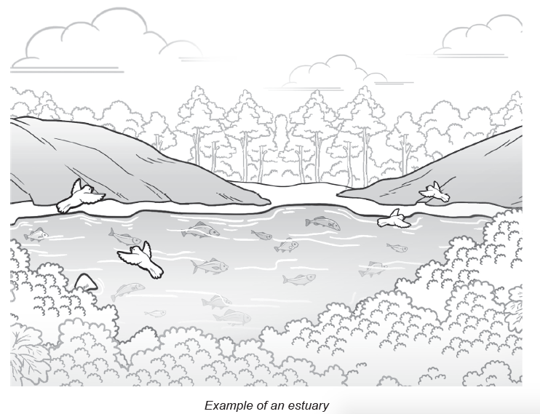
Interactions among Living Things and Nonliving Things in Estuaries
The Philippine waters are known for their rich ecosystems, housing different varieties of
fishes, corals, and seaweeds. The picture above is an example of an ecosystem known as an estuary. It is defined as an area where the fresh water from rivers and salt water from the seas meet. It is considered a wetland, a home for a variety of marine animals, birds, and plants, as well as nonliving things, such as rocks, sands, and shells. Estuaries are often described as brackish, having more salinity (the amount of salt dissolved in water) than fresh water, but not as much as seawater, which is believed to be the main reason for the presence of their high diversity of living organisms.

Slide 3
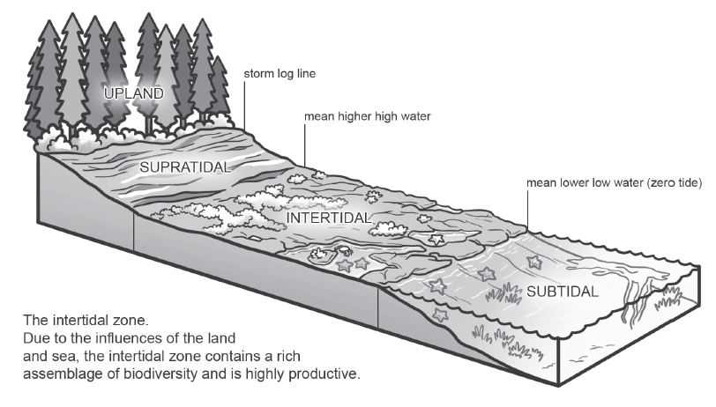
Interactions among Living Things and Nonliving Things in Estuaries
Different Zones of the Estuary
The estuary is divided into three tidal zones: the supratidal zone, intertidal zone, and subtidal zone. You may observe the image above for reference.

Slide 4
Interactions among Living Things and Nonliving Things in Estuaries
Supratidal Zone - This zone is seldom covered with water from the sea. This can be found above the high tide waterline that extends to the upland. The lower part of this zone may receive moisture coming from the waves from the sea.
Intertidal Zone - This zone is unique because it is being exposed to air and water at different times. During low tide, the area is exposed to the air, while during high tide, it is submerged in water. Also, this zone has varying salinity levels perfect for some animals and crabs to live in. A detailed discussion of the interaction of living and nonliving things will be discussed in the next lesson.
Subtidal Zone - This zone is always covered with water since this can be found below the low tide line. Most of the time, the organisms here cannot live on land or be exposed for a long time in the air.

Slide 5
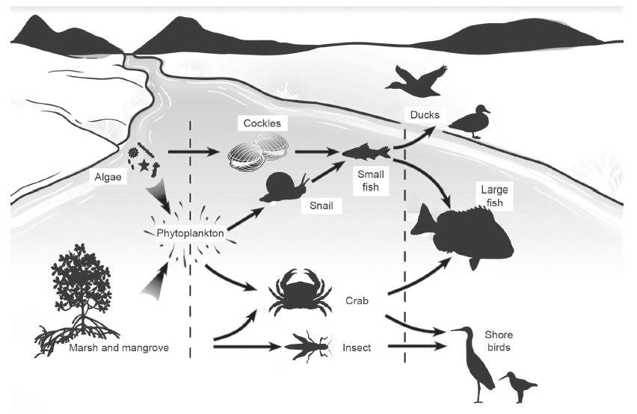
Interactions among Living Things and Nonliving Things in Estuaries
The Relationships and Interactions of the Organisms in Estuaries

Slide 6
Interactions among Living Things and Nonliving Things in Estuaries
The interaction of these living things starts with the phytoplankton present in the water. Phytoplankton are tiny organisms (algae) that are free flowing in water and, most of the time, are eaten by zooplankton, marine animals that feed on plants and plant-like organisms such as algae. Fishes and other animals, such as worms, crabs, snails, and shellfish, feed on green algae, kelps, and other zooplankton for their survival. Larger animals feed on those aforementioned small animals. The dead and decayed remains of many organisms release nutrients that are essential for phytoplankton to grow and survive.

Slide 7
Interactions among Living Things and Nonliving Things in Estuaries
Activity
Directions: In this exercises, you are going to choose the appropriate living organisms for every box based on the relationship or interaction they have as shown by each arrow. For example, the box containing the phytoplankton is related to the box with number 1, which are organisms that feed on phytoplankton. Do the rest of the boxes. Use the given choices of organisms below.
2
3
CRABS SHARKS SNAILS
SEA STARS WHALES KELPS
4
1
5
Phytoplankton

Slide 8
Interactions among Living Things and Nonliving Things in Estuaries
Answer Key
SEA STARS
CRABS
WHALES
SNAILS
SHARKS
Phytoplankton

