Slide 1
Survival in the Environment

Slide 2
Survival in the Environment
Organisms have basic needs, such as food, water, and shelter, that they must acquire for them to survive. Living (biotic factors) should interact with and nonliving things (abiotic factors) in their environment to meet these basic needs.
A side from receiving these needs, organisms must live in an environment where threats to their survival are few or none. However, conditions in the environment are constantly changing, so organisms have to respond or react to these changes in order for them to survive. Failure of the organisms to respond to these changes could lead to their death and, possibly, to the extinction of their species.
As the organisms respond to the changes in the environment, they, too, undergo changes. The feature of organisms that allow them to respond to changes in the environment is known as an adaptation. For the organisms to survive, they must have structures, physiological processes, and behaviors that would enable them to meet the requirements of living in their environment. The environment, therefore, plays an important role in determining what characteristics are present in an organism.

Slide 3
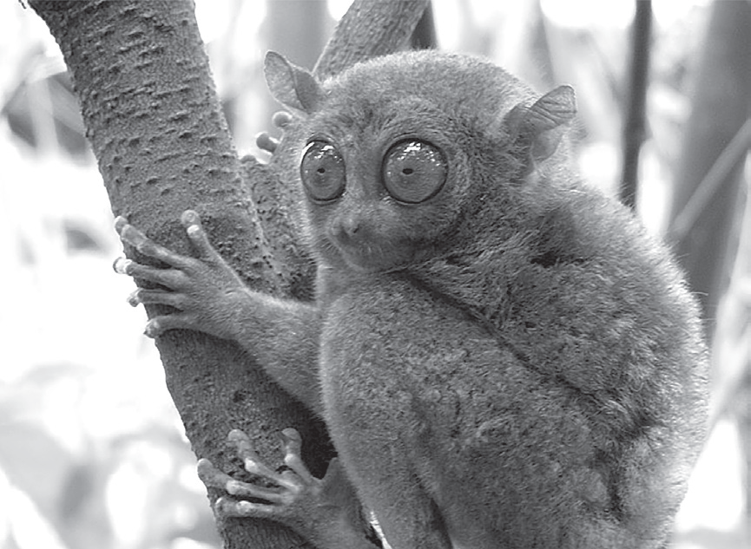
Survival in the Environment
Structural Adaptation
Structural adaptations involve changes in the appearance or morphology of the organism. The presence of thorns protects cacti from being foraged by thirsty herbivores in the desert environment. Predators have strong jaws and sharp teeth that can crush and tear the flesh and bones of their prey. Prey, on the other hand, can escape predators by resembling a twig, a stone, or a bark through cryptic coloration.
The tarsier in our example has excellent vision due to large eyes, padded fingertips for gripping branches, and a long tail for balance when jumping. For plants to survive on land, they must possess extensive root systems to get water and other important nutrients.
mtoz, CC BY-SA 2.0, via wikimedia commons

Slide 4
Survival in the Environment
Physiological Adaptation
Physiological adaptations are based on body chemistry and metabolism and can be considered any function that an organism exhibits as a direct response to environmental changes. Humans perspire when the environmental temperature gets higher than usual because it is an evaporative cooling process. Camels can travel long distances in the desert even in the absence of water because certain metabolic process converts the fats in their hump into water. The skin darkens when doing recreational activities in places exposed to the Sun because the darkening protects the underlying tissues from dehydration. Bamboos and other plants are capable of producing hydrogen cyanide that acts as a poison to protect themselves from herbivores.

Slide 5
Survival in the Environment
Behavioral Adaptation
Behavioral adaptations are any activities that are instinctive or that an organism had learned or had become conditioned to do as a reaction to environmental changes. Opossum play dead when they spot predators, birds migrate to other places during the winter season to look for a place with a better climate, and mammals hibernate during the winter season and estivate during summer in very dry places. Some animals are diurnal (active during the day) or nocturnal (active during the night) in their feeding habits to time their activities with that of their prey and to also avoid possible predators that may eat them in turn. Tarsiers are nocturnal, and they hunt for food during the night.

Slide 6
Survival in the Environment
Misconception about Adaptations
“Organisms are perfectly adapted to their environment.” Organisms are not perfectly adapted to their environment, and there is always a struggle for them to survive. The presence of adaptations helps them survive, but the constant changes in the environment mean that even the seemingly “best suited” organisms can find it difficult to survive and can even become extinct.

Slide 7
Survival in the Environment
Activity
Scenario Analysis
When conditions become very hot and dry, a bullfrog will use its strong legs to bury itself in mud. The bullfrog will then secrete a mucus membrane that will cover its body to protect it from drying out, and it hardens into a cocoon. The bullfrog will then undergo estivation in this cocoon as it waits for the rainy season to arrive. When it rains, the water will melt the mucus, and this awakens the bullfrog, which will then dig itself out and become active once more.
Directions: Answer the following questions.
1. What type of adaptation is having strong legs?
2. What type of adaptation is secreting a mucus membrane?
3. What type of adaptation is undergoing estivation?

Slide 8
Survival in the Environment
Answer Key
1. What type of adaptation is having strong legs?
- Structural Adaptation
2. What type of adaptation is secreting a mucus membrane?
- Physiological Adaptation
3. What type of adaptation is undergoing estivation?
- Behavioral Adaptation

