Slide 1
Homogeneous Mixtures

Slide 2
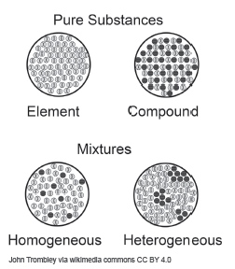
Homogeneous Mixtures
Pure substance is a form of matter that has constant chemical composition. It is either an element or a compound.
A mixture is a physical combination of two or more pure substances in which each substance retains its properties. A mixture has varied compositions. It means that the amount of substances that comprise a mixture is not definite, unlike pure substances that contain a set number of atoms, particles, or molecules.

Slide 3
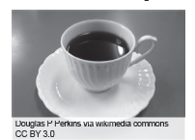
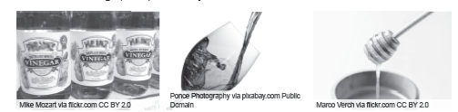
Homogeneous Mixtures
Homogeneous mixtures
Mixtures that seem to appear uniform to the eye
This type of mixture consists of a single phase whether it be solid, liquid, or gas
homogeneous mixture is called a solution
Homogeneous mixtures are uniformly distributed throughout the mixture
Examples of homogeneous mixtures in the liquid state
coffee
vinegar
wine
honey

Slide 4
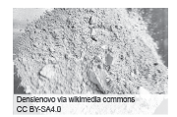
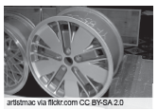
Homogeneous Mixtures
Examples of homogeneous mixtures in the solid state
Cement is a homogeneous mixture because it is a mixture of calcium compounds. Meanwhile, an alloy is a mixture of metallic elements.

Slide 5
Homogeneous Mixtures
Activity
Directions: Complete the following statements below by choosing the appropriate term from the choice box. Write your answer in the space provided.
chemical | alloy | cement
homogeneous | uniform | varied
1. Pure substances have constant __________ composition.
2. The composition of a mixture, unlike a pure substance, is __________ or not definite.
3. In __________ mixtures, a person will only be able to see a single phase.
4. __________ is a homogeneous mixture that is composed of two or more metallic substances.
5. The distribution of particles in a homogeneous mixture is __________.

Slide 6
Homogeneous Mixtures
Answer key
1. chemical
2. varied
3. homogeneous
4. Alloy
5. uniform

