Slide 1
Effects of Interactions of Organisms with the Environment

Slide 2
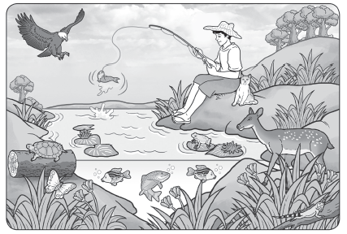
Effects of Interactions of Organisms with the Environment
Living things cannot live by themselves in an ecosystem. They depend on some abiotic factors in the places where they live. The abundant or limited distribution of these abiotic factors affects the organism’s life process.

Slide 3
Effects of Interactions of Organisms with the Environment
Environmental Conditions Needed by Living Things to Survive
Light - Being the main source of energy for organisms, light plays an important part in the life of most plants as it is used in the process of food making. The duration (length of time) and manner (direct or indirect) of exposure to light affect the process. Both the duration and manner of light affect the production and the amount of food available for all.
Water - Both plants and animals need water for survival. They both consume and use water to stay healthy and grow. Also, water is the natural habitat where aquatic plants and animals live and grow.

Slide 4
Effects of Interactions of Organisms with the Environment
Temperature and other weather conditions - The temperature prevailing in an area determines the kind of organisms that live in that ecosystem. There are certain maximum and minimum ranges of temperature in which both plants and animals require to survive. Also, organisms generally survive in a particular range of atmospheric pressure. Some may find it difficult to breathe in a place with high altitude and low air pressure. The decreased amount of oxygen at a certain height makes it difficult for some species to survive.
Air - Organisms need oxygen, which is present in the air that we breathe in. It also contains carbon dioxide that is used by plants to manufacture food. The food produced by the plants is eaten by the animals in the environment.

Slide 5
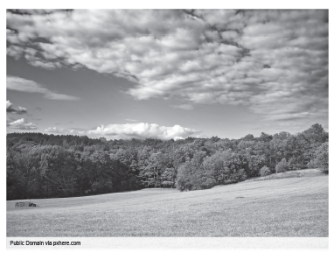
Effects of Interactions of Organisms with the Environment
Soil - Soil has different chemical components. Aside from that, the water content, soil fertility, and the presence of minerals are factors for a soil to be healthy. Healthy soil is important in plants’ growth and fruit-bearing stages.

Slide 6
Effects of Interactions of Organisms with the Environment
Effects of Interactions among Organisms in Their Environment
When organisms interact, the environment where they live is also affected either positively negatively.
Example of a positive interaction happens when organisms interact such that the ecosystem continues to grow and organisms continue to survive. However, since not all interactions are beneficial, they also have negative effects on the environment.
Example of negative effect is when predation and competition affect the population size of some organisms. These types of interactions could wipe out the existence of an organism in an area. The extinction of an organism in an ecosystem changes the environment as well.

Slide 7
Effects of Interactions of Organisms with the Environment
Interactions Change the Population Size
Population size is the number of organisms living in an area. The population size changes when new organisms move into an ecosystem. Another reason for a population change happens when organisms move out of an ecosystem.
Immigration is the arrival of organisms from outside a given area, while emigration is the exit of an organism from a given area. These migration patterns happen as organisms move in search of food or a safer environment. Even among people, migration has a huge effect on the population size. Even in this time, many people move from one place to another in search of livelihood, resources, and experiences.

Slide 8
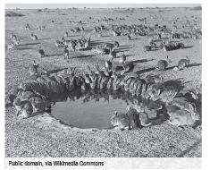
Effects of Interactions of Organisms with the Environment
An organism’s birth rate and death rate also affect its population size. If there are more births than deaths, the population size increases. Without predators, and with the right living conditions, a population of organisms will continue to grow. This creates an imbalance in the ecosystem. When predation happens, the stronger species survive and can control other species.

Slide 9
Effects of Interactions of Organisms with the Environment
Interactions Cause Animals to Defend Themselves
To increase their chances of surviving harmful interactions and relationships, organisms use protective mechanisms, such as warning coloration, camouflage, and mimicry.
Some species of snakes, newts, and toads show bright colors to warn their predators. This coloration signals that they are toxic or distasteful. This protective mechanism is called warning coloration.
Camouflage and mimicry are terms that you may be already familiar with. While some animals use bright colors for defense, others deceive their predators through camouflage. In this protective adaptation, animals blend with their surroundings for protection. Mimicry is when animals protect themselves from predators by imitating other animals or inanimate objects.

Slide 10
Effects of Interactions of Organisms with the Environment
Being the caretakers of our environment, we must solve the primary cause of environmental destruction, which is pollution. Pollution is the changing or adding of substances that harm the environment and the organisms living in it.
In a polluted environment, both biotic and abiotic factors of the ecosystem are affected. When the balance between these components changes, the population size of plants and animals is greatly affected.
Another cause of environmental destruction is wildlife depletion through deforestation and coral reef destruction.

Slide 11
Effects of Interactions of Organisms with the Environment
Deforestation happens when large-scale plant communities are removed from a certain land area. It is characterized as a careless and unselective cutting of trees for varied purposes. Forest regrowth must be done to protect the wildlife in every land area.
Destruction of coral reefs occurs when human activities, such as overfishing, muro-ami, and other pollution causing activities, are done. Cyanide and dynamite fishing also destroy coral reefs and the marine environment. Protecting these coral reefs will

Slide 12
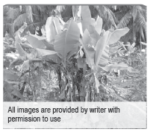
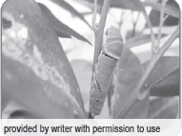
Effects of Interactions of Organisms with the Environment
Activity
Directions: Study the pictures and answer each of the following questions.
What happens when too many banana plants grow close to each other in a very limited land area?
What happens when many caterpillars eat the leaves of a calamansi plant?

Slide 13
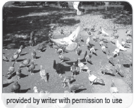
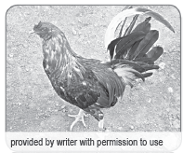
Effects of Interactions of Organisms with the Environment
What happens when too many pigeons gather to feed on a limited number of grains?
4. What happens when a rooster eats an earthworm that comes out of the soil?

Slide 14
Effects of Interactions of Organisms with the Environment
Answer Key
Answers may vary. Suggested answers may include the following:
The banana plants compete against each other for soil nutrients and water. With less food and water, the growth of the banana plants becomes stunted, and they will not bear fruits.
The plant will have fewer leaves for photosynthesis. Without the leaves, the plant will not be able to produce its own food, and it may also dry up and die.
The pigeons will be competing for the grains. They may get hurt trying to catch some grains, or they may go hungry due to lack of nutrients.
The earthworm is food for the rooster. If the food is healthy, it brings good nutrients to the consumer; the rooster will be properly nourished.

