Slide 1
Range, Average Deviation, Variance, and Standard Deviation of Grouped Data

Slide 2
Range, Average Deviation, Variance, and Standard Deviation of Grouped Data
The mathematical concept regarding the middlemost number of grouped data’s class interval is called a mid-value. In this lesson, you will be refreshed on how to identify the mid-values and how to compute for the measures of variability of grouped data. As you go through this lesson, observe the similarities and differences in the steps for finding the measures of variability.

Slide 3


Range, Average Deviation, Variance, and Standard Deviation of Grouped Data
Computing for the measures of variability for grouped data has a slight difference with how they are determined for ungrouped data. Begin with determining the formula for the range, average deviation, variance, and standard deviation of grouped data by identifying the mid-value of each class interval.
Recall that the mid-value of a class interval is the average of the upper boundary and the lower
boundary of the interval. For instance, for the interval 23–32, the mid-value is = 27.5 On
the other hand, for 20 < x ≤ 30, the mid-value is 25 because the average of 20 and 30 is 25 or

Slide 4
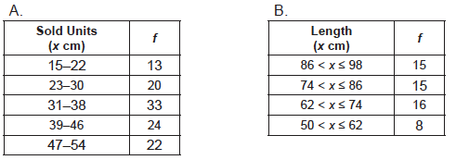
Range, Average Deviation, Variance, and Standard Deviation of Grouped Data
The range of grouped data is determined by finding the difference between the largest mid-value and the smallest mid-value. That is,
Range = largest mid-value – smallest mid-value
Example 1: Calculate the range of each frequency table.

Slide 5
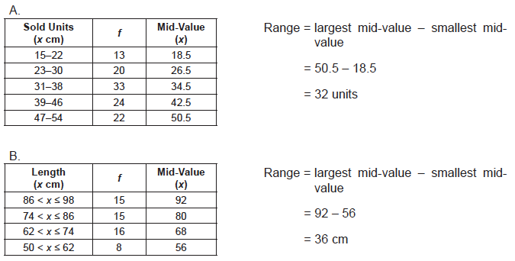
Range, Average Deviation, Variance, and Standard Deviation of Grouped Data
Solution:
Extend each table by adding a column on the right for the mid-values.

Slide 6

Range, Average Deviation, Variance, and Standard Deviation of Grouped Data
To find the average deviation of grouped data, you have to:
a. Compute for the mean , where Σ fx is the sum of the products of the frequencies and
their corresponding mid-values, and Σ f is the sum of the frequencies. Round the answer to the
nearest hundredth.
b. Subtract the mean ( x ) from the mid-values (x) and write the difference under the x − x column. Then, get the absolute values of the differences. Note that all values under the x − x column must be positive.
c. Multiply the frequencies with their respective I x − x I values. The products must be written under the f I x − x I column.

Slide 7

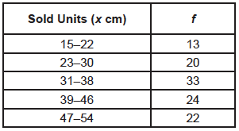
Range, Average Deviation, Variance, and Standard Deviation of Grouped Data
d. Find
e. Solve for the grouped data average deviation using the formula:
Example 2: Calculate the average deviation of the frequency table below.

Slide 8
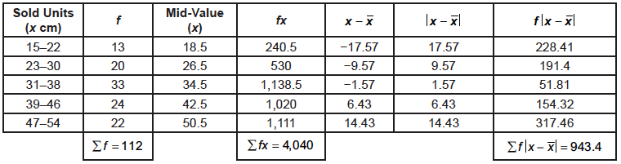


Range, Average Deviation, Variance, and Standard Deviation of Grouped Data
Solution:
To find the variance and standard deviation for grouped data, you have to square the difference between the mid-values and the mean and then multiply the squares with their corresponding frequencies. Afterward, find Use the formulas below to determine the grouped data’s variance and standard deviation.

Slide 9
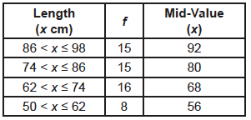
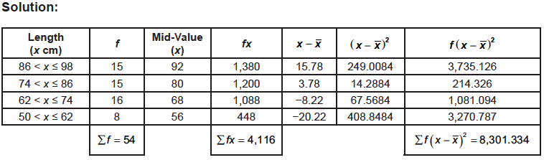
Range, Average Deviation, Variance, and Standard Deviation of Grouped Data
Example 3: Find the variance and standard deviation of the data on the right.

Slide 10
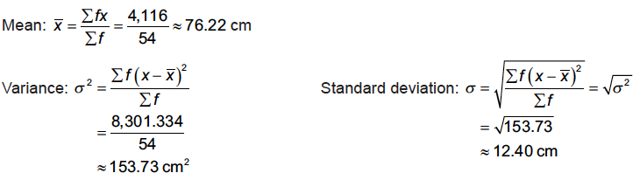
Range, Average Deviation, Variance, and Standard Deviation of Grouped Data
Example 3: Find the variance and standard deviation of the data on the right.

