Slide 1
Product of the Sum and Difference of Two Terms

Slide 2
Product of the Sum and Difference of Two Terms
The product of the sum and difference of two terms is the square of the first term minus the square of the second term.
The expressions (2x + 1) and (2x – 1) are binomials with the same terms: one is a sum, and the other is a difference.

Slide 3
Product of the Sum and Difference of Two Terms
The product of the sum and difference of two terms is the square of the first term minus the square of the second term.
The expressions (2x + 1) and (2x – 1) are binomials with the same terms: one is a sum, and the other is a difference.

Slide 4
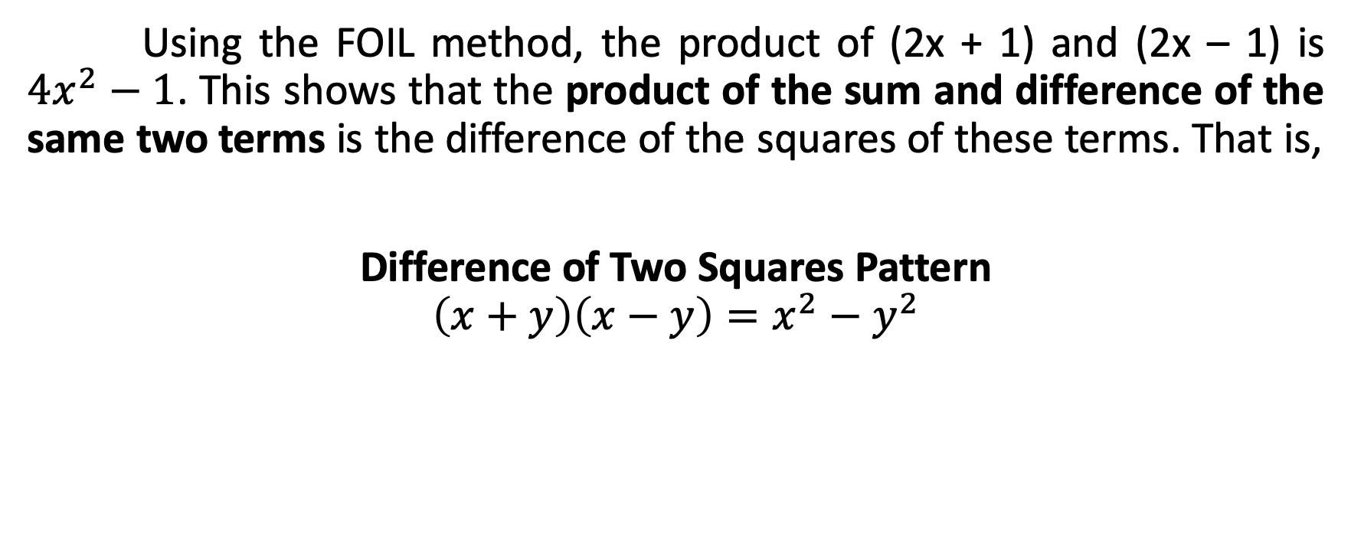
Product of the Sum and Difference of Two Terms
Using the FOIL method, the product of (2x + 1) and (2x – 1) is ${4x}^{2}−1$. This shows that the product of the sum and difference of the same two terms is the difference of the squares of these terms. That is,
Difference of Two Squares Pattern
$$\left(x+y\right)\left(x−y\right)=x^{2}−y^{2}$$

Slide 5
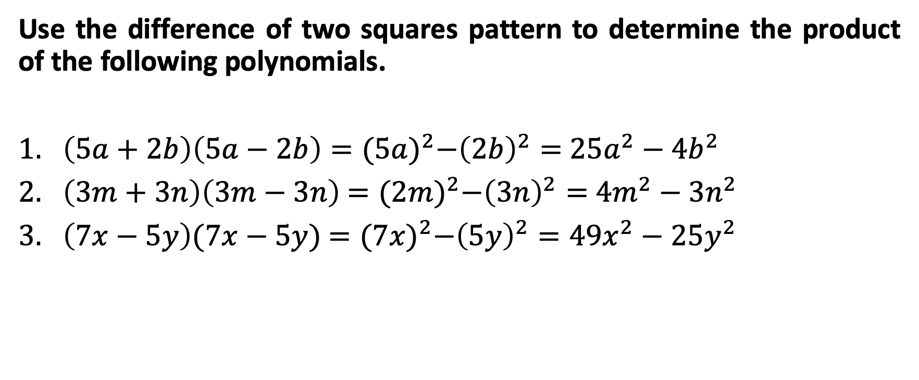
Product of the Sum and Difference of Two Terms
Use the difference of two squares pattern to determine the product of the following polynomials.
$\left(5a+2b\right)\left(5a−2b\right)={(5a)}^{2}−{\left(2b\right)}^{2}=$ ${25a}^{2}−{4b}^{2}$
$\left(3m+3n\right)\left(3m−3n\right)$ $={(2m)}^{2}−{\left(3n\right)}^{2}=$ ${4m}^{2}−{3n}^{2}$
$\left(7x−5y\right)(7x−5y)$ $={(7x)}^{2}−{\left(5y\right)}^{2}={49x}^{2}−{25y}^{2}$

