Slide 1
Product of a Binomial and Trinomial

Slide 2
Product of a Binomial and a Trinomial
The product of a binomial and a trinomial can be solved using two different methods:
Box method
Algebraic method

Slide 3
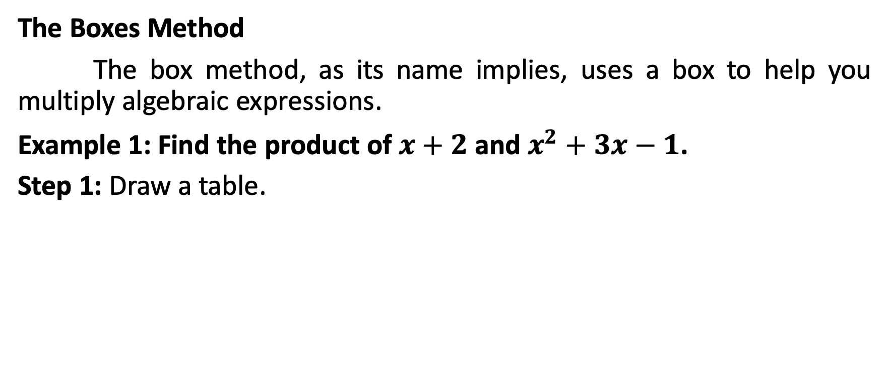
Product of a Binomial and a Trinomial
The Boxes Method
The box method, as its name implies, uses a box to help you multiply algebraic expressions.
Example 1: Find the product of $x+2$ and $x^{2}+3x−1$.
Step 1: Draw a table.

Slide 4
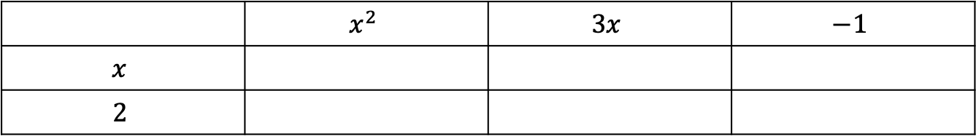
Product of a Binomial and a Trinomial
Step 2: Write the terms of the binomial in the first column and every term of the trinomial in the first row.
 | $$x^{2}$$ | $$3x$$ | $$−1$$
$$x$$
$$2$$

Slide 5
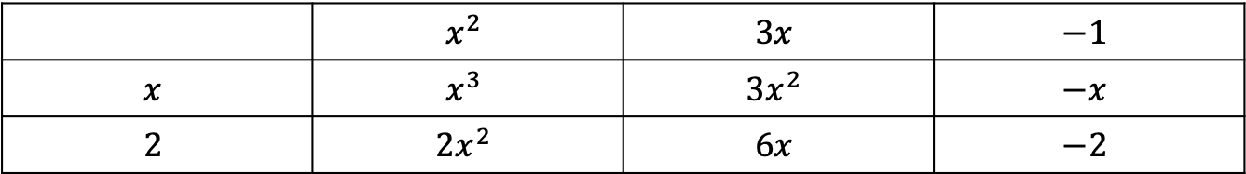
Product of a Binomial and a Trinomial
Step 3: Multiply every term in the first column to every term in the first row.
 | $$x^{2}$$ | $$3x$$ | $$−1$$
$$x$$ | $$x^{3}$$ | $${3x}^{2}$$ | $$−x$$
$$2$$ | $${2x}^{2}$$ | $$6x$$ | $$−2$$

Slide 6

Product of a Binomial and a Trinomial
Step 4: Combine the similar terms. They are usually placed diagonally.
$$x^{3}{+2x}^{2}+{3x}^{2}+6x−x−2$$
 | $$x^{2}$$ | $$3x$$ | $$−1$$
$$x$$ | $$x^{3}$$ | $${3x}^{2}$$ | $$−x$$
$$2$$ | $${2x}^{2}$$ | $$6x$$ | $$−2$$

Slide 7

Product of a Binomial and a Trinomial
Step 5: Obtain the final answer by combining the terms.
$$x^{3}{+2x}^{2}+{3x}^{2}+6x−x−2$$

Slide 8

Product of a Binomial and a Trinomial
Example 2: Find the product of $x−2$ and $x^{2}−2x+3$.
Step 1: Draw a table.

Slide 9
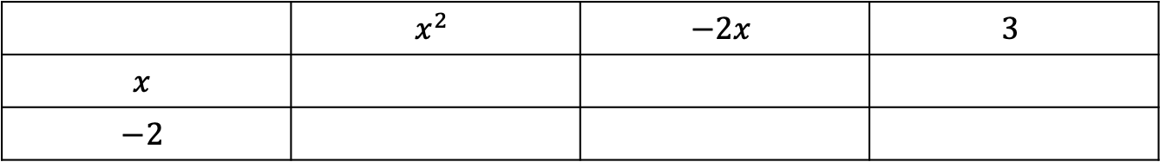
Product of a Binomial and a Trinomial
Step 2: Write the terms of the binomial in the first column and every term of the trinomial in the first row.
 | $$x^{2}$$ | $$−2x$$ | $$3$$
$$x$$
$$−2$$

Slide 10
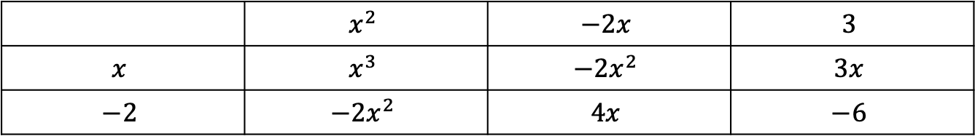
Product of a Binomial and a Trinomial
Step 3: Multiply every term in the first column to every term in the first row.
 | $$x^{2}$$ | $$−2x$$ | $$3$$
$$x$$ | $$x^{3}$$ | $${−2x}^{2}$$ | $$3x$$
$$−2$$ | $${−2x}^{2}$$ | $$4x$$ | $$−6$$

Slide 11

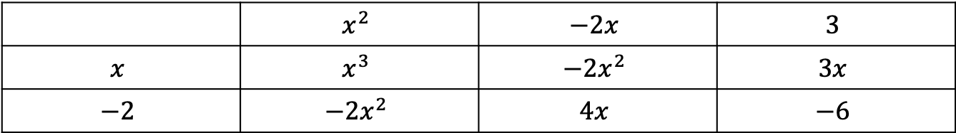
Product of a Binomial and a Trinomial
Step 4: Combine the similar terms. They are usually placed diagonally.
$$x^{3}{−2x}^{2}{−2x}^{2}+4x+3x−6$$
 | $$x^{2}$$ | $$−2x$$ | $$3$$
$$x$$ | $$x^{3}$$ | $${−2x}^{2}$$ | $$3x$$
$$−2$$ | $${−2x}^{2}$$ | $$4x$$ | $$−6$$

Slide 12

Product of a Binomial and a Trinomial
Step 5: Obtain the final answer by combining the terms.
$$x^{3}{−4x}^{2}+7x−6$$

Slide 13
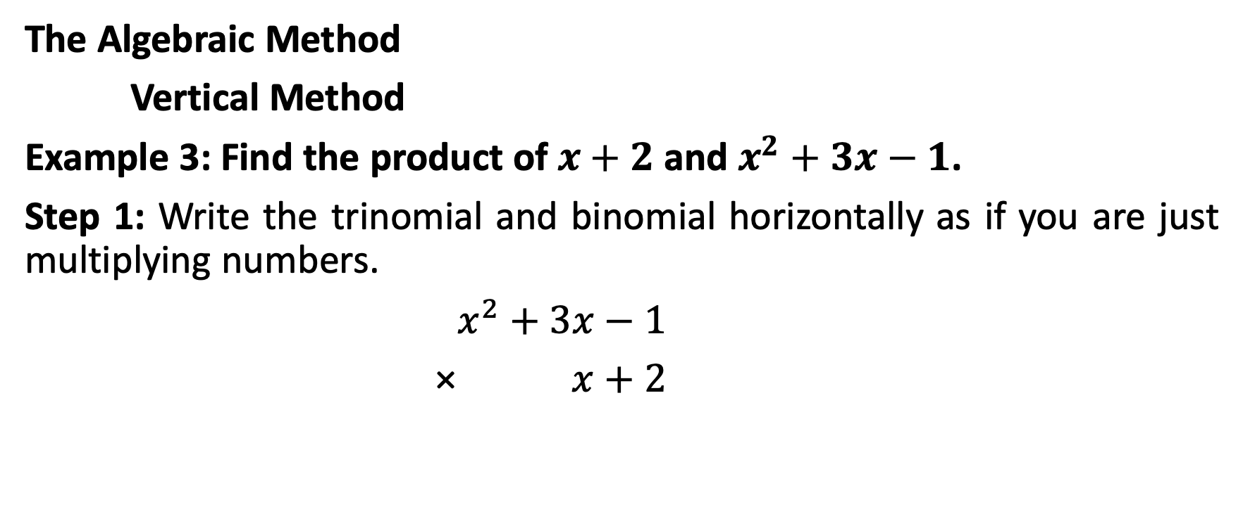
Product of a Binomial and a Trinomial
The Algebraic Method
Vertical Method
Example 3: Find the product of $x+2$ and $x^{2}+3x−1$.
Step 1: Write the trinomial and binomial horizontally as if you are just multiplying numbers.
$x^{2}+3x−1$
× $x+2$

Slide 14

Product of a Binomial and a Trinomial
Step 2: Multiply the last term of the binomial to every term of the trinomial.
$x^{2}+3x−1$
× $x+2$
$x^{2}+6x−2$

Slide 15

Product of a Binomial and a Trinomial
Step 3: Multiply the first term of the binomial to every term of the trinomial.
$x^{2}+3x−1$
× $x+2$
$x^{2}+6x−2$
$x^{3}+{3x}^{2}−x$

Slide 16
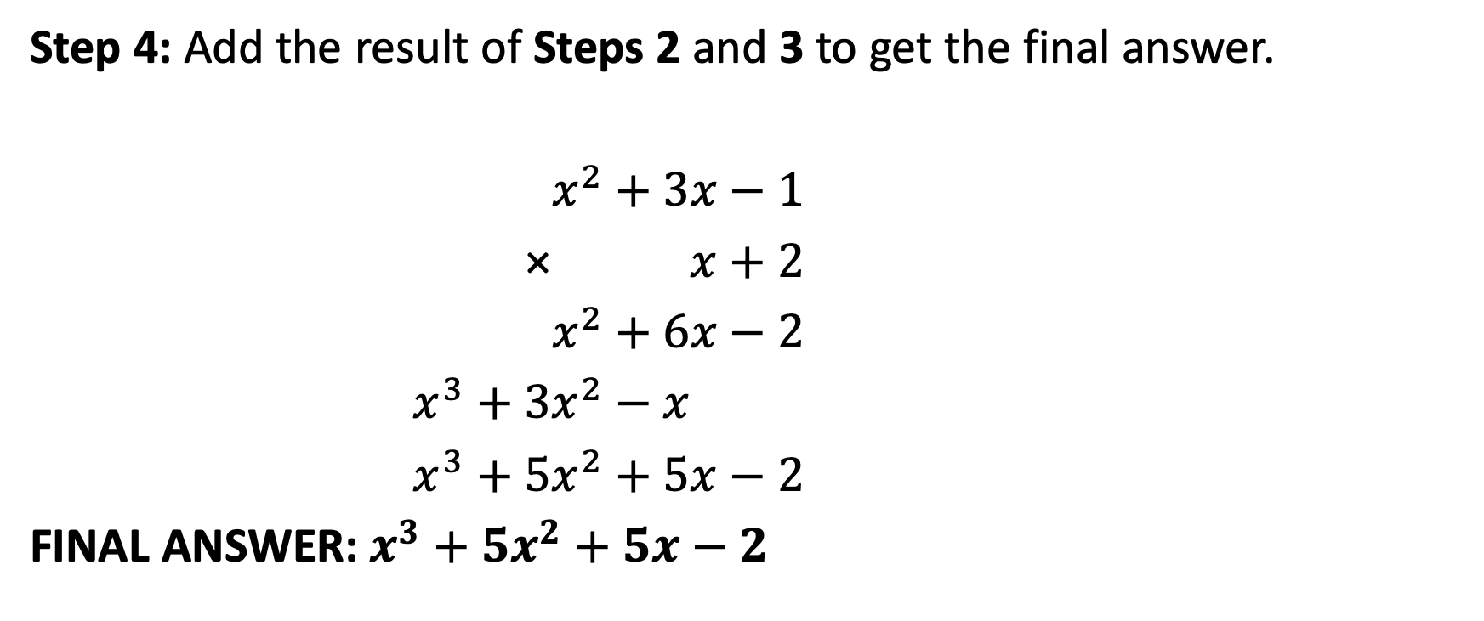
Product of a Binomial and a Trinomial
Step 4: Add the result of Steps 2 and 3 to get the final answer.
$x^{2}+3x−1$
× $x+2$
$x^{2}+6x−2$
$x^{3}+{3x}^{2}−x$
$x^{3}+{5x}^{2}+5x−2$
FINAL ANSWER: $x^{3}+{5x}^{2}+5x−2$

Slide 17
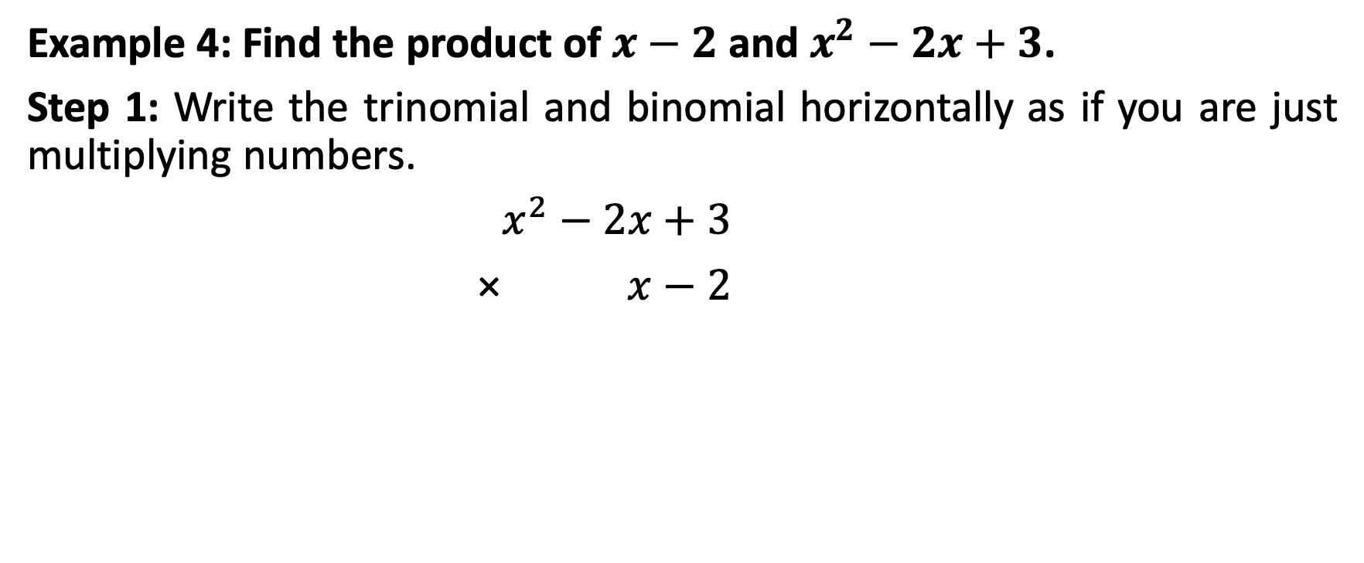
Product of a Binomial and a Trinomial
Example 4: Find the product of $x−2$ and $x^{2}−2x+3$.
Step 1: Write the trinomial and binomial horizontally as if you are just multiplying numbers.
$x^{2}−2x+3$
× $x−2$

Slide 18

Product of a Binomial and a Trinomial
Step 2: Multiply the last term of the binomial to every term of the trinomial.
$x^{2}−2x+3$
× $x−2$
${−2x}^{2}+4x−6$

Slide 19

Product of a Binomial and a Trinomial
Step 3: Multiply the first term of the binomial to every term of the trinomial.
$x^{2}−2x+3$
× $x−2$
${−2x}^{2}+4x−6$
$x^{3}−{2x}^{2}+3x$

Slide 20
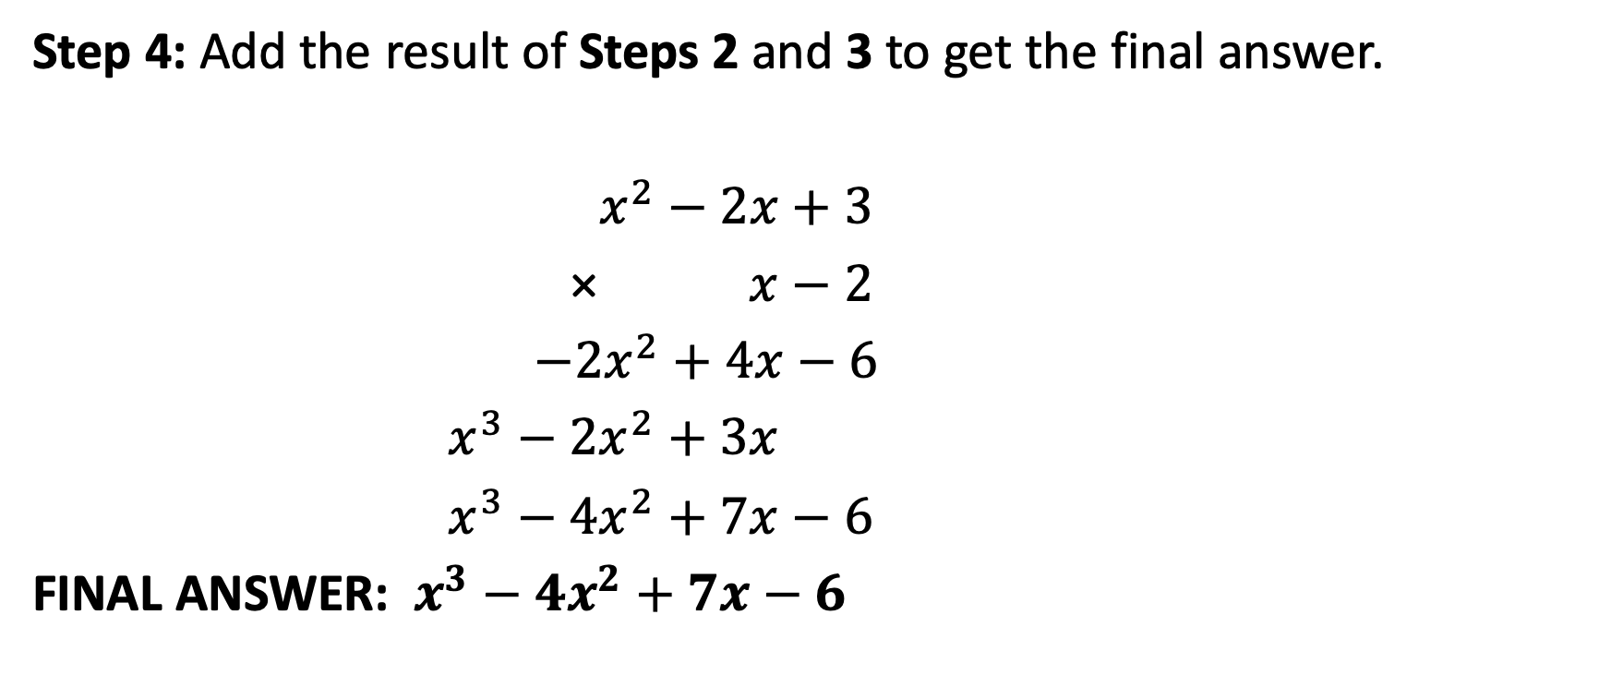
Product of a Binomial and a Trinomial
Step 4: Add the result of Steps 2 and 3 to get the final answer.
$x^{2}−2x+3$
× $x−2$
${−2x}^{2}+4x−6$
$x^{3}−{2x}^{2}+3x$
$x^{3}−{4x}^{2}+7x−6$
FINAL ANSWER: $x^{3}−{4x}^{2}+7x−6$

Slide 21
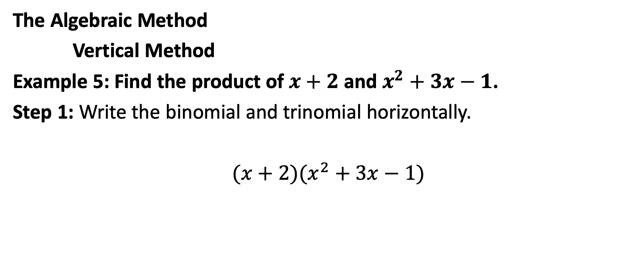
Product of a Binomial and a Trinomial
The Algebraic Method
Vertical Method
Example 5: Find the product of $x+2$ and $x^{2}+3x−1$.
Step 1: Write the binomial and trinomial horizontally.
$(x+2)(x^{2}+3x−1)$

Slide 22
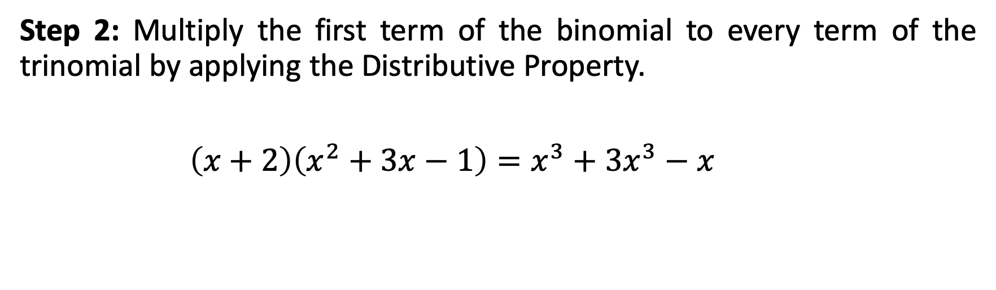
Product of a Binomial and a Trinomial
Step 2: Multiply the first term of the binomial to every term of the trinomial by applying the Distributive Property.
$\left(x+2\right)\left(x^{2}+3x−1\right)=x^{3}+3x^{3}−x$

Slide 23
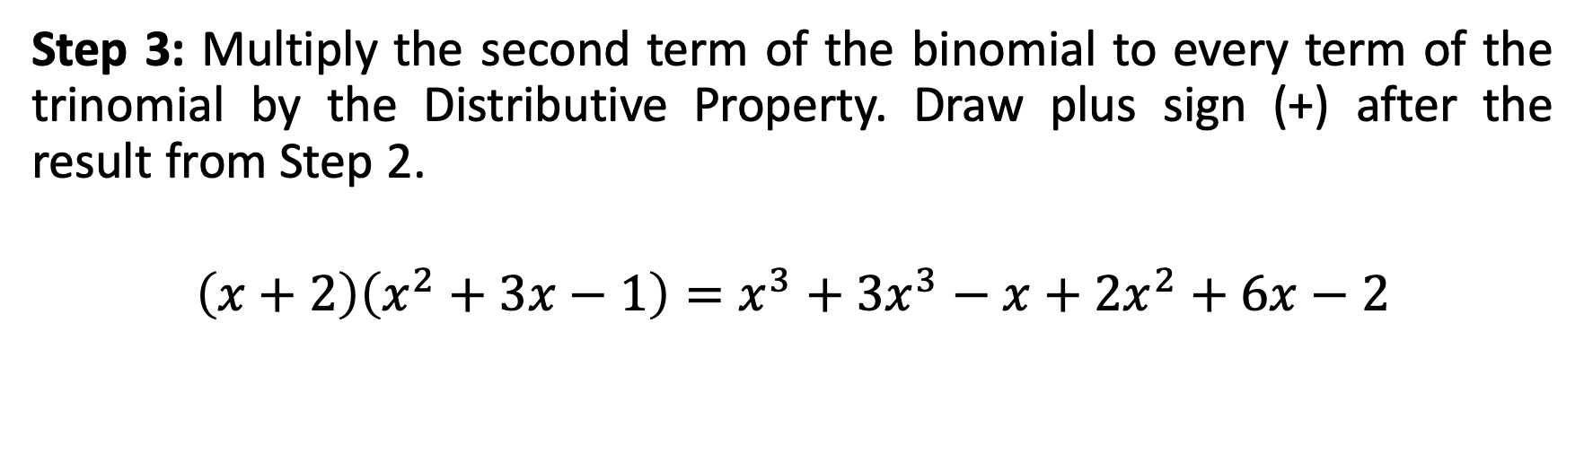
Product of a Binomial and a Trinomial
Step 3: Multiply the second term of the binomial to every term of the trinomial by the Distributive Property. Draw plus sign (+) after the result from Step 2.
$$\left(x+2\right)\left(x^{2}+3x−1\right)=x^{3}+3x^{3}−x+2x^{2}+6x−2$$

Slide 24
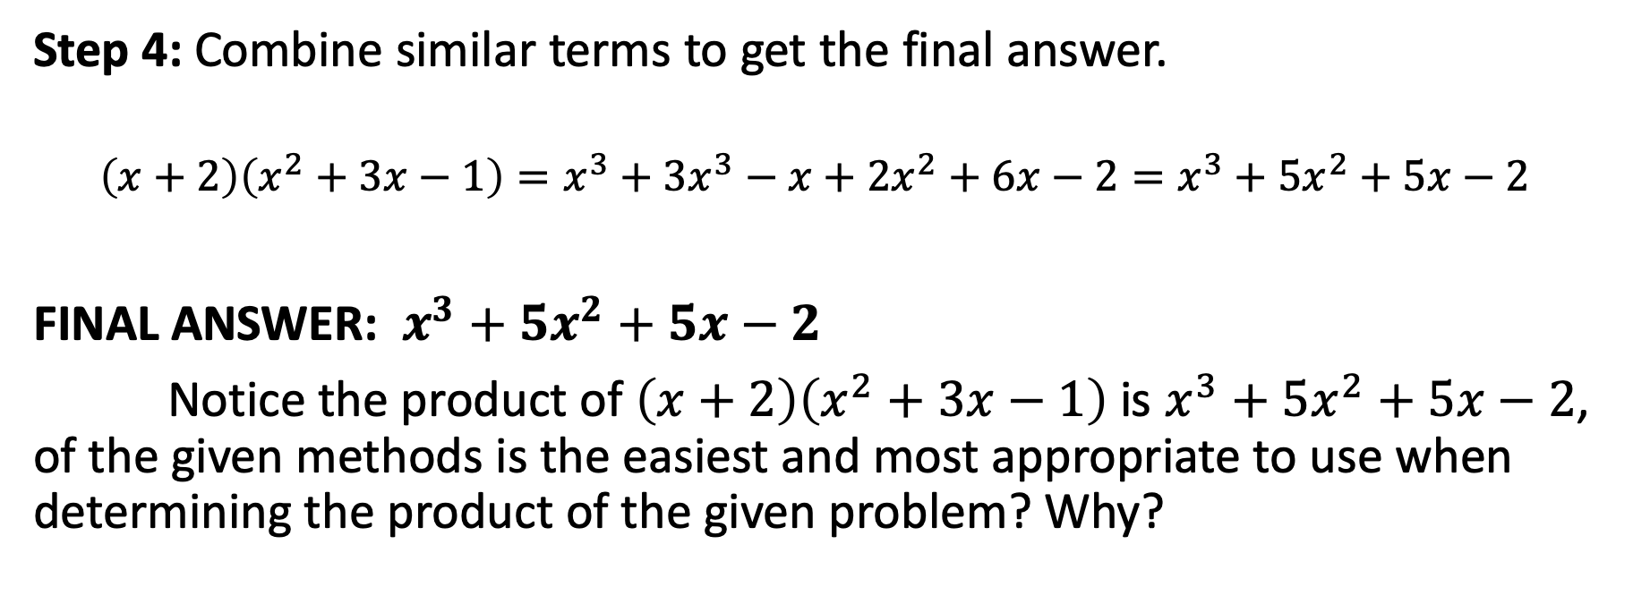
Product of a Binomial and a Trinomial
Step 4: Combine similar terms to get the final answer.
$$\left(x+2\right)\left(x^{2}+3x−1\right)=x^{3}+3x^{3}−x+2x^{2}+6x−2=x^{3}+5x^{2}+5x−2$$
FINAL ANSWER: $x^{3}+5x^{2}+5x−2$
Notice the product of $\left(x+2\right)\left(x^{2}+3x−1\right)$ is $x^{3}+5x^{2}+5x−2$, of the given methods is the easiest and most appropriate to use when determining the product of the given problem? Why?

