Slide 1

LAWS OF EXPONENTS

Slide 2
MULTIPLICATION LAW OF EXPONENTS
OR PRODUCT RULE
When multiplying expressions with the same base, you simply retain the common base and add the exponents. Then, you evaluate the result whenever necessary. This is called the multiplication law of exponents or the product rule. In general, if x is any real number, and if m and n are positive integers, we have:
x^{m} · x^{n} x^{m+n} .

Slide 3
POWER LAW OR POWER RULE
There are also instances when an expression containing an exponent is raised to another exponent. Look at the worked-out examples below. Can you guess the rule that should be followed in this case?
(4² )³ = 4² · 4² · 4² = (4 · 4) · (4 4) · (4 · 4) = 4⁶ = 4,096
(a³ )⁴ a³ · a³ · a³ · a³ = (a · a · a) · (a · a · a) · (a · a · a) · (a · a · a) = a¹²
What did you notice about the examples? What rule was applied?
If an expression involving an exponent is raised to a power, you retain the base and multiply the exponents. This is referred to as the power law or power rule. In symbols, if x is any real number and if m and n are positive integers, then
(x^{m} )^{n} = x^{mn} .

Slide 4
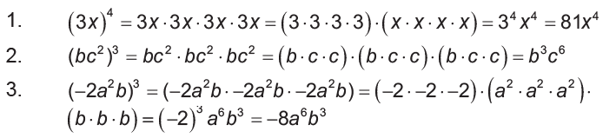
PRODUCT TO A POWER RULE
Now, let us look into the scenario of having expressions where a product is raised to a power. Do you think it will follow the same rules as above? Verify your guess with the following examples:
From these illustrations, it can be concluded that if a product is raised to an exponent, the result is given by the product of each factor raised to that exponent. That is, if x and y are real numbers and m is a positive integer, then
( xy ) ^{m} = x ^{m}y^{n}
This law is called the product to a power rule.

Slide 5
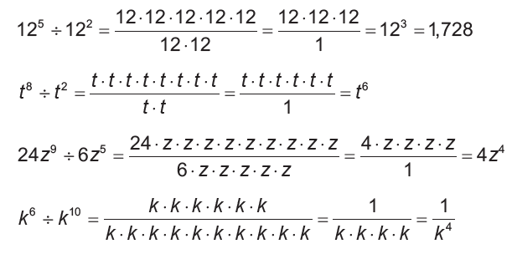

QUOTIENT RULE
Division is another operation performed on exponential expressions. Study the examples below to identify what must be done when dividing exponential expressions with similar bases.
Based on the given examples, what rule was applied when dividing the expressions?
The quotient rule for exponents states that to divide exponential expressions containing similar bases, copy the common base and subtract their respective exponents. In symbols, if x is a nonzero number and m and n are positive integers, then:

Slide 6
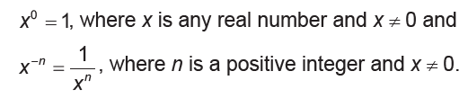
QUOTIENT TO A POWER RULE
Consider an exponential expression where the exponent in the numerator is less than that of the denominator. If we apply the quotient rule, what will be the sign of the resulting exponent? How about if the respective exponents of the numerator and denominator are the same?
Applying the quotient rule to the first scenario will result in a negative exponent. On the other hand, the second situation will produce a zero exponent. There are also certain rules that should be remembered when dealing with these kinds of exponents.
In general, we define:

Slide 7
EXAMPLES

Slide 8
1. X² · X⁻⁵
  = X² ⁺ ⁽ ⁻⁵ ⁾
  = X⁻³
  = 1
  X³
Product rule
Simplifying the exponents 2 + ( -5)
Rewriting with positive exponent

Slide 9
2. X⁻² · X⁻⁵
X²
= X ⁻² ⁺ ⁽ ⁻⁵ ⁾
X²
= X⁻⁷
X²
= X ^{–7 – 2}
= X⁻⁹
= 1
X⁹
Product rule
Simplifying the exponents -2 + ( -5)
Quotient rule
Simplifying the exponents -7 -2
Rewriting with positive exponent

Slide 10
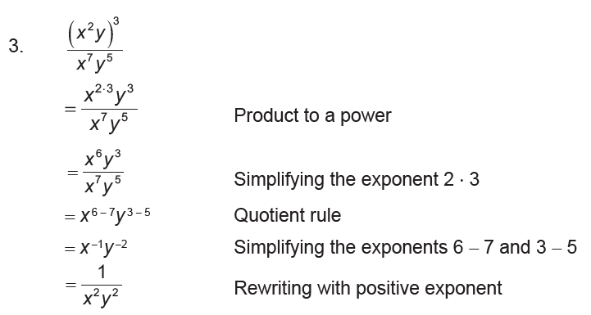

Slide 11
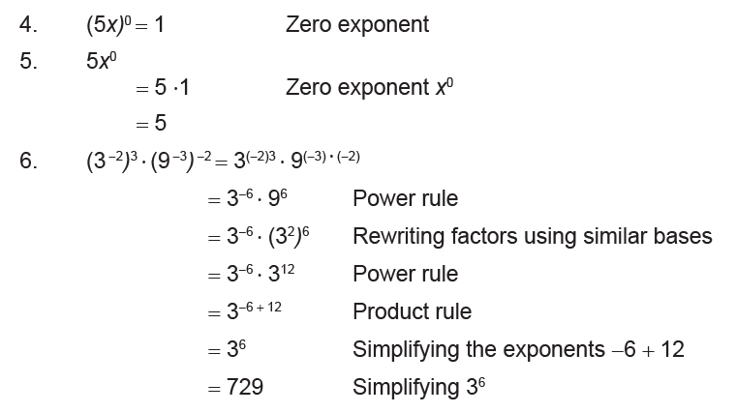

Slide 12
ACTIVITY

Slide 13
INSTRUCTION: Answer the following questions. Circle the letter of the correct answer.
1. What is the result when you multiply 2x³ · x⁷ · x5?
  a. 2x¹⁰⁵ b. 4x¹⁰⁵ c. 2x¹⁵ d. 4X¹⁵
2. What is the product of 3y⁴ ( - 5y³ )?
  a. -15y⁷ b. 15Y⁷ c. -15y¹² d. 15y¹²
3. What is 28m9 divided by 4m3?
  a. 28m⁶ b. 7m⁶ c. 24m³ d. 7m³
4. What is the quotient in -21h7 ÷ (-3h¹⁴)?
  a. 7h⁷ b. 7/h⁷ c. h⁷/7 d. -7/h⁷
5. Which of the following is the result of raising y8 to the 7th power?
  a. y b. y¹⁵ c. y^{1.5} d. y⁵⁶

