Slide 1
Dividing Polynomials Using Long Division

Slide 2


Dividing Polynomials Using Long Division
To divide a polynomial by a polynomial with more than one term, use a procedure similar to long division in arithmetic. Study the following examples:
Example 1: Divide 3x² - 14x - 12 by x – 2.
Solution:
Write the problem in long division format.
Note: Arrange the dividend and the divisor in descending order and check if there is missing power.
Divide the leading term in the dividend, 3x².

Slide 3
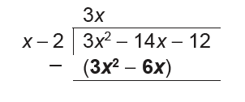
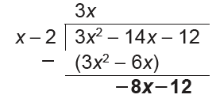
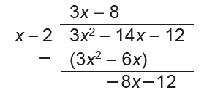
Dividing Polynomials Using Long Division
Multiply the result 3x by the divisor (x - 2) and write the
result under the dividend. Thus, 3x (x - 2) = 3x² - 6x.
Subtract the quantity 3x² - 6x from the dividend. To do
this, add its opposite. Then bring down the next term of
the dividend, -12.
Divide the first term of the result, -8x by the leading term
in the divisor, x. We may now have -8x ÷ x = -8. This is
the second term in the quotient.

Slide 4
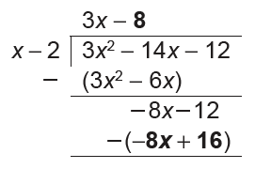
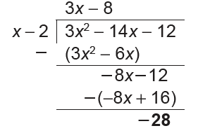
Dividing Polynomials Using Long Division
Multiply the result, -8 by the divisor x - 2.
-8(x - 2) = -8x + 16.
Write the result under the dividend. Then subtract. The
remainder is -28. Since the degree of the remainder
is less than the degree of the divisor, we can now stop
dividing.

Slide 5
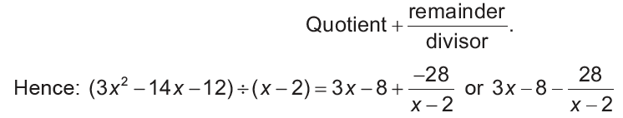
Dividing Polynomials Using Long Division
Summary:
The dividend is 3x² - 14x - 12. The quotient is 3x - 8.
The divisor is x - 2. The remainder is -28.
The solution to a long division can be written in the form:

Slide 6

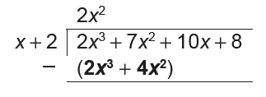
Dividing Polynomials Using Long Division
Example 2: Divide 2x³ + 7x² + 10x + 8 by x + 2.
Solution:
Divide 2x³ by x.
Multiply (x + 2) by 2x².

Slide 7
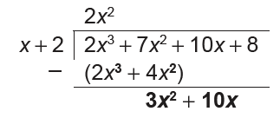
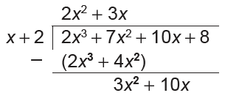
Dividing Polynomials Using Long Division
Subtract 2x³ + 4x² from 2x³ + 7x².
Bring down 10x.
Divide 3x² by x.

Slide 8
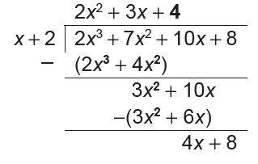
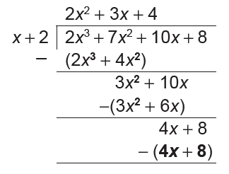
Dividing Polynomials Using Long Division
Divide 4x by x.
Multiply x + 2 by 4.

Slide 9
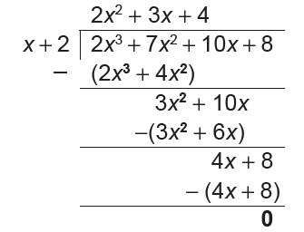
Dividing Polynomials Using Long Division
Subtract 4x + 8 from 4x + 8.
The quotient is 2x² + 3x + 4, and the remainder is 0.

Slide 10
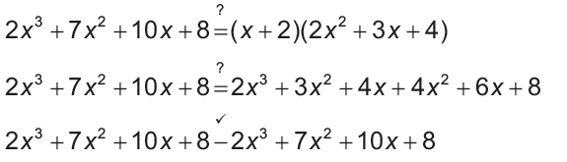
Dividing Polynomials Using Long Division
Check by verifying if (x + 2)(2x² + 3x + 4) is 2x³ + 7x² + 10x + 8.
Notice that in this example, the remainder is zero. Thus, both (x + 2) and (2x² + 3x + 4) are factors of 2x³ + 7x² + 10x + 8.

Slide 11
Dividing Polynomials Using Long Division
Example 3: Divide 4x3 - 41x + 15 by x - 3.
Solution:
This is a case where the polynomial has an incomplete degree of terms or there is missing power. If either the dividend or the divisor has missing terms, it is helpful to write those terms with a zero coefficient. The dividend has no x² term. Insert the term 0x2 and write the problem in the long division format.

Slide 12
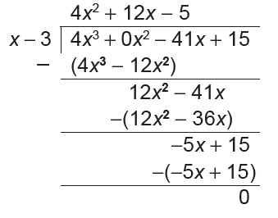
Dividing Polynomials Using Long Division
4x³ ÷ x = 4x², the first term in the quotient.
4x²(x - 3) = 4x³ - 12x²
(4x³ + 0x² ) - (4x³ - 12x²) = 12x². Bring down -41x.
12x² ÷ x = 12x, second term in the quotient
12x(x - 3) = 12x² - 36x
(12x² - 41x) - (12x² - 36x) = -5x. Bring down 15.
-5x ÷ x = -5, third term in the quotient.
-5(x - 3) = -5x + 15
The quotient is 4x² + 12x - 5, and the remainder is 0.

Slide 13
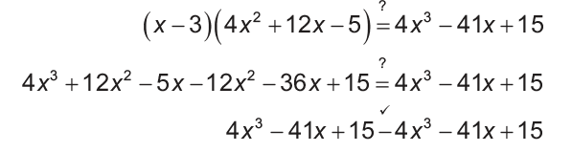
Dividing Polynomials Using Long Division
Check as follows:

