Slide 1
Dividing Polynomials Using Synthetic Division

Slide 2
Dividing Polynomials Using Synthetic Division
The long division method can be simplified using synthetic division. Synthetic division is a numerical method used for dividing a polynomial by a binomial of the form x - c. Now, let us look at the steps involved in the synthetic division.
Study the following examples:

Slide 3

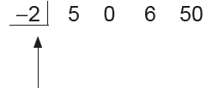
Dividing Polynomials Using Synthetic Division
Example 1: Use synthetic division to divide 5x3 + 6x + 50 by x + 2.
Solution: Set the divisor in the form x - c. Thus, we write x + 2 as x - (-2). This means that the divisor is c = -2. Write the 0 coefficient for the missing x2 term in the dividend and express the division problem as follows:
Set up the problem so that synthetic division can be used.
← Coefficient of the dividend
This is the subtrahend c in x -(-2).

Slide 4
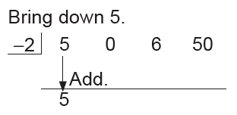
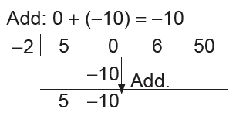
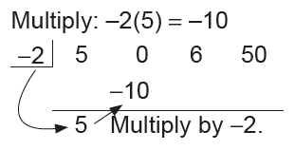
Dividing Polynomials Using Synthetic Division
Start the synthetic division process by bringing down 5. This is followed by a series of operations involving multiplication and addition.
1. 3.
2.

Slide 5
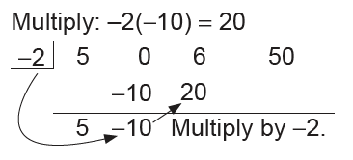
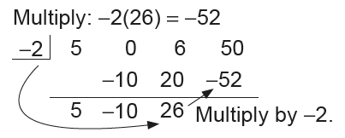
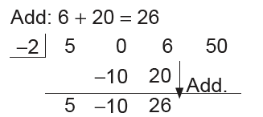
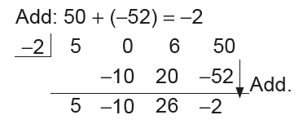
Dividing Polynomials Using Synthetic Division
4. 6.
5. 7.

Slide 6
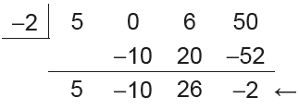


Dividing Polynomials Using Synthetic Division
The numbers in the last row represent the coefficients of the quotient and the remainder. The degree of the first term of the quotient is one less than the degree of the dividend. Because the degree of the dividend is 3, the degree of the quotient is 2. This means that the 5 in the last row represents 5x².
The remainder is -2.
The last line indicates the quotient is 5x2 - 10x + 26 and a remainder of -2.
Thus, the quotient of is

Slide 7



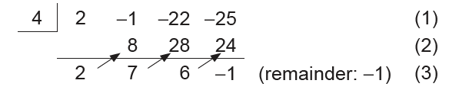
Dividing Polynomials Using Synthetic Division
Example 2: Use synthetic division to find the quotient when 2x³ - x² - 22x - 25 is divided by x - 4.
Solution:
We will write the quotient in the form
We begin by writing
The divisor is the negative of -4, or 4. Then we have

Slide 8
Dividing Polynomials Using Synthetic Division
This process was done with these steps:
1. 2 is “brought down” from the line (1) to line (3).
2. 8 is the product of 2 and 4 and written in the next position on the line (2).
3. 7 is the sum of -1 and 8 and is written on line (3).
4. 28 is the product of 4 and 7 and is written in the next position on the line (2).
5. 6 is the sum of -22 and 28 and is written on line (3).
6. 24 is the product of 4 and 6 and is written in the next position on the line (2).
7. -1 is the sum of -25 and 24 and is written on line (3).

Slide 9

Dividing Polynomials Using Synthetic Division
Then, we use the first three numbers on line (3) as coefficients to what will be the polynomial of degree less than the degree of the dividend. This is the quotient without the remainder. The last number is the remainder. Thus, the quotient of (2x³ - x² - 22x - 25) ÷ (x - 4) is

Slide 10

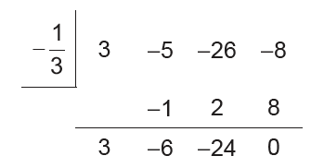

Dividing Polynomials Using Synthetic Division
Example 3: Divide 3x3 - 5x2 - 26x – 8 by 3x + 1.
Solution:
Method 1:
The divisor must be written in x - c form. Equate the divisor 3x + 1 to 0.
Thus, 3x + 1 = 0 implies
Hence, the quotient is or x² - 2x - 8, and the remainder is 0.

Slide 11
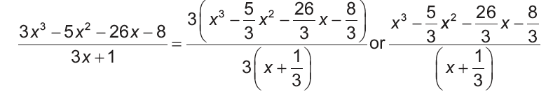
Dividing Polynomials Using Synthetic Division
Observe that we need to divide the coefficients of the quotient (last row) by 3 because we actually divided c by 3 before applying synthetic division.
Check: (3x + 1)(x² - 2x - 8) = 3x³ - 5x² - 26x - 8
Method 2:

Slide 12

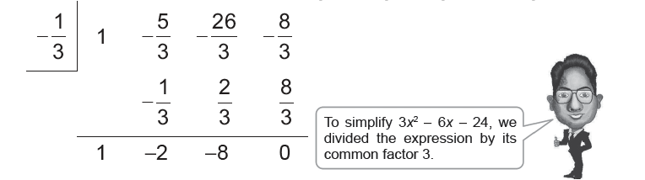
Dividing Polynomials Using Synthetic Division
Now, use the synthetic division to divide
Hence, the quotient is x² - 2x - 8.
Please do Learning Task to find out if you understand Lesson 2.

